Slide 1
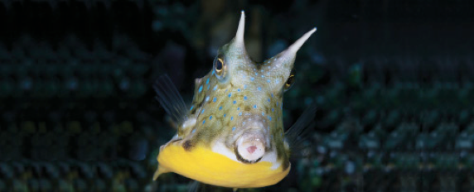
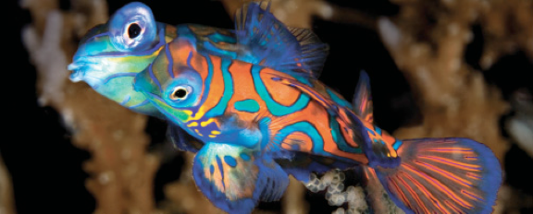
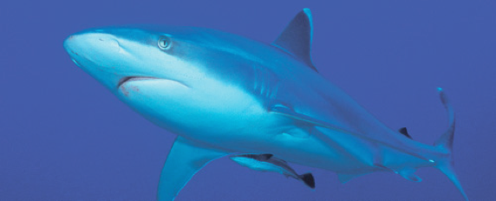
Lesson 2 Skeleton, skin and scales
Ichthyology
Shanghai Ocean University
Fall, 2025

Slide 2
Skull (or cranium)
The skull encloses and protects the brain and is composed of the neurocranium (脑颅) and the branchiocranium (咽颅).
Actinopterygians (辐鳍鱼类) have more skull bones than do sarcopterygians (肉鳍鱼类).

Slide 3
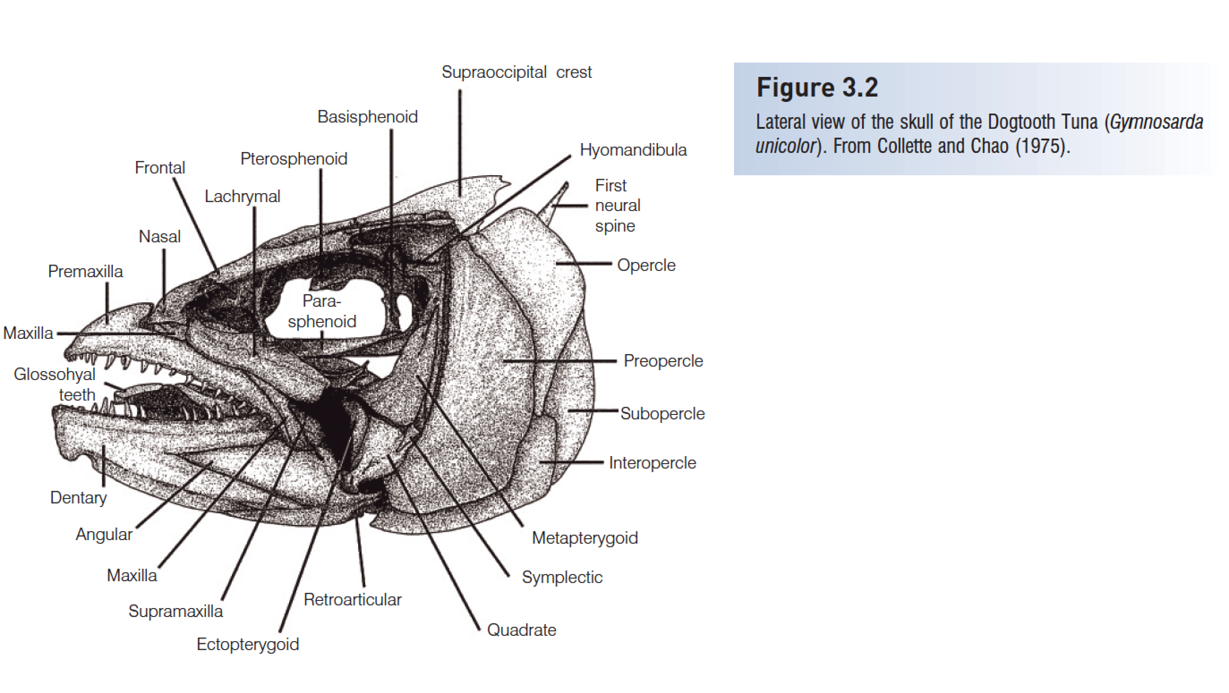
Skull (or cranium)

Slide 4
Neurocranium
The neurocranium is derived from the chondrocranium (the original cartilaginous braincase) and the dermatocranium (dermal bones derived from scales).
Actinopterygian skull bones can be divided into four regions: ethmoid (筛骨区), orbital (蝶区), otic (耳区), and basicranial (枕区).

Slide 5
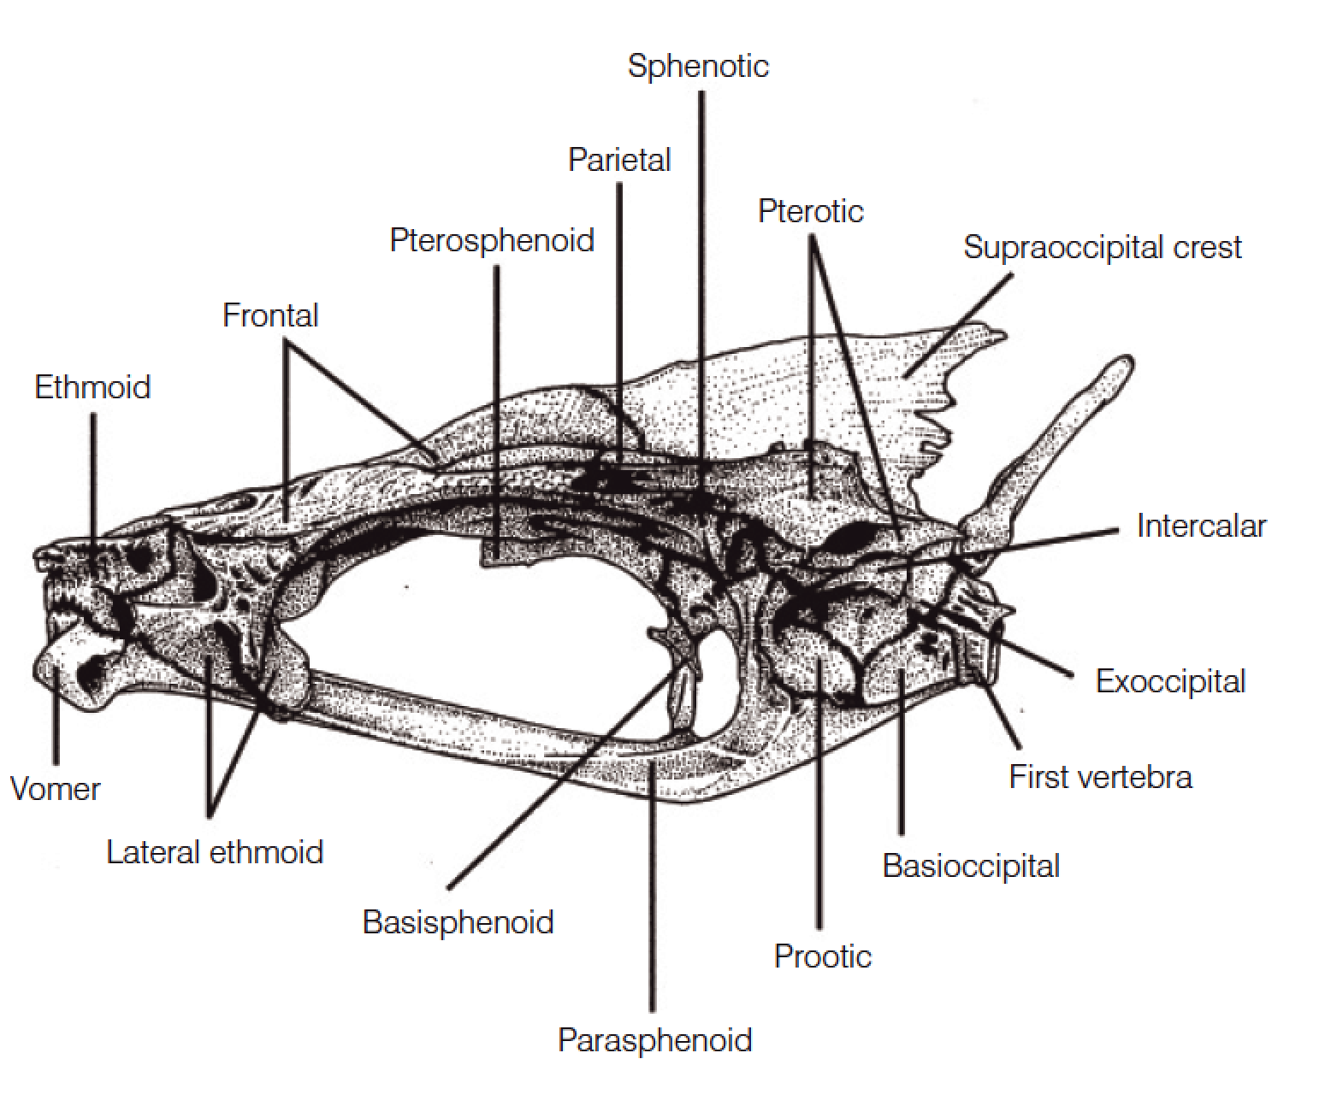
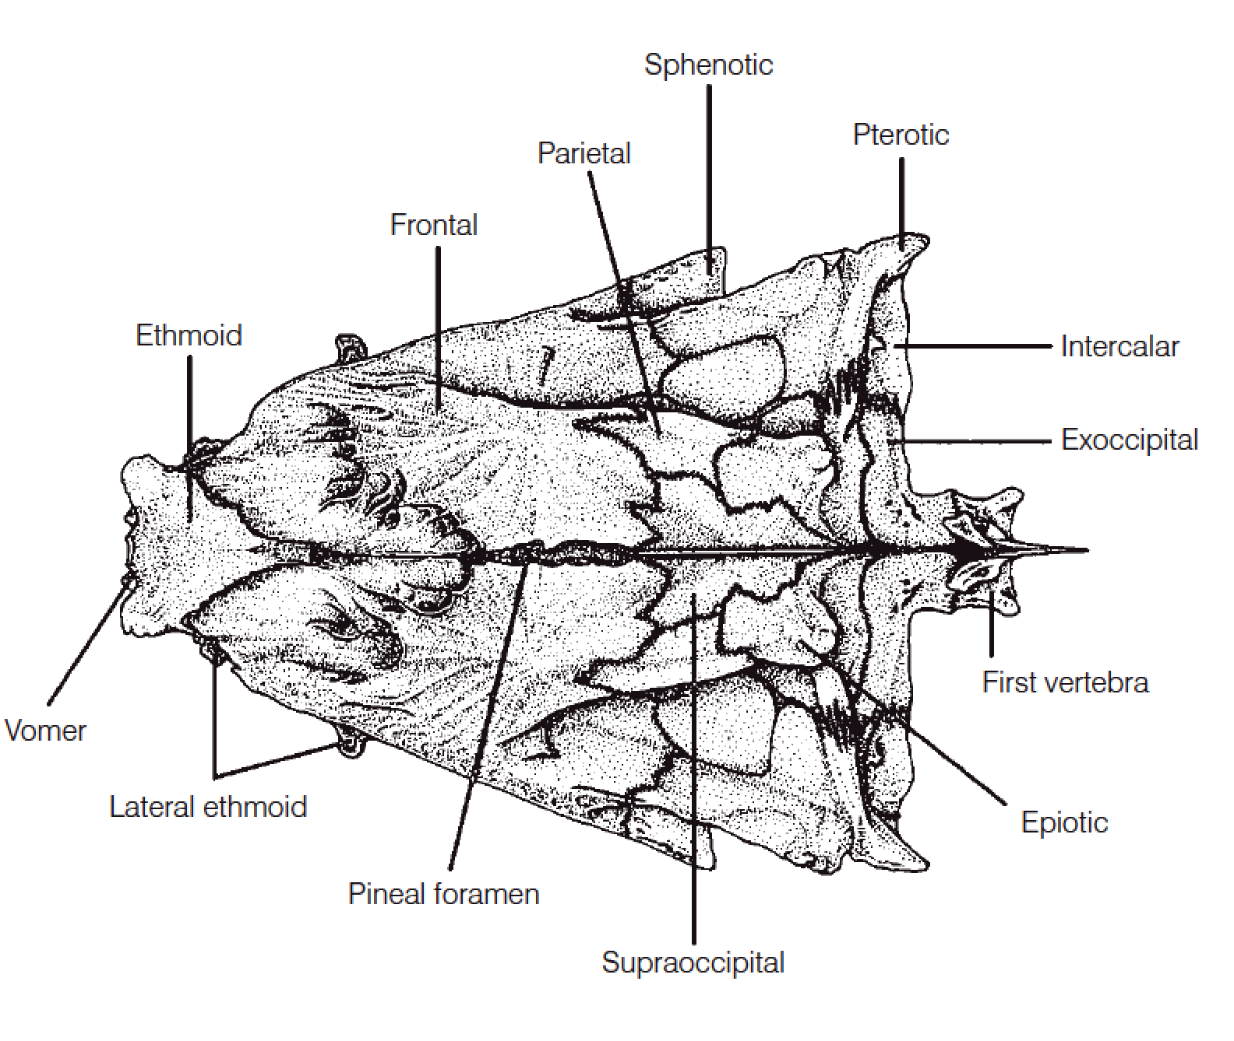
Ethmoid region
Two sets of dermal bones in this region:
vomer (犁骨)
mesethmoid (中筛骨)
Two main sets of cartilage bones:
lateral ethmoids
ethmoid (筛骨)

Slide 6
Orbital region
Two sets of dermal bones in this region:
the paired frontals (额骨)
the circumorbitals (围眶骨)
Three sets of cartilage bones:
Pterosphenoids (翼蝶骨)
Basisphenoid (基蝶骨)
Parasphenoid (副蝶骨)
Sclerotic cartilages (巩膜软骨)

Slide 7
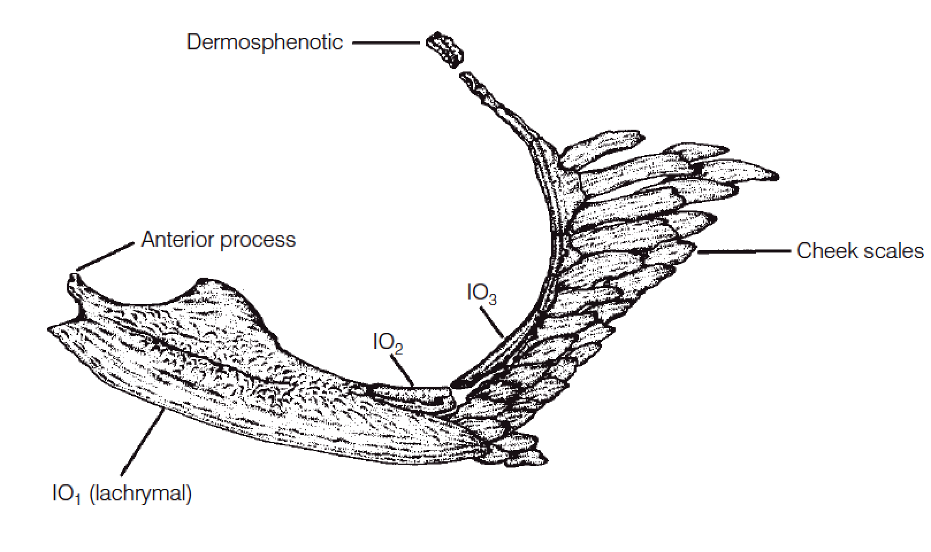
Orbital region
Two sets of dermal bones in this region:
the paired frontals
the circumorbitals
-A chain of infraorbital bones (眶下骨)

Slide 8
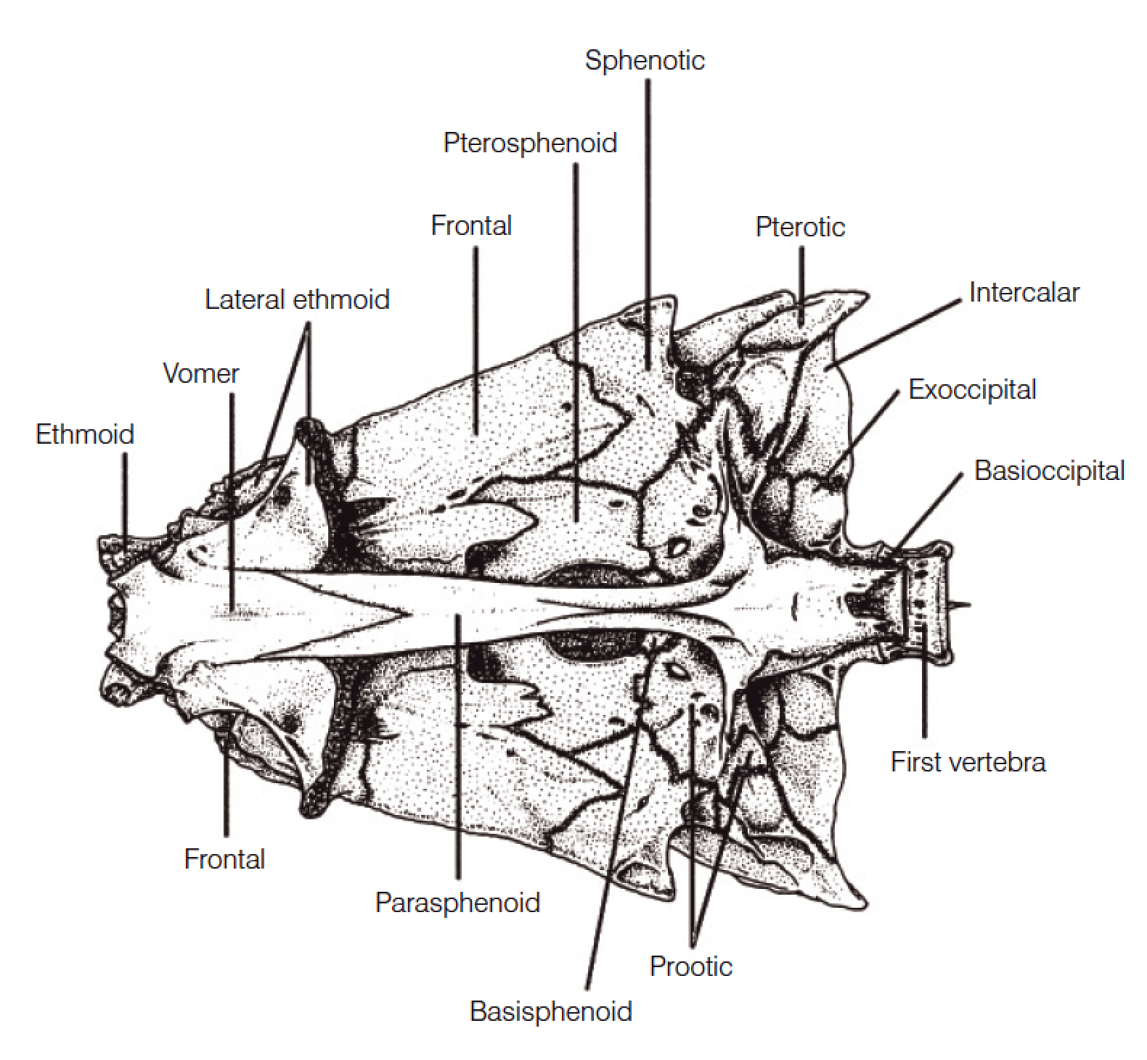
Otic region
Five cartilage bones enclose each bilateral otic (ear) chamber inside the skull:
Sphenotics (蝶耳骨)
Pterotics (翼耳骨)
Prootics (前耳骨)
Epiotics (上耳骨)
Intercalars (间骨)
Dermal bones
Parietals (顶骨)

Slide 9
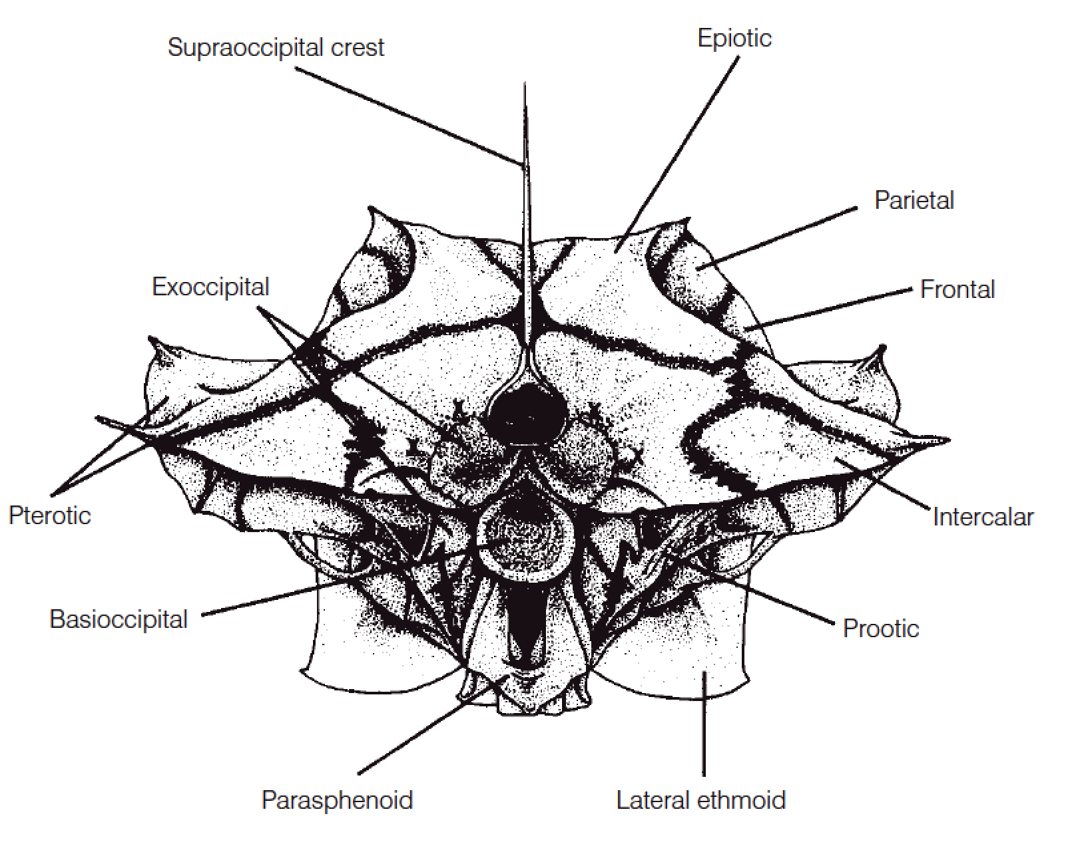
Basicranial region
Three sets of cartilage bones,:
Exoccipitals (外枕骨)
Basioccipital (基枕骨)
Supraoccipital (上枕骨)
Dermal bones
parasphenoid (副蝶骨)

Slide 10
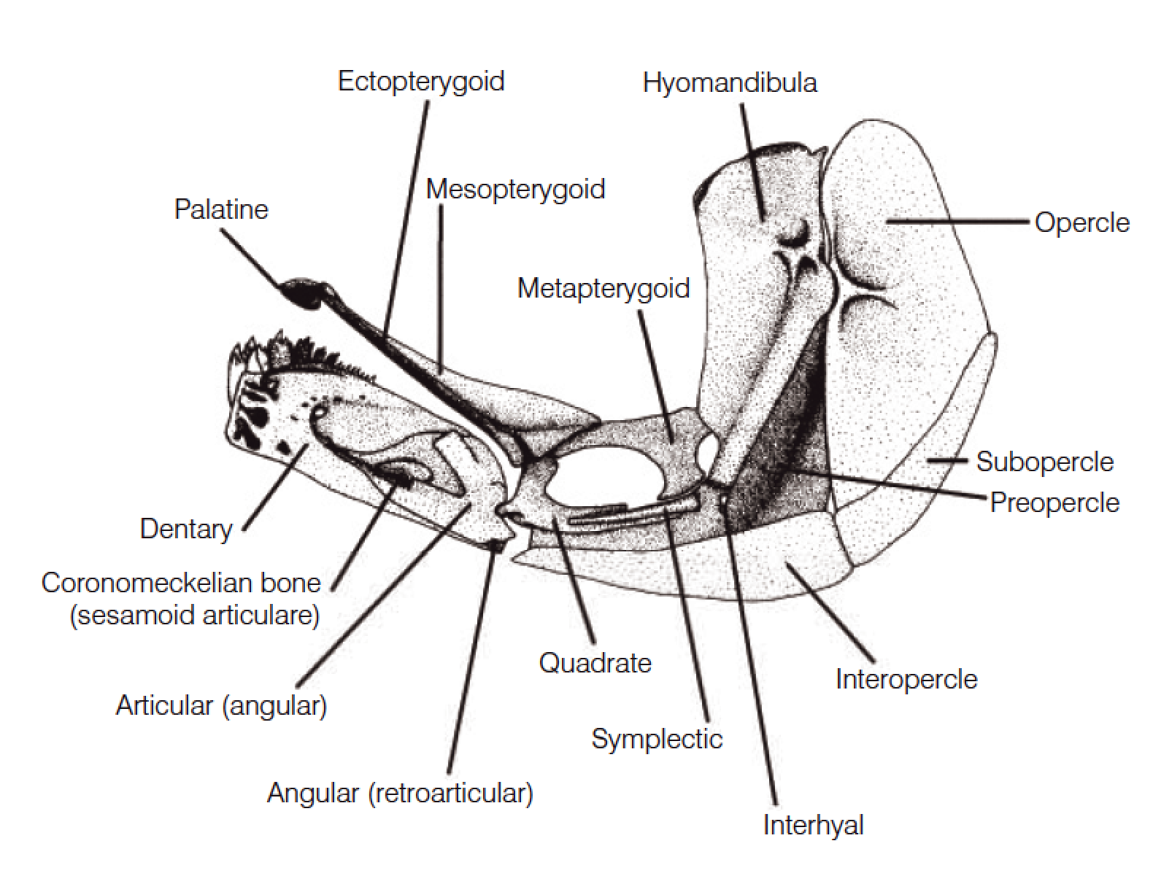
Branchiocranium
The branchiocranium is divisible into five parts:
Mandibular (颌骨)
Palatine (腭骨)
Hyoid (舌骨)
Opercular (鳃盖骨)
Branchial (鳃)

Slide 11
Mandibular arch
Upper jaw known as the palatoquadrate cartilage (腭方软骨) in Chondrichthyes
in bony fishes. may have three sets of bones.
Premaxillae (前颔骨)
Maxillae (上颌骨)
Supramaxilla (上主上颌骨)

Slide 12
Mandibular arch
The lower jaw consists of Meckel’s cartilage in Chondrichthyes.
In bony fishes:
dentary (齿骨)
articular (下颚关节骨)
angular (隅骨)

Slide 13
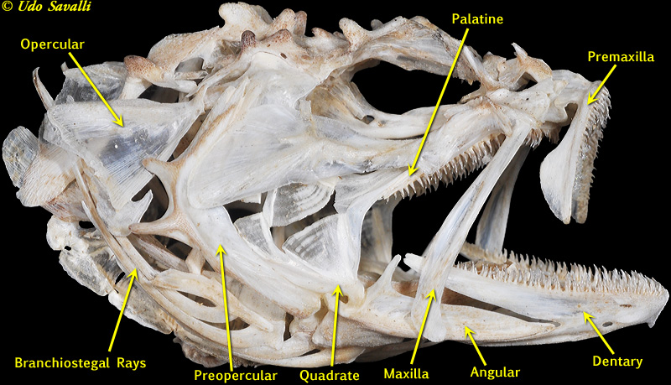

Slide 14
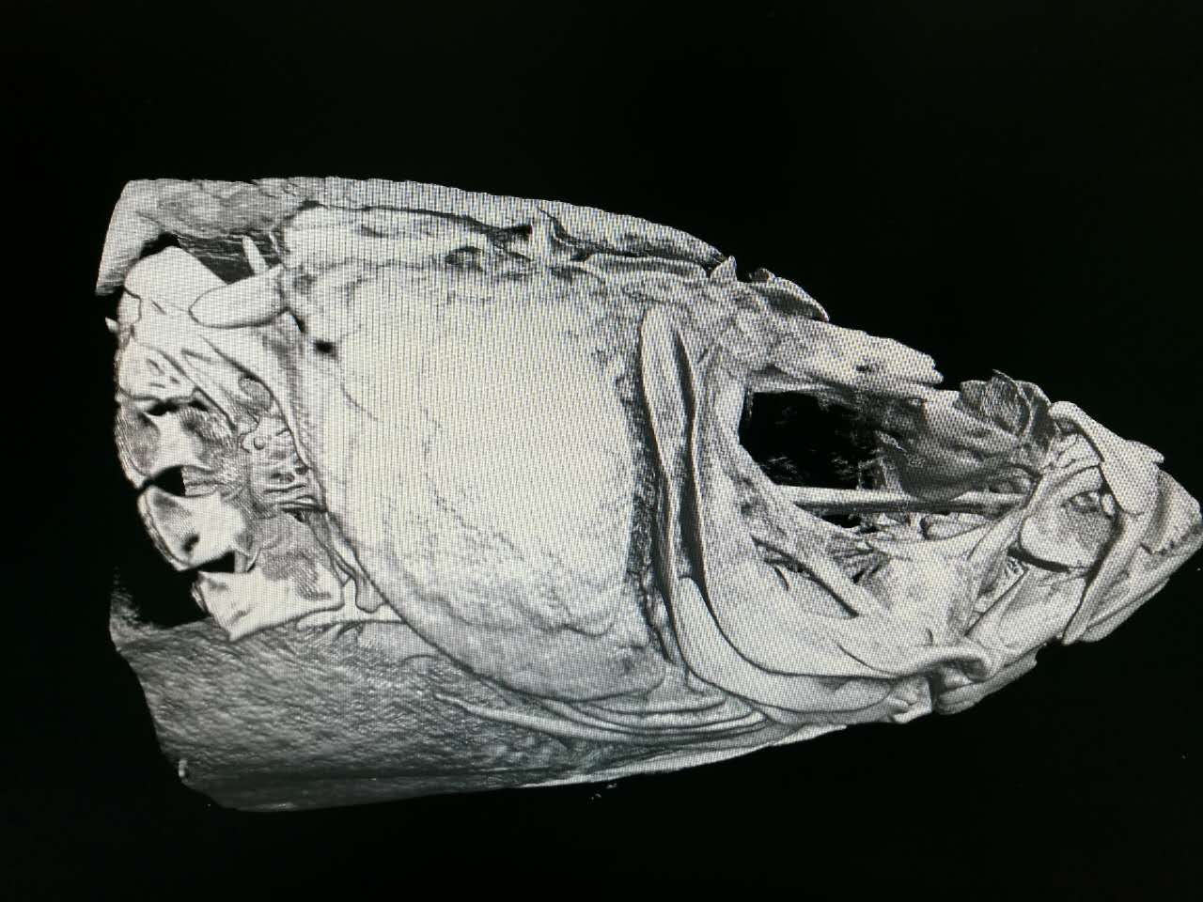
CT scan, a skull of Microdus chalmersi

Slide 15
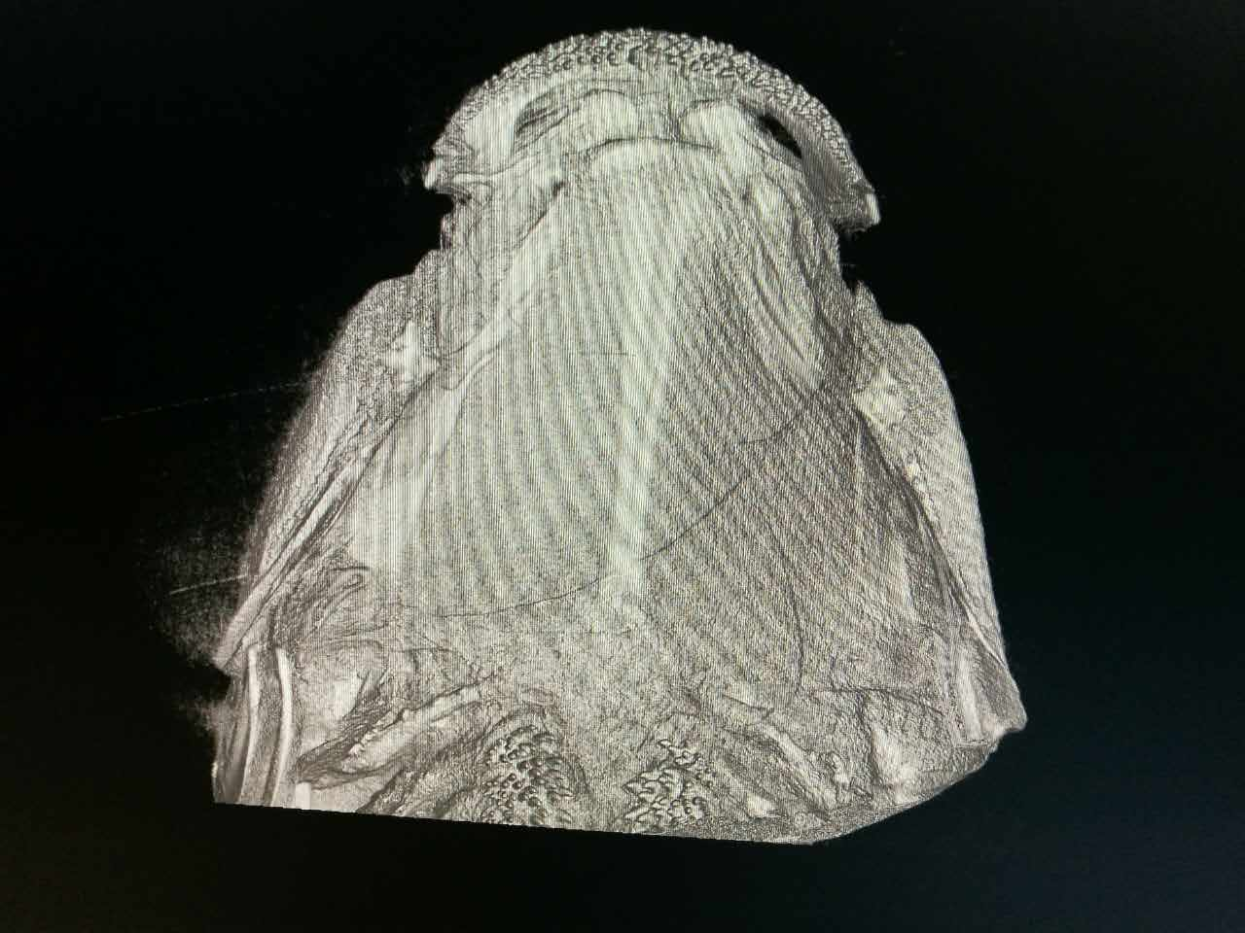
Ventral view of the neurocranium

Slide 16
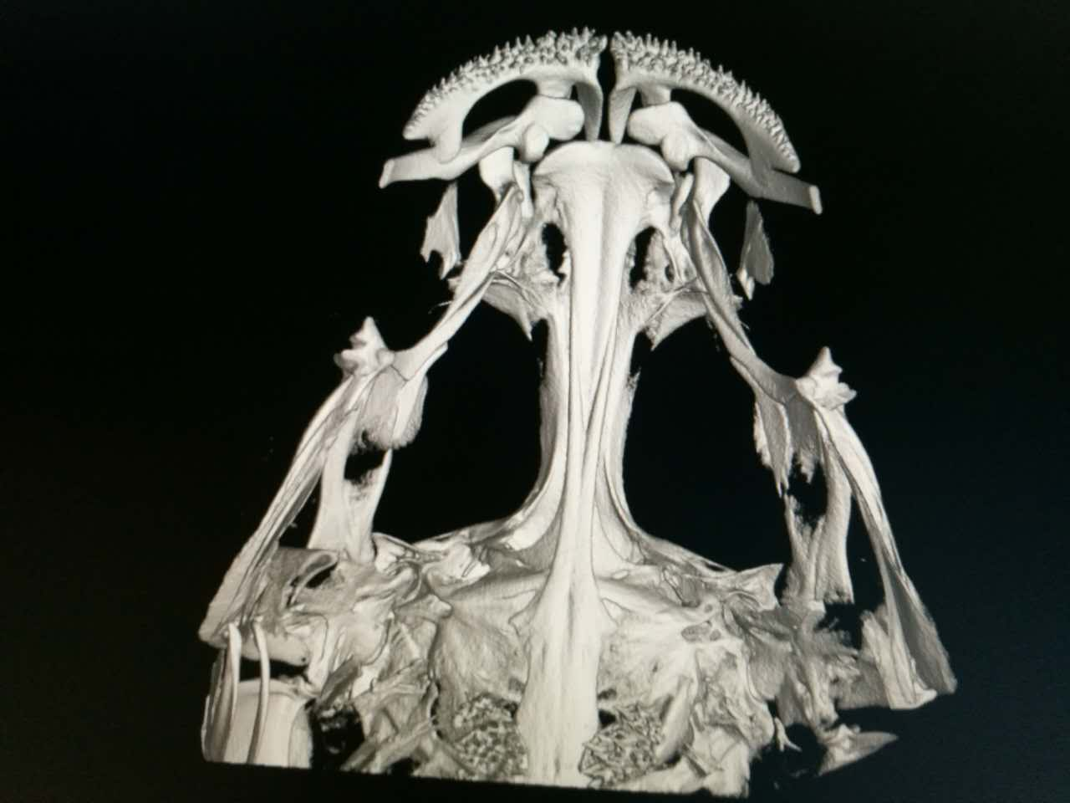
Ventral view of the neurocranium

Slide 17
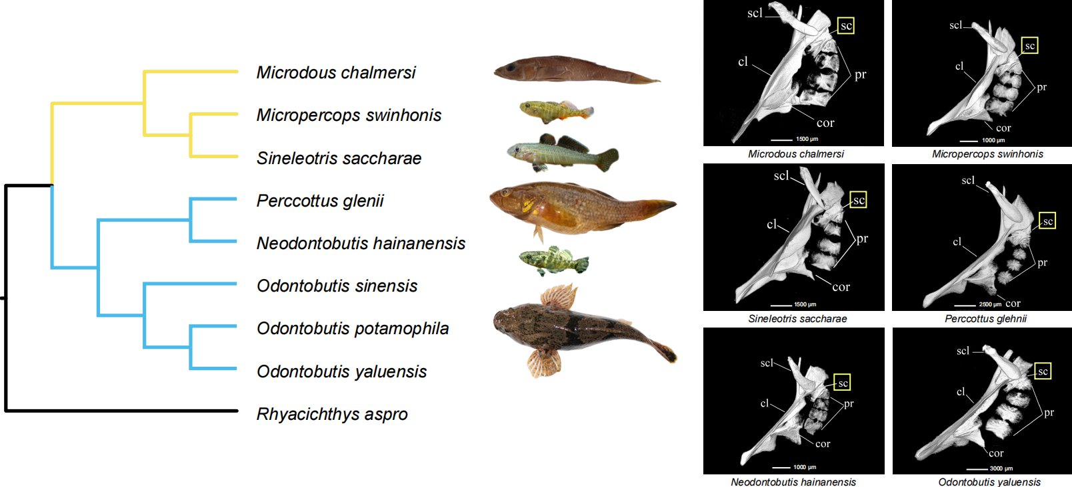
H Li, Y. He, J. Jiang, Z. Liu, C. Li, 2018. Molecular systematics and phylogenetic analysis of the Asian endemic freshwater sleepers (Gobiiformes: Odontobutidae). Molecular Phylogenetics and Evolution, 121, 1–11.

Slide 18
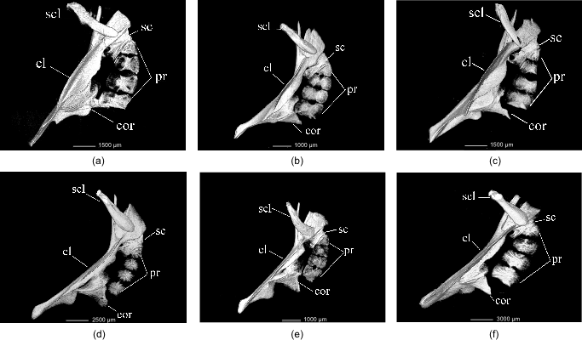

Slide 19
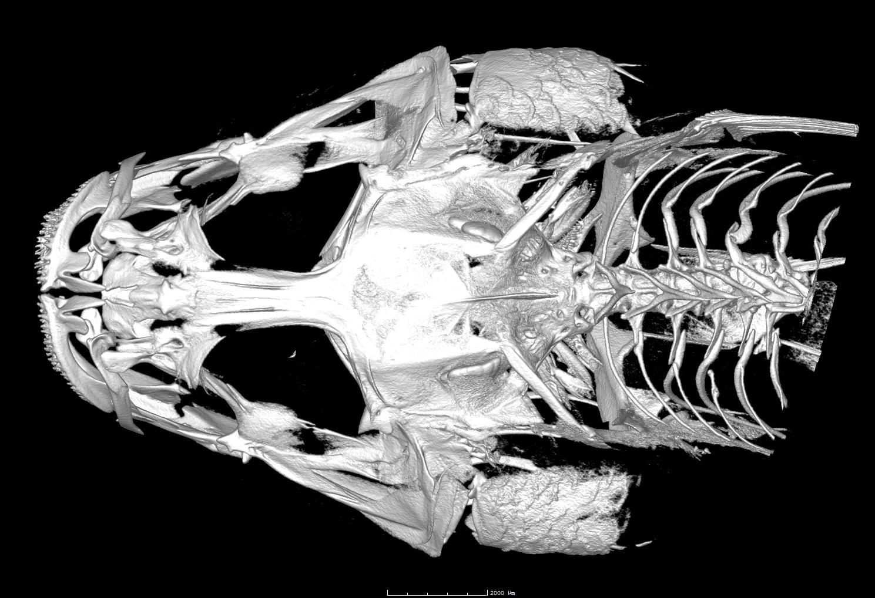
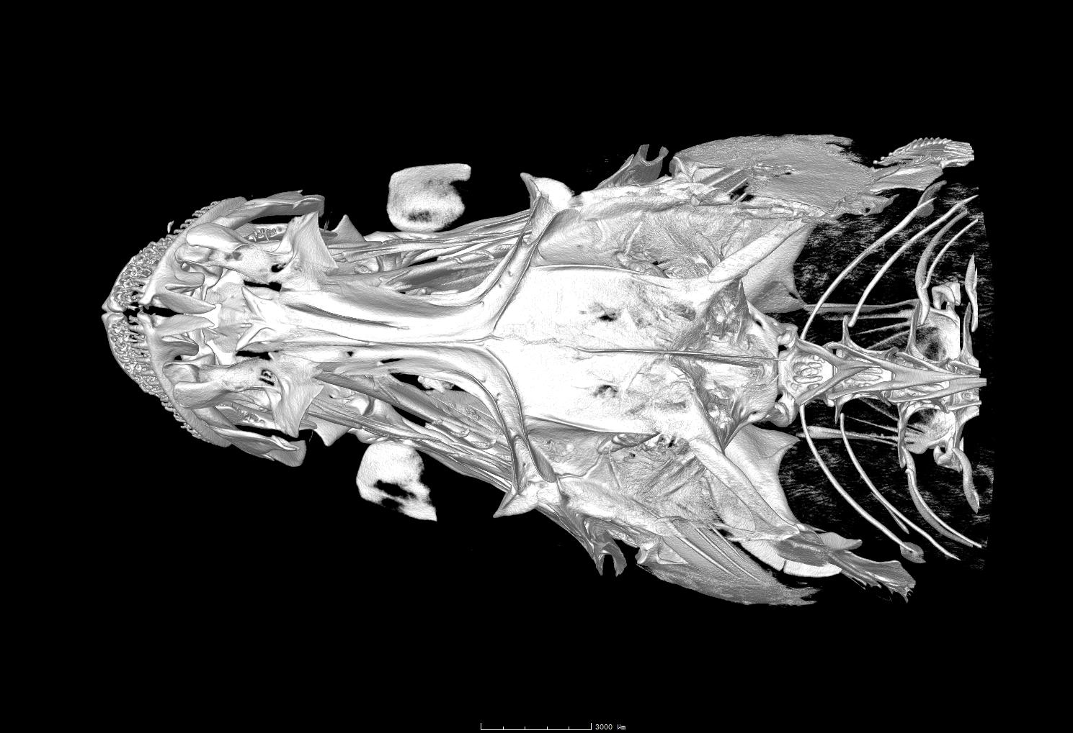
Microdus chalmersi ???
Microdus chalmersi

