Slide 1
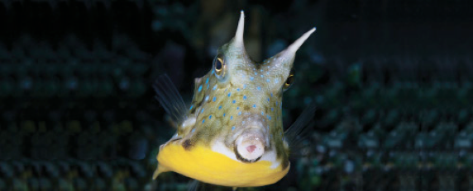
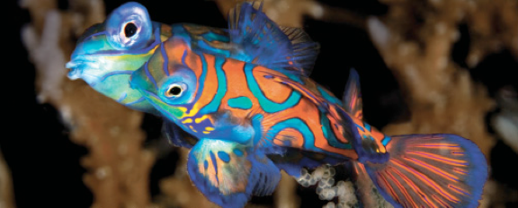
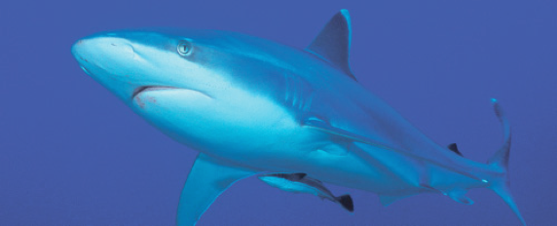
Lesson 2 Skeleton, skin and scales
Ichthyology
Shanghai Ocean University
Fall, 2025

Slide 2
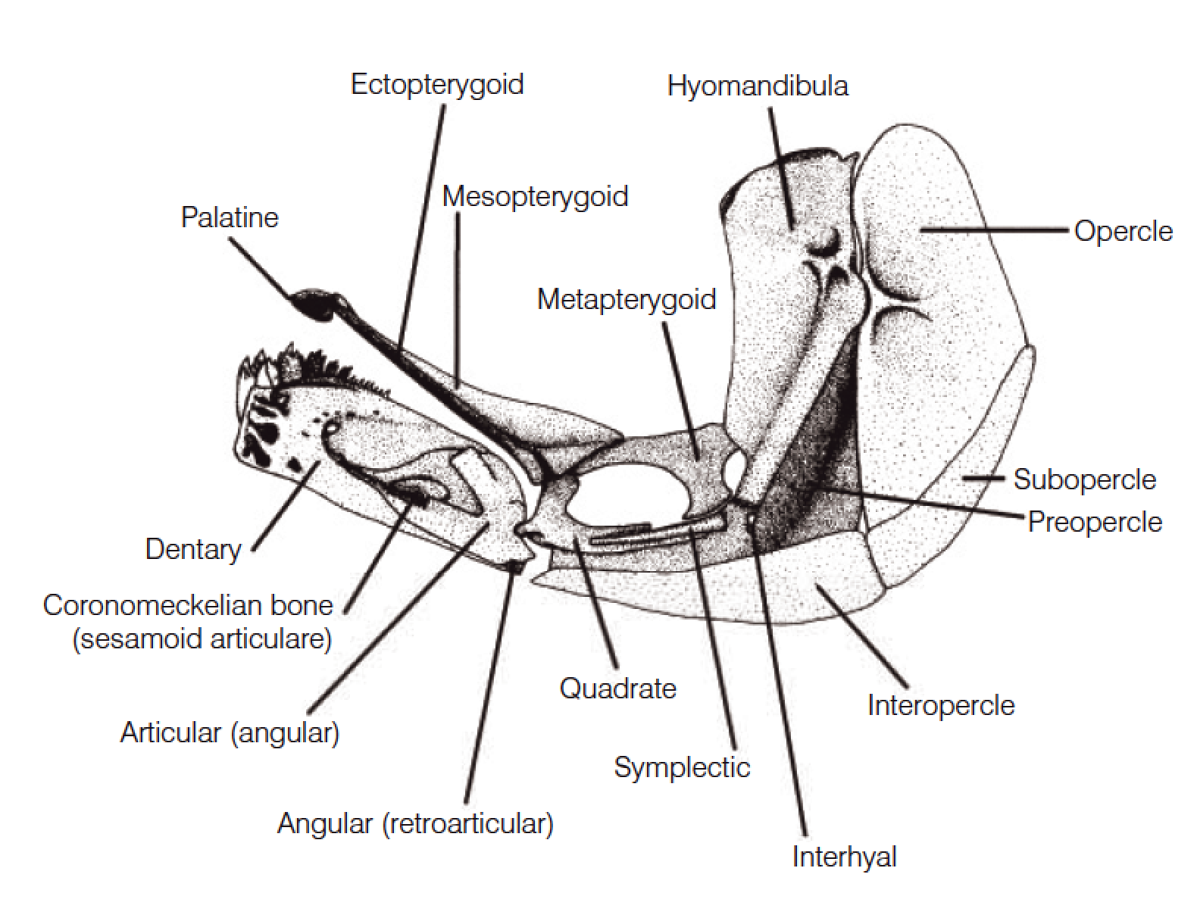
Branchiocranium
The branchiocranium is divisible into five parts:
Mandibular (颌骨)
Palatine (腭骨)
Hyoid (舌骨)
Opercular (鳃盖骨)
Branchial (鳃弓)

Slide 3
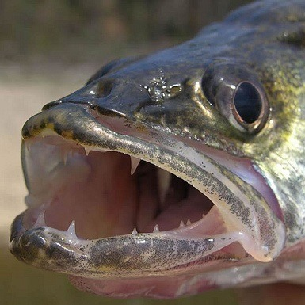
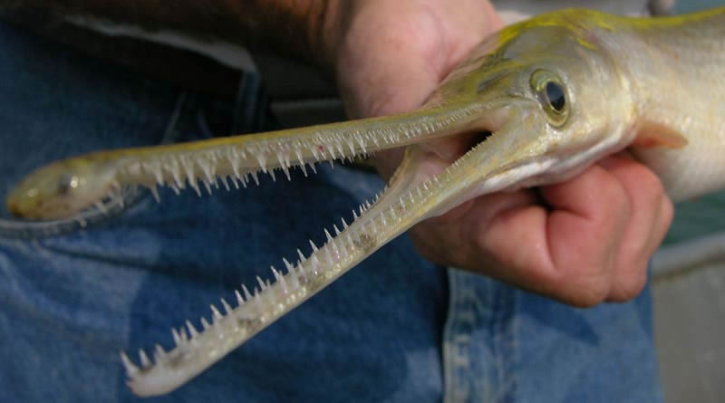
Teeth
The oral jaws and many pharyngeal bones may bear teeth.
Many different terms have been applied to the different sizes and shapes of teeth
Canine
Villiform
Molariform
Incisor

Slide 4
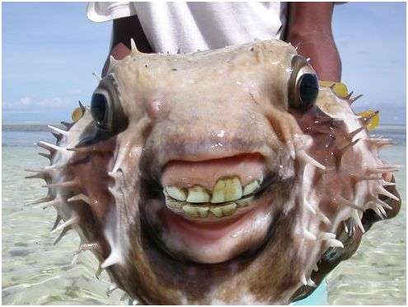
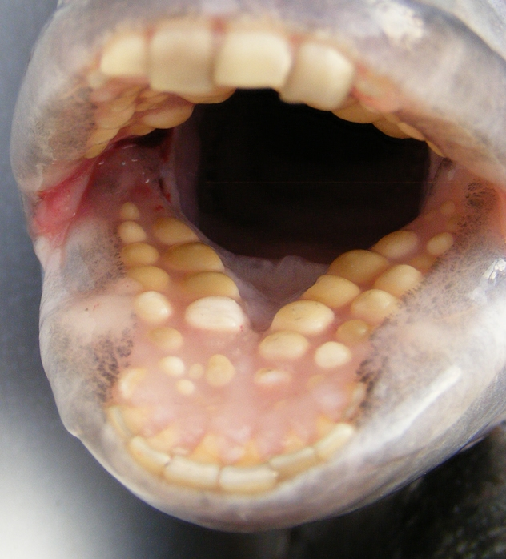
Teeth
The oral jaws and many pharyngeal bones may bear teeth.
Many different terms have been applied to the different sizes and shapes of teeth
Canine
Villiform
Molariform
Incisor

Slide 5
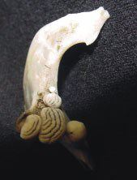
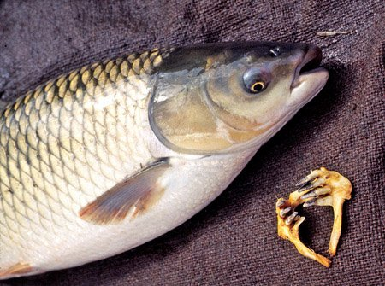
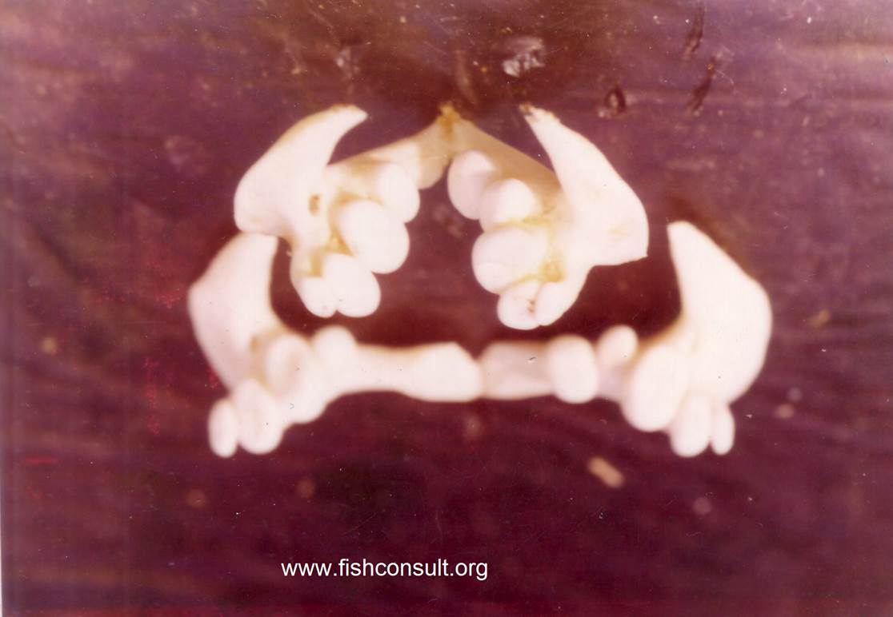
Pharyngeal teeth

Slide 6
Branchiocranium
The branchiocranium is divisible into five parts:
Mandibular (颌骨)
Palatine (腭骨)
Hyoid (舌骨)
Opercular (鳃盖骨)
Branchial (鳃)

Slide 7
Palatine and hyoid arches
The palatine arch consists of four pairs of bones in the roof of the mouth:
palatines (腭骨）
ectopterygoids (外翼骨)
mesopterygoids (内翼骨)
metapterygoids (上翼骨)
The suspensorium consists of a chain of primarily cartilage
bones that attach the lower jaw and opercular apparatus to the skull
hyomandibula (舌颌骨)
quadrate (方骨)

Slide 8
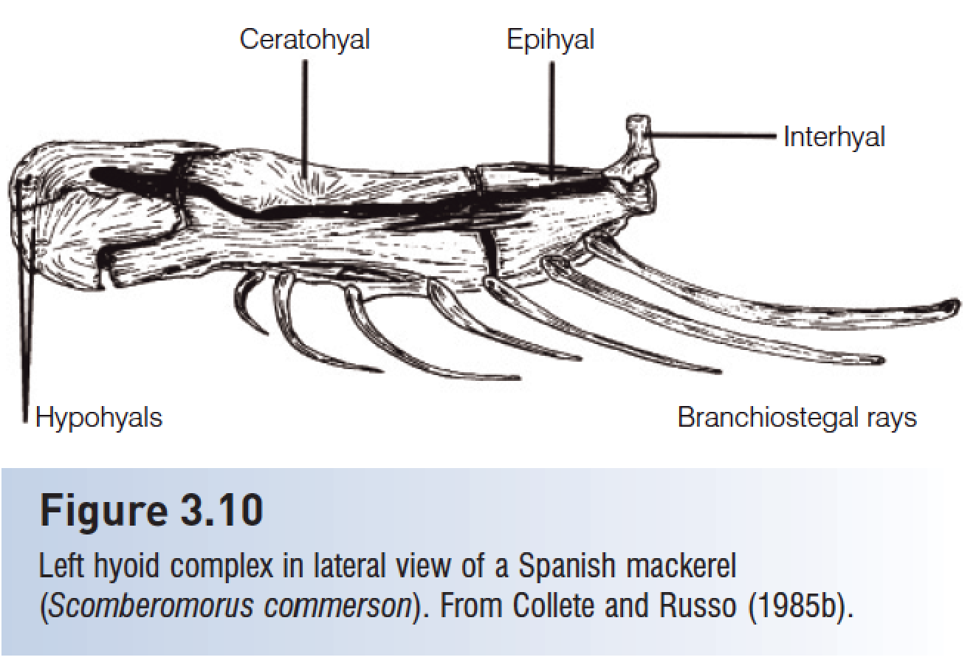
Palatine and hyoid arches
The hyoid complex is a series of five pairs of bones that lie medial to the lower jaw and opercular bones and lateral to the branchiostegal rays that attach to them.

Slide 9
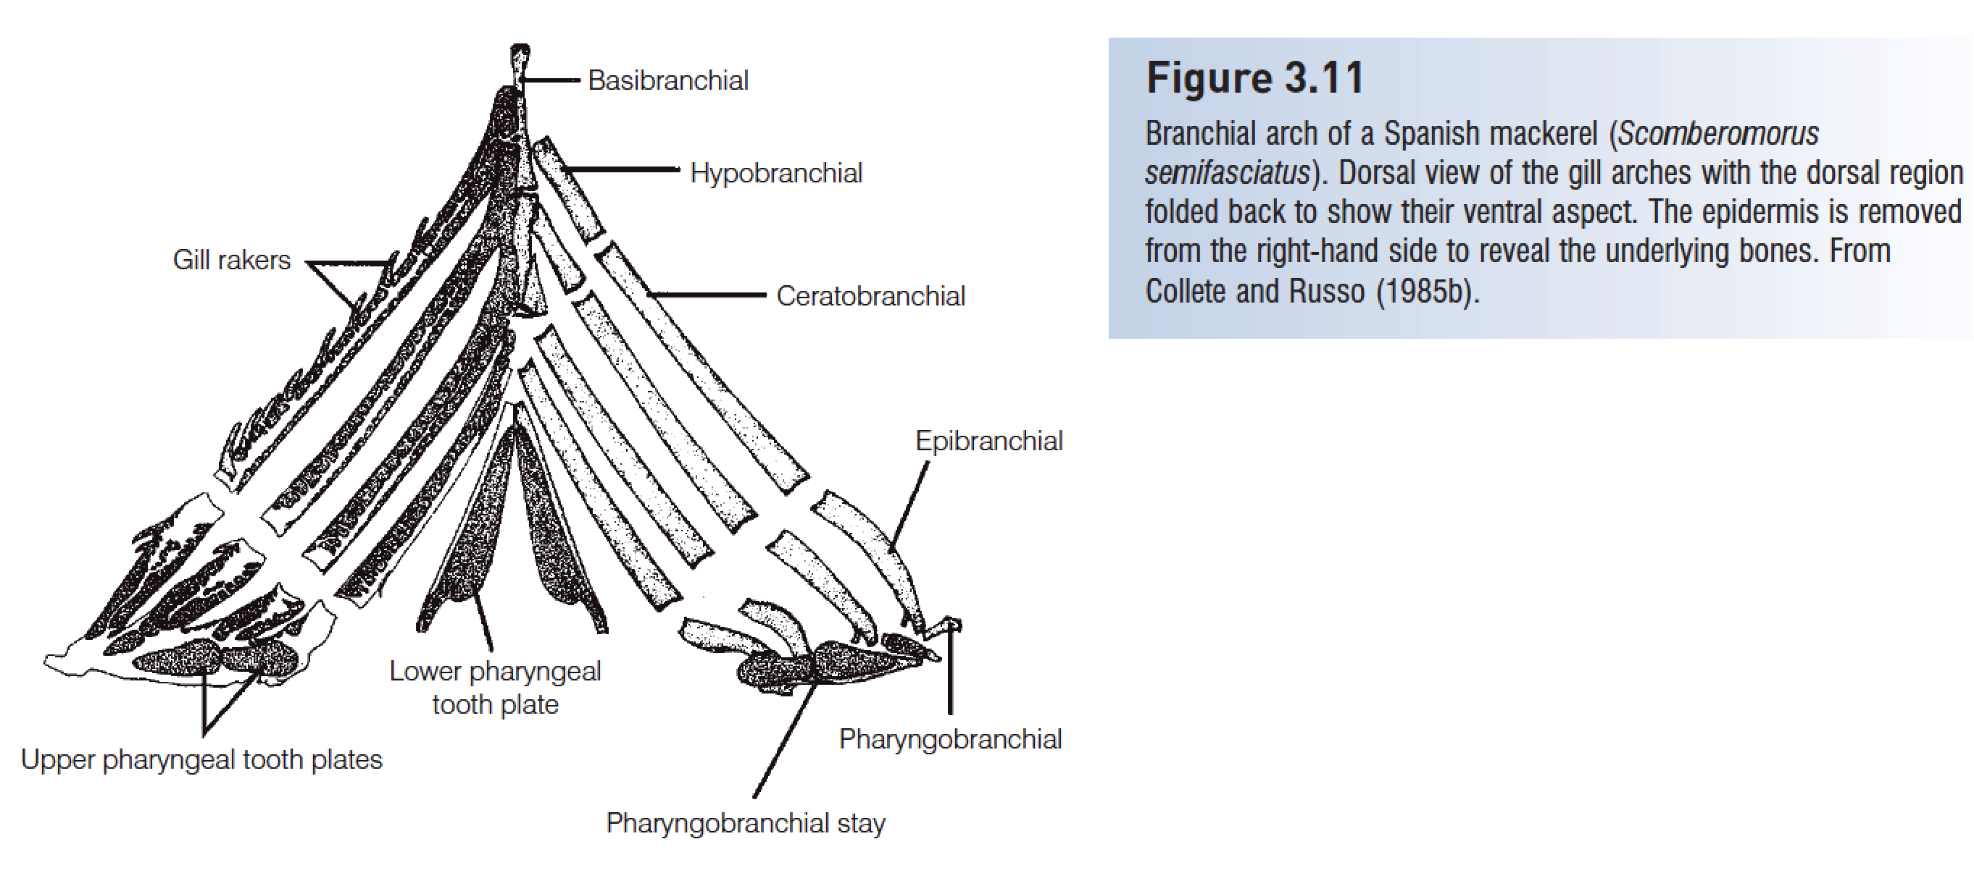
The dermal bones of the hyoid arch are the branchiostegal rays, elongate, flattened, riblike structures

Slide 10
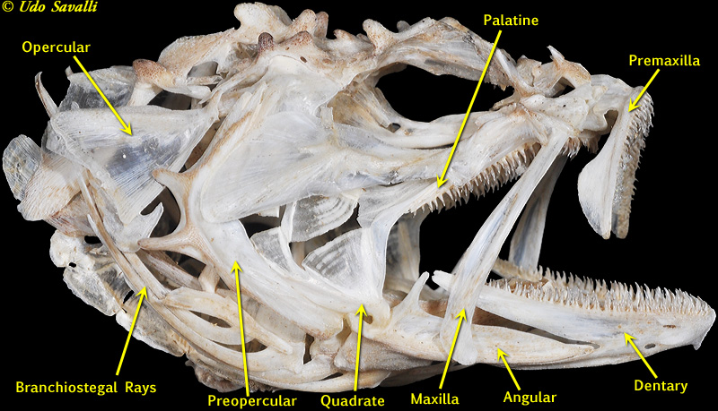

Slide 11
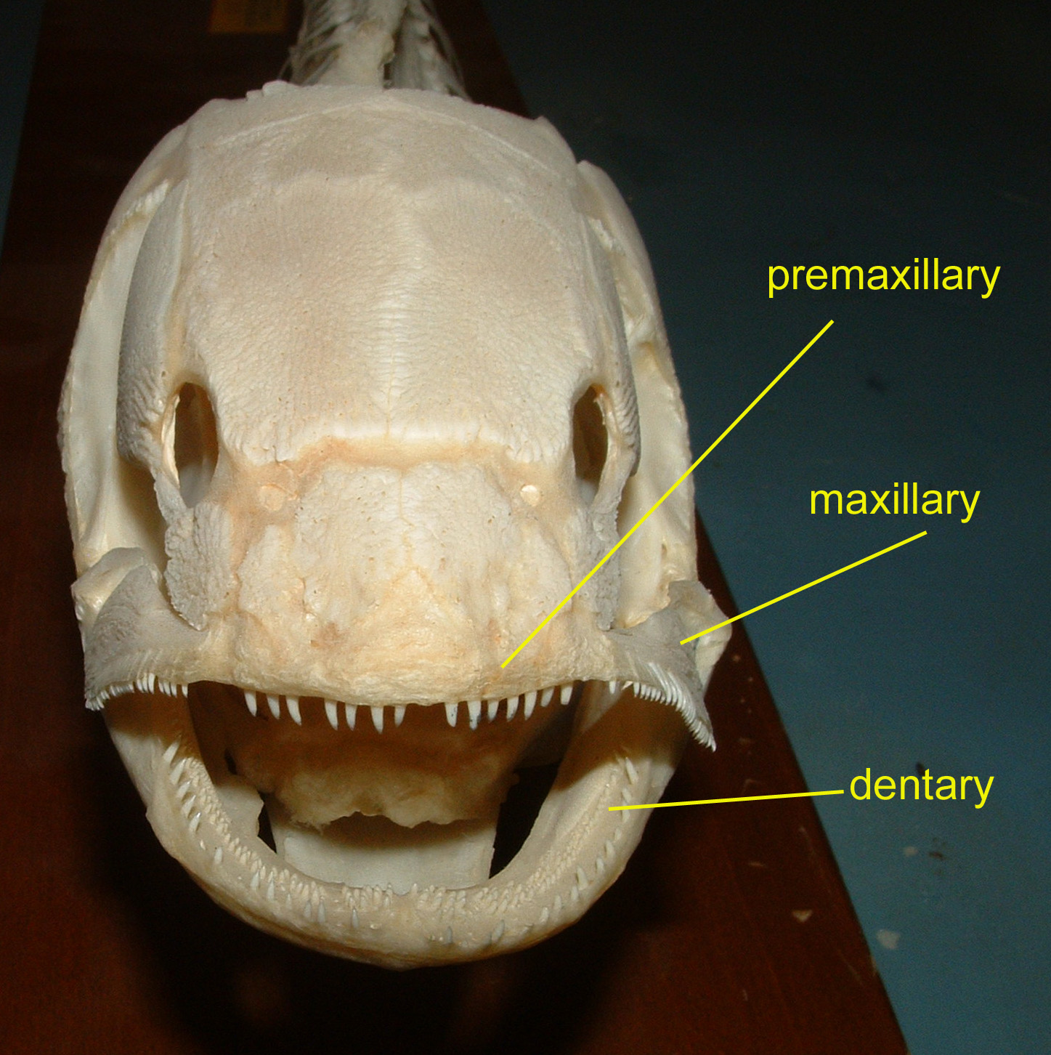

Slide 12
Postcranial skeleton
The notochord of primitive chordates is replaced by the vertebral column in lampreys, Chondrichthyes (软骨鱼), and osteichthyans (硬骨鱼).
Posterior vertebrae support the caudal fin in most fishes.
In teleosts, hypurals (尾下骨) (enlarged haemal spines, 脉棘) support the branched principal caudal fin rays.

Slide 13
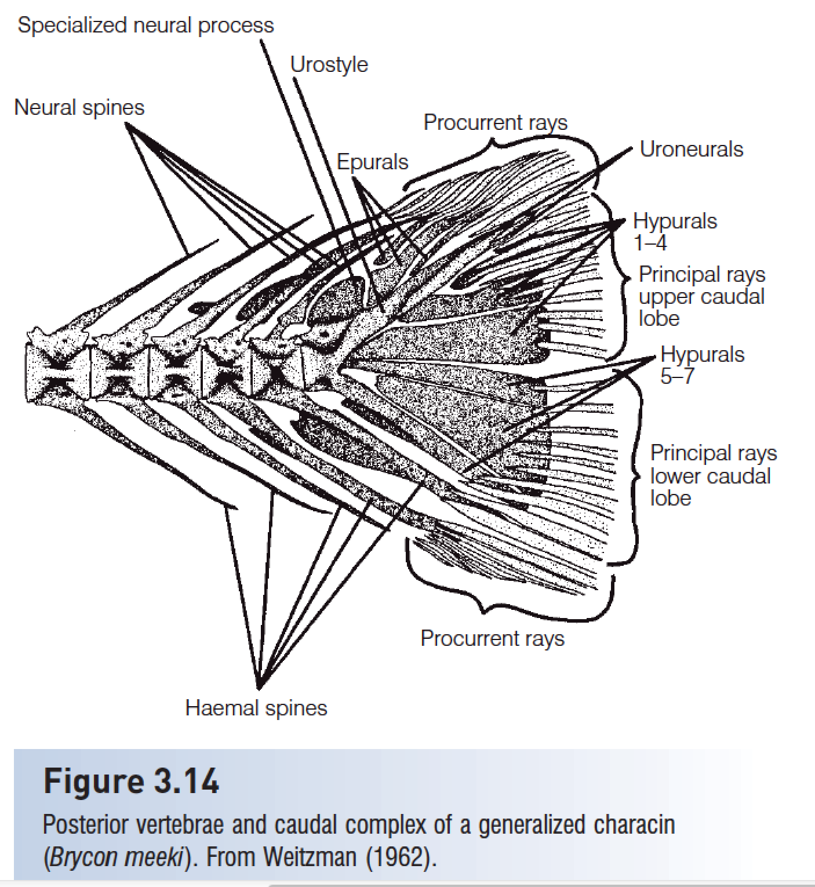
Caudal complex

Slide 14
Ribs (pleural ribs) attach to the vertebrae and protect the viscera.
Intermuscular bones are segmental, serially homologous ossifications in the myosepta of teleosts.

Slide 15
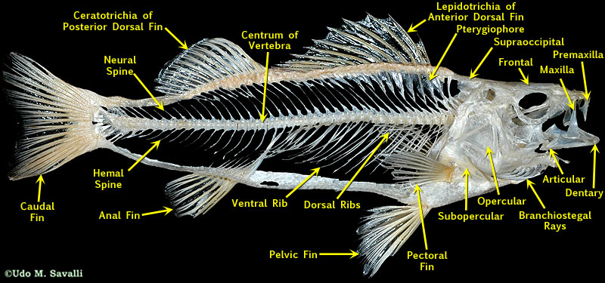
Skeletal Structures

Slide 16
Presentation for next week (Oct 17)
李乾
Describe the cardiovascular system of fish.
赵鸿晰
How does fish manage gas exchange in swim bladder?
黄乐菲
Describe five parts of fish brain.

Slide 17
Presentation for next week
Sent me your ppt before the class (Oct 17).
Talk for 7 - 10 min

Slide 18
HWK
Homework 2
due on Oct 17
No late hand-in will be graded
Read Chapter 4
Name your species
List species (scientific name), the reason for choosing the species, and the original description
Send me through 学习通 by Oct 17

