Slide 1
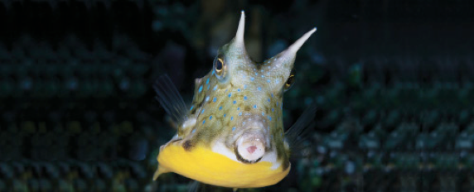
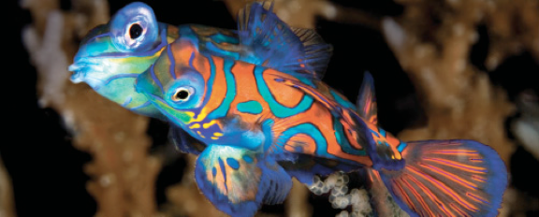
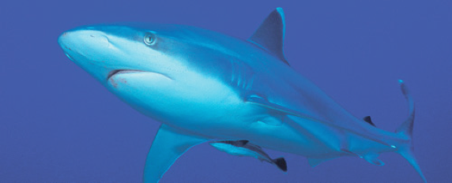
Lesson 2
Skeleton, skin and scales
Ichthyology
Shanghai Ocean University
Fall, 2025

Slide 2
Three basic types of caudal fins are:
(i) protocercal, the primitive undifferentiated caudal fin of adult lancelets, hagfishes, lampreys, and larvae of more advanced fishes
(ii) heterocercal, or unequal-lobed tail, in Chondrichthyes and primitive osteichthyans; and
(iii) homocercal, or equal-lobed tail, found in most teleosts.

Slide 3
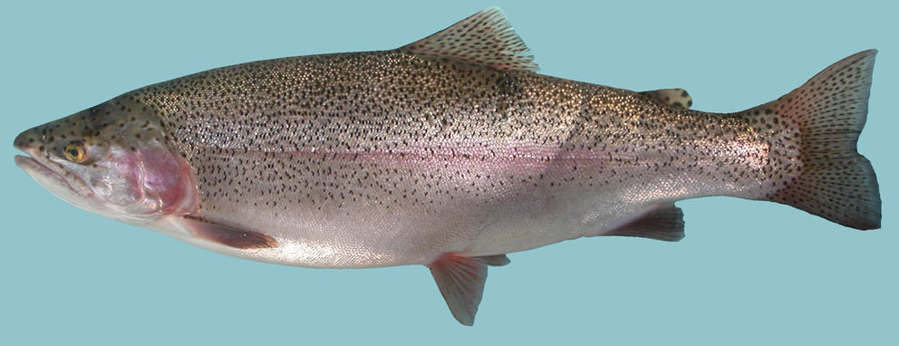
The dorsal, anal, and adipose fins (脂鳍) form the median or unpaired fins.

Slide 4
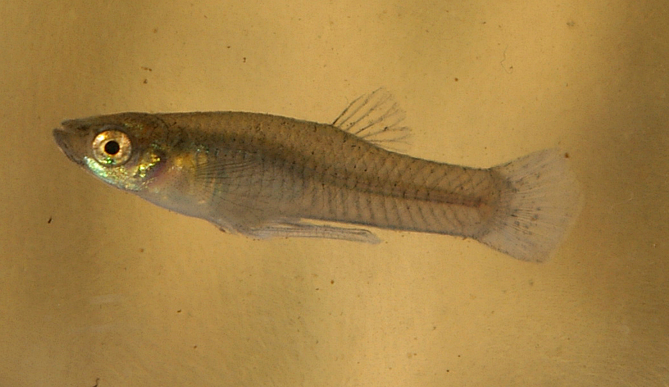
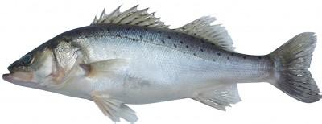
“Early-branching” teleosts have a single dorsal fin composed of soft rays.
Advanced teleosts usually have two dorsal fins: the anterior fin composed of spines and the posterior fin composed of soft rays.

Slide 5
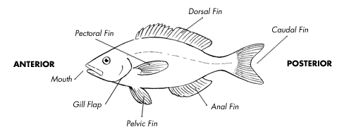


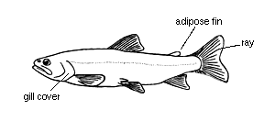
Six fin types
Fin Name | Paired or Single | Typical Function
Dorsal | single | Keel (stabilizer); may be divided
Caudal | single | Propulsion!!!
Anal | single | Stabilizers
Pelvic | paired | Stabilizers; braking
Pectoral | Paired | Steering
Adipose | single | Unknown
http://www.pbs.org/wgbh/nova/teachers/activities/3003_fish_01.html
Heterocercal tail
Homocercal tail

Slide 6
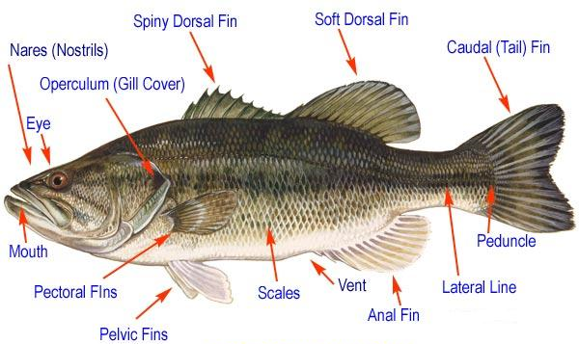
External features – bony fish
Premaxilla
Dentary
Maxilla

Slide 7
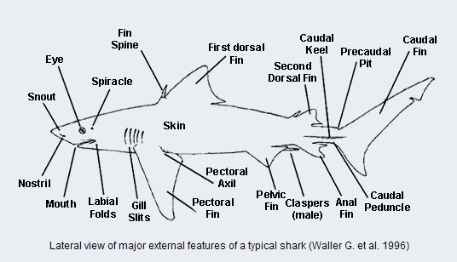
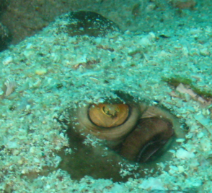
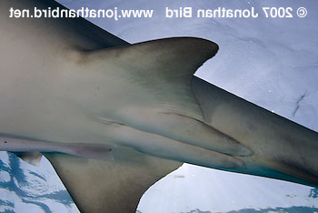
External features – cartilagenous fish

Slide 8
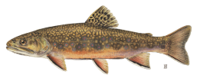
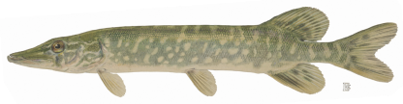
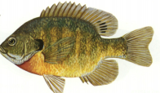
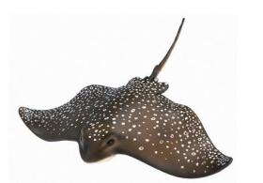
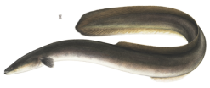
Body shapes
Fusiform (torpedo-like)
Sagittiform (arrow-like)
http://pond.dnr.cornell.edu/nyfish/Esocidae/northern_pike.html
Compressiform
(horizontally flattened)
Depressiform
(vertically flattened)
Anguilliform
(circular; eel-like)

Slide 9
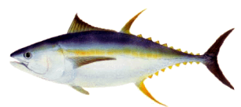
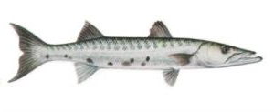
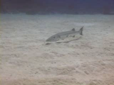
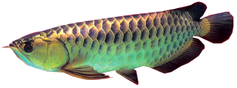
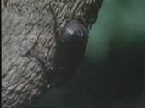
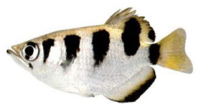
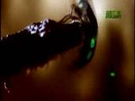
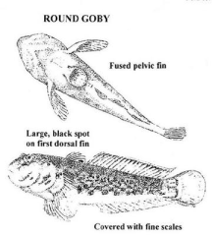
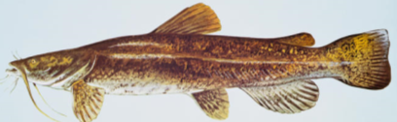
Body types by function
Rover predators
Lie-in-wait predators
Surface-oriented
Bottom rover
Bottom clinger

Slide 10
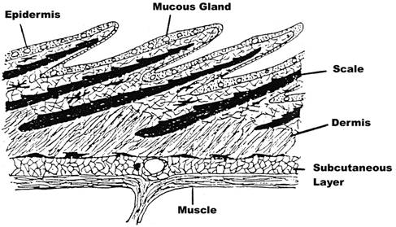
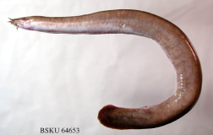
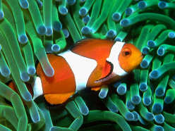
Skin and Scales
1. Epidermis
10-30 of cells
Mostly flat / compressed epithelial cells
Mucus glands
Protective barrier
2. Dermis
Matrix of connective tissue – connected to muscles
Pigment cells, blood vessels, dermal skeleton
http://www.icanteachmyself.com/edu_694_assignments/1_2/clownfish.jpg

Slide 11
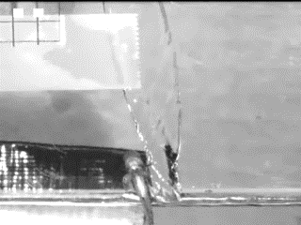

Slide 12
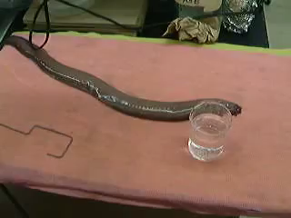

Slide 13
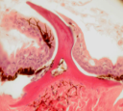
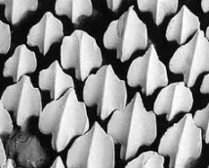


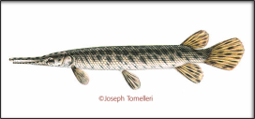
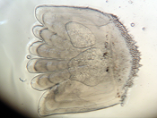
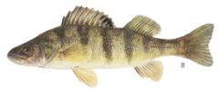
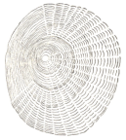
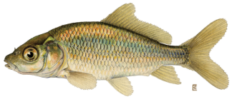
Skin and Scales
Scales – 3/4 main types in living fishes
Housed within pocket of dermal cells
1. Placoid (denticles)
        Tooth-like projections on sharks
        VERY different from scales in other fish
        Pulp cavity just like teeth!
2. Ganoid – diamond-shaped
        Hard protein covering (ganoine)
        Not flexible
        Non-overlapping
3. Bony-ridge scales – overlapping, flexible bony ridges
  Ctenoid – comb-like rim
  Cycloid – smooth rim

Slide 14
Presentation for next week
(Oct 17)
李乾
  Describe the cardiovascular system of fish.
赵鸿晰
  How does fish manage gas exchange in swim bladder?
黄乐菲
  Describe five parts of fish brain.

Slide 15
Presentation for next week
Sent me your ppt before the class (Oct 17).
Talk for 7 - 10 min

Slide 16
HWK
Homework 2
  due on Oct 17
  No late hand-in will be graded
Read Chapter 4
Name your species
  List species (scientific name), the reason for choosing the species, and the original description
  Send me through 学习通 by Oct 17

Slide 17
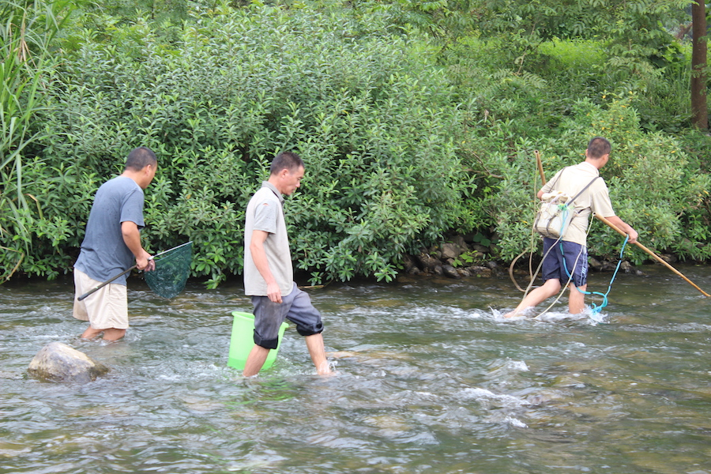
Have a nice week!
广西百寿

