Slide 1
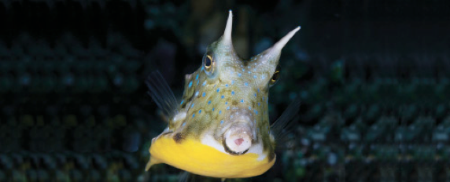
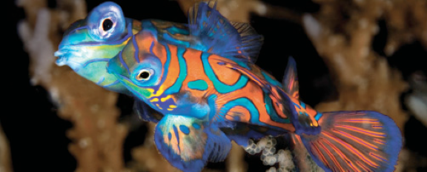
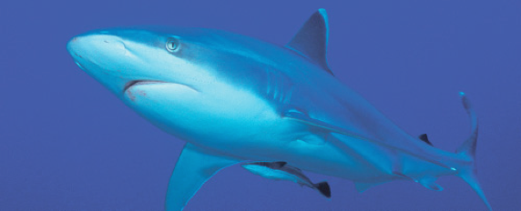
Lesson 3
Soft anatomy
Ichthyology
Shanghai Ocean University
Fall, 2025

Slide 2
Nervous system
The nervous system can be divided into the cerebrospinal and autonomic systems.
The cerebrospinal system is composed of the central nervous system and the peripheral nervous system.
The central nervous system is further subdivided into the brain and the spinal cord (Healey 1957; Bernstein 1970; Northcutt & Davis 1983).

Slide 3
Nervous system
The peripheral system is composed of the cranial and spinal nerves and the associated sense organs (vision, smell, hearing, lateralis system, touch, taste, and electrical and temperature detection; see Chapter 6).
The autonomic nervous system is composed of sympathetic and parasympathetic ganglia and fibers.

Slide 4
Fish brain
Fish brains are on average only 1/15 the size of the brain of a bird or mammal of equal body size.
Sharks have much larger brains relative to body size than teleosts and pelagic sharks have larger brains than pelagic teleosts (Linsey & Collins 2006).
In pickerels (Esox), the brain is only 1/1305 of body weight. Elephantfishes (Mormyridae) have the largest brains among fishes, 1/52 to 1/82 of body weight.

Slide 5
Five parts of fish brain
黄乐菲

Slide 6
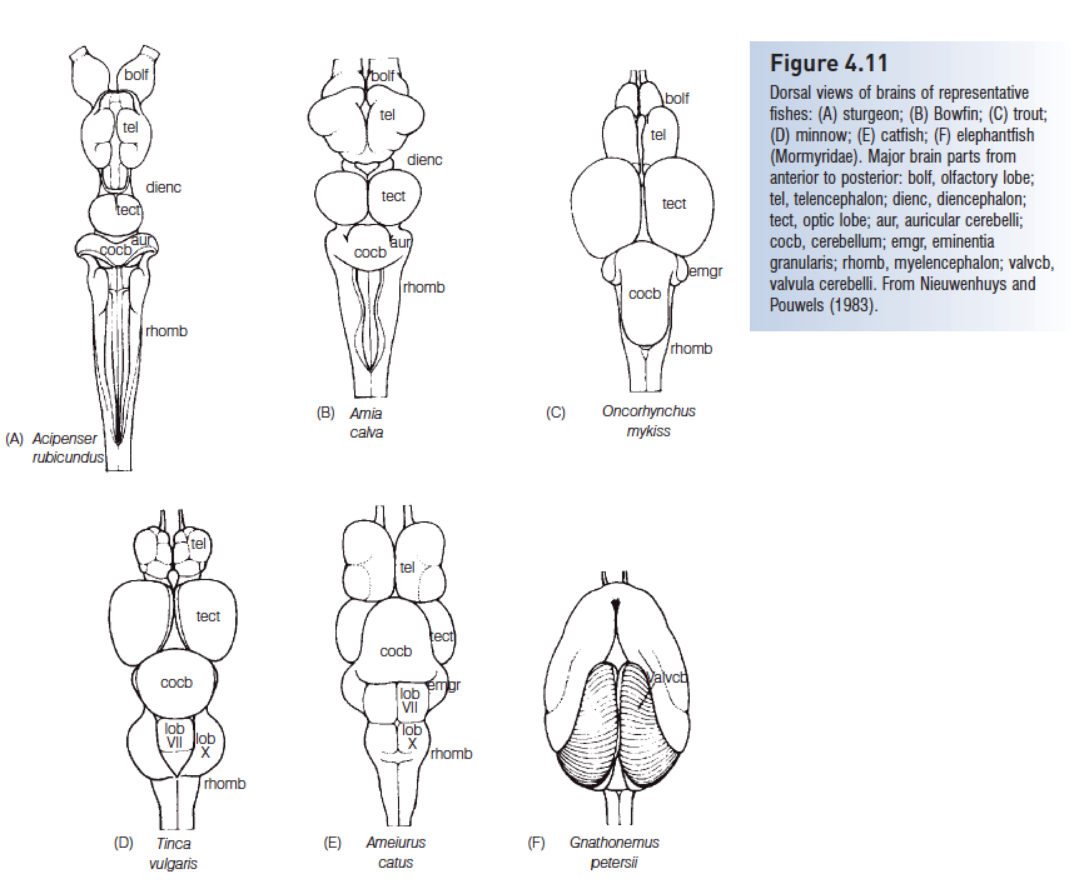
The brain can be divided into fi ve parts from anterior to posterior (Fig. 4.11).

Slide 7
Five parts of fish brain
The most anterior part is the telencephalon, or forebrain, which becomes the cerebrum of tetrapods. Its function in fishes is primarily associated with reception and passage of olfactory stimuli.

Slide 8
Five parts of fish brain
The diencephalon, or ‘tween brain, lies between the forebrain and the midbrain and is also known as the saccus dorsalis. It functions as a correlation center for incoming and outgoing messages regarding homeostasis and the endocrine system.

Slide 9
Five parts of fish brain
The mesencephalon, or midbrain, is important in vision. The optic nerve (cranial nerve II) brings impulses from the eyes and enters the brain here.
The midbrain is also a correlation center for messages coming from other sensory receptors. Fishes have two optic lobes, which are relatively large in sight-feeding species such as trouts and minnows

Slide 10
Five parts of fish brain
The metencephalon, or hindbrain, functions in maintaining muscular tone and equilibrium in swimming. The cerebellum, a large single lobe, is the largest component of the fish brain.
Cranial nerve IV (trochlear) runs from the metencephalon to the eye muscles. The metencephalon is small in lampreys (Petromyzontidae) and almost absent in hagfishes (Myxinidae).
In elephantfishes (Mormyridae), the cerebellum is hypertrophied to form the valvula cerebelli (Fig. 4.11F), which extend over the dorsal surface of the telencephalon. This large cerebellum is related to reception of electrical impulses.

Slide 11
Five parts of fish brain
The myelencephalon, brainstem, or medulla oblongata is the posterior portion of the brain and the enlarged anterior part of the spinal cord. Cranial nerves V through X arise here.
The myelencephalon serves as the relay station for all the sensory systems except smell (cranial nerve I) and sight (cranial nerve II). It contains centers that control certain somatic and visceral functions.
In bony fishes, it also contains respiratory and osmoregulatory centers

Slide 12
Peripheral nervous system
Cranial nerveI, the olfactory nerve, is a sensory nerve that runs from the olfactory bulb to the olfactory lobes.
The optic nerve (cranial nerve II) runs from the retina to the optic lobes.
As in other vertebrates, cranial nerves III (oculomotor), IV (trochlear), and VI (abducens) are somatic motor nerves that innervate the six striated muscles of the eye: IV, the superior oblique; VI, the external rectus; and III, the other four eye muscles.

Slide 13
Peripheral nervous system
Unlike in most other vertebrates, four cranial nerves (VII through X) innervate parts of the lateral line system. The trigeminal, V, is a mixed somatic sensory and motor nerve serving the anterior portion of the head.
Cranial nerve VII, the facial, and VIII, the acoustic, usually join to form the acousticofacialis nerve, which then subdivides into four groups of mixed nerves serving the temporal and branchial regions of the head.

Slide 14
Peripheral nervous system
Patterns of nerves, such as that of the ramus lateralis accessorius of the facial nerve (which innervates taste buds on the posterior head and body), have proved to be useful in assessing relationships of teleosts (Freihofer 1963).
The glossopharyngeal, IX, is a mixed nerve that supplies the gill region. It often fuses with cranial nerve X, the anterior ramus of the vagus. The vagus is a mixed nerve connected to the body lateral line and viscera.

Slide 15
Summary
1 Fishes have three kinds of muscles (skeletal, smooth, and cardiac, or heart, muscle) and have relatively more skeletal muscle than do other vertebrates.
2 In the locomotory system, white muscle forms most of the postcranial body and is used anaerobically for burst swimming but fatigues quickly. Red muscle usually forms thin, lateral, superficial sheets under the skin; it is used in sustained swimming and fatigues slowly.
3 The basic pattern of the cardiovascular system is a single-pump, single-circuit system that goes from the heart to gills to body and back to the heart. Many fishes have a pseudobranch, a small structure under the operculum composed of gill-like filaments that may provide oxygenated blood to the visual system.

Slide 16
Summary
4 The anterior region of the alimentary tract consists of the buccal cavity (mouth) and the pharynx. The posterior region consists of the foregut (esophagus and stomach), midgut or intestine, and hindgut (rectum). Alimentary tract length and structure differ as a function of feeding habits.
5 The gas or swim bladder is a gas-filled sac located between the alimentary canal and the kidneys. It develops from the roof of the foregut. A pneumatic duct connects the gas bladder and the gut in primitive teleosts (physostomous condition). Physostomous fishes can take gas in and emit it through the mouth and pneumatic duct. Advanced teleosts are physoclistous, losing the connection in adults. Physoclistous fishes have a secretory region containing a gas gland and a rete mirabile to produce gas, and an oval where gas is resorbed.

Slide 17
Summary
6 Kidneys, paired longitudinal structures ventral to the vertebral column, are one of the primary organs involved in excretion and osmoregulation. A pronephros is present in hagfishes and larval fishes, whereas a mesonephros is the functional kidney in Actinopterygii.
7 The sexes in fishes are usually separate, and the gonads are usually paired. Males have testes that produce sperm, and females have ovaries that produce eggs. In Chondrichthyes and primitive osteichthyans, eggs are shed into the body cavity – the gymnovarian condition. In gars and most teleosts, the lumen of the hollow ovary is continuous with the oviduct – the cystovarian condition.

Slide 18
Summary
8 The fish brain can be divided into five parts, from anterior to posterior: (i) the telencephalon, or forebrain, primarily associated with smell; (ii) the diencephalon, a correlation center for messages regarding homeostasis and the endocrine system; (iii) the mesencephalon, or midbrain, important in vision; (iv) the metencephalon, or hindbrain, which maintains muscle tone and equilibrium in swimming and has a large median lobe (cerebellum), which is the largest component of the fish brain; and (v) the myelencephalon, brainstem, or medulla oblongata, the posterior portion of the brain and enlarged anterior portion of the spinal cord that relays input for all sensory systems except smell and sight.
9 Fishes have small brains but sharks have larger brains than teleosts. The largest brains occur in elephant fishes (Mormyridae), which have a large proportion of their brain devoted to electroreception.

Slide 19
HWK
Homework 3.docx
  due on Oct 20
  No late hand-in will be graded
Read Chapter 6

Slide 20
Presentation for next meeting
(Oct 20)
叶心语
  Explain what are tuberous receptors, and how do they work
张天泽
  Describe the three types of photoreceptive glycoprotein (opsin) and their difference
张宇琳
  Name two types of vision related structural adaptation
王澔天
  Describe how the countercurrent flow mechanism works in fish respiration.

Slide 21
Presentation for next week
Sent me your ppt on Sunday (Oct 20).
Talk for 7 -10min

Slide 22
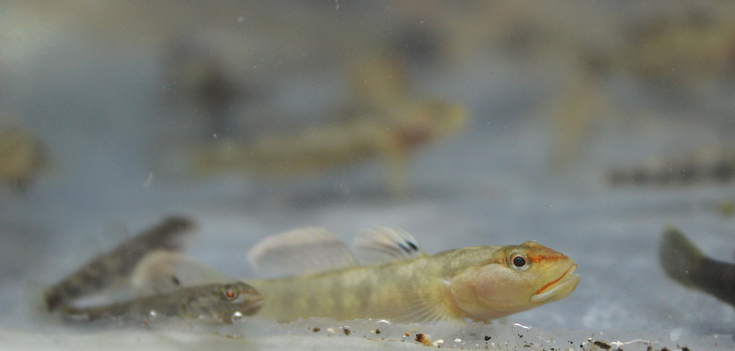
Have a nice week!
萧氏吻虾虎鱼（Rhinogobius xiaoi）广东揭东

