Slide 1
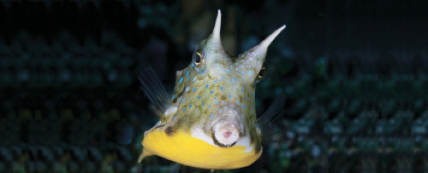
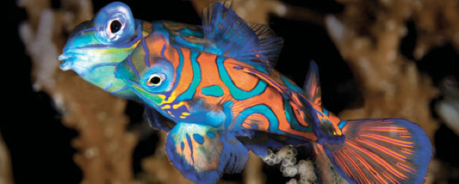
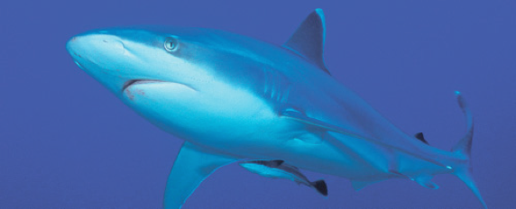
Lesson 10 Reproduction
Ichthyology
Shanghai Ocean University
Fall, 2020

Slide 2
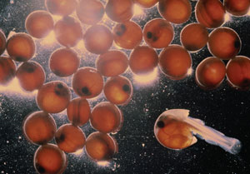
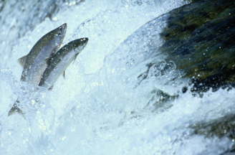
Reproduction: many strategies to reach the same goal
Chapter 21
Notes:
The variation in reproductive strategies among fishes – particularly bony fishes – is truly amazing.

Slide 3
“The success of any fish species ultimately is determined by the ability of it’s members to reproduce successfully in a fluctuating environment.”
- Moyle and Cech
Notes:
Here is a direct quote from your book, and it is very true. Successful reproduction is the cornerstone of a species’ longterm persistence. In terms of their surrounding environment, think of the extremes that fishes have to face. As I mentioned earlier, fishes inhabit virtually every type of water body on the planet that has (or has recently had) some type of connection to the broad water mosaic that covers the earth.

Slide 4
Reproductive patterns
Reproductive success is the ultimate determinant of adaptations. Factors that characterize the breeding systems of fishes include
frequency of mating
number of partners
gender role of individuals.

Slide 5
Semelparity vs. iteroparity
Semelparous
spawning one time and dying
semelparous fishes are diadromous or include at least one major migratory phase in their life cycle.
most salmon of the genus Oncorhynchus, anadromous
Anguillid (freshwater) eels, catadromous
Variation within species, American Shad (Alosa sapidissima) are semelparous in southern locations (30–33°N), largely iteroparous at northern latitudes
Iteroparous
spawning more than once during their lives
e.g., sharks, lungfishes, sturgeons, gars, tarpons, minnows, codfishes, seabasses

Slide 6
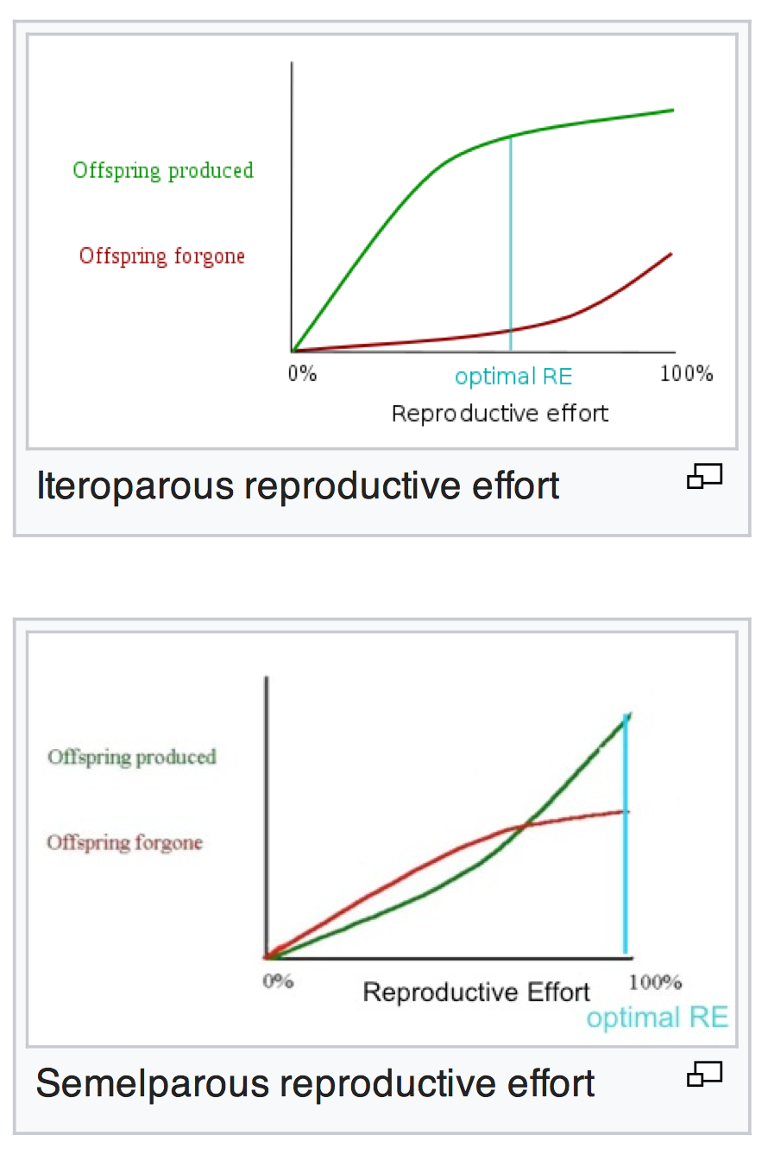
Semelparity vs. iteroparity
Models based on non-linear trade-offs
Bet-hedging models
Iteroparity is a hedge against unpredictable juvenile survivorship (avoiding putting all one's eggs in one basket)

Slide 7
Semelparity vs. iteroparity
It has been shown that semelparous species have higher expected adult mortality, making it more economical to put all reproductive effort into the first (and therefore final) reproductive episode.
Semelparity can be a characteristic of r strategists, and iteroparity a characteristic of K strategists.

Slide 8
Bioenergetics – some terms
* Reproductive effort – energy investment
* Age of onset of reproduction
* Fecundity - # of gametes produced
* Survivorship - # of individuals that reach the next year of life
* Frequency of reproduction
Semelparity vs Iteroparity
(Spawn once vs Many times)
Notes:
A few quick notes on bioenergetics…

Slide 9
Bioenergetic balances / tradeoffs
Reproductive effort
Frequency of reproduction
Notes:
Every species is directed toward some sort of optimum balance via natural selection, both in terms of reproductive effort vs frequency, and…

Slide 10
Bioenergetic balances / tradeoffs
Fecundity
Survivorship
Notes:
Fecundity vs survivorship. Is it best to produce huge numbers of gametes, but not invest in parental care, or is it better to produce fewer offspring but provide care and protection for them. There is no ‘cut and dry’ answer, but rather a continuum.

Slide 11
R-selected vs. K-selected?
陈滢萱
Compare R-selected vs. K-selected reproduction strategy, give some examples.

Slide 12
R-selected vs. K-selected?
Rapid growth
Early maturation
Short gestation
High fecundity
No parental care
Slow growth
Delayed maturation
Long gestation
Low fecundity
Parental care
Notes:
This is a fundamental ecological concept. We call it “R-K” selection. Note the characteristics of each.

Slide 13
Based on the information given in this lecture, which of the following fishes might best be classified as r-selected?
Western mosquitofish
Sturgeon
Pipefish
Anchovy

Slide 14
Based on the information given in this lecture, which of the following fishes might best be classified as r-selected?
Western mosquitofish
Sturgeon
Pipefish
Anchovy
But… r/k selection is a continuum and most organisms fall somewhere in the middle!

Slide 15
Number of partners
The three most common categories are
Promiscuous
no obvious mate choice occurs, where both males and females spawn with multiple partners
Polygamous
only one sex has multiple partners, takes multiple forms
Monogamous
fish live in pairs that stay together and mate, bonytongues, catfishes, snakeheads, blennies, gobies, surgeonfishes, and pufferfishes

Slide 16
Polygamous
Evolutionarily, these systems are purported to have an increased chance of passing on “good genes” from individuals that compete for the ability to mate with multiple partners.
This mating system can occur with one male and many females (see polygyny) or one female and multiple males (see polyandry)

Slide 17
Gender
Gender roles in fishes are labile. Although most fishes remain one functional sex throughout their adult lives, sex reversal in either direction is fairly common.
Strong influences on the occurrence, timing, and direction of sex reversal include the social environment, in terms of the number of members of each sex, their relative positions in dominance hierarchies, and the relative reproductive contributions of the sexes at different sizes.
All-female species of parthenogenetic livebearers use sperm from donor males to activate cell division in eggs, but the male’s genes do not contribute to future generations.

Slide 18
顾佳
Introduce the phenomenon of sex change in fishes, give examples and explain how did it evolved.

Slide 19
Sex reversal
In perhaps 34 families belonging to 10 orders,
including moray eels (Anguilliformes), loaches (Cypriniformes), lightfishes (Stomiiformes), killifishes (Atheriniformes), swamp eels (Synbranchiformes), flatheads (Scorpaeniformes), boxfishes (Tetraodontiformes),
and at least 24 perciform families
including snooks, seabasses, tilefishes, emperors, rovers, porgies, threadfins, angelfishes, bandfishes, damselfishes, wrasses, parrotfishes, and gobies)

Slide 20
Sex reversal
simultaneous hermaphrodites
capable ofreleasing viable eggs or sperm during the same spawning
sequential hermaphrodites
functioning as males during one life phase, and as females during another.
protandrous fishes，develop first as males and then later change to females,
protogynous fishes mature first as females and then later become males.

Slide 21
Panther grouper (Cromileptes altivelis)

Slide 22
Sex reversal
The questions are “why change sex?” and “when to change?”
Answers lie primarily in the ecologies of individual species, greatly influenced by the relative reproductive success of males versus females at different sizes.

Slide 23
Parthenogenetic
Parthenogenesis is a natural form of asexual reproduction in which growth and development of embryos occur without fertilization.
Gynogenesis is closely related phenomena in which a sperm triggers the development of the egg cell into an embryo but makes no genetic contribution to the embryo.

Slide 24
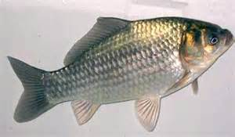
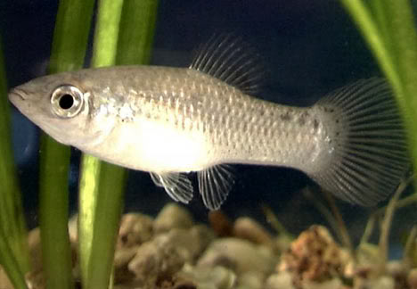
Parthenogenetic / Gynogenesis
Fang zheng Caucian carp
（Carassius auratus gibelio）
方正银鲫
Amazon molly (Poecilia formosa)
亚马逊帆鱼

Slide 25
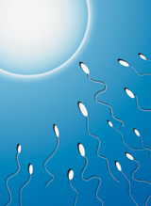
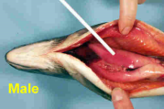
Reproductive anatomy
Differences between the sexes
Internal
Ovaries: 30-70% of body mass
Differences between sexes
Testes: <12% of body mass (usually)
Notes:
Let’s begin with reproductive anatomy. Sexual dimorphism is a term that you should know. It means that there are physical differences between the sexes. Of course, this is true of their internal reproductive anatomy. As with any other vertebrate, the sex glands are the ovaries in females and testes in males. We discussed energy investments during the lesson on feeding and nutrition. Females of some species invest an amazing quantity of energy into producing eggs. Indeed, at the outset of the spawning season (spawning definition = release or deposition of eggs by fishes, but most people think of the term as the collective acts in fish reproduction), the ovaries can make up as much as 70% of the total body mass in the females of some species! Males, on the other hand, do not invest as much in the testes as they make up as the maximum relative size (to the best of my knowledge) is 12% of the total body mass. Why such a difference? Think of the gametes; that is, sperm and egg cells. Egg cells contain not only the female’s DNA, but all of the other machinery necessary for growth once fertilization occurs. Sperm cells, on the other hand, are simply a small capsule of the male’s DNA with an “engine” to get them to their destination. The difference in size is profound. So…females invest a lot in gamete production while males invest some in gamete production, but also a lot of energy in attracting mates, defending territories, etc.

Slide 26
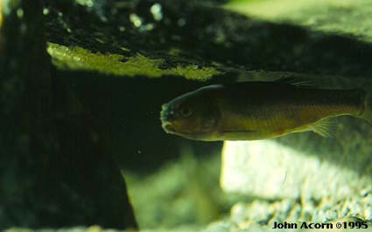
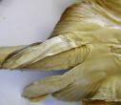
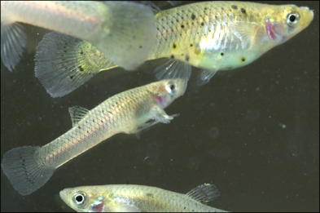
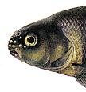
Sexual dimorphism – modified fins
Pelvic claspers
Differences between sexes
Gonopodium
Breeding tubercles
Notes:
I used the term “sexual dimorphism” on the last slide. Usually, this refers to external physical differences between the sexes. In some fishes, males and females are difficult to tell apart, but in others, the differences are profound. Some males have fins that are modified into copulatory organs; that is, to guide the sperm into the reproductive tract of females. This allows for internal fertilization, which is not all that common in the fish world. One large group that uses is internal fertilization are the sharks, rays, and skates (cartilagenous fishes). In this group, pelvic claspers are present in males. In poeciliids (family Poeciliidae – guppies, swordfish, etc.), males have a modified anal fin, the gonopodium, that performs the same funciton.
There may also be other significant differences in secondary sexual characters. The males of some fishes develop knobby breeding tubercles on their head, and perhaps on many other areas of the body. These perform various functions. In fathead minnows, males use this to scrape away the undersurface of a rock to prepare for deposition of eggs by the female. Here is a fathead male guarding a clutch of eggs (see eggs on undersurface of rock above the male).

Slide 27
祝悦
Describe three major differences between the sexes in fish, and give examples.

Slide 28
Sexually selected traits
Truly random mating is rare; some choice of mates is the norm.
Sexually selected traits are those that result from intrasexual competition and from the breeding preferences of the opposite sex.
Anatomical differences between sexes are called sexual dimorphisms, and include differences in body size, shape, color, dentition, or ornamentation.
In most fishes, the male is the “dimorphic” sex (except that females are generally larger). Many fishes develop breeding tubercles or contact organs, again primarily in the males.
A major cost of dimorphisms is that the dimorphic sex is more conspicuous to predators.

Slide 29
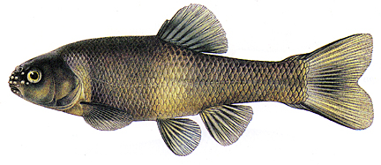
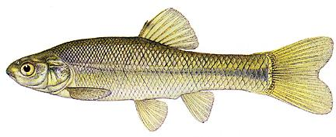
Sexual dimorphism – color
♂
Differences between sexes
Fathead minnow
(Pimephales promelas)
♀
Sexual dichromatism
Notes:
There may also be profound color differences.

Slide 30
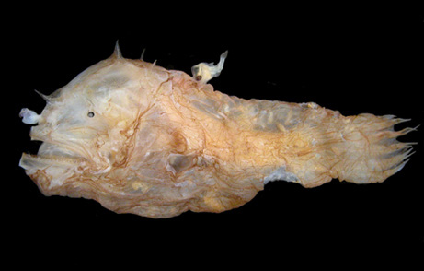
…and size!
male (6 mm)
Differences between sexes
Female deep sea anglerfish
Notes:
…and size differences! In fact, males in some anglerfishes become physically attached ‘parasites’ that live on the females. They are simply a little ‘sperm vessel’ that the female carries around. What’s the reason for this? Well, the odds of a male and female anglerfish actually encountering one another in the vast expanses of the deep ocean are pretty low. This strategy ensures that they will stay together and increases the likelihood of successful reproduction!

