Slide 1
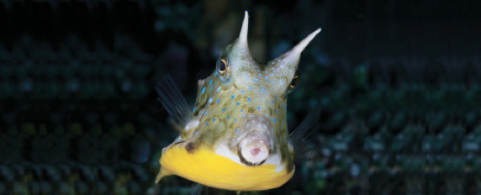
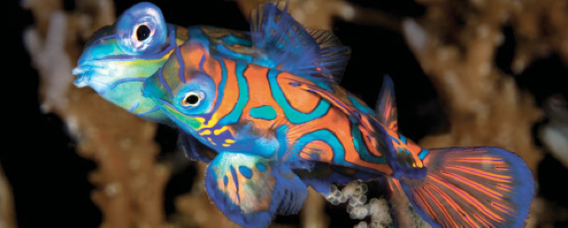
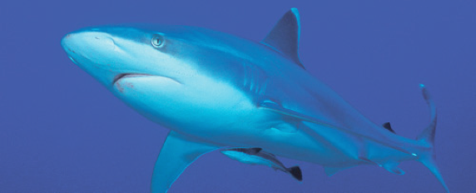
Lesson 10 Reproduction
Ichthyology
Shanghai Ocean University
Fall, 2020

Slide 2
王昉欣
Describe different types of parental care.

Slide 3
Breeding behavior / spawning habits
Incredible variety!!!
Generally classified in 3 major categories
Nonguarders Guarders Bearers
Notes:
There are a great many variations in spawning modes. We can generally place them in three categories.

Slide 4
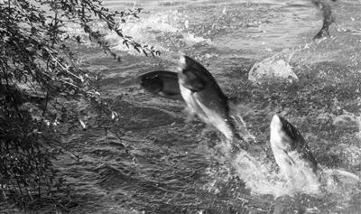
Nonguarders – no protection of embryos / fry once spawning is complete
Open-substrate spawners – no active concealment of embryos
Pelagic
Hypophthalmichthys molitrix （鲢鱼）

Slide 5
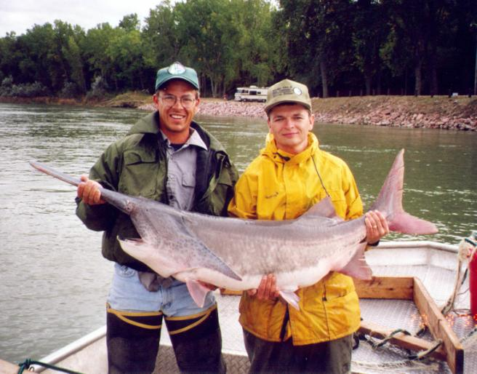
Nonguarders
Open-substrate
Benthic spawners on silt/gravel
Paddlefish – Polyodon spathula, Gavins Point Dam, SD
Spawns on flooded silt-free gravel bars

Slide 6
Nonguarders
Brood hiders – conceal eggs/embryos
Benthic spawners
Notes:
Spawning occurs over open gravel substrate; spawning activity stirs eggs into substrate and then they are abandoned. (e.g., brook trout)

Slide 7
Nonguarders
Brood hiders – conceal eggs/embryos
Beach spawners
Notes:
Smelt - introducted to Lake Michigan where they have become well-established.
Smelting VERY popular in spring when the run occurs, especially on the south shore of Lake Superior by Ashland.
Shallows near beaches “boil” with fish at night.

Slide 8
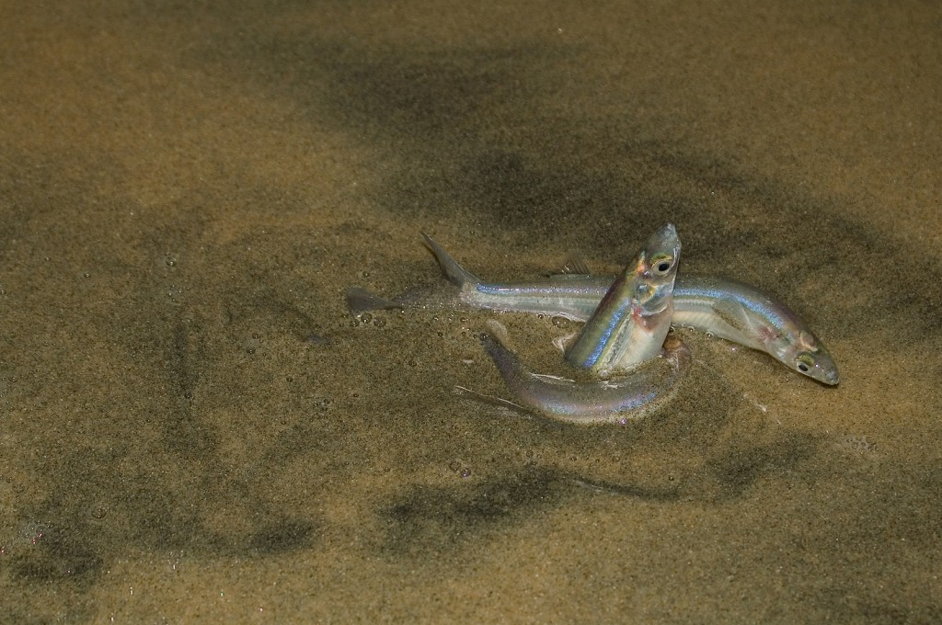
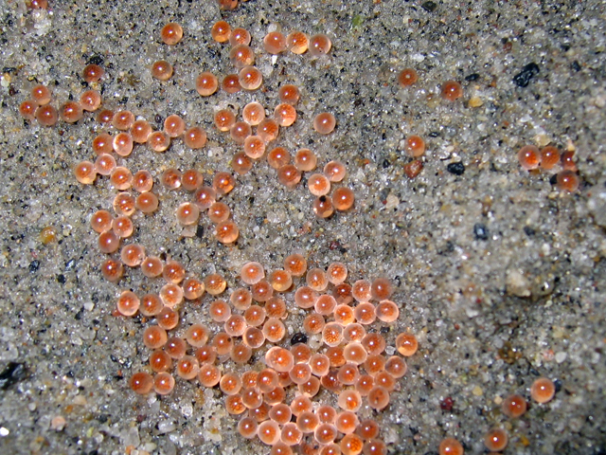
The California Grunion (Leuresthes tenuis)

Slide 9
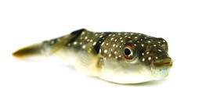
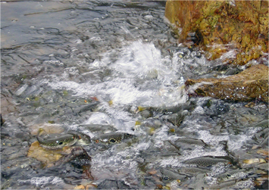
The grass puffer (Takifugu niphobles) 星点东方鲀

Slide 10
Guarders – exhibit at least some parental care for embryos/offspring
Substratum choosers
Nest spawners
Notes:
Rock tenders
Plant tenders
Terrestrial tenders

Slide 11
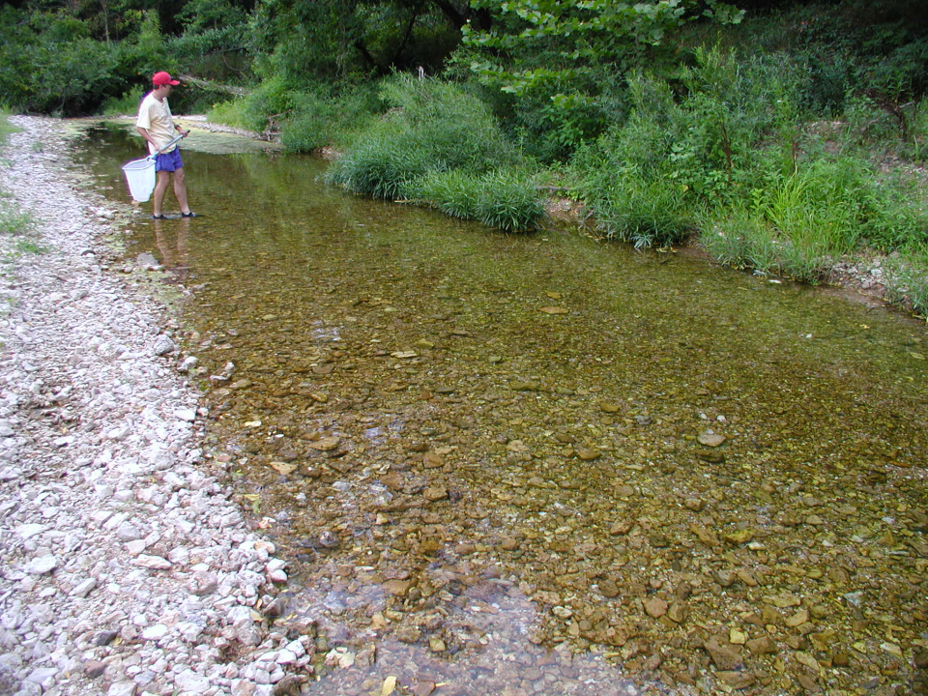
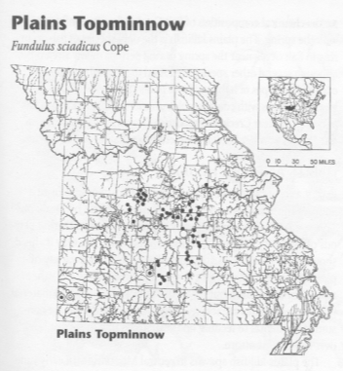
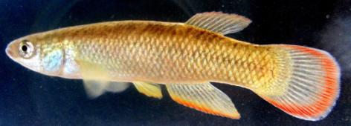
Guarders
Saline Creek, Jefferson County
A substrate chooser…
Orti & Bessert, 2005
Plains topminnow – Fundulus sciadicus
Notes:
The plains topminnow is a fish that I am doing genetic studies on. It is a substrate chooser that guards a nesting area (but doesn’t construct a nest) in dense vegetation of the clear, cold streams where it occurs.

Slide 12
Nest spawners
Many fishes spawn in nests that may be simple depressions in the bottom
or more elaborate structures made of rocks or vegetation and constructed (usually) by the male, occasionally glued together with body secretions.
Guarders
Notes:
The most familiar example of a local fish that constructs nests are the Centrarchids (sunfishes and bass).
In most, males dig a shallow basin in the substrate, court the female, then guard the nest.

Slide 13
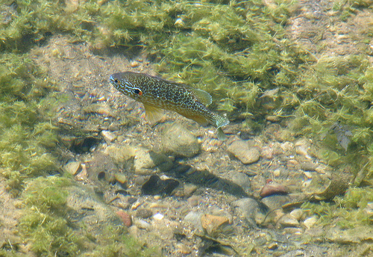
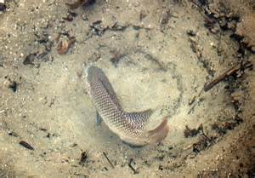
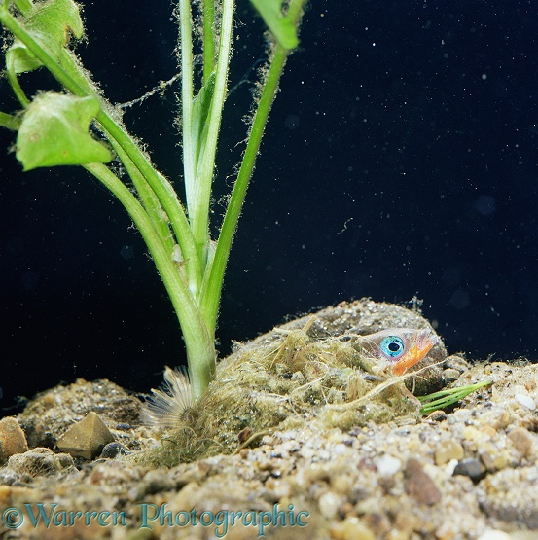
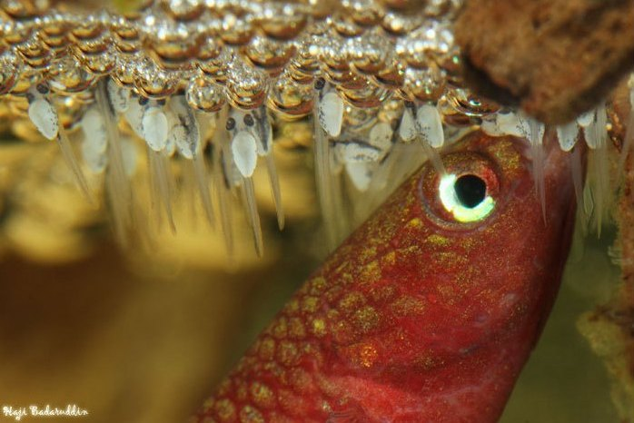
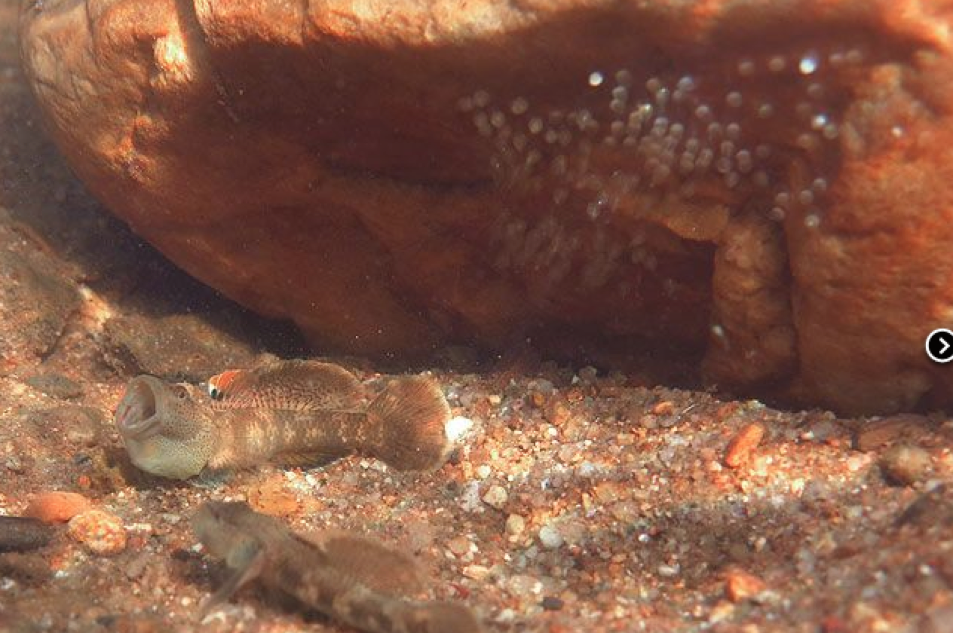
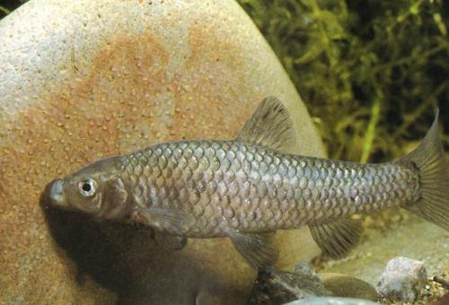
Sunfish
（太阳鱼）
Tilapia
（罗非鱼）
Stickleback
（刺鱼）
Sand / mud nesters
Plant material nesters
Beta fish
（斗鱼）
Rhinogobius chiengmaiensis
（吻虾虎）
Pseudorasbora parva
（麦穗鱼）
Bubble nesters
Rock and gravel nesters

Slide 14
Puffer nest

Slide 15
Bearers – carry their embryos with them, either externally or internally
External bearers
Auxiliary brooders
Mouth brooders
Gill chamber brooders

Slide 16
Bearers
External bearers
Auxiliary brooders
Mouth brooders
Gill chamber brooders

Slide 17
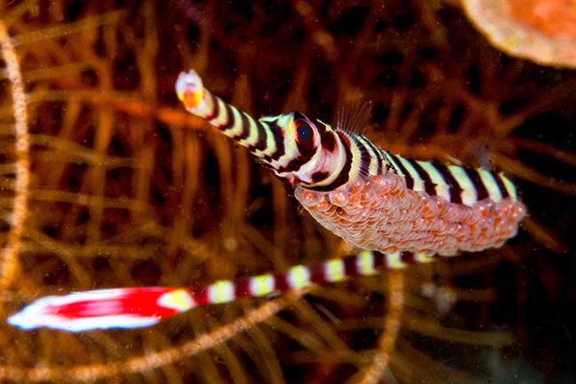
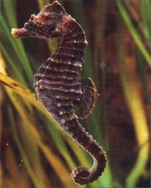
Evolution of auxiliary brooding in Sygnathidae
Bearers
Skin brooders
Pipefish
Open-pouch
brooders
Closed-pouch
brooders
Seahorse

Slide 18
Bearers
External bearers
Auxiliary brooders
Mouth brooders
Gill chamber brooders
Some Cichlids

Slide 19
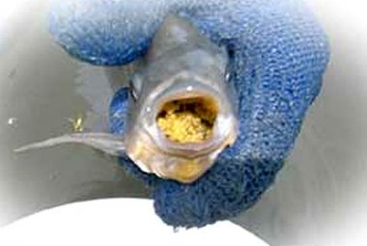
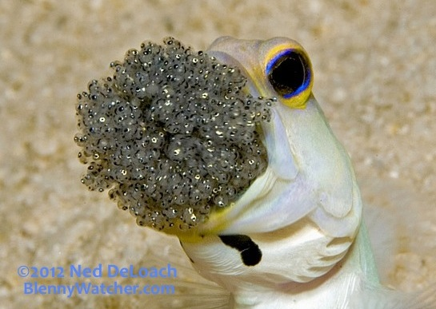
Tilapia (Oreochromis niloticus)
罗非鱼
Jawfish (Opistognathus aurifrons)
黄头后颌鱼

Slide 20
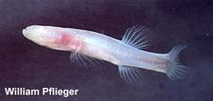
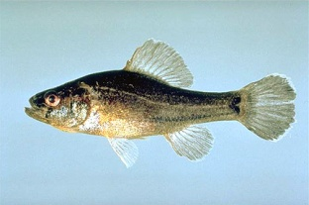
External bearers
Auxiliary brooders
Mouth brooders
Gill chamber brooders?
Bearers
Cavefishes - Amblyopsidae
Pirate perch –
Aphredoderus sayanus
Hmmm… MAYBE!

Slide 21
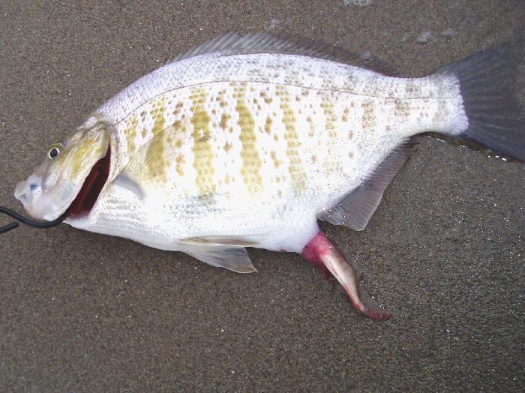
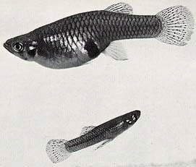
Internal bearers
Some killifish
Facultative internal bearers
Obligate internal bearers
Livebearers
Sharks and rays
Bearers
Western mosquitofish –
Gambusia affinis
Surfperch - Amphistichus argenteus
Notes:
We don’t have any mosquitofish in Wisconsin, but I’ll show you some specimens from Nebraska.

Slide 22
Guppy video

Slide 23
How would you classify this fish?!?
Non-guarder
B. Guarder
C. Bearer
D. I have no clue, but it looks pretty cool!

Slide 24
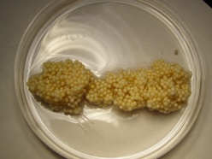
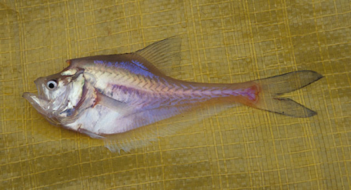
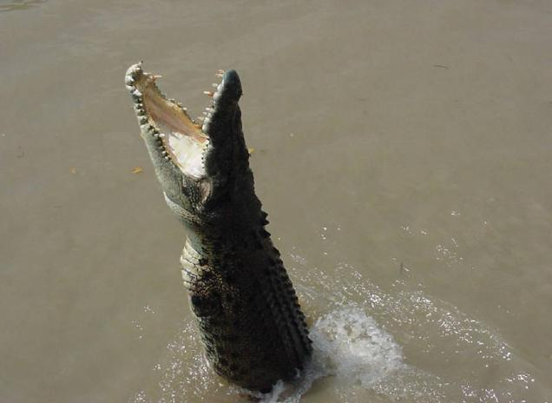
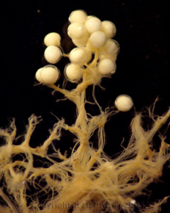
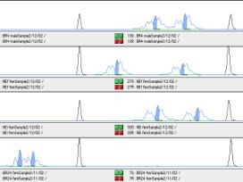
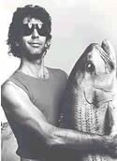
The enigmatic nurseryfish (Kurtus gulliveri)
Bearer
Notes:
The nurseryfish is actually a bearer. Males develop a highly vascularized dorsal “hook” (on their forehead) on which they carry around fertilized egg masses! I have done some genetic work on these. They are difficult to study due to their co-occurrence with estuarine crocodiles in Australia.

