Slide 1
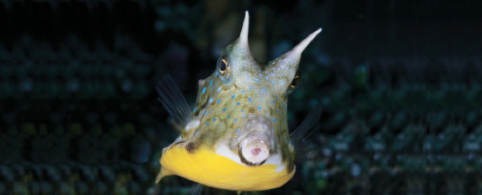
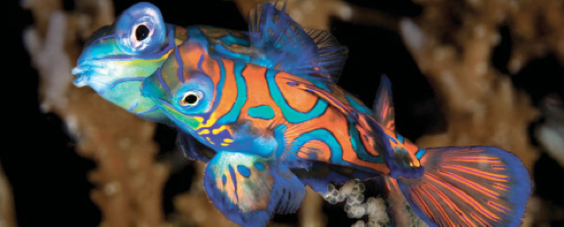
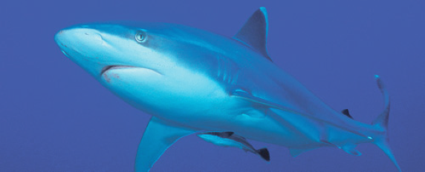
Lesson 10 Reproduction
Ichthyology
Shanghai Ocean University
Fall, 2020

Slide 2
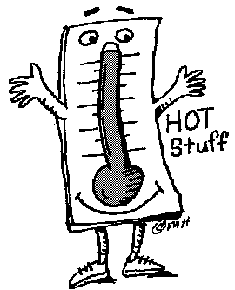
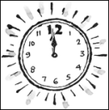
Environmental cues
photoperiod
temperature
Notes:
So, what causes fish to go into spawning mode? Well, there are a number of environmental cues that have been correlated with spawning onset, but it’s not the same in all fishes.

Slide 3
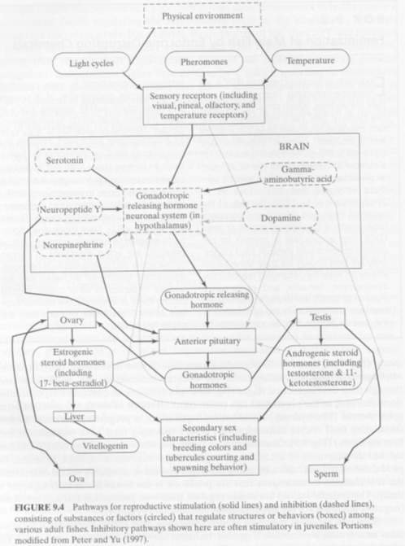
Photoperiod
and temperature
are important, but
it’s more
complicated than
that…
Notes:
Photoperiod is important, but the whole process is pretty complex. The amount of light may be one of many factors that causes some genes to turn on which start a hormone cascade in the body of the fish that pushes them into spawning mode.

Slide 4
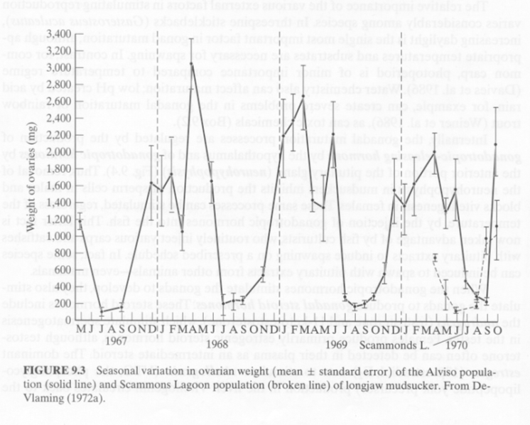
Insert GSI graph.
Gonadosomatic Index (GSI)
Notes:
One way of studying the timing of reproduction is to calculate a gonadosamatic index for a large number of specimens over several years. In this way you can determine when gonad size is at its peak. That, of course, is highly correlated with peak spawning activity.

Slide 5
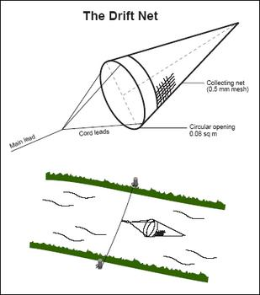
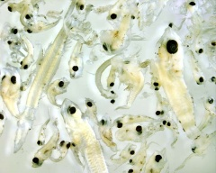
Timing of reproduction:
Less direct methods…
Picking drift!
Notes:
Another less direct method for studying the timing of reproduction is to collect larval fish as they float (“drift”) downstream.

Slide 6
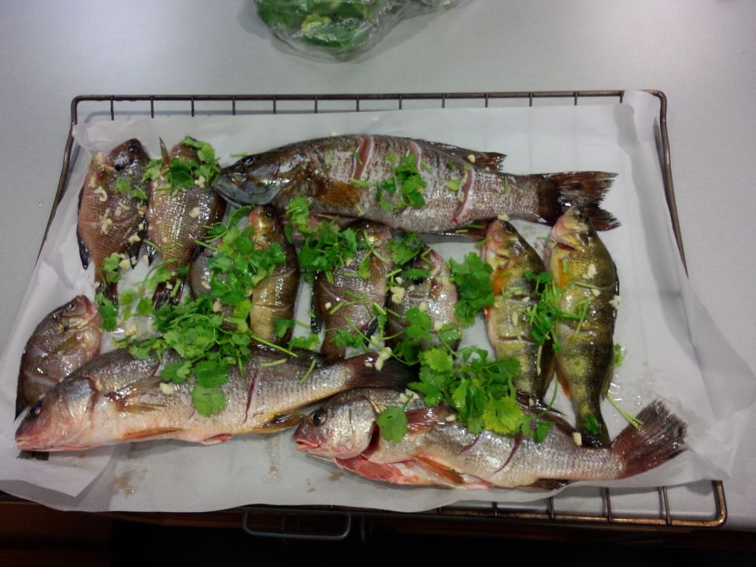
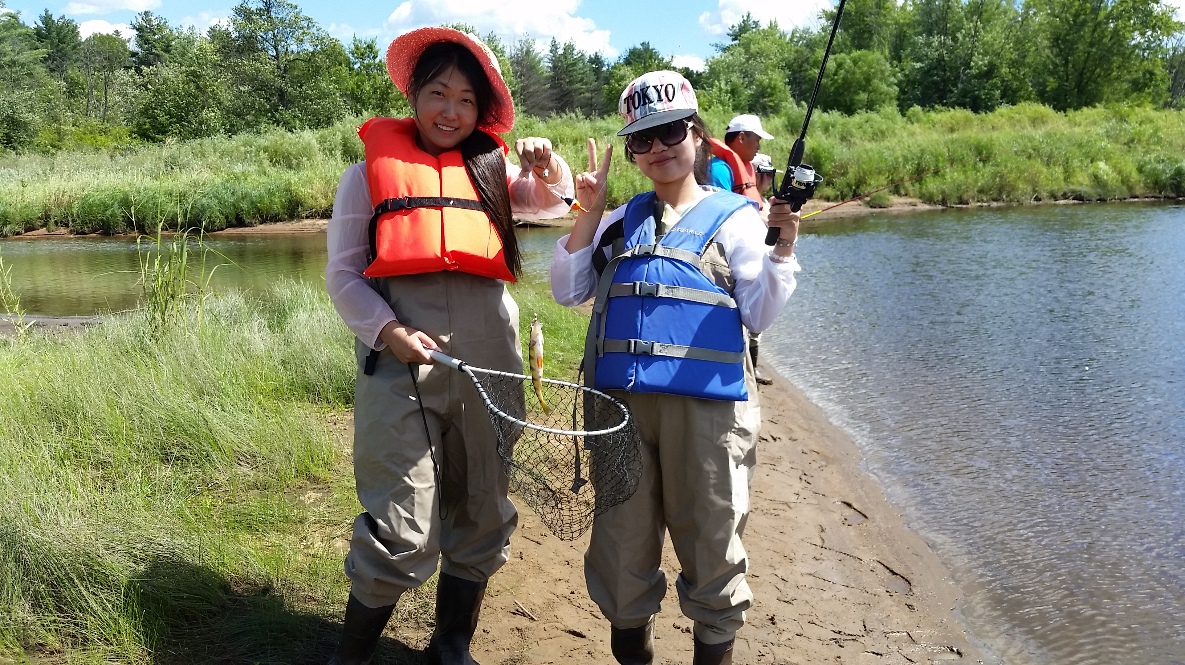
Sampling fish lavae in Chippewa River, WI, 2015

Slide 7
Alternative mating systems and tactics
Not all members of a population use the same reproductive tactics.
Sneaking is known from many species (salmons, sunfishes, wrasses, gobies) in which generally smaller males lurk on the edge of a spawning area and dash in rapidly while a territorial male is spawning.
Whether such alternative tactics are genetically fixed in individuals or represent modifiable responses is unknown.

Slide 8
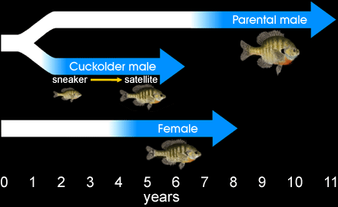
Other possibilities
Alternative Life Histories of the Bluegill Sunfish
– Mart Gross & Bryan Neff

Slide 9
Take home message
However, sneaking is negatively frequency dependent in that, because of competition, the advantages of sneaking decrease as the density of sneakers increases.
Alternatively, no single strategy may confer a consistently greater selective advantage over others, so each is favored at different times and is consequently maintained at least at low frequencies in a population.
Finally, differing reproductive modes may represent nothing more than alternative, equally adaptive responses to similar environmental forces (Fischer & Petersen 1987)

Slide 10
Presentation for next week (Dec 13)
陈思宇
Describe different type of eggs and postulate why they are different (adaptive values)
徐楠
Describe different type of Embryonic development and give examples
田若彤
Explain the process of smoltification
陆晓薇
Sex determination is very complex, summarize different ways of sex determination in fishes and give examples

Slide 11
HWK
Homework 10 (Dec 13)

Slide 12
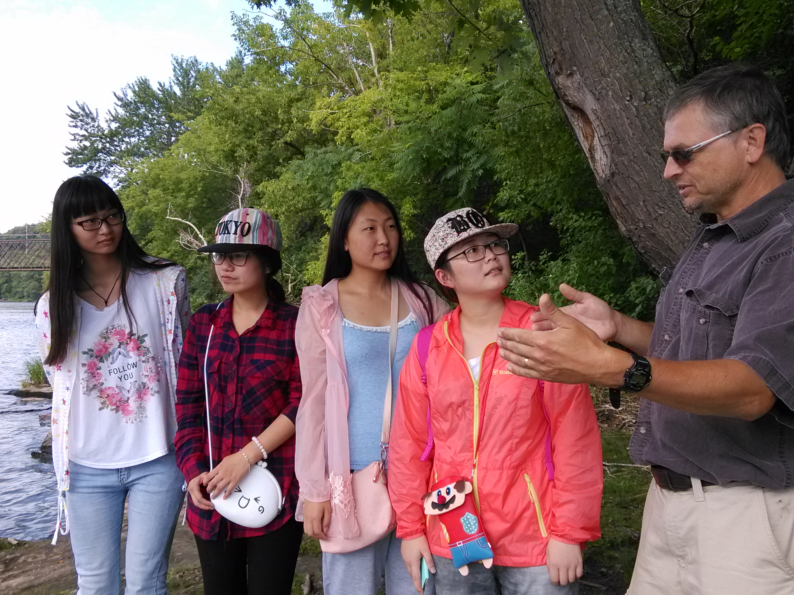
Have a nice week!
A field trip to Menomonie, Wisconsin, July, 2015

