Slide 1
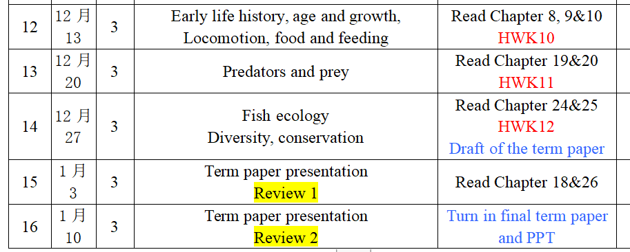

Slide 2
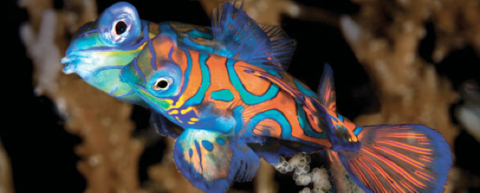
Lesson 11 Early Life History, Age and Growth
Ichthyology
Shanghai Ocean University
Fall, 2020

Slide 3
Indeterminate growth
Fishes experience indeterminate growth, growing throughout their lives, changing from larvae to juveniles to adults.
They also change continually in terms of anatomical traits and ecological requirements and interactions.

Slide 4
Indeterminate growth
In most respects, large size confers physiological and ecological advantages on an individual.
Larger females producing more and bigger eggs
Mate choice by both males and females often favors larger individuals
larger fish are better able to defend a spawning territory
Larger fish can swim faster and migrate over larger distances
Predation rate is typically greater on smaller fish
Different size individuals essentially function as different species, the so-called ontogenetic niche

Slide 5
LIFE HISTORY STAGE DEFINITIONS
EGG STAGE (spawning to hatching，卵):
There are two general categories of diagnostic characters pertaining to fish eggs. First, there are the characters related to the egg itself: egg size and shape; envelope sculpturing and color; yolk diameter, pigmentation, and character (homogeneous or segmented); number, size, and position of oil globules; and width of perivitelline space.
There is also a set of diagnostic characters for the embryo developing within the egg: pigmentation, timing of development, body shape, number of myomeres, and presence or absence of elongate fin rays.

Slide 8
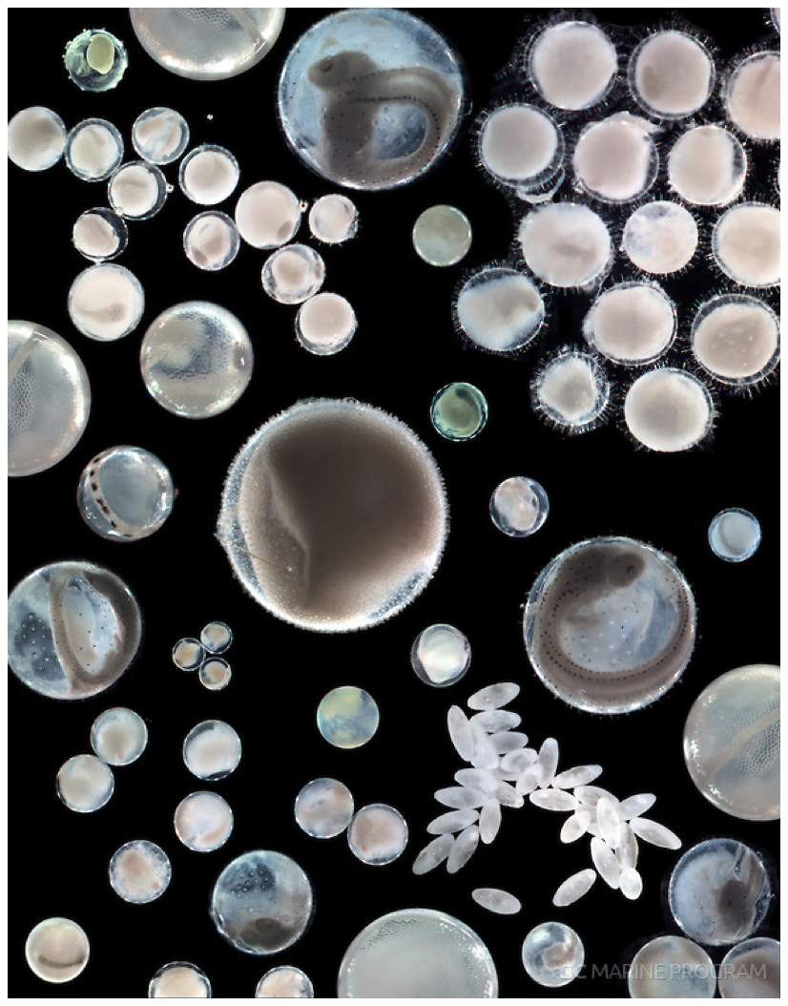

Slide 9
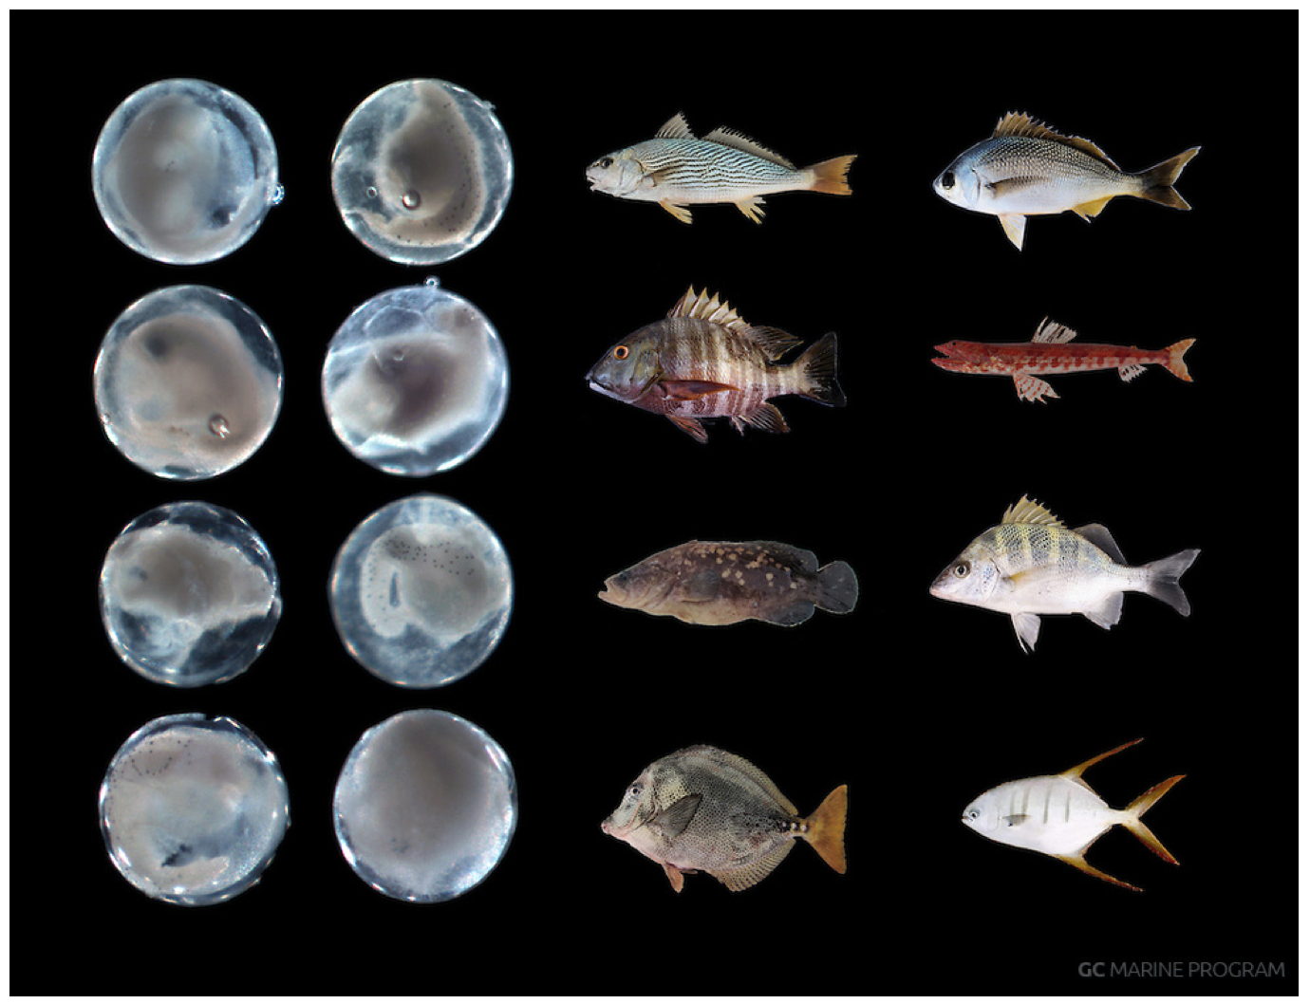

Slide 10
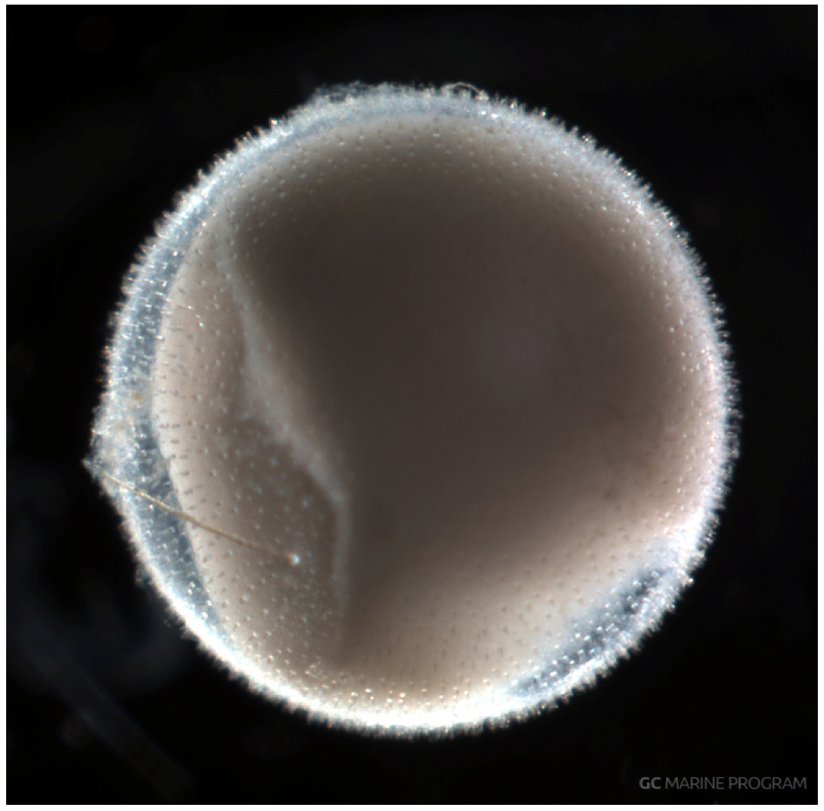
Regalecus glesne

Slide 11
LIFE HISTORY STAGE DEFINITIONS
YOLK-SAC STAGE (hatching to complete absorption of yolk sac，卵黄期仔鱼):
Larvae hatch from the egg at various stages of development.
For larvae hatched from pelagic marine eggs, hatching generally occurs before the yolk sac has been completely absorbed.
However, the larvae of species with demersal eggs often bypass the yolk-sac stage, absorbing the yolk while in the egg, and usually emerge as preflexion larvae.
In species that do have a yolk-sac stage, the larvae usually hatch without functional mouths, eye pigment, and differentiated fins.
Diagnostic characters for yolk-sac larvae include body size and shape, gut shape and length, pigment patterns, size and shape of yolk sac, oil globule size and position, and presence or absence of specialized larval characters such as elongate fin rays, enlarged finfolds, and stalked eyes.

Slide 12
LIFE HISTORY STAGE DEFINITIONS
PREFLEXION STAGE (complete yolk-sac absorption to start of notochord flexion，弯曲前期仔鱼):
The preflexion stage begins once both hatching and complete absorption of the yolk sac have occurred and ends with the start of notochord flexion. Diagnostic characters for preflexion larvae are similar to those for other larval stages: meristics (myomeres, fin rays), body size and shape, fin development sequence, gut shape and length, pigmentation pattern, presence or absence of head spines, and presence or absence of specialized larval characters such as fin-ray ornamentation, stalked eyes, and a trailing gut.
FLEXION STAGE (start of notochord flexion to completion of notochord flexion，弯曲期仔鱼):
The flexion stage is defined as beginning with the dorsal bending of the notochord tip concurrent with development of the caudal-fin rays and supporting skeletal elements. Diagnostic characters for this stage are similar to those for other larval stages: meristics (myomeres, fin rays), body size and shape, fin development sequence, gut shape and length, pigmentation pattern, presence or absence of head spines, and presence or absence of specialized larval characters such as fin-ray ornamentation, stalked eyes, and a trailing gut. Additionally, osteological characters, such as the sequence and timing of ossification, become useful during this stage. The flexion stage ends when the notochord tip has reached its final position at approximately 45 degrees from the notochord axis and the principal caudal-fin rays and supporting skeletal elements are in the adult longitudinal position. The supporting skeletal elements may or may not be completely developed.
POSTFLEXION STAGE (completion of notochord flexion to start of metamorphosis，弯曲后期仔鱼):
The postflexion stage begins after the completion of notochord flexion and ends at the onset of metamorphosis (transformation). Diagnostic characters for this stage are similar to those for other larval stages: meristics (myomeres, fin rays), body size and shape, fin development sequence, gut shape and length, pigmentation pattern, presence or absence of head spines, presence or absence of specialized larval characters such as fin-ray ornamentation and stalked eyes, and osteological characters such as timing and sequence of bone and cartilage development.

Slide 13
LIFE HISTORY STAGE DEFINITIONS
TRANSFORMATION STAGE (start of metamorphosis to completion of fin-ray development and start of squamation，转换期仔鱼):
The loss of larval characters and the attainment of juvenile/adult characters distinguish the transformation stage.
Changes in body shape and pigment pattern can be dramatic. Additional changes that may occur include fin migration, photophore formation, loss of specialized larval characters, eye migration, and squamation (scale formation).
The transformation stage is generally defined as ending with the completion of fin-ray development and the start of squamation. The duration of this stage differs among taxa.

Slide 14
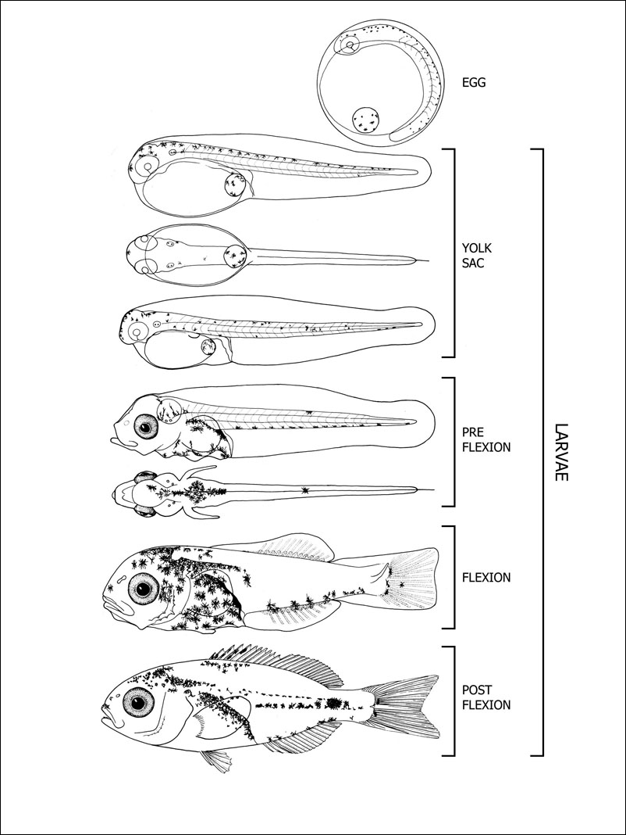

Slide 15
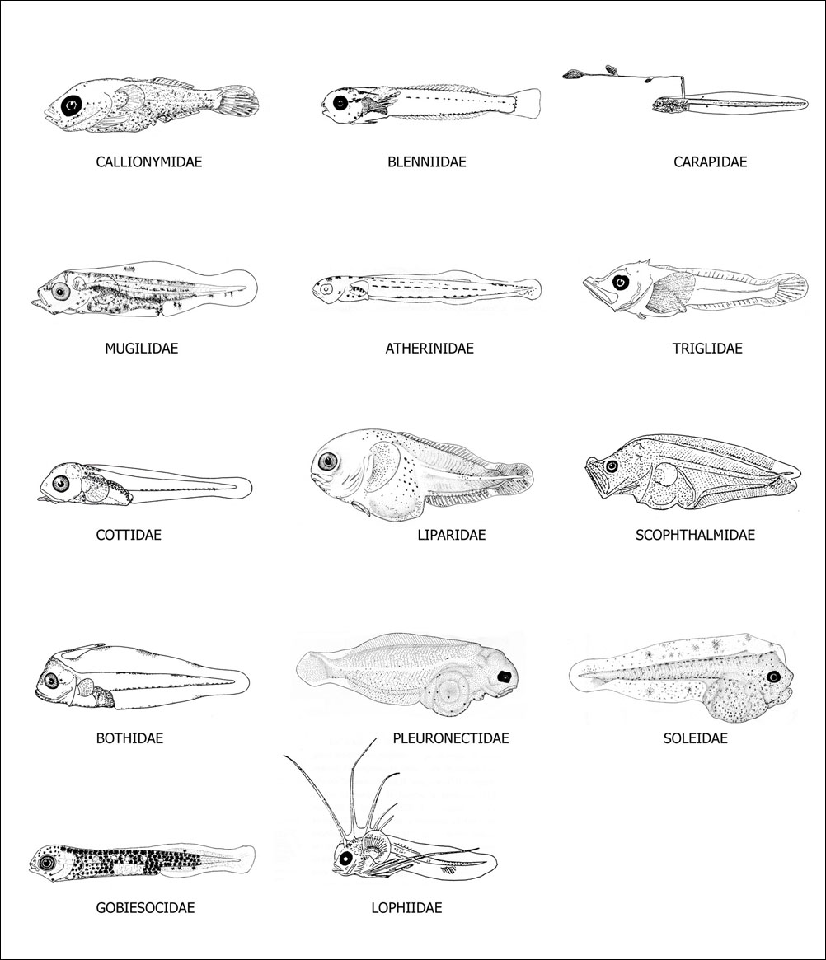

Slide 16
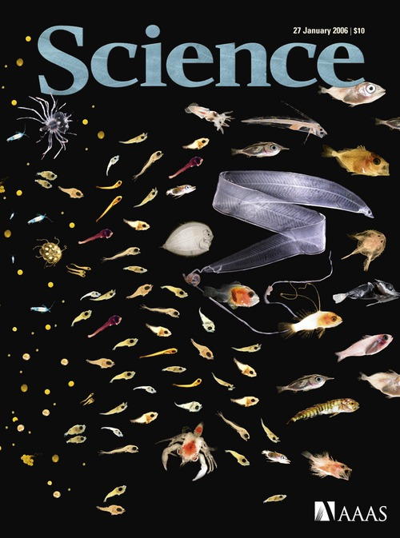

Slide 17
LIFE HISTORY STAGE DEFINITIONS
JUVENILE STAGE (completion of fin-ray development and start of squamation to attainment of sexual maturity，稚鱼期):
Individuals that have reached the juvenile stage of development generally resemble small adults.
Although the juvenile stage is characterized by the attainment of different developmental landmarks in different families, squamation (except for scaleless fishes) and complete ossification of the skeleton occurs during this period. The stage ends with the attainment of sexual maturity.

