Slide 1
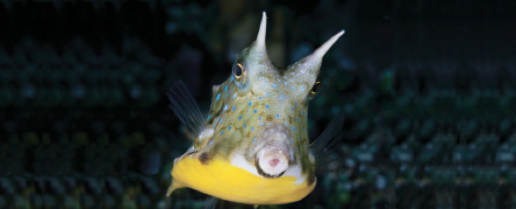
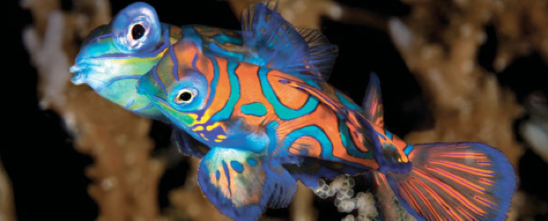
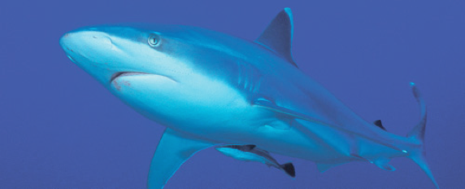
Lesson 11 Early Life History, Age and Growth
Ichthyology
Shanghai Ocean University
Fall, 2020

Slide 2
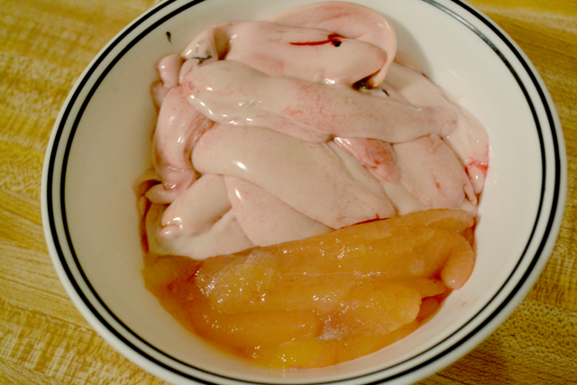
Gametogenesis
Gametogenesis describes the development of sperm and eggs through a series of definable stages.
His’n’Hers*
Herring testes and ovaries

Slide 3
Gametogenesis
Fish sperm vary in size, shape, and number of accessory structures (flagella, acrosomes).
Fish eggs develop as oocytes that are invested with yolk. Females are able to reabsorb unshed eggs and reuse the materials that went into egg production.
Fecundity, the number of eggs a female produces, generally increases with increasing body size within a species and varies among species from one or two in some sharks to many millions in large teleosts.

Slide 4
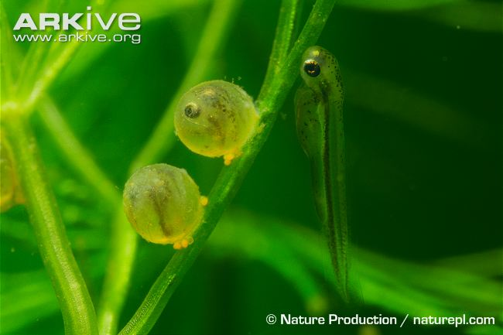
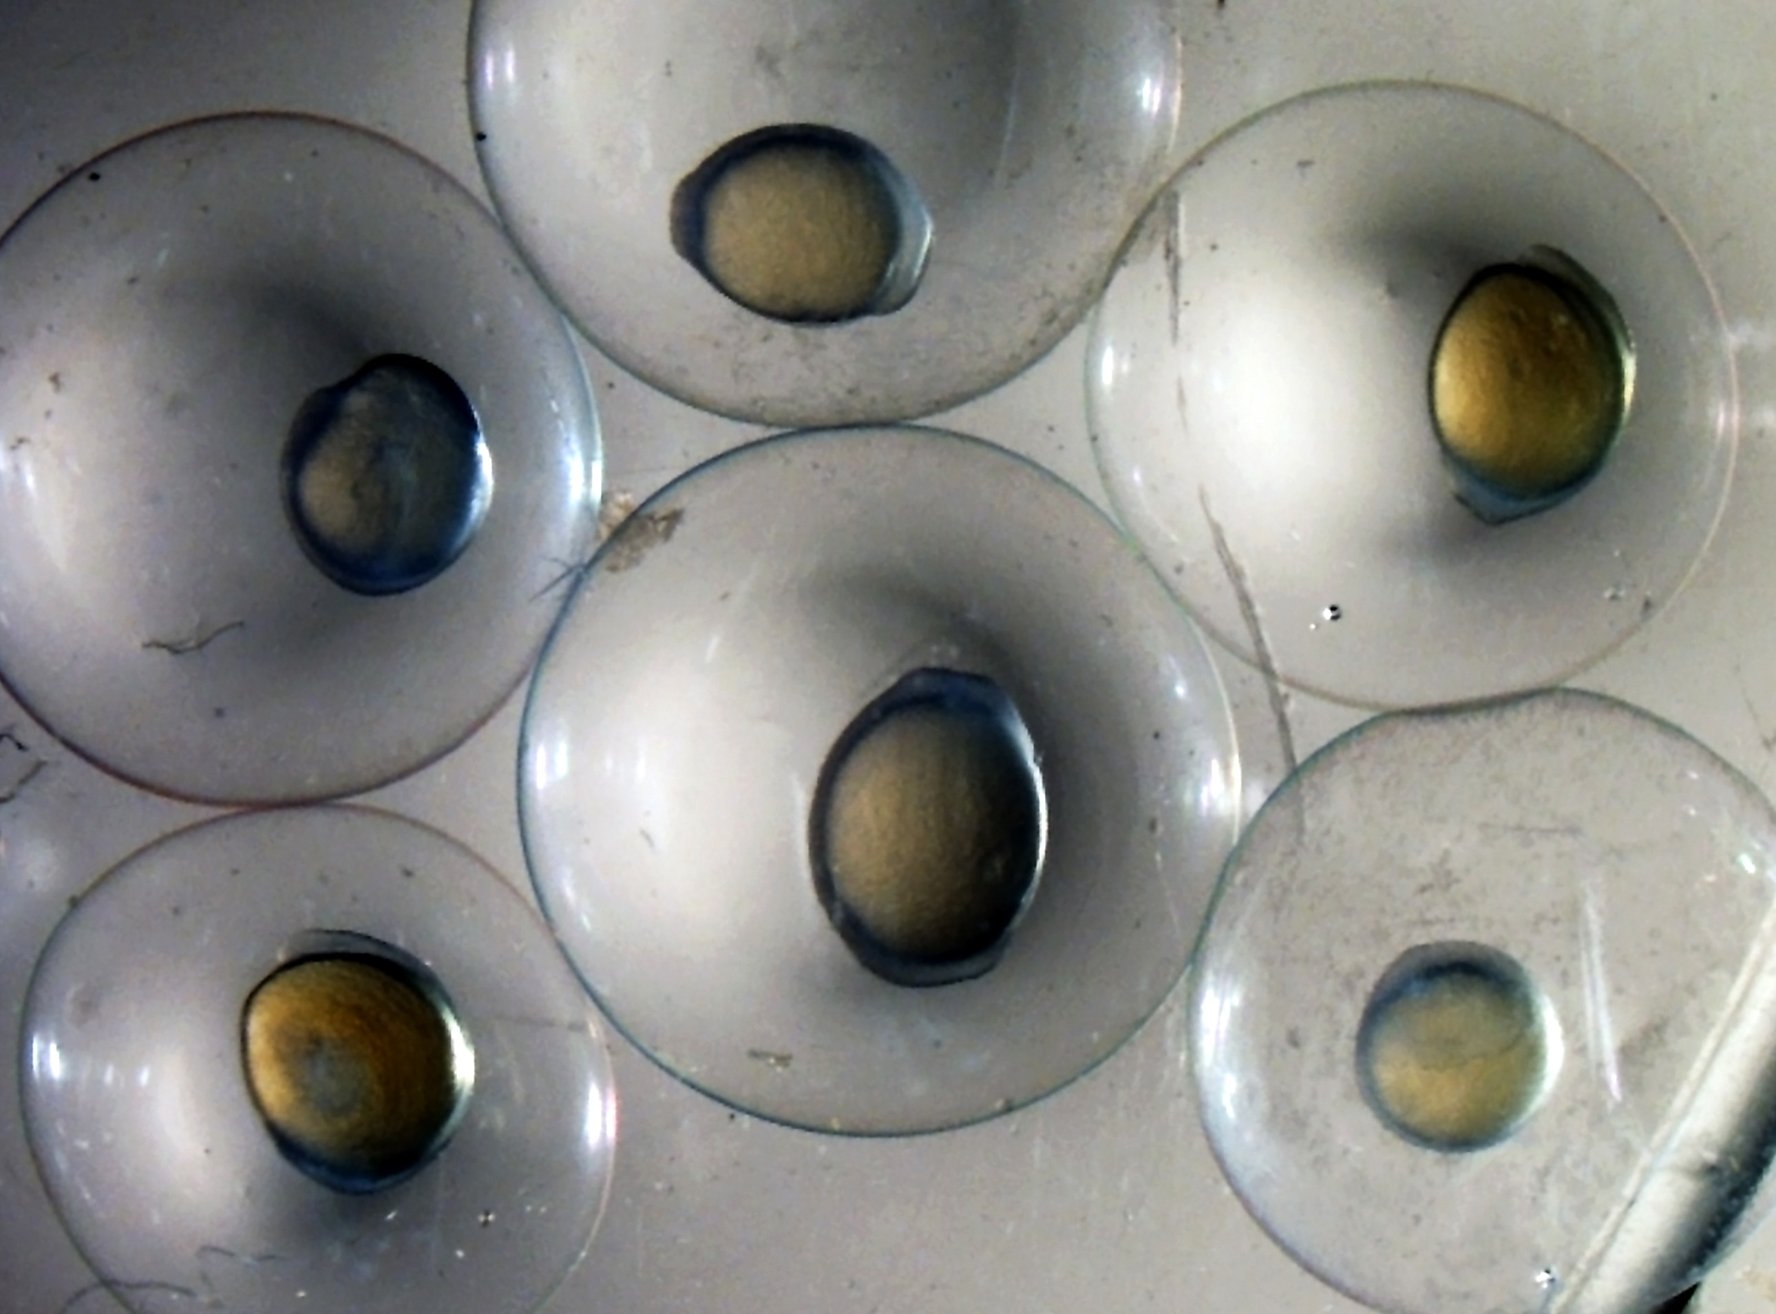
Types of eggs
Most marine fishes produce pelagic eggs that are fertilized externally and from which pelagic larvae hatch.
Most freshwater fishes deposit eggs on vegetation or on the bottom, often in nests.
Common carp
Bighead carp

Slide 5
28_陈思宇_egg_types
Describe different type of eggs and postulate why they are different (adaptive values)

Slide 6
Reproductive effort
Reproductive effort is a measure of the energy allocated to reproduction by an individual
and can be characterized in part by gonad weight/body weight, adjusted for the frequency with which an individual spawns and the phase of the spawning cycle.
True costs of reproduction must also account for energy expended during reproductive migrations, courtship, spawning, and internal brooding and other forms of parental care, among other factors. Energy expended in nongonadal growth can be substantial.

Slide 7
Gonosomatic index
One popular and simple instantaneous measure is the GSI, variously called the gonosomatic index
a calculation of the percentage of the body mass of an animal devoted to gonadal material.
The GSI can be calculated as gonad weight/total body weight
Values range greatly among species:
cichlids < 5%
darters 11–23%
pupfishes 2–14%
American plaice 5–20%
Sticklebacks20%
salmonids 20–30%
European eels 47%.

Slide 8
Fertilization
Fertilization occurs external to the body of the female in most bony fishes
internally in most elasmobranchs and in about a dozen families of bony fishes.

Slide 9
Fertilization
Females of some internally fertilized species can store sperm for several months.
Males of internally fertilizing species possess an intromittent organ, modified from fins or cloacal tissue, for injecting sperm into the female.

Slide 10
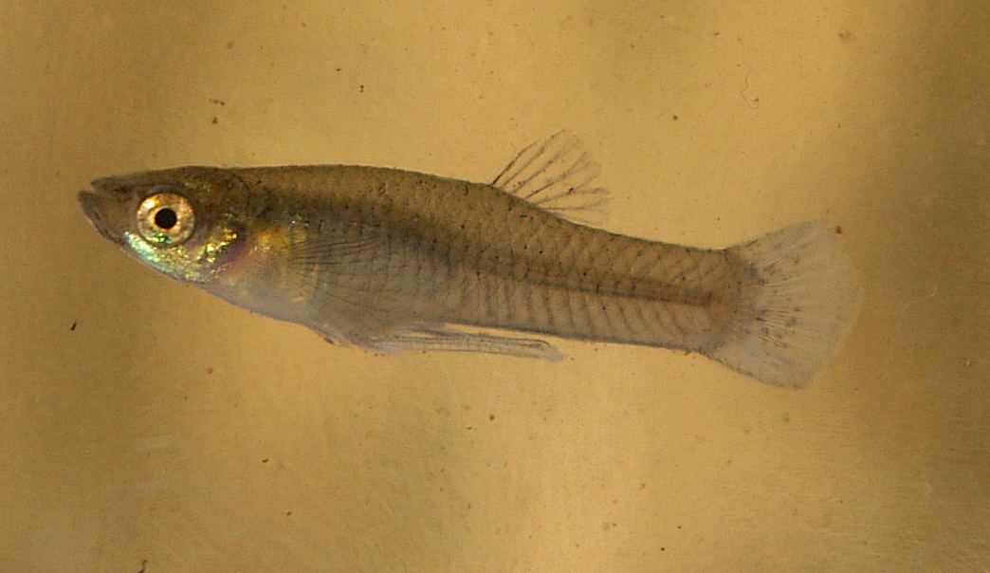
This male mosquitofish has a gonopodium, an anal fin which functions as an intromittent organ

Slide 11
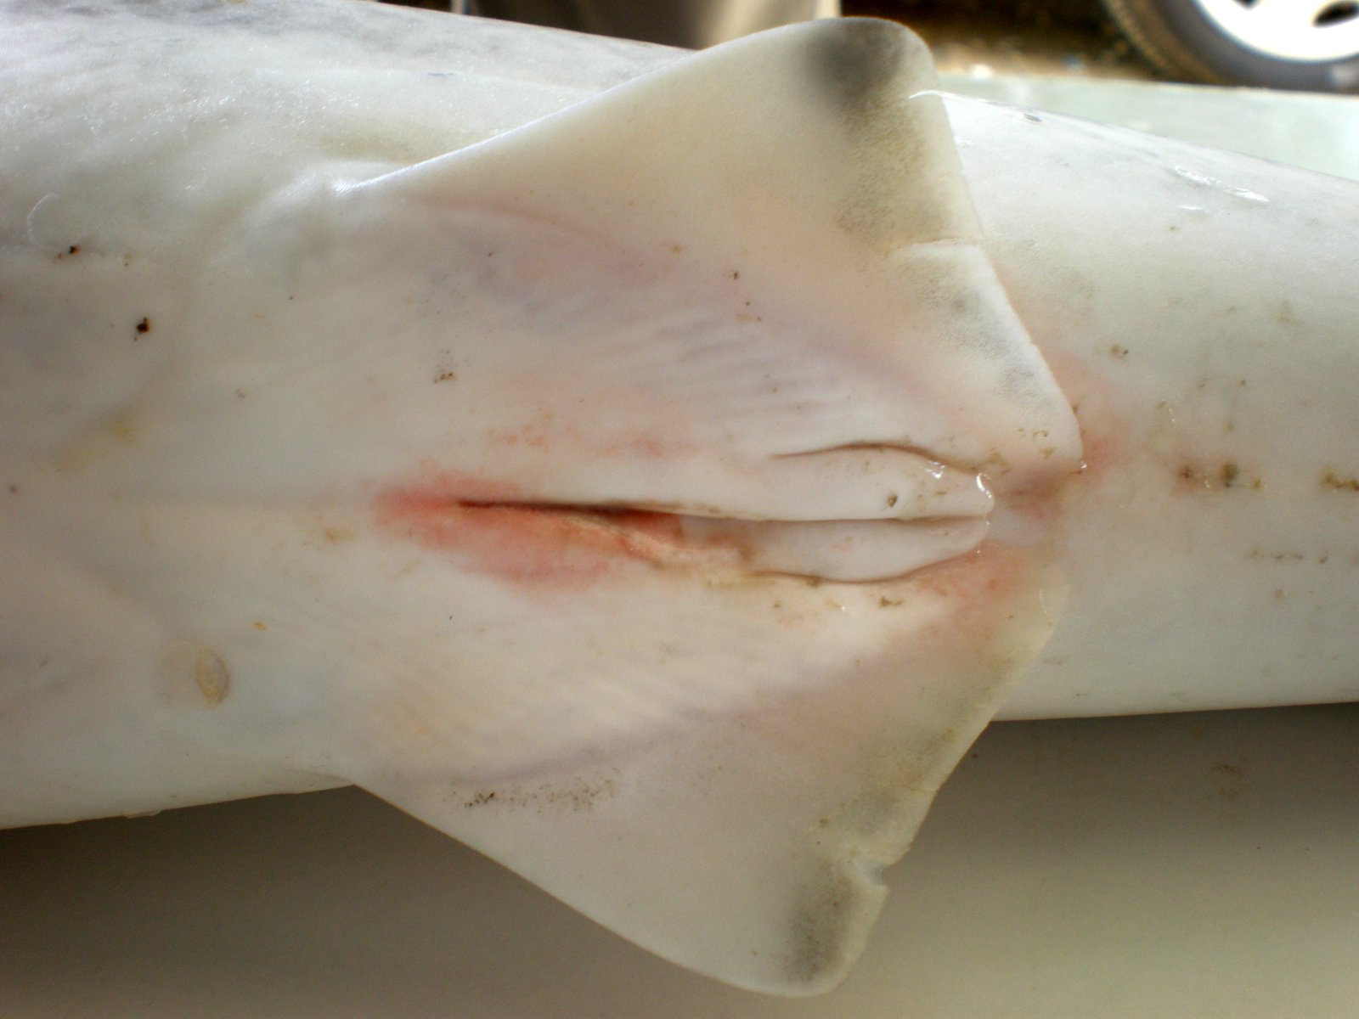
This young male spinner shark has claspers, a modification to the pelvic fins which also function as intromittent organs

Slide 12
Embryonic development
Embryonic development in fishes proceeds as in most vertebrates.
Many species are identifiable at or just after the time of hatching, based on pigmentation and fin development.
Although most fishes hatch from eggs (oviparity), some undergo internal gestation and are born live (viviparity), with various intermediate conditions (generally referred to as ovoviviparity).

Slide 13
29_徐楠_embryonic_development
Describe different type of Embryonic development and give examples

Slide 14
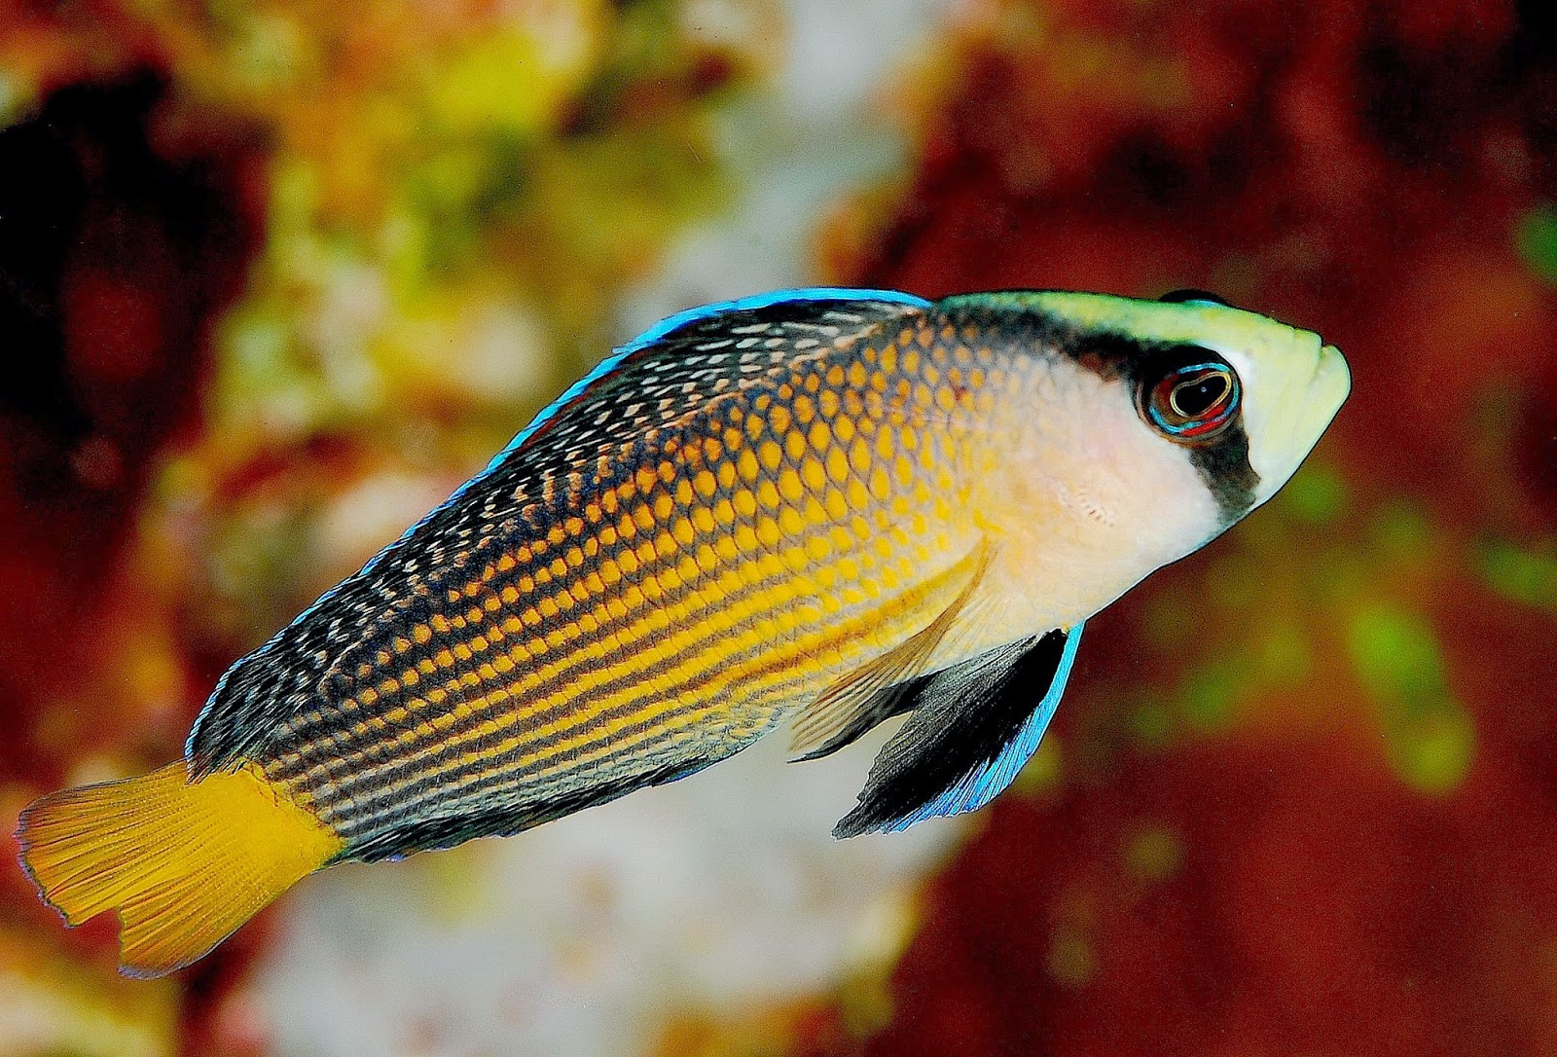
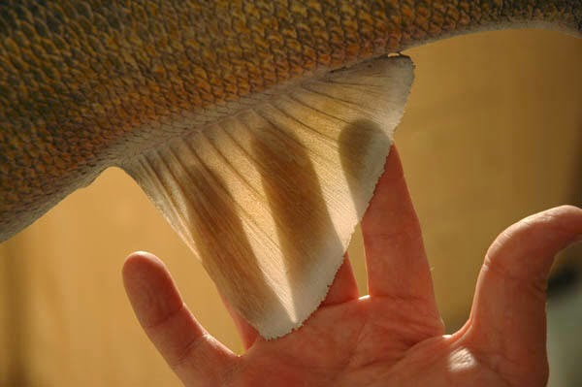
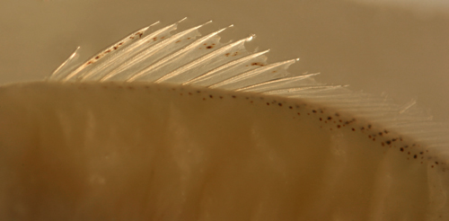
Meristic (countable) traits
Meristic (countable) traits may vary among developing fishes as a function of environmental conditions.
Typically, fishes that develop in colder water lay down greater numbers of scales, fin rays, and vertebrae.
1. Scale counts:
2. Fin (Ray and Spines) count:

Slide 15
The larval period
The larval period is most often the stage at which an individual disperses from the habitat of its parents.
An important event in a larva’s life comes when the yolk supply is exhausted and the young fish must forage on its own.
Food availability during this “critical period” may determine the future size of a population and may determine many aspects of spawning locale and timing. Most larvae die from starvation or predation during their first week of life.
Physiological tolerance and sensitivity, ecological and behavioral competence, and survivorship all increase with increasing age.

Slide 16
Fish larvae
Fish larvae often bear little external resemblance to the adults into which they grow. Larvae often possess large spines and trailing fins and appendages that may give them protection from predators.
Many fish larvae and juveniles were originally given different specific, generic, and even familial names before they were linked with the species into which they develop.

Slide 17
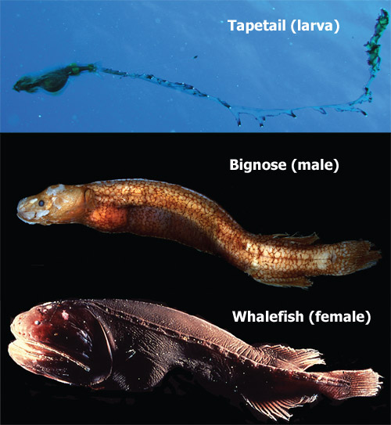
Fishes grow throughout their lives, changing their ecological role several times. In some fishes, differences between larvae and adults are so pronounced that many larvae were originally described as entirely different taxa (see Chapter 9).
Then, a Japanese group led by Masaki Miya found that a whalefish and a tapetail had almost identical genomes in their mitochondria.
Notes:
Fishes grow throughout their lives, changing their
ecological role several times. In some fi shes,
differences between larvae and adults are so
pronounced that many larvae were originally described
as entirely different taxa (see Chapter 9).

Slide 18
Movement of fish larvae
Many marine fishes spawn far offshore. The mechanisms by which their larvae move inshore to nursery habitats are a matter of debate.
Onshore movement may involve passive transport via wind driven surface currents.
Movement into an estuary can involve selective tidal stream transport, where a small fish moves up into the water column on flood tides and then hugs the bottom during ebb tides.
Most interpretations of distribution patterns and behavior propose a combination of passive and active mechanisms.

Slide 19
Movement of fish larvae

Slide 20
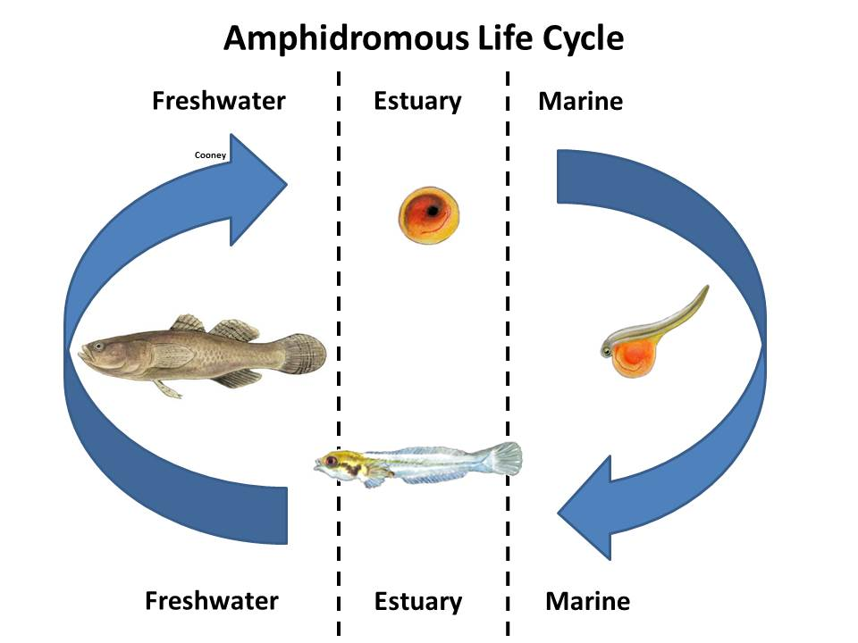
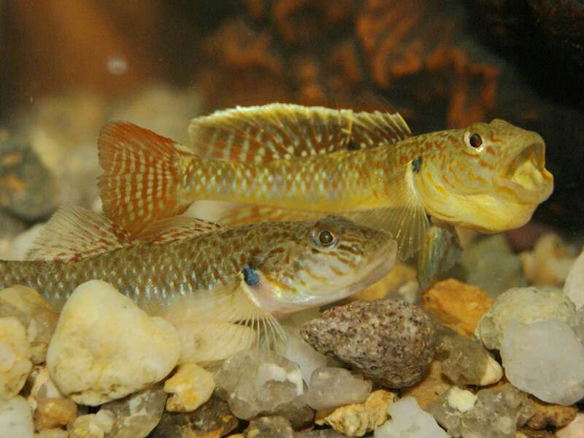
Amphidromous Rhinogobius

