Slide 1
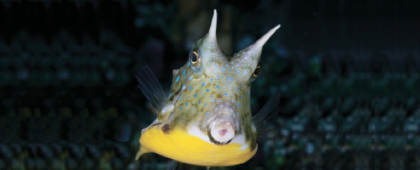
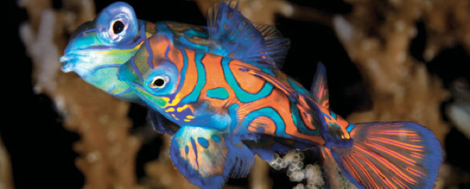
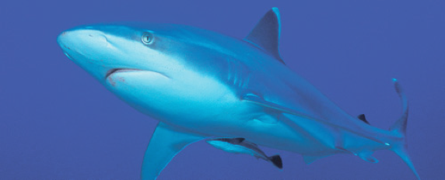
Lesson 11 Early Life History, Age and Growth
Ichthyology
Shanghai Ocean University
Fall, 2020

Slide 2
Although we recognize specific phases during the ontogeny of an individual, the transitions that occur between phases often require long time periods and can involve complex changes and reworkings of the anatomy and physiology of a fish.
Examples of complex and protracted transitions include smoltification, when young salmon move from fresh water to the ocean, and metamorphosis, when flatfish change from symmetrical, planktonic larvae to asymmetrical, bottom-dwelling juveniles.

Slide 3
30_田若彤_smoltification
Explain the process of smoltification

Slide 4
Reproductive development
includes three very different processes: determination, differentiation, and maturation.
Gender determination in most fishes is probably under genetic control and occurs at the time of fertilization. In some fishes, environmental conditions such as temperature can affect determination.
Differentiation occurs when recognizable ovaries or testes appear in an individual.
Maturation is synonymous with achieving adulthood and occurs when a fish produces viable sperm or eggs.

Slide 5
31_陆晓薇_sex_dertermination
Sex determination is very complex, summarize different ways of sex determination in fishes and give examples

Slide 6
Reproductive development
Complicating this picture are many fish species that undergo postmaturational sex reversal, changing from functional females to functional males (protogyny) or from male to female (protandry).
A few species are simultaneous hermaphrodites, functioning as males and females at the same time. Self-fertilization is exceedingly rare in fishes.

Slide 7
Maturation
Age at first reproduction and longevity vary greatly among fishes.
Some male surfperches are born mature
whereas some sharks, sturgeons, and eels may not mature until they are older than 20 years.

Slide 8
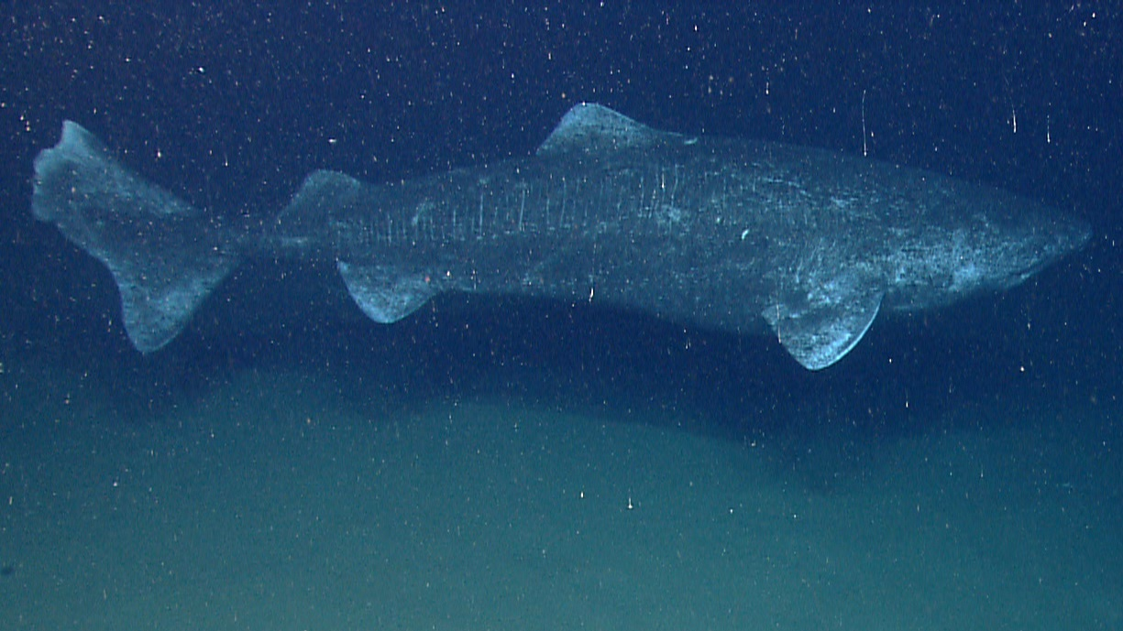
Longevity
Longevity also ranges from less than 1 year in annual fishes to more than 100 years in sturgeons and rockfishes.

Slide 9
Death
Death usually occurs as a result of accident or disease
but some fishes such as lampreys and salmons show programmed death (senescence) similar to that observed in mammals.

Slide 10
Determining age of fish
The age of a fish can be determined by counting growth rings on otoliths, vertebrae, fin spines, and other hard body parts.

Slide 16
Determining age of fish
Such growth rings are usually added annually to a structure, but climatic and other environmental factors can lead to variation that can provide information about habitat shifts during ontogeny.

Slide 17
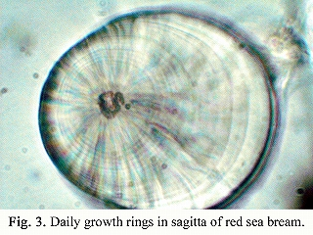
Determining age of fish
Daily growth increments are often detectable on the otoliths of young fishes, allowing back-calculation to actual spawning dates.

Slide 18
Growth curves
Size at a particular age varies greatly in fishes. Growth curves that describe size/age relationships can be calculated using a number of equations, the von Bertalanffy growth equation being a commonly used indicator.
The parameter t₀ is included to adjust the equation for the initial size of the organism and is defined as age at which the organisms would have had zero size. Thus to fit this equation you need to fit 3 parameters (L∞, K and t₀ ) by nonlinear regression.

Slide 19
Growth curves

Slide 20
Growth curves
The von Bertalanffy growth coefficient (K) can be useful in assessing fishery management approaches because slower growing fishes with lower K values tend to be more vulnerable to overfishing. Some typical values of K for a variety of fishes are as follows (data courtesy of J. Musick from various sources):
Anchovies, Engraulidae: 0.80–1.40
Tunas, Scombridae: 0.42
Menhaden, Clupeidae: 0.39
Flounder, Paralichthyidae: 0.32–0.40
Spanish mackerels, Scombridae: 0.17–0.35
Epinepheline grouper, Serranidae: 0.18
Porgy, Pagridae: 0.09
Swordfi sh, Xiphiidae: 0.09–0.19
Ground sharks, Carcharhinidae: 0.04–0.078

