Slide 1
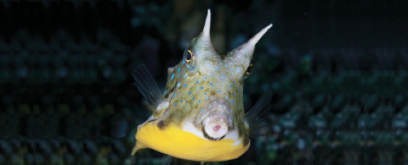
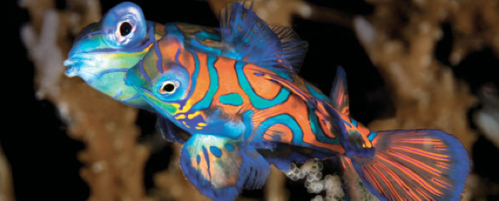
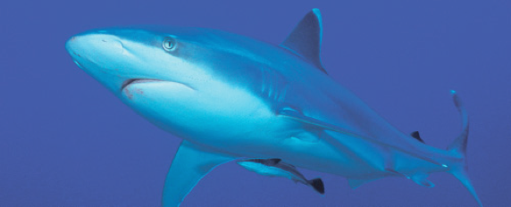
Lesson 11 Early Life History, Age and Growth
Ichthyology
Shanghai Ocean University
Fall, 2020

Slide 2
Condition
The condition of a fish, calculated by dividing body mass by length, is one indicator of the kind of growth conditions an individual has experienced.
K = W/L³
can be used to calculate the condition factor, K, of a fish,
where W is weight or mass and L is length.

Slide 3
Allometric
As a fish grows, the dimensions of its body change, as do the materials used in construction; together these modifications represent an alteration in the design of the individual.
Changes in the relationship between body parts during growth or between body functions and body size can often be described by an allometric equation. In most instances, the relationship is nonlinear.

Slide 4
Allometric

Slide 5
Ontogeny differences
Fishes undergo indeterminate growth and have complex life cycles.
At each stage during its life, a fish must function physiologically, ecologically, and behaviorally.
Such function is compromised by transitional periods, by alterations that are preparatory for the next stage, and by traits retained from previous stages.

Slide 6
Paedomorphosis
Evolution may occur through adjustments in the timing or rate of ontogenetic development. Such heterochronic changes include the rapid maturation of juveniles or retention of juvenile characteristics in adults (neoteny, paedomorphosis)
may explain the evolution of some of the smallest fish species as well as speciation in lampreys, elopomorphs, salmons, and deepsea anglerfishes.

Slide 7
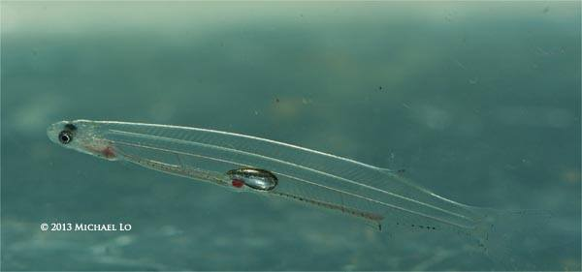
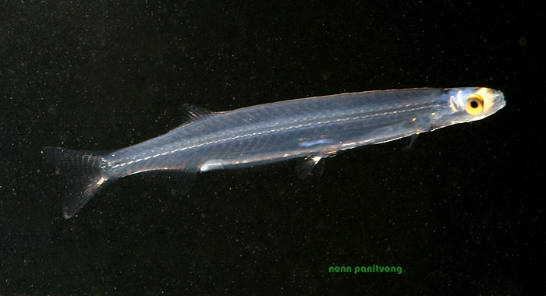
Paedomorphosis
Habitat partitioning?
Ontogenetic accident?
湄公河巽他银鱼(Sundasalanx mekongensis)
15 – 20 mm.

Slide 8
MariTech Inc.

Slide 13
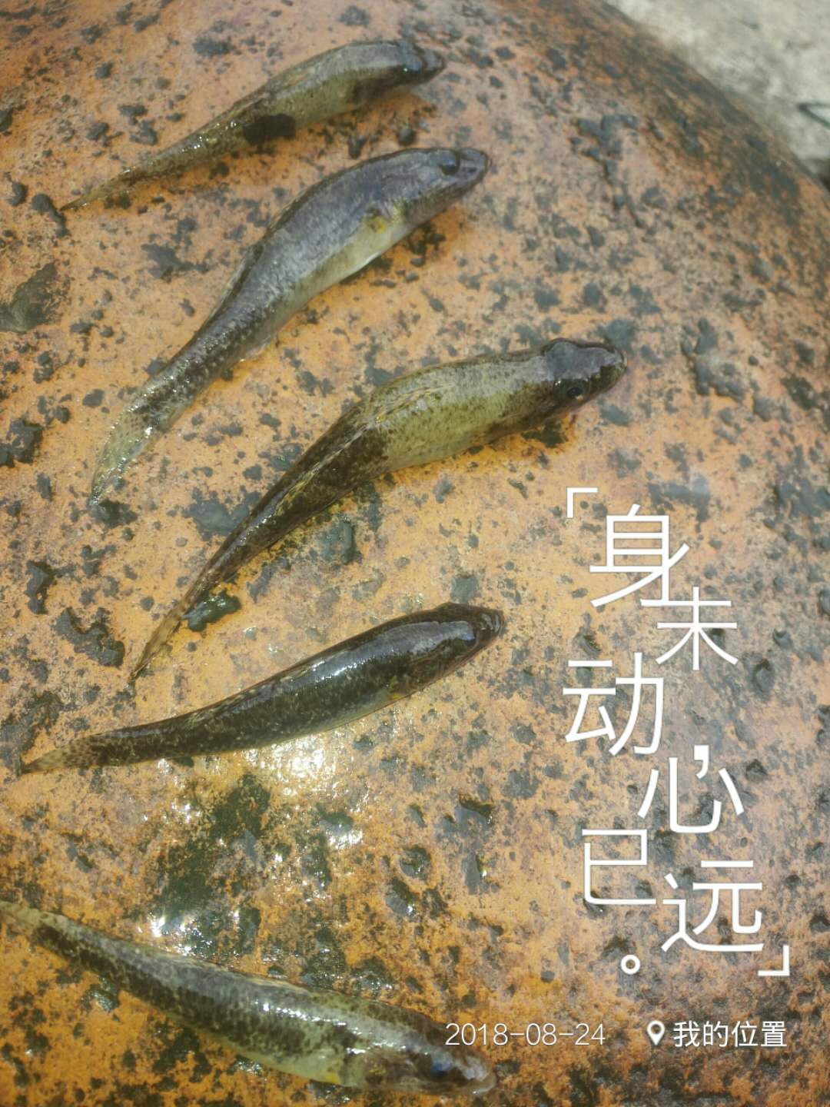
Have a nice week!
海南细齿黝，五指山，Aug, 2018

