Slide 1
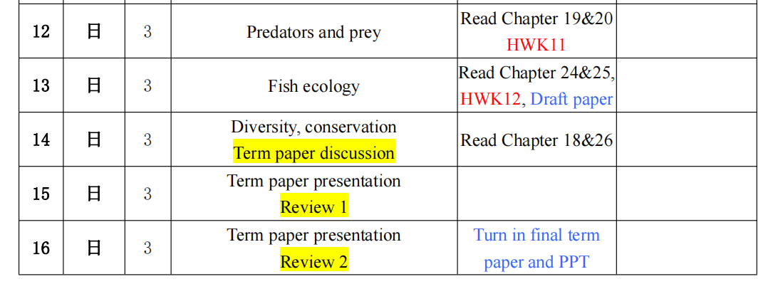

Slide 2
hand in your final paper on 2 Jan
Don’t forget your nameuble side
Double line space
Use subtitles
Introduction
Physical description …
Flow of your logic at macro and micro level
Need English editing
Choose the correct words, e.g. intramuscular bone, not thorn
Tense and consistent verb…
Avoid redundancy
Spend more time on it!

Slide 3
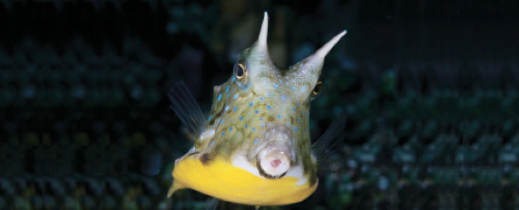
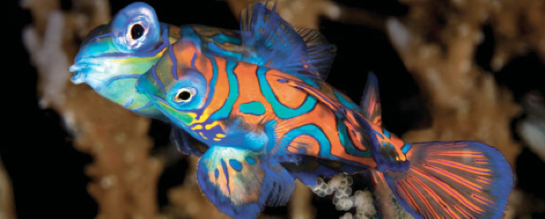
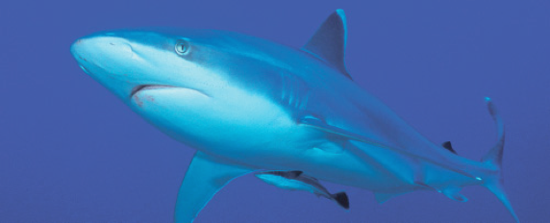
Lesson 12 (chapter 8, 19, 20) Locomotion, feeding, predator and prey
Ichthyology
Shanghai Ocean University
Fall, 2022

Slide 4
Locomotion
Locomotion in water presents very different physical challenges than are experienced by terrestrial animals.
Density and drag are much greater in water, making locomotion energetically expensive and leading to the general hydrodynamic, streamlined shape of most fishes.
Swimming in fishes usually involves alternating contractions and relaxations of muscle blocks on either side of the body that result in the fish pushing back against the water and consequently moving forward.

Slide 5
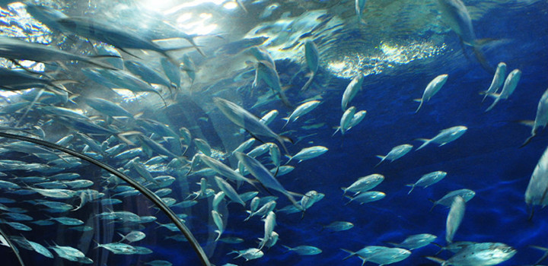
Swimming modes
Many variations on this basic theme exist, and about 10 different modes of swimming have been identified that involve either undulatory waves or oscillatory back-and-forth movements of the body or fins.

Slide 6
Name at least five different swimming modes and give some examples for each.

Slide 7
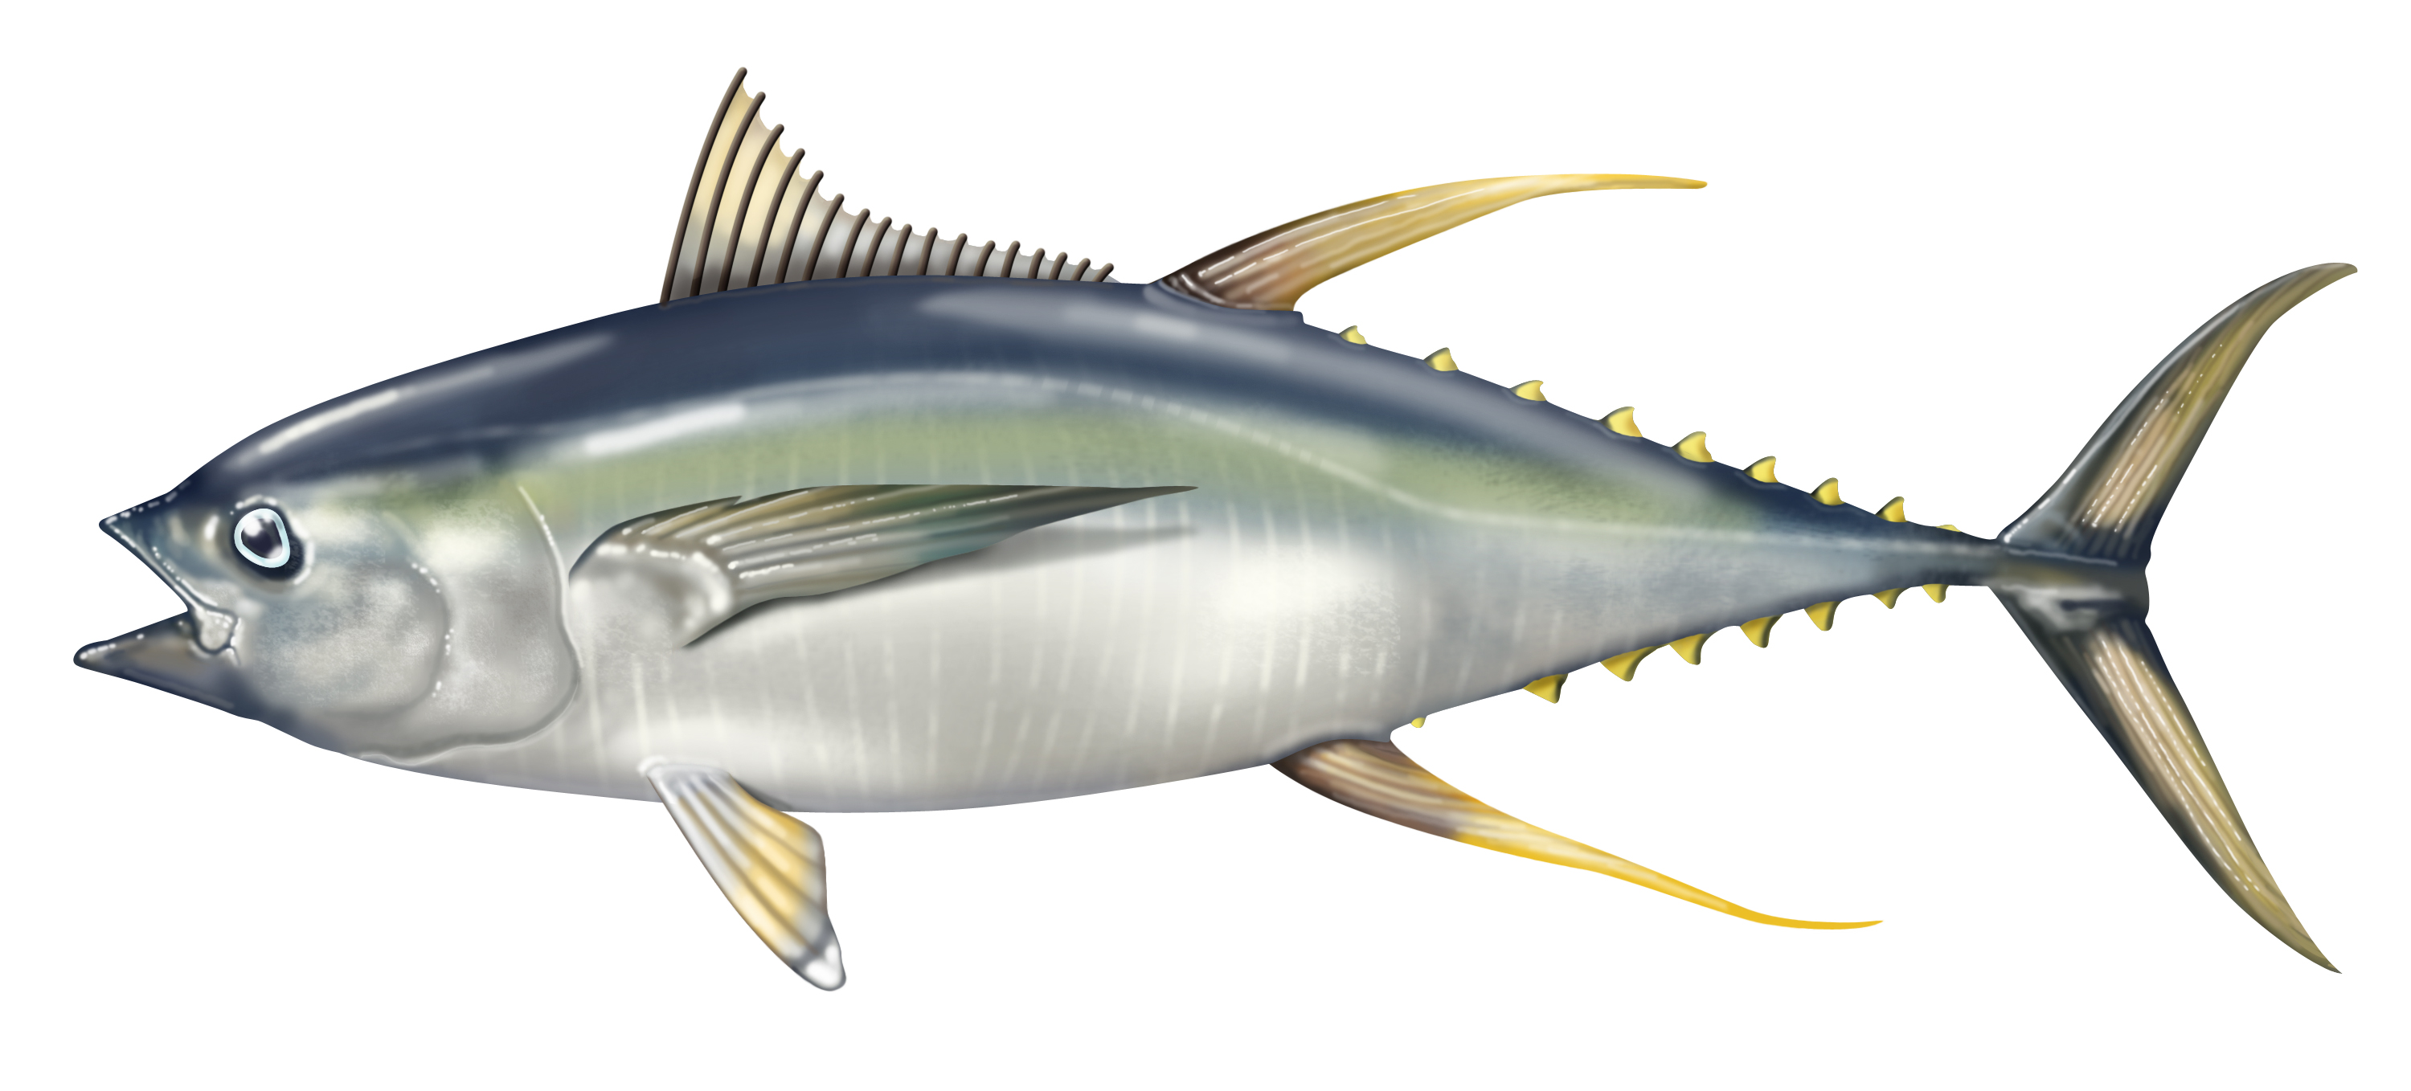
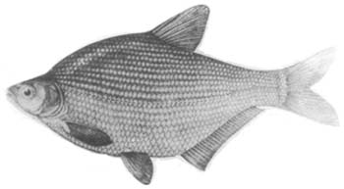
Swimming morphology
Body and fin shape correlate strongly with locomotory mode and habitat
the most extreme examples being the rapid swimming, highly pelagic mackerel sharks, tunas, and billfishes with streamlined bodies and lunate, high aspect ratio tails (the shape reduces viscous drag by reducing surface area).
Locomotory adaptations create trade-offs. Maneuverability is often achieved at a cost in fast starts and sustained speed and vice versa.

Slide 8
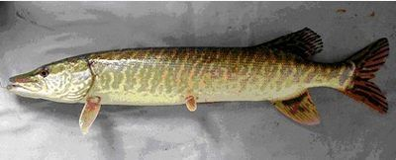
Lie-in-wait
Fast start predators, these unrelated fishes have
elongate, flexible bodies;
long (“protruded”) snouts with many sharp, often thin teeth;
broad, symmetrical median fins placed far back on the body opposite one another;
and relatively large caudal fins with low aspect ratios.
Pike
Barracuda
鯮鱼

Slide 9
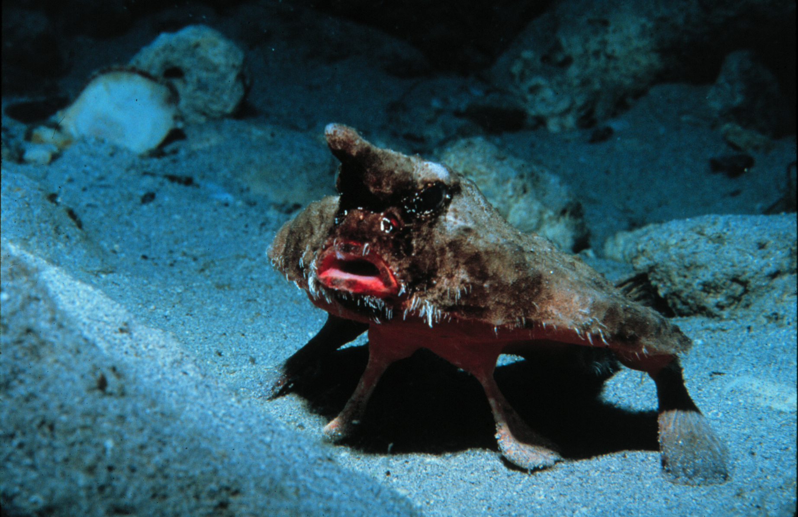
Highly specialized locomotion includes fishes that can “walk” across the bottom or on land, climb terrestrial vegetation, leap, glide, and even fly.
red-lipped batfish
(Ogcocephalus darwini)

Slide 10
Sharks
Being cartilaginous, cannot rely on muscles attached to a rigid bony skeleton for propulsion. They instead undulate via contractions of their body muscles, which are firmly attached to a relatively elastic skin; the skin functions as an external tendon and provides propulsive force by rebounding.
Some propulsive force comes from changing hydrostatic pressure inside the cylinder of the shark’s body.
The spacing of the two dorsal fins aids the tail in propulsion, and the tail works in concert with flattened ventral surfaces in the head region to counteract the weight of the body and to provide forward thrust.

