Slide 1
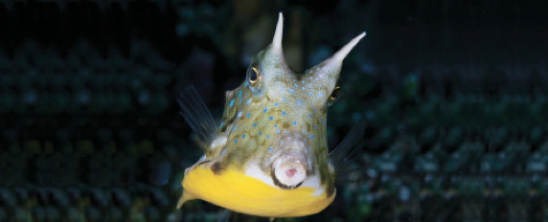
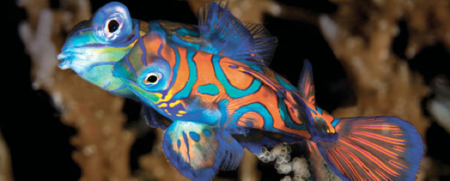
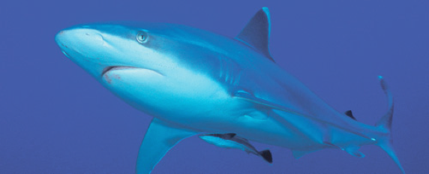
Lesson 13 (chapter 18, 24) Ecology
Ichthyology
Shanghai Ocean University
Fall, 2022

Slide 2
Ecology
Ecology is the scientific analysis and study of interactions among organisms and their environment.
Ecology focuses on organism–environment interactions at the level of individuals, populations, assemblages, communities, ecosystems, and landscapes.

Slide 3
Individual
An individual’s life history results from differences in the allocation of energy and resources to the often-conflicting demands of maintenance, growth, reproduction, survival, and migration.
Large size is advantageous in fishes; larger fishes produce more eggs and escape more predators.
Reproduction at an early age and small size incurs a substantial cost in future reproduction; delayed reproduction means more eggs spawned but occurs at the risk of dying before ever spawning.
Theory accurately predicts the effects of mortality on reproductive age, size, interval, and allotment; individuals in populations with high adult mortality reproduce earlier and have higher fecundity and shorter reproductive intervals.

Slide 4
Geographic patterns / convergent evolution
In many families, related species living in different habitats often adopt life history patterns appropriate for that habitat, and unrelated fishes converge on suites of life history adaptations.
Mouth-brooding fishes worldwide have converged on small clutches of large eggs, slow growth rates, and protracted breeding seasons (bonytongues, marine catfishes, cichlids).
Such convergence is evidence of the importance of environmental selection factors promoting one life history over another and can be found at relatively large geographic scales.

Slide 5
Phylogenetic constraints
Phylogenetic Constraint is like a basic body plan. It can be modified (what evolution does) but it can't be fully changed.
Constraints occur when a trait is precluded from reaching, shifted away from, or slowed down in its approach to a (defined) selective optimum.
Whales did not develop gills.
Vestigial features (things like the human appendix which is a remnant of our ancestors, but is no longer used) provide evidence of common ancestry and phylogenetic constraint.

Slide 6
Populations
A population consists of all the individuals of a particular species in a given area.
Populations grow and decline as a result of age specific reproduction and survivorship rates.
Because of dispersing larvae, migration into populations (recruitment and colonization) has a strong influence on year class strength.
Different age fishes differ substantially in size and feeding habits, making cannibalism a frequent cause of mortality.
Production is a measure of how much biomass a population produces yearly and is important in determining sustainable exploitation rates for commercial fishes.
Most fish populations produce <10 g/m2/year, most of which occurs in younger age classes.

Slide 7
Populations
Many populations are relatively isolated from other populations of the same species, which allows for genetic differentiation.
Genetically distinct populations can exist in neighboring lakes (e.g., whitefishes, sticklebacks), and Pacific salmons occur as genetically isolated stocks in adjacent rivers.
In contrast, hybridization between species results when species-specific spawning habitat is unavailable or degraded, or when disproportionate numbers of one species exist.
Hybridization is more common among freshwater fishes.

Slide 8
Assemblages
Species generally have relatively predictable habitat use patterns and predator–prey and competitive interactions (= niche).
Species that utilize similar resources in similar ways are members of a guild, as in the zooplanktivore and cleanerfish guilds on coral reefs.
Niches and guild memberships change as fish grow and their food and habitat preferences change.
Two general aspects of habitat use in fishes is that bigger individuals within a species occur in deeper habitats and that habitats in rivers and the species occupying them differ as one moves downstream.

Slide 9
Competition
Competition within and between species results when two consumers use a limiting resource. Shifts in resource use due to competition result in resource partitioning.
Competition for food resources is most common in fishes, which can lead to dramatic habitat shifts and can also influence predator–prey interactions.
Differences in resource use do not automatically imply that competition is occurring; physiological requirements, phylogenetic constraints, and differential susceptibility to predation can also produce species differences in resource use.
Introduced species frequently have strong, deleterious, competitive impacts on native species.

Slide 10
Predation
Predation can directly affect prey density through predator-caused mortality, or can have indirect effects through predator avoidance that places prey in suboptimal environments, thereby slowing individual growth and reproductive output.
Predation can also cause genetic differences in coloration, habitat use, and schooling and breeding behavior.
Introduced predators have decimated natives in many locales.

