Slide 1
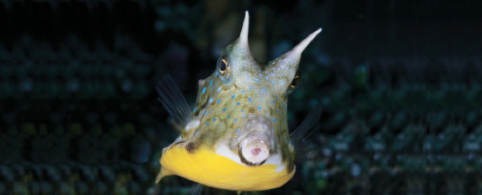
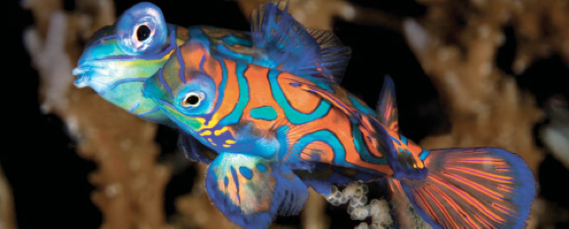
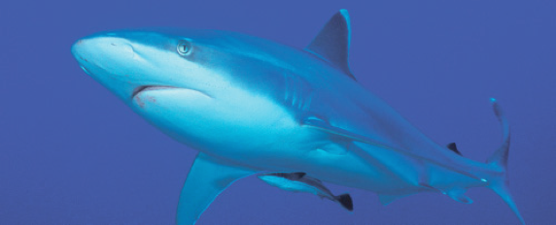
Lesson 13 (chapter 18, 24) Ecology
Ichthyology
Shanghai Ocean University
Fall, 2022

Slide 2
Synthesis: what determines assemblage structure among coral reef fishes?
The incredible diversity of coral reef fishes has fueled a debate over the relative importance of the physical environment versus biological interactions as determinants of how many and what kinds of fishes occur on any one reef.
Much of the debate focuses on whether adult populations are determined by larval mortality (recruitment limitation) or by events occurring after recruitment, such as predator–prey and competitive interactions among juveniles and adults.
It is likely that all factors contribute and that their relative importance differs temporally and spatially.

Slide 3
Interactions between fishes and other taxonomic groups
Fishes interact with non-fish taxa, competing for food and space while eating and being eaten.
The distribution of many fish species represents an avoidance of piscine, mammalian, and avian predators
In many streams, fishes are squeezed out of deep water by fish predators and out of shallow water by wading birds.

Slide 4
Herbivory
Herbivory among fishes is more common in tropical than temperate habitats; common herbivores include minnows, characins, catfishes, and cichlids in tropical fresh water, and surgeonfishes, parrotfishes, rudderfishes, blennies, and damselfishes on coral reefs.
Fishes influence plant biomass, productivity, growth form, energy allocation, and species composition; fishes also disperse seeds.
Plants have evolved mechanical and chemical defenses against herbivorous fishes.
Damselfishes on reefs “garden” algae within their territories, encouraging edible species and discouraging growth of less palatable species. Damselfish activities thus affect the diversity and distribution of algae and the many invertebrates that live in algal patches.

Slide 5
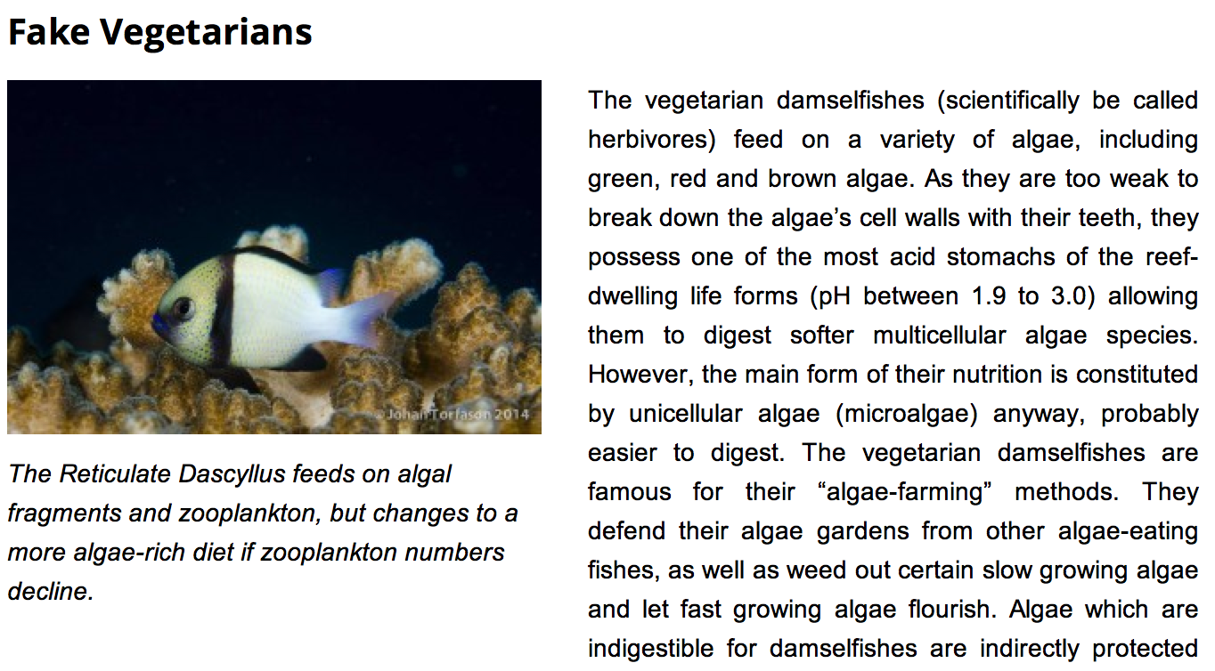

Slide 6
Temperate freshwater herbivores
Temperate freshwater herbivores include minnows, catfishes, suckers, pupfishes, and killifishes. During warm months when plants grow quickly, grazing minnows can crop most of the plant productivity.
During cold months, temperate herbivores commonly shift to carnivory.
Phytoplanktivory also occurs in temperate lakes, where fish such as shad can affect plankton abundance and diversity.

Slide 7
Zooplanktivores
Lake fishes prefer to eat large zooplankters, which shifts the size and species composition of the plankton to smaller zooplankton species.
Marine zooplanktivores that are active by day also preferentially eat large prey.
Avoidance of foraging fishes may be responsible for daily vertical migrations by zooplankters, for day–night differences in zooplankton assemblage composition, and for life history and anatomical traits of zooplankters and other invertebrates.

Slide 8
Trophic cascades
“Trophic cascades” describe the direct and indirect effects that predators at the top of a food web can have on trophic levels several steps below. For example, piscivorous fishes eat zooplanktivorous fishes, which feed on herbivorous zooplankton, which eat phytoplankton. Hence removing the top piscivores has the unexpected effect of increasing phytoplankton density.
Complex interactions of this nature indicate that changes in fish populations can ultimately affect water chemistry, calcium carbonate deposition, the distribution of water masses of different temperatures, and ultimately the heat budget of a lake.

Slide 9
Trophic cascades
Describe “trophic cascades” and give an example of how it works

Slide 10
Nutrient cycling and transport by fishes
Fishes can directly affect the transport and cycling of nutrients in aquatic habitats.
Phosphorus excretion by fishes is important for algal growth.
Benthic fishes disturb sediments, which increases the transfer of nutrients from the mud to the water column.
Fish bodies contain a large fraction of the nutrients in many ecosystems; nutrients are released through excretion from the gills, through defecation, and through decomposition after death.
Vertical and horizontal migrations by fishes that feed in one area and rest in another influence coral growth on coral reefs and kelp growth in kelp beds; the long-distance migrations of salmons link oceanic ecosystems with headwater streams, even influencing the growth of trees in nearby forests.
Fishes can also affect the production and distribution of substrate, as when parrotfishes grind coral into sand, or when tilefishes or breeding minnows pile rocks over their burrows or nests.

Slide 11
Influence of physical factors and disturbance
Physical factors that appear to have the greatest effects on fish assemblages include reductions in dissolved oxygen from drought and ice cover, storm induced increases in stream and river discharge, and habitat destruction on coral reefs and kelp beds from storm-caused waves.
Biological disturbances with ecosystem-wide repercussions include outbreaks of disease or population explosions of species that literally eat the food and habitat resources of a system.

Slide 12
Convergence and adaptation
The Principle of Convergence states that strong selection pressures tend to produce strong similarities in unrelated animals. Several aquatic habitats offer examples.
Mesopelagic ocean depths between 200 and 1000 m contain 750 species of fishes that are typically dark in color, with photophores, large mouths, slender teeth, reduced skeletons and squamation, long rete mirabiles, low enzyme activity, and daily vertical migrations.
Bathypelagic fishes (1000–4000 m, 200 species) show stronger and more bizarre convergences, including sex reversal, extreme skeletal and musculature reduction, eye loss, longer retes, marked sexual dimorphism, and behavioral energy conservation. These characteristics are apparent adaptations to low energy availability.

