Slide 1
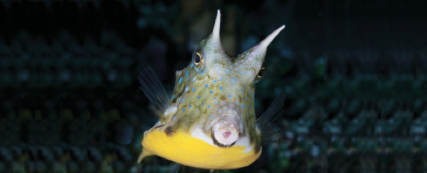
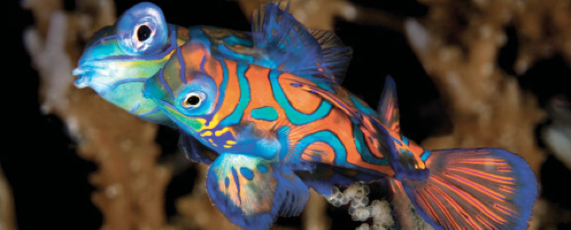
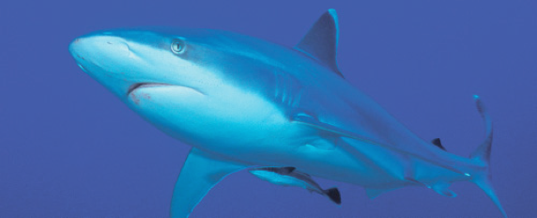
Lesson 14 (chapter 25, 26) Adaptation and conservation
Ichthyology
Shanghai Ocean University
Fall, 2022

Slide 2
Convergence and adaptation
The Principle of Convergence states that strong selection pressures tend to produce strong similarities in unrelated animals. Several aquatic habitats offer examples.
Mesopelagic ocean depths between 200 and 1000 m contain 750 species of fishes that are typically dark in color, with photophores, large mouths, slender teeth, reduced skeletons and squamation, long rete mirabiles, low enzyme activity, and daily vertical migrations.
Bathypelagic fishes (1000–4000 m, 200 species) show stronger and more bizarre convergences, including sex reversal, extreme skeletal and musculature reduction, eye loss, longer retes, marked sexual dimorphism, and behavioral energy conservation. These characteristics are apparent adaptations to low energy availability.

Slide 3
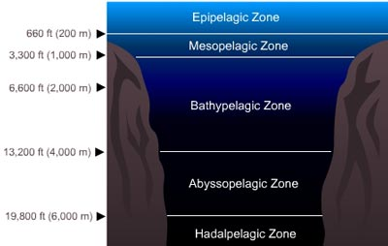
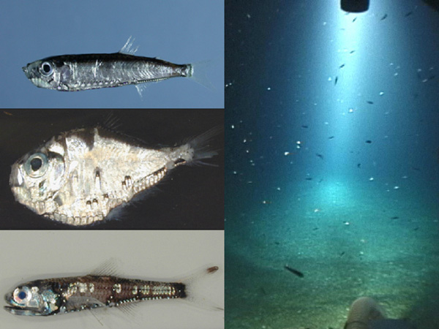

Slide 4
Pelagic fishes
Oceanic, pelagic fishes swim in the upper 100–200 m of water. This is the primary region for commercial fish production and is the habitat of herringlike fishes, sauries, carangoids, dolphinfishes, mackerels, tunas, and billfishes.
Pelagic fishes are typically streamlined, silvery, and migratory, with a high proportion of red muscle for sustained swimming.
They respire efficiently and save energy by using ram-gill ventilation.
Life history differences between temperate and tropical species are influenced by seasonal and spatial food availability, and lead to dramatic differences in year class fluctuations.
Freshwater pelagics have converged on many traits with oceanic species.

Slide 5
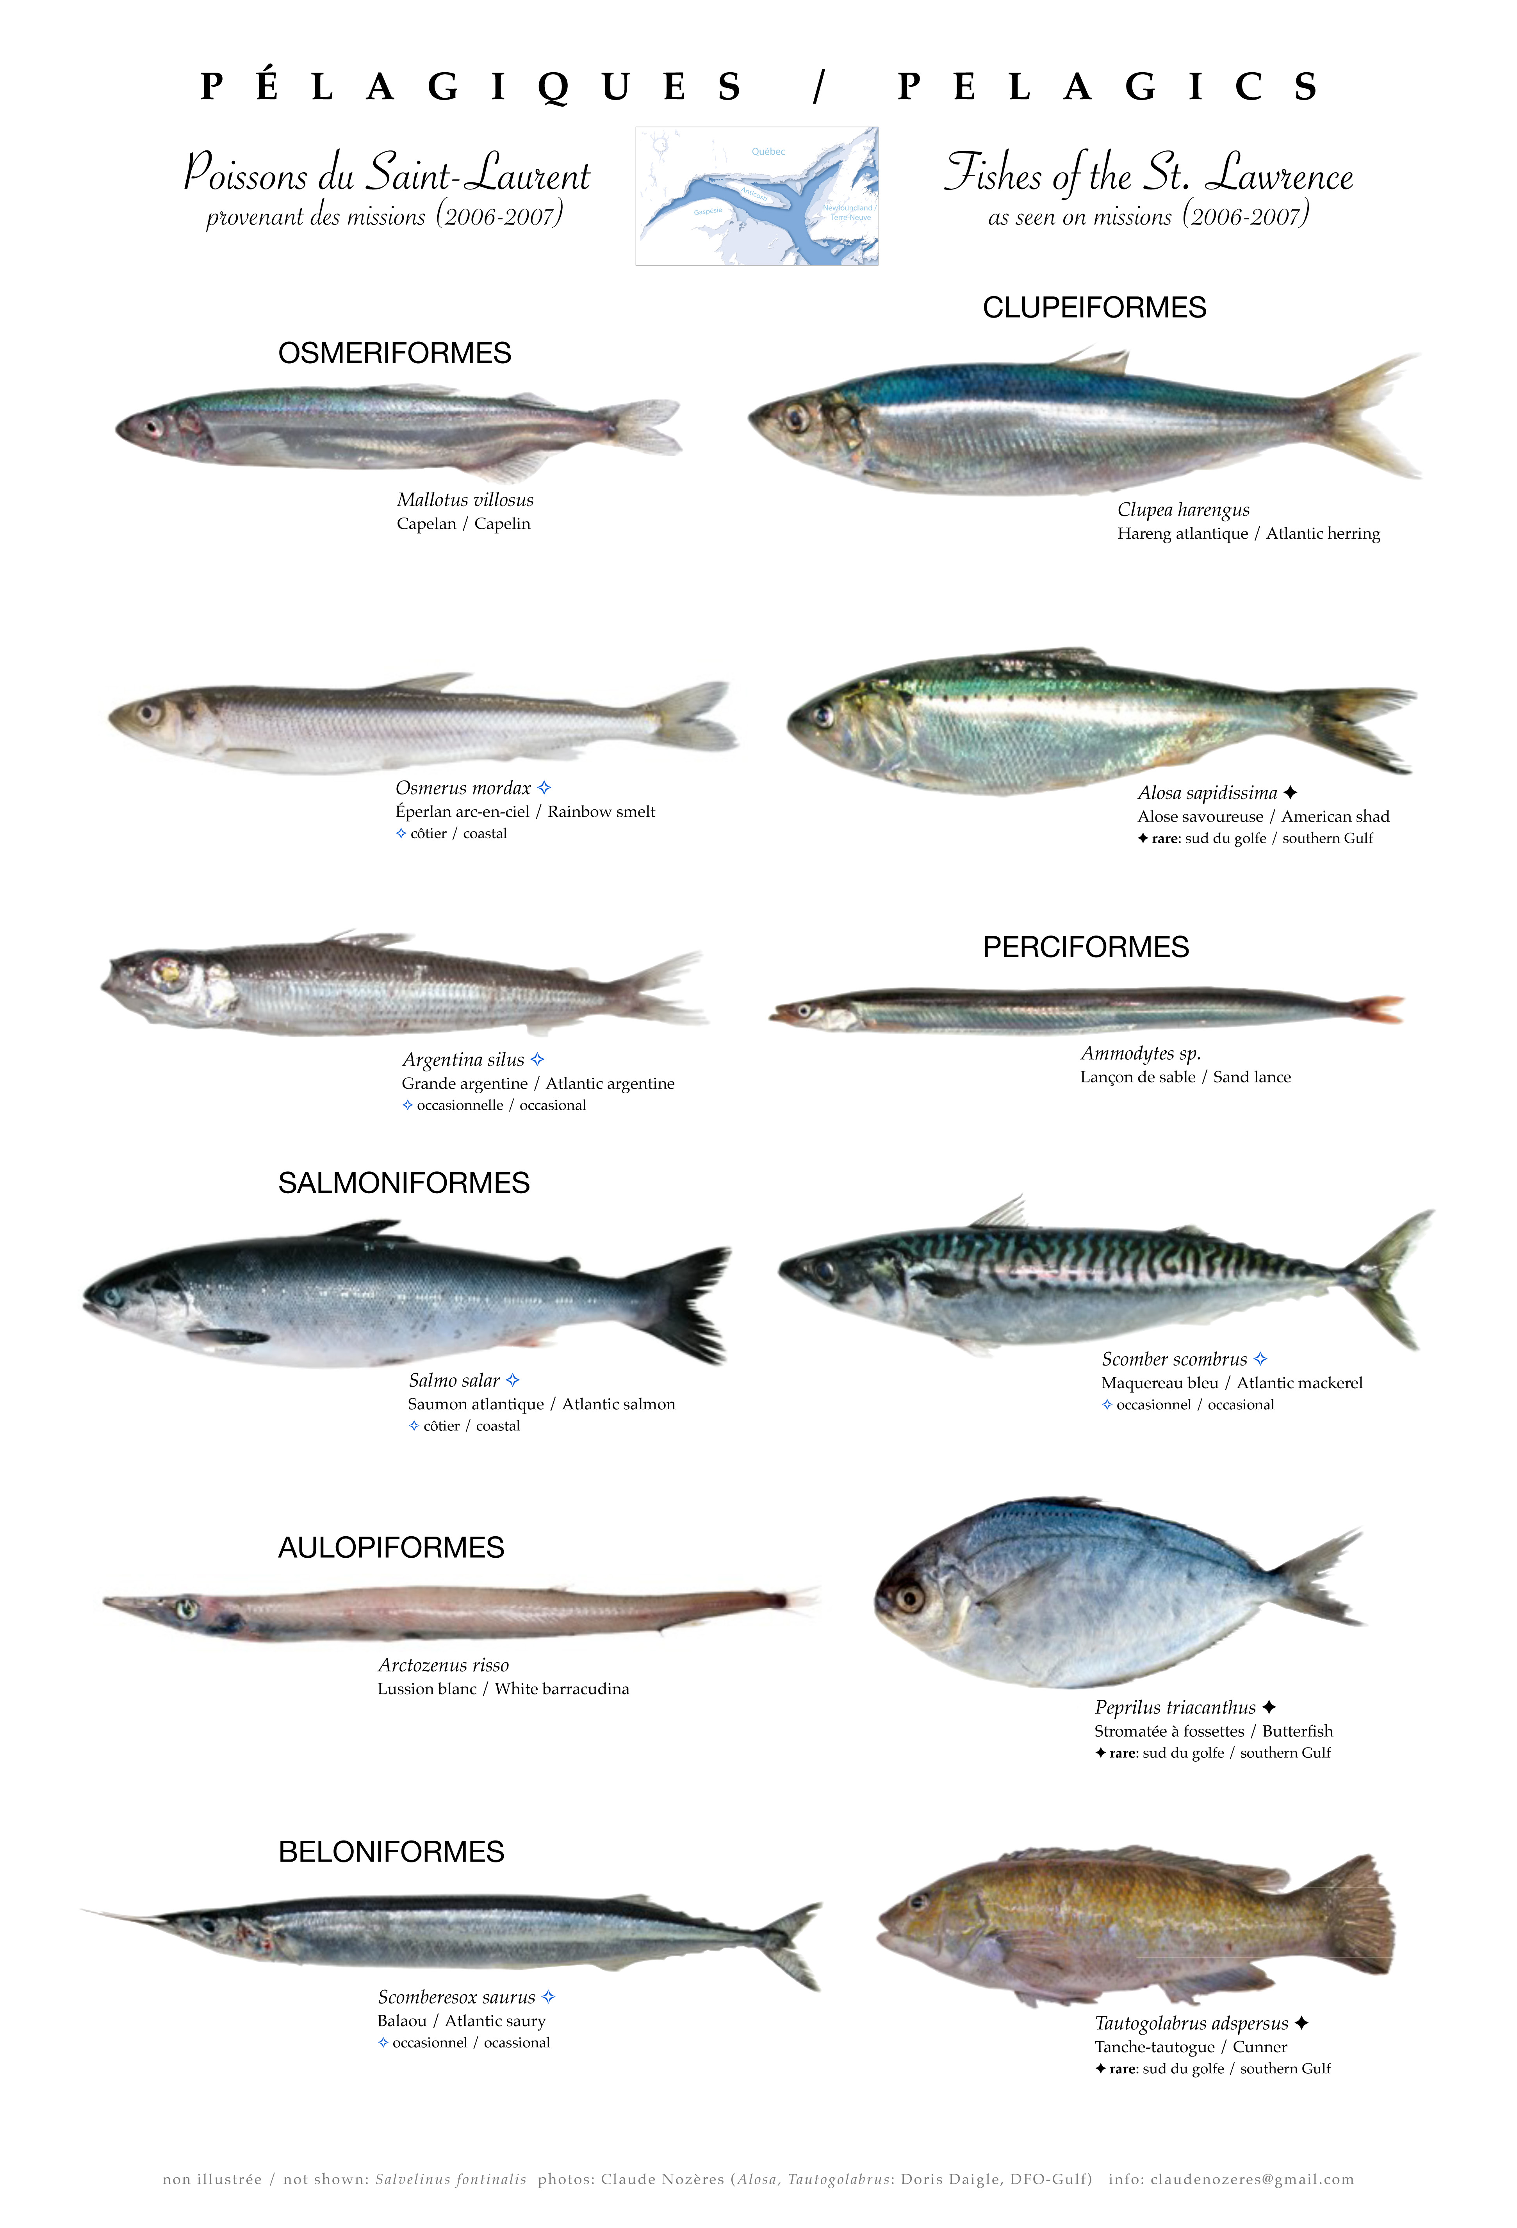

Slide 6
Polar Arctic and Antarctic regions
The polar Arctic and Antarctic regions lie above 60° latitude. The Antarctic has more endemic, specialized fishes, half of which are in the icefish suborder Notothenioidei. Antarctic fishes avoid freezing because their blood contains antifreeze compounds.
Channichthyids are unusually pale because they lack hemoglobin and myoglobin. Some notothenioids have evolved neutral buoyancy via reduced skeletal mineralization and increased lipid deposition.
Arctic fishes have converged on similar traits.

Slide 7
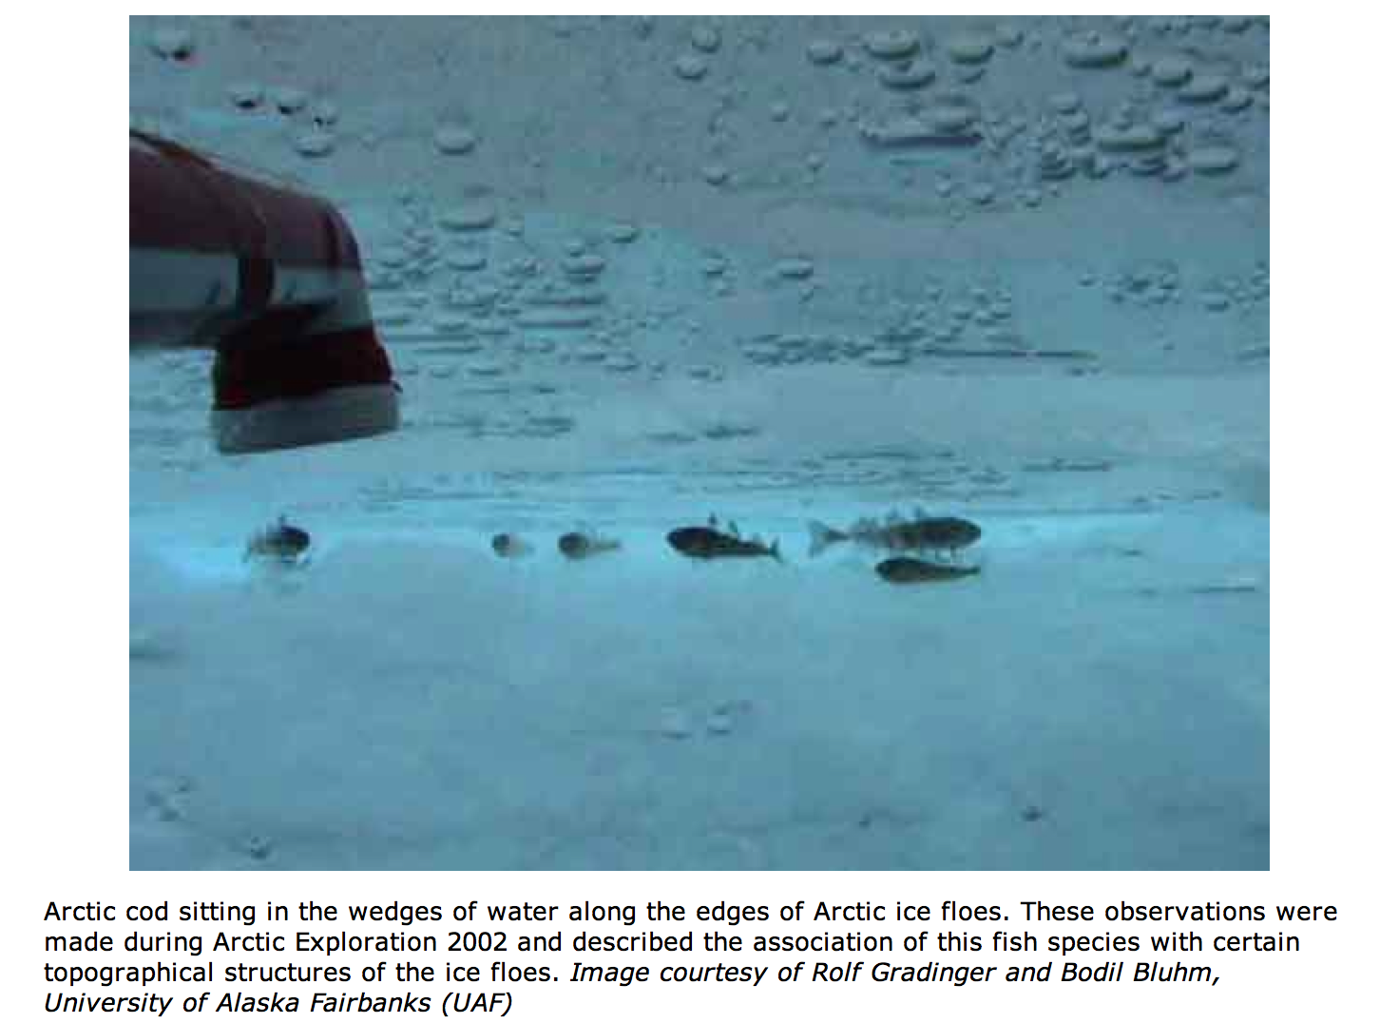

Slide 8
Desert fishes
Desert freshwater fishes live on almost all continents in regions where water scarcity creates extreme conditions.
Desert fishes often possess accessory respiratory structures for using atmospheric oxygen, and have a life cycle that includes a resting stage during droughts, either involving a diapausing egg or an estivating adult.
In addition to low oxygen, desert fishes often encounter extremes of salinity and alkalinity. The deserts of the southwestern USA and western Mexico have a surprising diversity of endemic fishes, many of which are threatened.

Slide 9
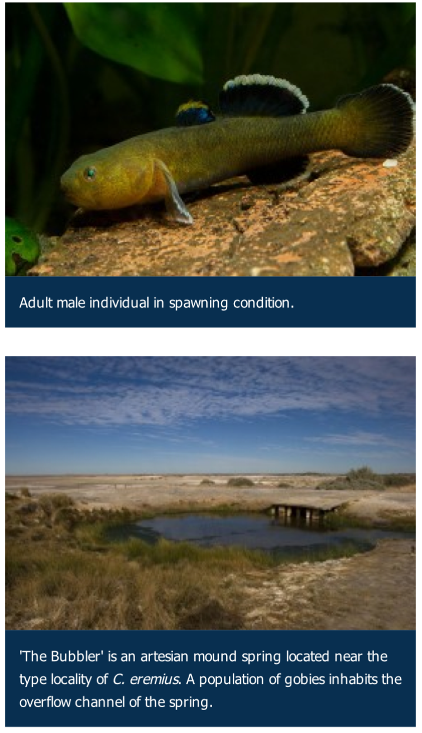
Desert goby

Slide 10
Fishes that inhabit high-energy zones
Fishes that inhabit high-energy zones such as the wave-swept intertidal zone or steep stream beds have converged upon a body shape that is depressed, paired fins that are expanded, a suction device, subterminal mouths, and small body size.
All these traits appear to facilitate the holding of position on the bottom despite strong water flow.

Slide 11
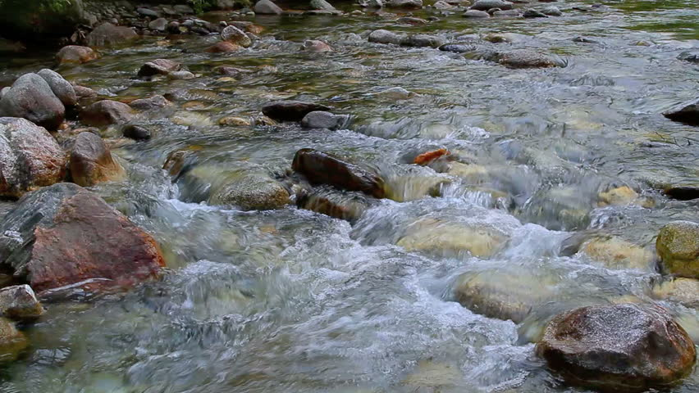
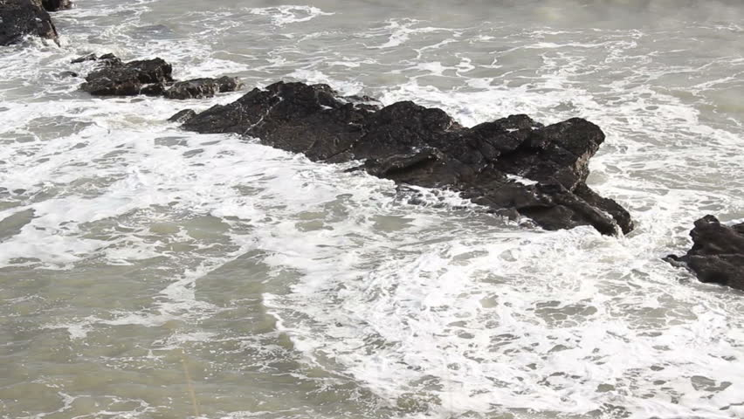

Slide 12
Cave fishes
Cave fishes live in lightless, freshwater environments where food is scarce.
Cave-adapted forms typically have reduced eyes, pigmentation, and squamation; low metabolic activity and reproductive rates; low population densities; and increased chemosensory and lateral line development.
Their biology makes them especially vulnerable to habitat disturbances.
Cave-dwelling fishes have converged on many of the traits evolved by deepsea fishes, probably in response to food and light scarcity.

Slide 13
