Slide 1
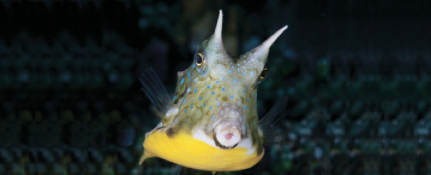
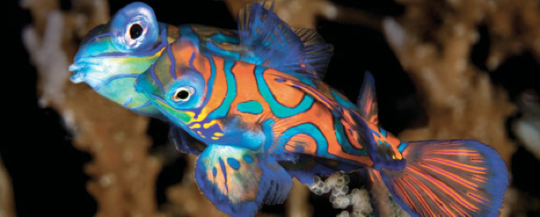
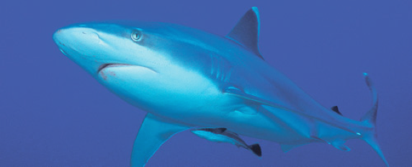
Lesson 14 (chapter 25, 26) Adaptation and conservation
Ichthyology
Shanghai Ocean University
Fall, 2022

Slide 2
Conservation
Extinction rates have increased dramatically in the past 50 years due to human activities; present rates are 1000 times greater than average and 10–100 times greater than during past periods of mass extinction.
About 20% of the world’s 9000 species of freshwater fishes are either extinct or nearly so; 40 fishes have gone extinct in North America in the past century and the rate is accelerating.
Marine fishes are less threatened because of their wider distributions, although many commercially important species are showing serious declines.

Slide 3
Causes of fish extinction
Major causes of biodiversity loss are habitat loss and modification, species introductions, pollution, commercial exploitation, and global climate change.
Habitat loss occurs through modification of bottom type, as happens during dredging, log removal, coral or gravel mining, trawling, and from silt deposition due to deforestation of the surrounding watershed.
Other causes of habitat loss include channelization of streams and rivers, dam building, and water withdrawal.

Slide 4
Invasive species
Introduced species affect native species because introduced fishes are often freed from their evolved population controls, and natives are evolutionarily unprepared for the introductions.
Predation by and competition and hybridization with introduced species are common results, as is the introduction of new pathogens.
The introduction of Nile Perch into Lake Victoria has led to the possible extinction of hundreds of species of endemic cichlids that previously supported an important local fishery.

Slide 5
Environment monitor
Chemical, nutrient, and sediment pollution all have adverse effects on fishes; predation on fishes by birds and mammals links aquatic and terrestrial ecosystems via such pollution. Fishes can therefore serve as valuable indicators of environmental health.

Slide 6
Overfishing
Approximately 40% of the commercial marine fish species important to the USA are exploited at unsustainable rates. The Pacific Sardine, Peruvian Anchoveta, and Giant Totoaba were all very abundant commercial species that have essentially disappeared due largely to overfishing. Some species reductions are the indirect result of other fisheries.
Bycatch in the shrimp fisheries of the Gulf of Mexico greatly reduces the available stocks of Red Snapper and Spanish Mackerel, among other species.
Coral reef fishes are commercially exploited for the home aquarium trade, which has led to reef destruction and species depletion in many places. Few such fishes live more than a few months in captivity.

Slide 7
Climate change
Greenhouse gases have been pumped into the atmosphere at increasing rates during the past century, raising the prospect of global warming, sea level rises, ocean current shifts, and major climatic changes such as drought, floods, and cyclonic storms.
Global warming has and will alter the distribution, abundance, reproductive timing, trophic relationships, and migration patterns of fishes through its impacts on water temperature, rainfall patterns, freeze–thaw cycles, oxygen availability, heat budgets, oceanic currents, primary productivity, ocean acidification, and metabolic processes.
Coral reef ecosystems have been especially degraded due to slightly elevated temperatures, and prospects for the future are not promising. Major shifts in freshwater fish distribution and diversity would also occur.

Slide 8
Solution
Biodiversity loss is a symptom of environmental deterioration on a global scale.
Solutions to environmental problems include ecosystem and landscape preservation, development of reserves, habitat restoration, and captive breeding of endangered species.
None of these efforts will be successful if human population growth and overconsumption are not curtailed.

Slide 9
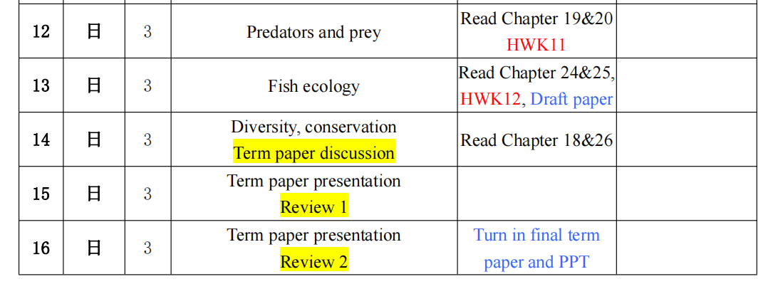

Slide 10
Term paper presentation
Next two weeks, no absence
Save in ppt format, name it with your name
Email it to me before class
Must be in English (both written and spoken)
5 min talk + 2 min answering questions
I will pick presenter randomly

Slide 11
Hand in your PPT by next Saturday (Dec 24)

Slide 12
Term paper presentation
10 points to your final grade
Main parts, covering taxonomy, basic biology, life history etc. (3 points)
Discussion, showing at least one new research on the species (3 points)
Clearness, flow of macro- micro-logic (2 points)
Presentation, articulate speech, timing (2 points)

Slide 13
Your final paper is due on Jan 1st
Don’t forget your name
Double side
Double line space
Use subtitles
Introduction
Physical description …
Flow of your logic at macro and micro level
Need English editing
Choose the correct words, e.g. intramuscular bone, not thorn
Tense and consistent verb…
Avoid redundancy
Spend more time on it!

Slide 14
Have a nice week!

