Slide 1
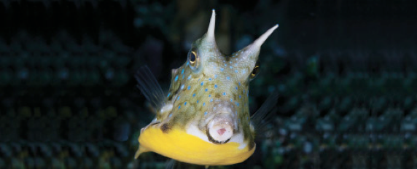
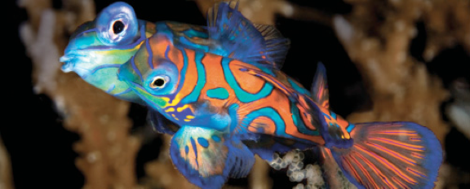
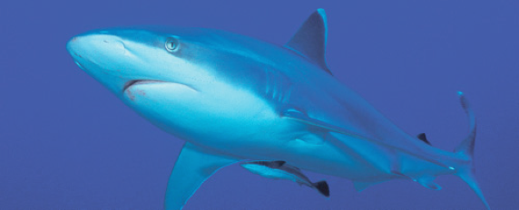
Lesson 1
Introduction to fishes, history of ichthyology and systematics
Ichthyology
Shanghai Ocean University
Fall, 2023

Slide 2
1.1 Course Introduction

Slide 3
李晨虹
主讲课程：《鱼类学》《生物信息》《分子系统和生态》
研究方向：鱼类的系统演化、分子生态
办公地点：生命学院B楼
联系方式：chli@shou.edu.cn 15692161233
答疑时间与地点：邮件或电话预约
1993，上海水产大学，水生生物，理学士
1996，上海水产大学，水产养殖，硕士
2007，University of Nebraska – Lincoln, Biology, PhD
2012，上海海洋大学，教授

Slide 4
Kishor Kumar Sarker
主讲课程：《鱼类学》
研究方向：比较基因组学、鲱形目进化
办公地点：生命学院B楼
联系方式：kishorssf91@gmail.com 18621974360
答疑时间与地点：邮件或电话预约
2014 孟加拉国贾格纳特大学 学士 动物学
2016 孟加拉国贾格纳特大学 硕士 动物学
2022 上海海洋大学 博士 生物学
2022- 上海海洋大学 博士后 生物学

Slide 5
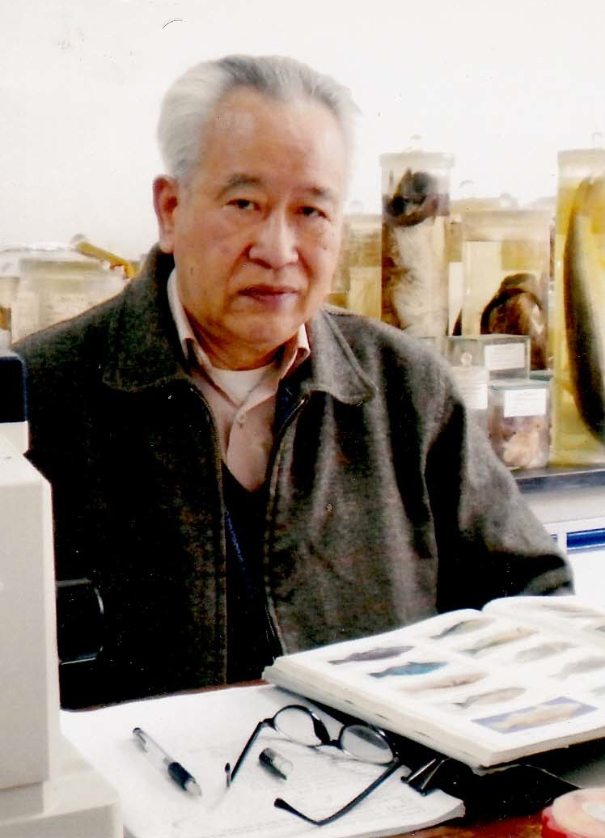
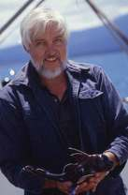
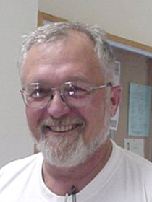
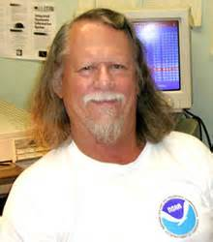
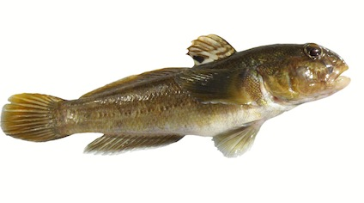
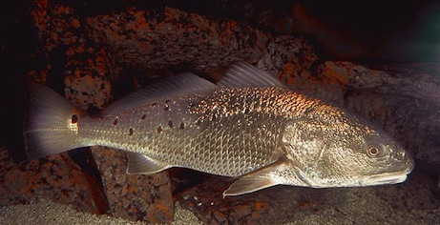
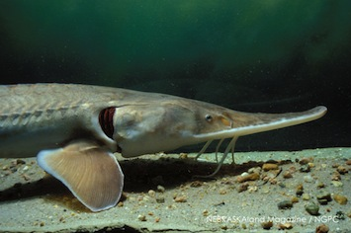
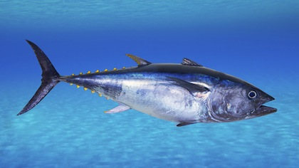
伍汉霖
上海水产大学
Hanlin Wu
SOU
Grant Gilmore
Florida Tech, NASA
Ed Peters
Univ. Nebraska
Bruce Colette
NOAA
Gobies
Red drum
Pallid sturgeon
Scomberids

Slide 6
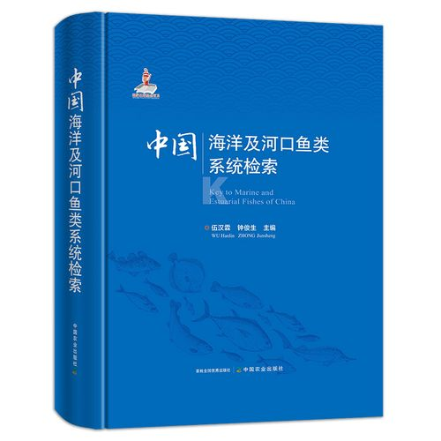

Slide 7
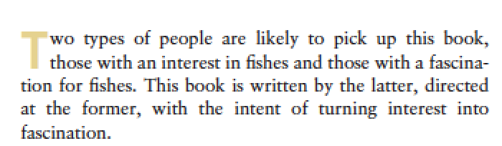
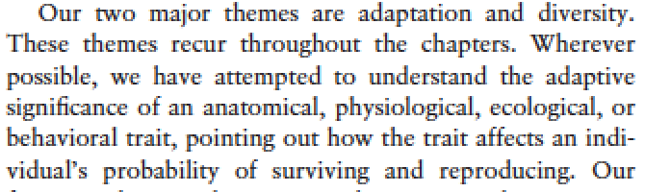
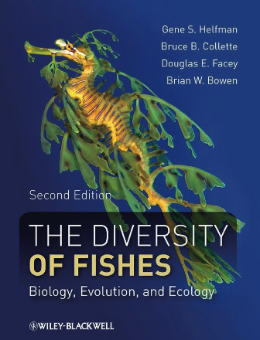

Slide 8
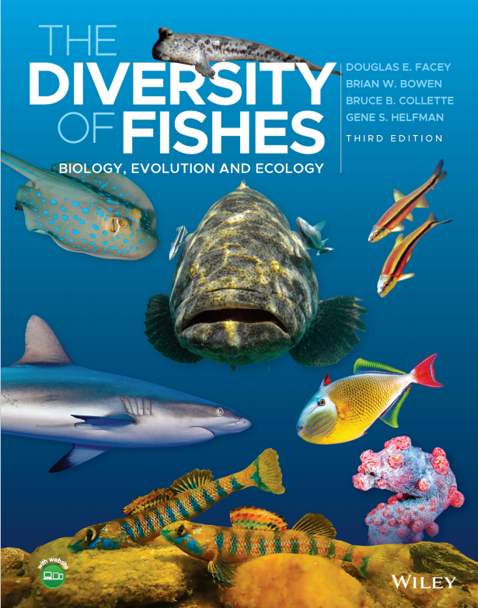

Slide 9

Resource you could use for this course
ppt slides from lectures
  Lesson1_Intro…
  …
the book
  For further reading and as a reference
homework
  homework1…
  …
www.blyun.com
or other resources

Slide 10
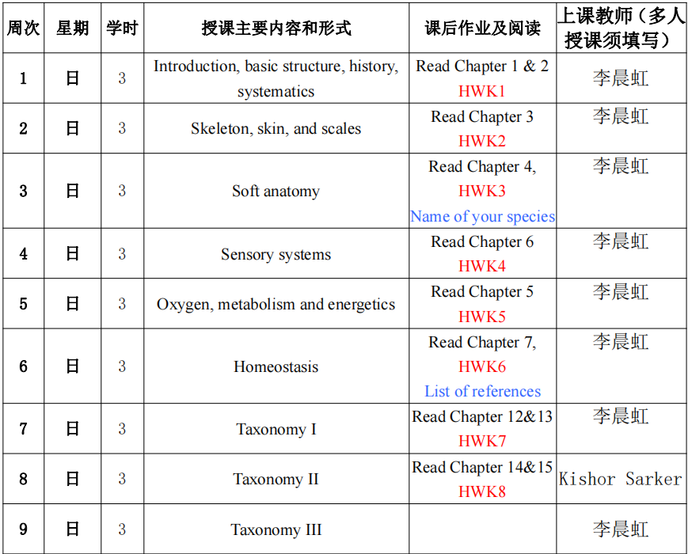

Slide 11
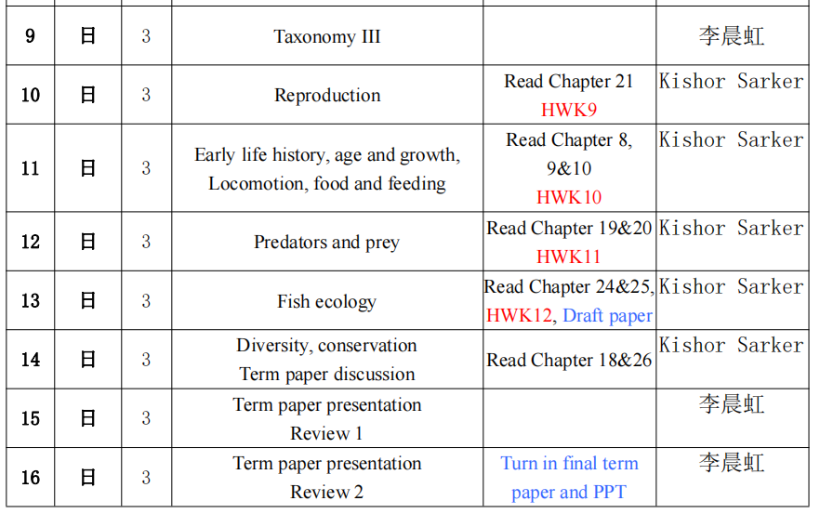

Slide 12
Grading
  Homework, 15%
  Short lecture，5%
  Term paper，20% (10% paper + 10% talk)
  Final，60%

Slide 13
Term paper
Life History Paper Instructions – 2020.pdf
Life History Paper example.pdf
example description and reference.pdf
example final paper.pdf
example presentation.ppt

Slide 14
Please provide your give me your name of the species by Sunday, Oct 8., by email, chli@shou.edu.cn.
Send the reference by Oct 29.
Note that introduction, general description and a preliminary list of references are due on Dec 17;
and the final paper is due on Jan 7.

Slide 15
Short lecture
Each of you will give a chance to prepare a short lecture on a topic (~10 min)
I will talk about the topics one weeks before the class.

Slide 16
Where to find credible information?
onlin:baidu.com, Google, www.bing.com
Journal paper
Electrical resources from library

Slide 17
Journals
Copeia
Transactions of the American Fisheries Society
Journal of Fish Biology
Ichthyologic Research
Zootaxa
Zookeys
Molecular Phylogenetics and Evolution
…

Slide 18
Learning in English
Why?
-access to broader information
-exchange ideas
-get prepared
How?
-spend more time
-learning English in English
http://dictionary.cambridge.org
https://ahdictionary.com
you can do it

Slide 19
Ichthyology [ˌɪkθɪ'ɒlədʒɪ]

Slide 20
http://www.lmse.org/learning/Ichthyology.html

Slide 21
