Slide 1
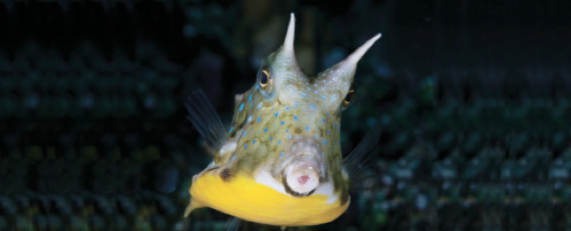
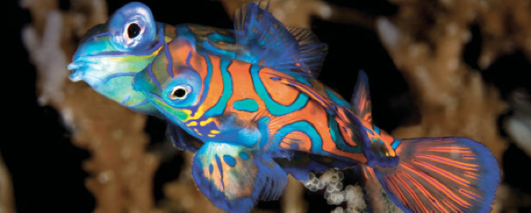
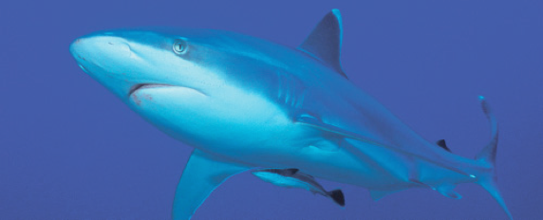
Lesson 2 Skeleton, skin and scales
Ichthyology
Shanghai Ocean University
Fall, 2022

Slide 2
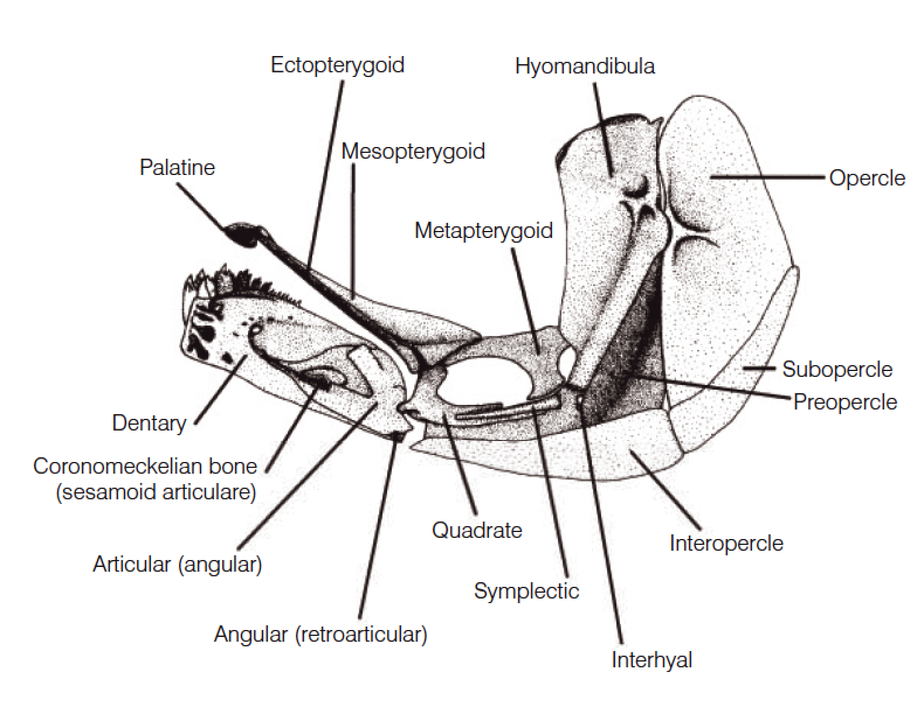
Branchiocranium
The branchiocranium is divisible into five parts:
Mandibular (颌骨)
Palatine (腭骨)
Hyoid (舌骨)
Opercular (鳃盖骨)
Branchial (鳃弓)

Slide 3
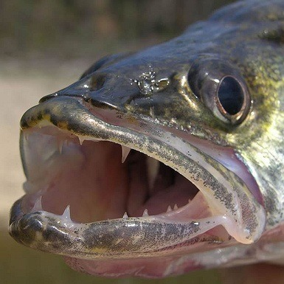
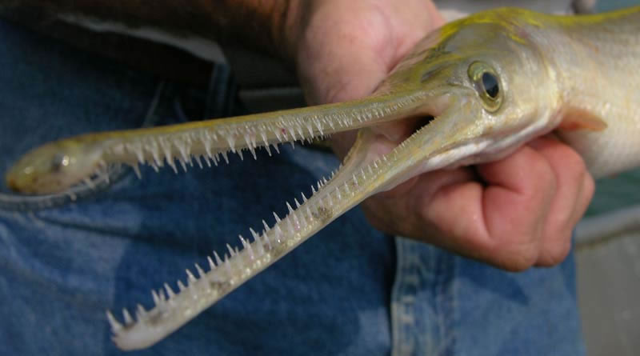
Teeth
The oral jaws and many pharyngeal bones may bear teeth.
Many different terms have been applied to the different sizes and shapes of teeth
Canine
Villiform
Molariform
Incisor

Slide 4
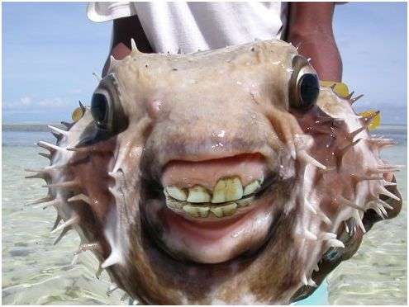
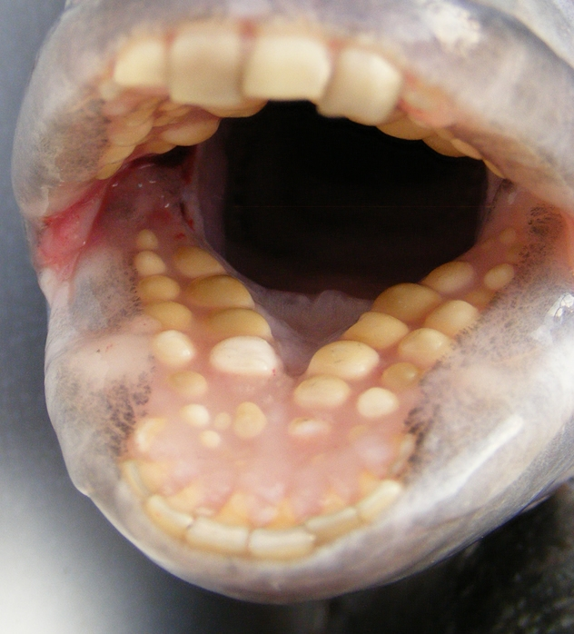
Teeth
The oral jaws and many pharyngeal bones may bear teeth.
Many different terms have been applied to the different sizes and shapes of teeth
Canine
Villiform
Molariform
Incisor

Slide 5
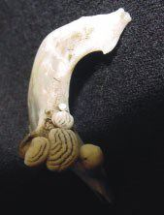
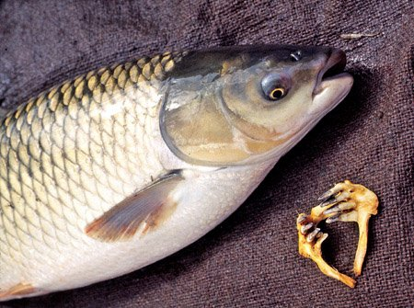
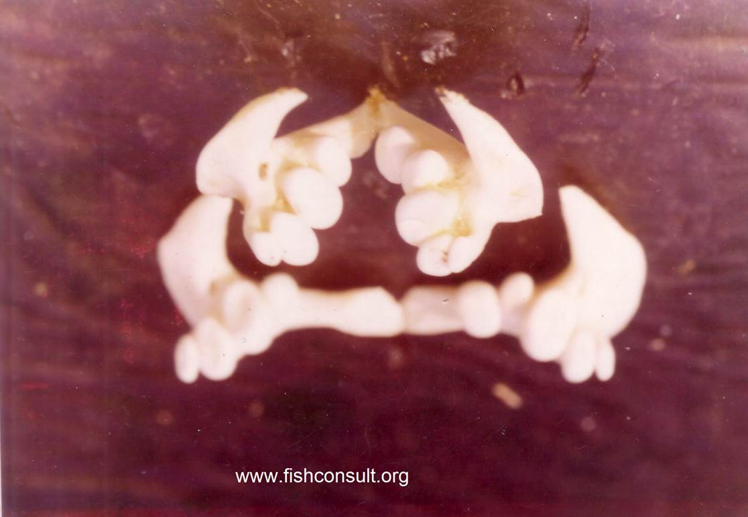
Pharyngeal teeth

Slide 6
Branchiocranium
The branchiocranium is divisible into five parts:
Mandibular (颌骨)
Palatine (腭骨)
Hyoid (舌骨)
Opercular (鳃盖骨)
Branchial (鳃)

Slide 7
Palatine and hyoid arches
The palatine arch consists of four pairs of bones in the roof of the mouth:
palatines (腭骨）
ectopterygoids (外翼骨)
mesopterygoids (内翼骨)
metapterygoids (上翼骨)
The suspensorium consists of a chain of primarily cartilage
bones that attach the lower jaw and opercular apparatus to the skull
hyomandibula (舌颌骨)
quadrate (方骨)

Slide 8
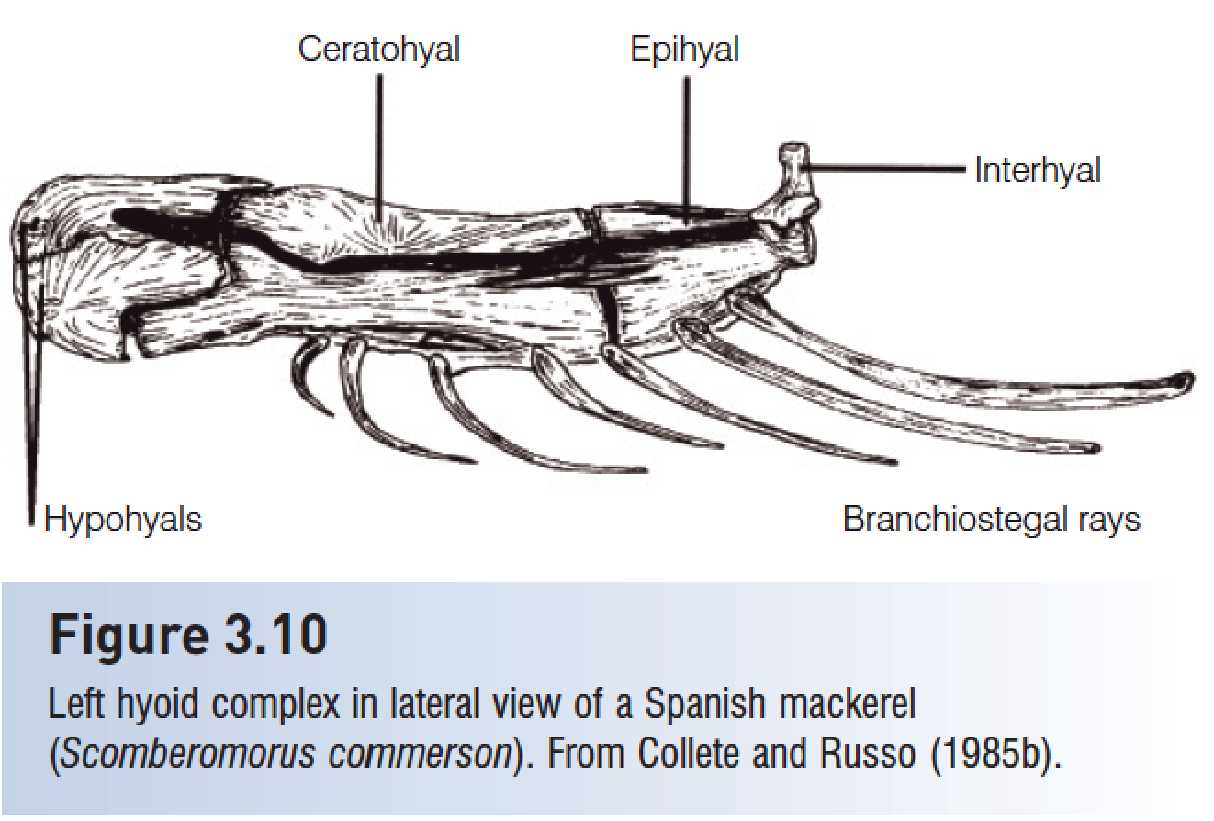
Palatine and hyoid arches
The hyoid complex is a series of five pairs of bones that lie medial to the lower jaw and opercular bones and lateral to the branchiostegal rays that attach to them.

Slide 9
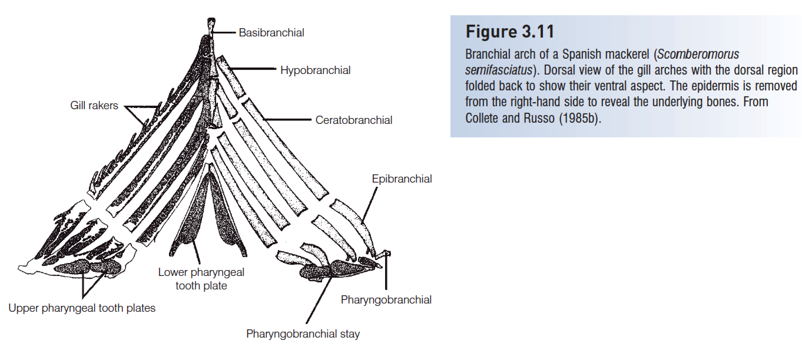
The dermal bones of the hyoid arch are the branchiostegal rays, elongate, flattened, riblike structures

Slide 12
Postcranial skeleton
The notochord of primitive chordates is replaced by the vertebral column in lampreys, Chondrichthyes (软骨鱼), and osteichthyans (硬骨鱼).
Posterior vertebrae support the caudal fin in most fishes.
In teleosts, hypurals (尾下骨) (enlarged haemal spines, 脉棘) support the branched principal caudal fin rays.

Slide 13
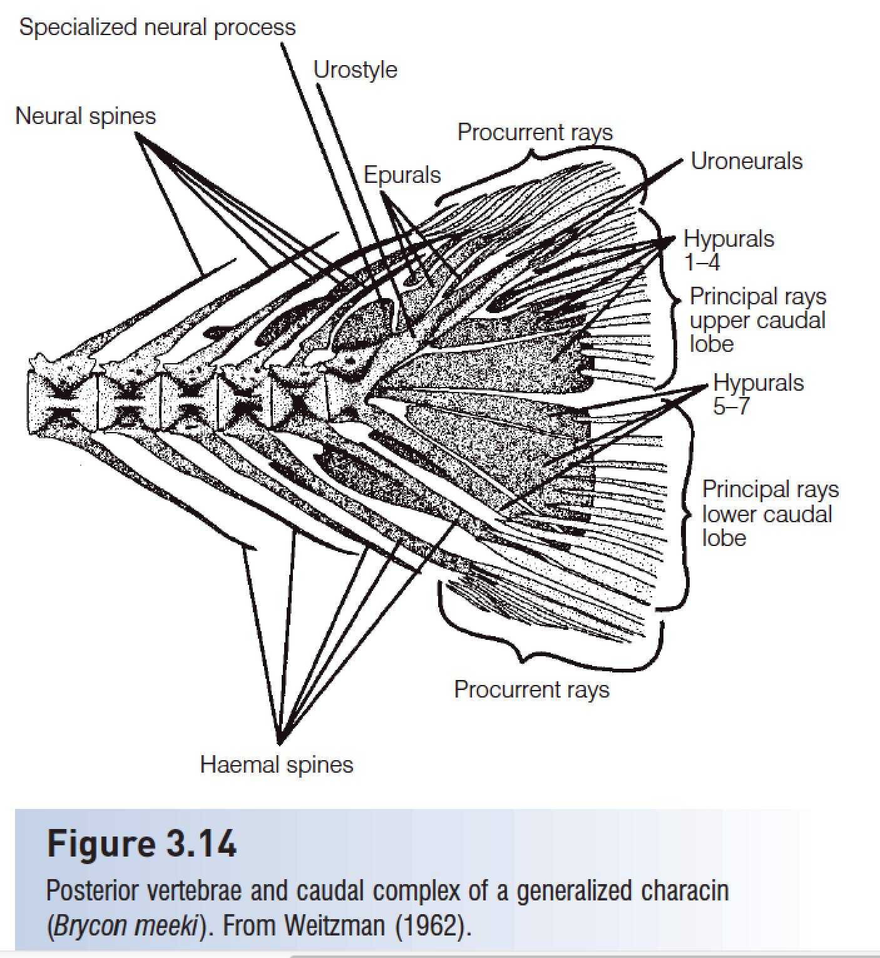
Caudal complex

Slide 14
Ribs (pleural ribs) attach to the vertebrae and protect the viscera.
Intermuscular bones are segmental, serially homologous ossifications in the myosepta of teleosts.

Slide 15
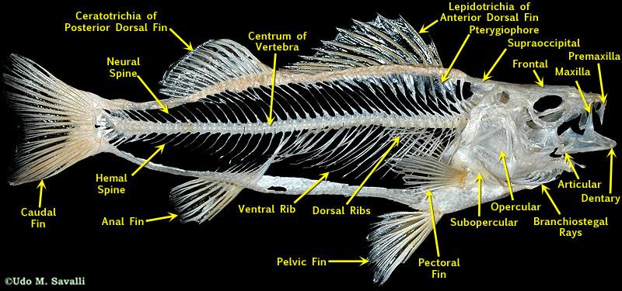
Skeletal Structures

