Slide 1
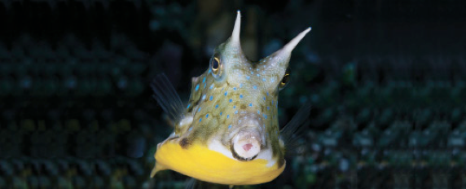
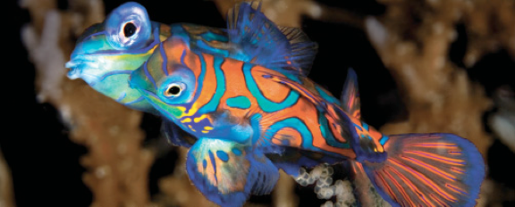
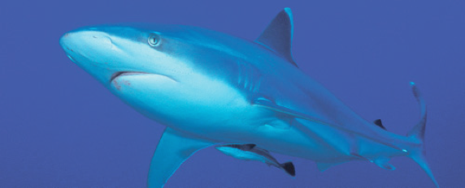
Lesson 3
Soft anatomy
Ichthyology
Shanghai Ocean University
Fall, 2022

Slide 2
Cardiovascular system
周兴泓

Slide 3
Cardiovascular system
The cardiovascular system serves all bodily functions but is most closely associated with respiration, excretion, osmoregulation, and digestion.
The cardiovascular system is the system of arteries, veins, and capillaries that carry respiratory gases, wastes, excretory metabolites, minerals, and nutrients.
The cardiovascular systems of only a few fish species have been investigated extensively

Slide 4
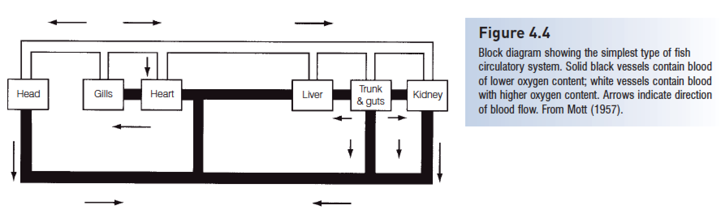
Cardiovascular system

Slide 5
The heart
is located posterior and ventral to the gills in all fishes, although it is located farther anterior in teleosts than in chondrichthyans.
It lies in a membranous pericardial cavity that is lined with parietal pericardium.

Slide 6
The heart
The basic fish heart consists of four chambers in series: venous blood enters
  (i) the sinus venosus (a thin-walled sac) from the ducts of Cuvier and the hepatic veins; it next flows into
  (ii) the atrium; then into
  (iii) the ventricle, a thick-walled pump; and finally blood flows out of the heart into
  (iv) the conus or bulbus arteriosus (Farrell & Jones 1992).
The bulbus dampens pressure oscillations, thereby providing continuous rather than pulsed blood supply to the body.

Slide 7
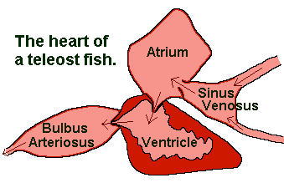
The heart

Slide 8
The heart
In lungfishes, the atrium and ventricle are partly divided by a partition, partially separating oxygenated and deoxygenated blood
a step toward development of the two pump, four-chambered heart of tetrapods.

Slide 9
Blood vessels of the gills and head
afferent branchial arteries bringing oxygen deficient blood to the gills from the ventral aorta.
Efferent branchial arteries bring oxygenated blood from the gills to the rest of the body.

Slide 10
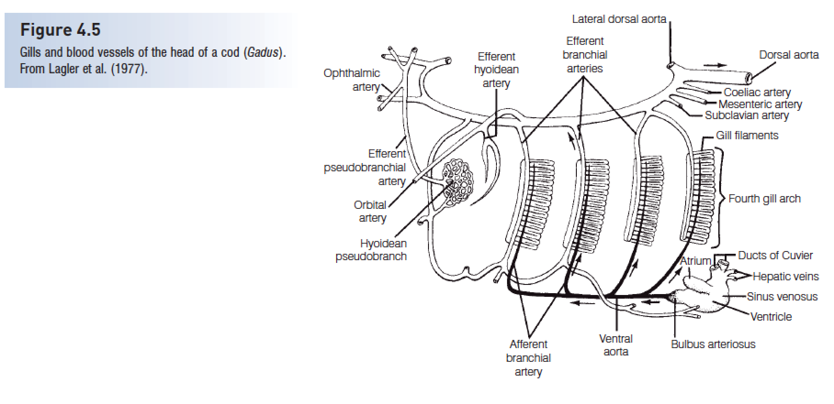
Blood vessels of the gills and head

Slide 11
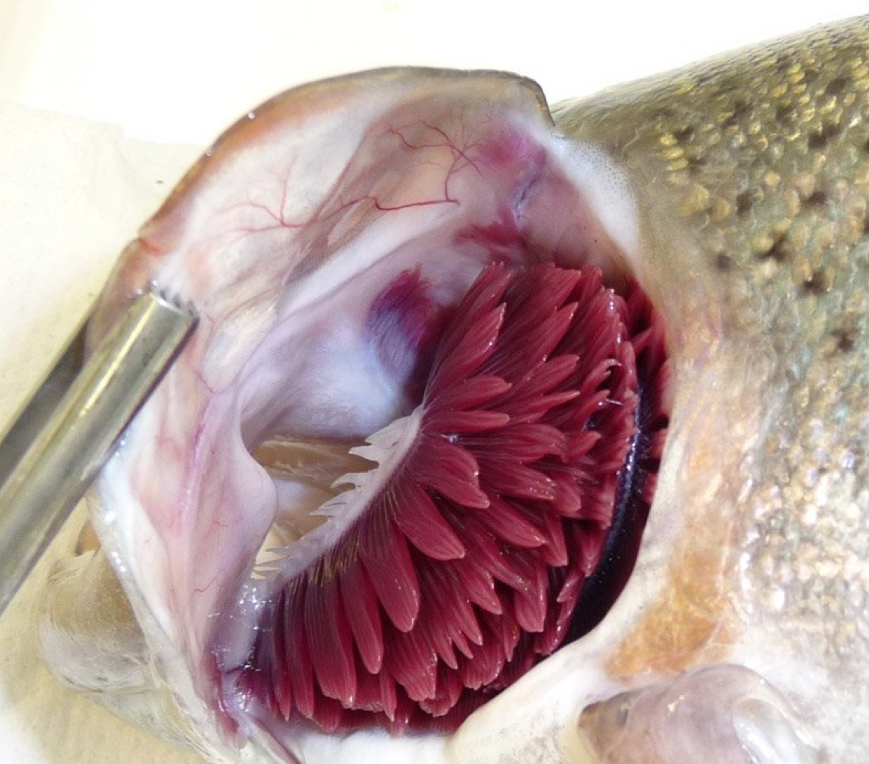
Blood vessels of the gills and head
Many fishes have a pseudobranch (rudimentary gill, hemibranches), a small structure under the operculum composed of gill-like filaments

Slide 12
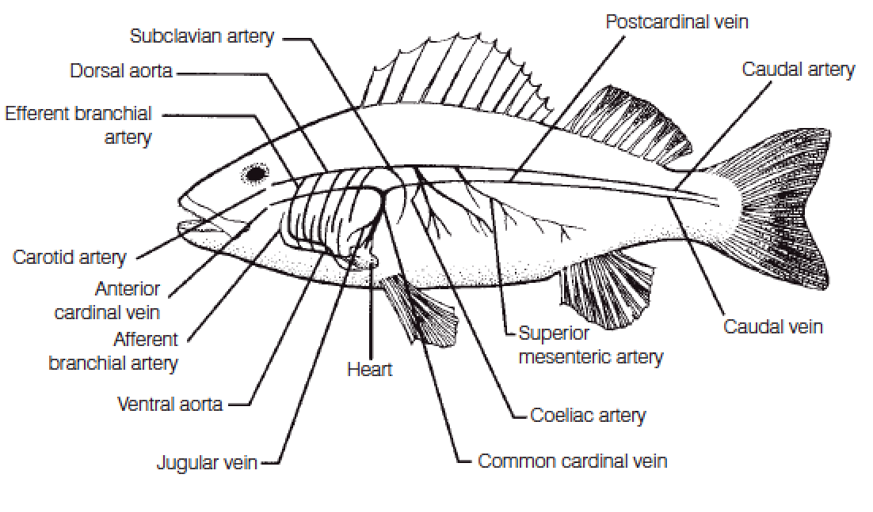
Blood vessels of the body
dorsal aorta is the main route of transport of oxygenated blood from the gills to the rest of the body

Slide 13
Blood vessels of the body
The subclavian artery goes to the pectoral girdle,
the coeliaco-mesenteric artery supplies the viscera
The major return route of blood from most of the body is the postcardinal vein. It is best developed on the right side and empties into the common cardinal or ducts of Cuvier, then into the sinus venosus

Slide 14
Blood vessels of the body

Slide 15
Blood and Lymphatic system
The volume of blood in teleosts is less than in Chondrichthyes, and both have lower blood volumes than tetrapods.
Blood itself is composed of plasma and blood cells.
Plasma contains dissolved minerals, digestive products, waste products, enzymes, antibodies, and dissolved gases

Slide 16
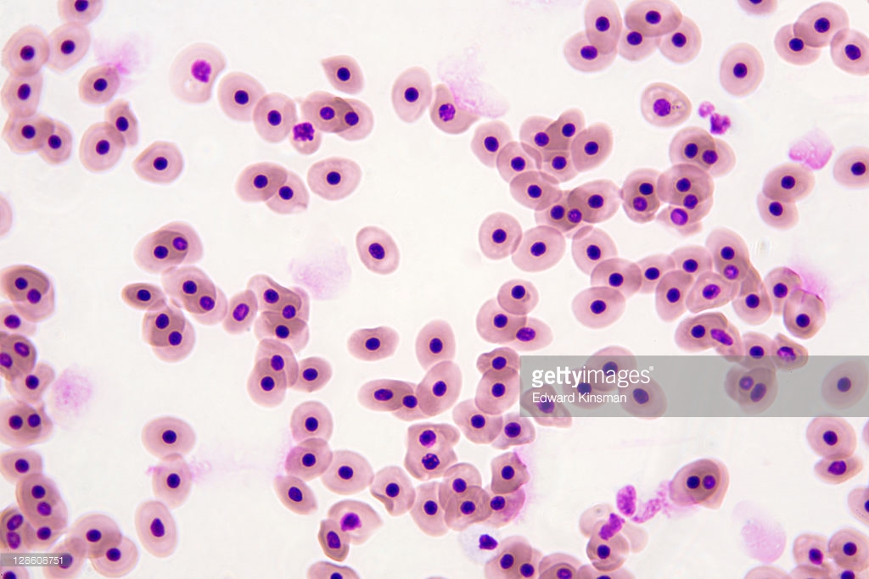
Blood and Lymphatic system
RBCs are nucleated, yellowish-red, oval cells in most fishes but are round in lampreys. Fishes have relatively fewer and larger RBCs than do mammals.
The lymphatic system is derived from the venous part of the blood vascular system and is similar to that of other vertebrates.

