Slide 1
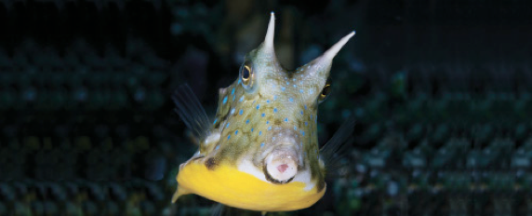
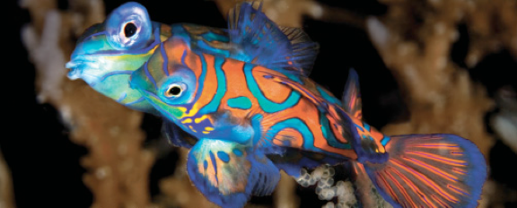
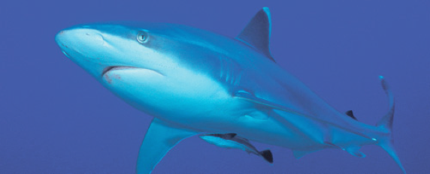
Lesson 3
Soft anatomy
Ichthyology
Shanghai Ocean University
Fall, 2022

Slide 2
Alimentary canal（消化道）
can be divided into anterior and posterior regions.
The anterior part consists of the mouth, buccal cavity, and pharynx.
The posterior part consists of the foregut (esophagus and stomach), midgut or intestine, and hindgut or rectum.

Slide 3
Alimentary canal
Voluntary striated muscle extends from the buccal cavity into the esophagus
involuntary smooth muscle from the posterior portion of the esophagus through the large intestine.

Slide 4
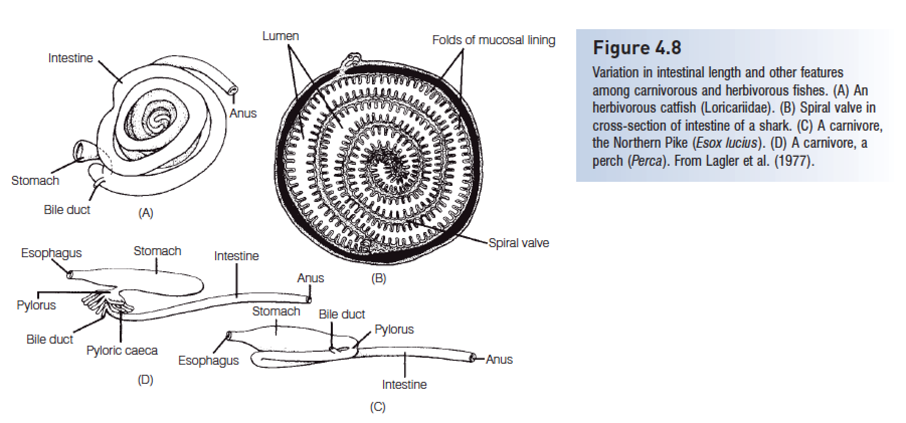
Alimentary canal
spiral valve increase the surface area of the intestine

Slide 5
Mouth
The buccal cavity (mouth) and pharynx lack the salivary glands present in mammals.
These areas are lined with stratified epithelium, mucous cells, and, frequently, taste buds.

Slide 6
The esophagus
The esophagus is a short, thick-walled tube lined with stratified ciliated epithelium, mucous-secreting goblet cells, and, often, taste buds.
The anterior portion has striated muscles,
the posterior part smooth muscles that produce peristaltic movement of food toward the stomach.

Slide 7
Stomach
In predaceous fishes, the stomach is lined with columnar epithelium with mucous-secreting cells and
one type of glandular cell that produces pepsin and hydrochloric acid.
Many gnathostome fishes lack true stomachs. This is a secondary condition with no simple ecological explanation

Slide 8
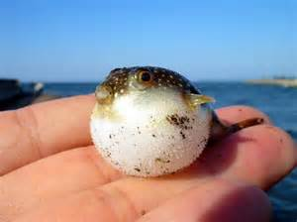
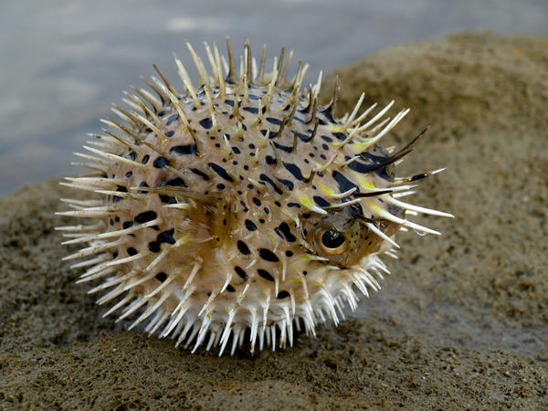
Stomach modification
For example, the stomach, not the gas bladder, is used for defense by blowfishes and porcupinefishes

Slide 9
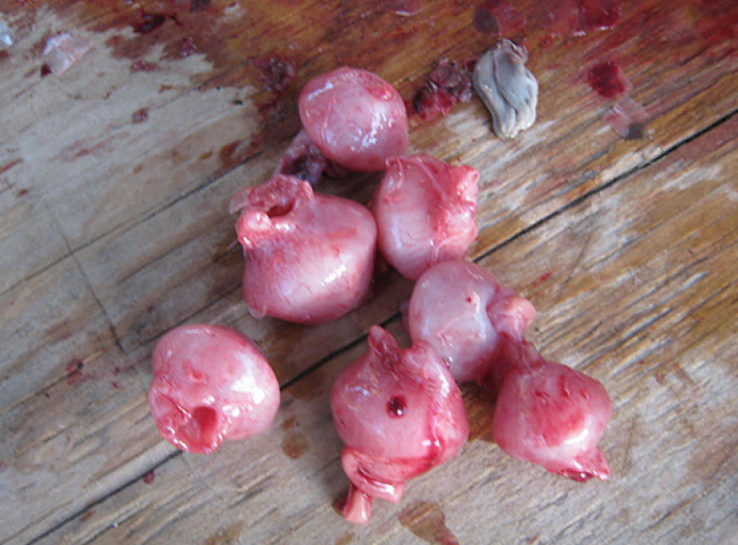
Stomach modification
The stomach is modified into a grinding organ in sturgeons (Acipenseridae), gizzard shads (Dorosoma), and mullets (Mugilidae)

Slide 10


Slide 11
The intestine
The intestine of most fishes is lined with simple columnar epithelium and goblet cells.
Usually no multicellular glands are present.
The length of the intestine varies and is generally correlated with feeding habits
The hindgut or rectum is not as well defined externally in fishes as it is in tetrapods.

Slide 12
Pyloric caeca
Pyloric caeca, fingerlike pouches that connect to the intestine near the pylorus, are often present.
may function in absorption or digestion.
They vary in number from only three in a scorpionfish (Setarches) to thousands that form a caecal mass in tunas.

Slide 13
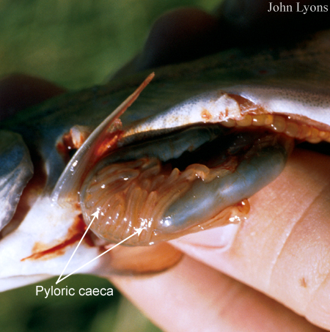
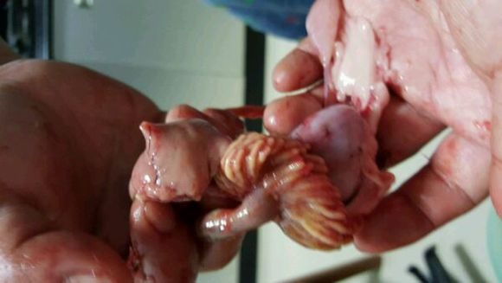
Siniperca roulei 4-9
S. obscura 9-17
S. undulata 40-88
S. chuatsi >100

Slide 14
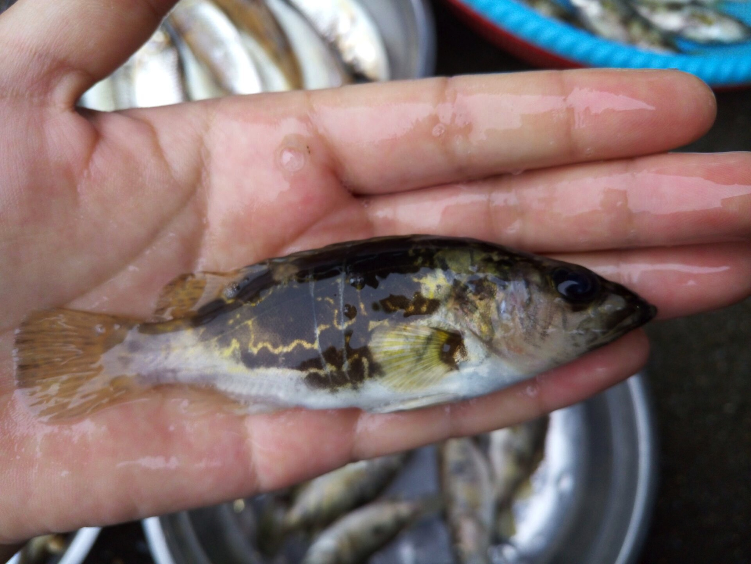
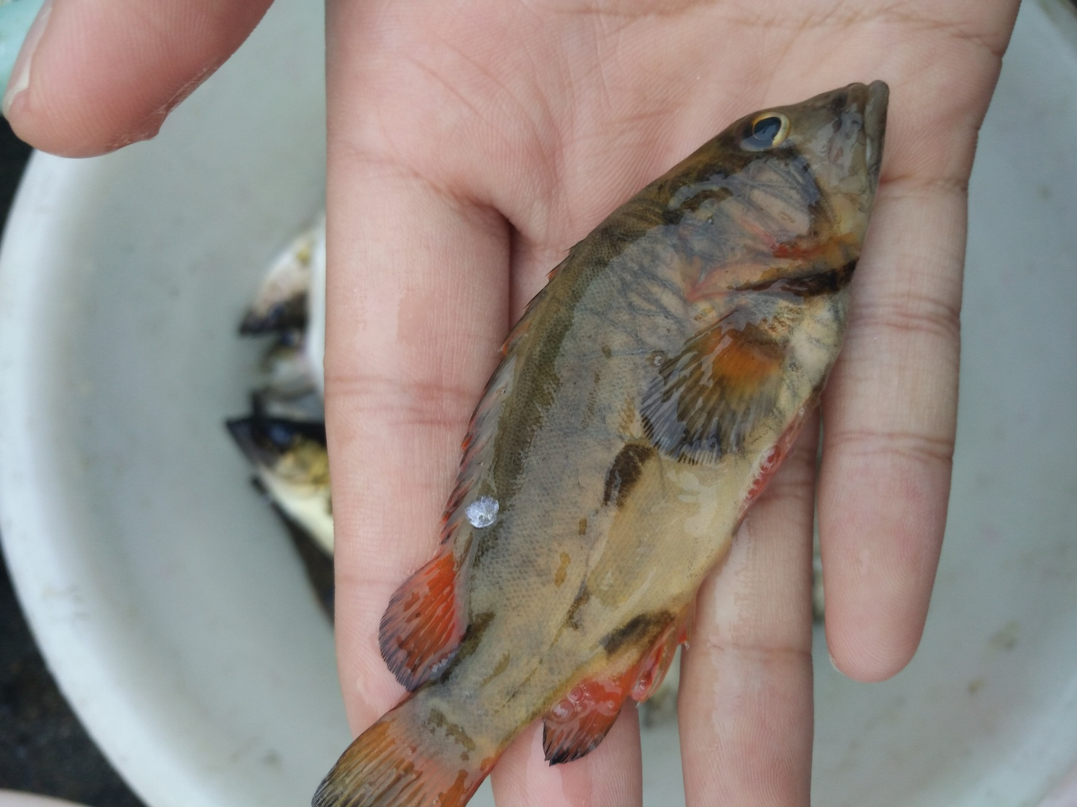
Siniperca undulata 40-88
Siniperca sp.

Slide 15
The liver and pancreas both participate in digestion.
The liver develops as a ventral evagination of the intestine, as in other vertebrates. The anterior portion develops into the liver proper, and the posterior portion into the gallbladder and bile duct. The liver also stores fat in some fishes.

Slide 16
The gallbladder is a thin-walled temporary storage organ for the bile. It empties into the intestine near the pylorus by contraction of smooth muscles.
Bile is usually green due to bile pigments (biliverdin and bilirubin) resulting from the breakdown of blood cells and hemoglobin, and also contains fat-emulsifying bile salts
which may assist in converting the acidity of the stomach to the neutral conditions in the intestine.

Slide 17
The pancreas is both an endocrine organ and an exocrine organ that produces digestive enzymes.
These enzymes include proteases such as trypsin, carbohydrases such as amylase and lipase, and, in some insectfeeding fishes, chitinase.
The pancreas is a compact, often two-lobed structure in Chondrichthyes, is distinct in softrayed teleosts, but becomes incorporated into the liver as a hepatopancreas in most spiny-rayed teleosts.

