Slide 1
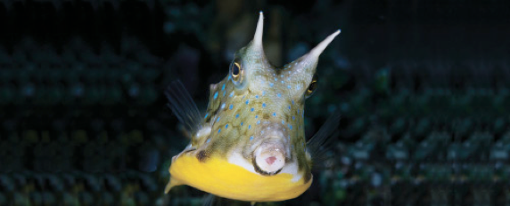
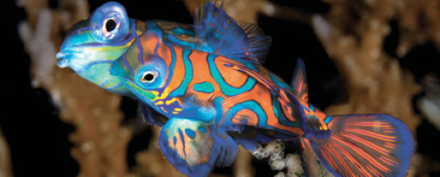
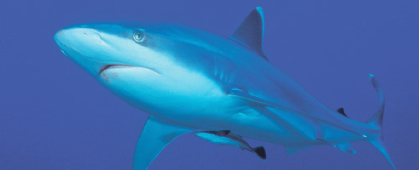
Lesson 3 Soft anatomy
Ichthyology
Shanghai Ocean University
Fall, 2022

Slide 2
Gas bladder
The gas bladder (swim bladder) is a gas-filled sac located between the alimentary canal and the kidneys
It is filled with carbon dioxide, oxygen, and nitrogen in different proportions than occur in air
The original function of the gas bladder was probably as a lung, but in most fishes today it functions mainly as a hydrostatic organ that helps control buoyancy.

Slide 3
Gas bladder
It also plays a role in respiration, sound production, and sound reception in some fishes.
Some species in at least 79 of 425 families of extant teleosts have lost their gas bladders, at least as adults
Most of these fishes are either benthic or deepsea species.

Slide 4
Gas bladder (mechanisms)
刘浩楠

Slide 5
Gas bladder
The structures and mechanisms by which gases enter and are released from the gas bladder differ in the major groups of teleosts.
The pneumatic duct is a connection between the gas bladder and the gut. Physostomous fishes retain the connection in adults, whereas physoclistous fishes lose the connection in adults
In physostomous fishes, gas can be taken in and emitted through the pneumatic duct. More primitive soft-rayed teleosts have the primitive physostomous condition; whereas more advanced spiny-rayed fishes are physoclistous, lacking a pneumatic duct

Slide 6
Gas bladder
Another, more complex mechanism, which involves two distinct regions of the gas bladder, has evolved to allow gas exchange in these fishes.
The anteroventral secretory region contains the gas gland and the rete mirabile.
The gas gland secretes lactic acid into the beginning of the capillary loop. This acidifies and reduces the solubility of all dissolved gases. A change of 1 pH unit releases 50% of the oxygen bound to hemoglobin. This raises the partial pressure of blood oxygen by the Root and Bohr effects

Slide 7
Gas bladder
The rete mirabile, or wonder net, is not actually a net but a looping bundle of arterial and venous capillaries associated with the gas gland that functions as a countercurrent multiplier.
The rete is better developed in deepdwelling fishes that have longer retial capillaries, thus providing more surface area and allowing a greater multiplying factor
Rattails (Macrouridae) and ophidioids living at abyssal depths of 4000 m and deeper have retial capillaries 25 mm in length or more; shallow water forms have retes only 1 mm long

Slide 8
Gas bladder
The posterodorsal resorptive region of the gas bladder is called the oval. It develops from the distal end of the degenerating pneumatic duct and consists of a thin, highly vascularized area.
Circular muscles contract and close off the oval, preventing outflow of gases. Longitudinal muscles contract and expose the oval, permitting gas escape. The walls of the gas bladder are lined with a layer of cells containing crystals of guanine 3 μm thick, which decreases permeability by 40 times over an unlined membrane and thus limits gas escape except at the oval, when it is open.

Slide 9
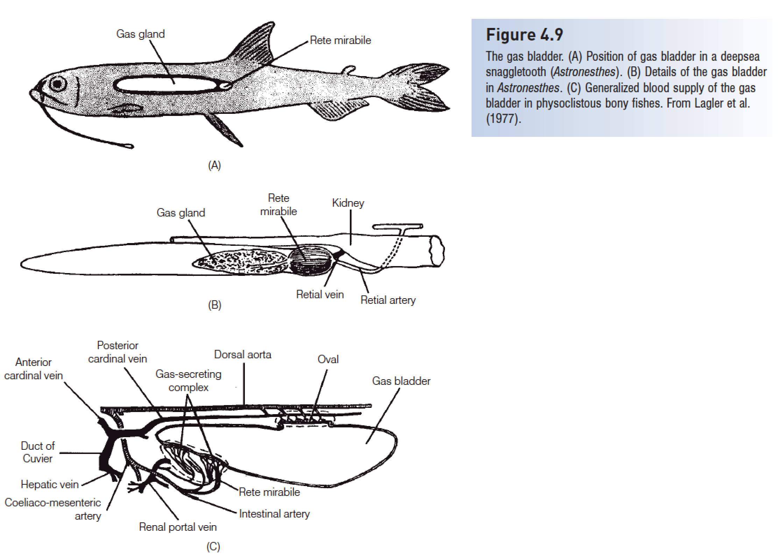

Slide 10
Kidneys
The kidneys are paired longitudinal structures located retroperitoneally (outside of the peritoneal cavity), ventral to the vertebral column.
Left and right kidneys frequently join together to form soft black material under the vertebrae from the back of the skull to the end of the body cavity.
The kidneys are one of the primary organs involved in excretion and osmoregulation

Slide 11
Kidneys
Three kinds of kidneys are present in vertebrates: pronephros, mesonephros, and metanephros.
A pronephros is present in larval fishes,
a mesonephros is the functional kidney in Actinopterygii, and
the metanephros is the kidney present in tetrapods.

Slide 12
Kidneys
The pronephros has nephrostomes, anterior funnels that empty into the body cavity by way of pronephric tubules.
The mesonephros is a more complex kidney that does not have funnels emptying into the body cavity. The mesonephros consists of a number of renal corpuscles, each composed of a glomerulus surrounded by a Bowman’s capsule. The glomerulus receives blood from an afferent arteriole from the dorsal aorta.
The glomerulus acts as an ultrafilter to remove water, salts, sugars, and nitrogenous wastes from the blood.
The filtrate is collected in Bowman’s capsule and then passes along a mesonephric tubule where water, sugars, and other solutes are selectively resorbed.

Slide 13
Kidneys
Marine and freshwater fishes differ considerably in kidney structure, reflecting the different problems faced by animals living in solutions of very different solute concentrations
Freshwater fishes have larger kidneys with more and larger glomeruli, up to 10,000 per kidney and measuring 48–104 μm across (mean of several freshwater species = 71 μm). The glomeruli of marine fishes are only 27–94 μm across

Slide 14
Urine
Urine contains water plus creatine, creatinine, urea, ammonia, and other nitrogenous waste products. Only 3–50% of the nitrogenous wastes are excreted through the urine, and much of this is as ammonia;
most of the rest is excreted as ammonia at the gills during respiration.

Slide 15
Urine
Freshwater fishes produce copious amounts of highly dilute urine to avoid “waterlogging” by the large amount of water diffusing in through all semipermeable membranes (see Fig. 7.3).
Marine fishes drink sea water to correct dehydration and excrete a low volume of highly concentrated urine.
Most nitrogenous wastes are excreted extrarenally through the gills.

Slide 16
Gonads
As in tetrapods, the sexes in fishes are usually separate (dioecious), with males having testes that produce sperm, and females having ovaries that produce eggs.
“Fishes as a group exemplify almost every device known among sexually reproducing animals; indeed, they display some variations which may be unique in the animal kingdom”

Slide 17
Testes
The testes are internal, longitudinal, and usually paired.
They are suspended by lengthwise mesenteries known as mesorchia.
The testes lie lateral to the gas bladder when one is present. Kidney tubules and ducts serve variously among different groups of fishes to conduct sperm

Slide 18
Testes
Hagfishes and lampreys have a single testis.
Among Chondrichthyes, internal fertilization is universal, males using modified pelvic fins, termed claspers, to inseminate females.

Slide 19
Ovaries
The ovaries are internal, usually longitudinal, and primitively paired but are often variously fused and shortened.
Sometimes only one ovary is present in adults, as in some needlefishes (Belonidae).
The ovaries are suspended by a pair of lengthwise mesenteries, the mesovaria. The ovaries are typically ventral to the gas bladder.

Slide 20
Ovaries
The anterior part of the oviduct is specialized to form a nidamental or shell gland where fertilization takes place.
The nidamental gland secretes a membrane around the fertilized egg. In oviparous (egg-laying) taxa, the membrane is horny, composed of keratin.
The nidamental gland may function as a seminal receptacle where sperm are nourished before fertilization.
In viviparous (live-bearing) species, the posterior part of the oviduct is modified to form a uterus, which houses the developing embryo.

Slide 21
Summary
1 Fishes have three kinds of muscles (skeletal, smooth, and cardiac, or heart, muscle) and have relatively more skeletal muscle than do other vertebrates.
2 In the locomotory system, white muscle forms most of the postcranial body and is used anaerobically for burst swimming but fatigues quickly. Red muscle usually forms thin, lateral, superficial sheets under the skin; it is used in sustained swimming and fatigues slowly.
3 The basic pattern of the cardiovascular system is a single-pump, single-circuit system that goes from the heart to gills to body and back to the heart. Many fishes have a pseudobranch, a small structure under the operculum composed of gill-like filaments that may provide oxygenated blood to the visual system.

Slide 22
Summary
4 The anterior region of the alimentary tract consists of the buccal cavity (mouth) and the pharynx. The posterior region consists of the foregut (esophagus and stomach), midgut or intestine, and hindgut (rectum). Alimentary tract length and structure differ as a function of feeding habits.
5 The gas or swim bladder is a gas-filled sac located between the alimentary canal and the kidneys. It develops from the roof of the foregut. A pneumatic duct connects the gas bladder and the gut in primitive teleosts (physostomous condition). Physostomous fishes can take gas in and emit it through the mouth and pneumatic duct. Advanced teleosts are physoclistous, losing the connection in adults. Physoclistous fishes have a secretory region containing a gas gland and a rete mirabile to produce gas, and an oval where gas is resorbed.

Slide 23
Summary
6 Kidneys, paired longitudinal structures ventral to the vertebral column, are one of the primary organs involved in excretion and osmoregulation. A pronephros is present in hagfishes and larval fishes, whereas a mesonephros is the functional kidney in Actinopterygii.
7 The sexes in fishes are usually separate, and the gonads are usually paired. Males have testes that produce sperm, and females have ovaries that produce eggs. In Chondrichthyes and primitive osteichthyans, eggs are shed into the body cavity – the gymnovarian condition. In gars and most teleosts, the lumen of the hollow ovary is continuous with the oviduct – the cystovarian condition.

