Slide 1
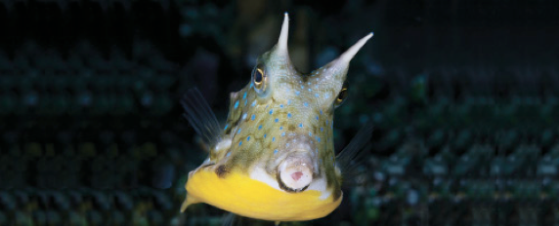
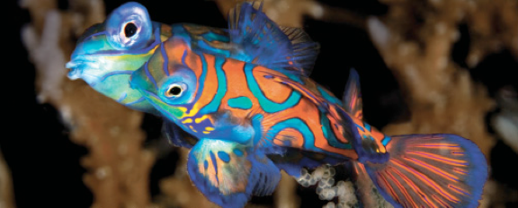
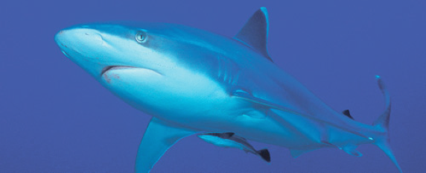
Lesson 3
Soft anatomy
Ichthyology
Shanghai Ocean University
Fall, 2022

Slide 2
Nervous system
The nervous system can be divided into the cerebrospinal and autonomic systems.
The cerebrospinal system is composed of the central nervous system and the peripheral nervous system.
The central nervous system is further subdivided into the brain and the spinal cord (Healey 1957; Bernstein 1970; Northcutt & Davis 1983).

Slide 3
Nervous system
The peripheral system is composed of the cranial and spinal nerves and the associated sense organs (vision, smell, hearing, lateralis system, touch, taste, and electrical and temperature detection; see Chapter 6).
The autonomic nervous system is composed of sympathetic and parasympathetic ganglia and fibers.

Slide 4
Fish brain
Fish brains are on average only 1/15 the size of the brain of a bird or mammal of equal body size.
Sharks have much larger brains relative to body size than teleosts and pelagic sharks have larger brains than pelagic teleosts (Linsey & Collins 2006).
In pickerels (Esox), the brain is only 1/1305 of body weight. Elephantfishes (Mormyridae) have the largest brains among fishes, 1/52 to 1/82 of body weight.

Slide 5
Five parts of fish brain
孙立

Slide 6
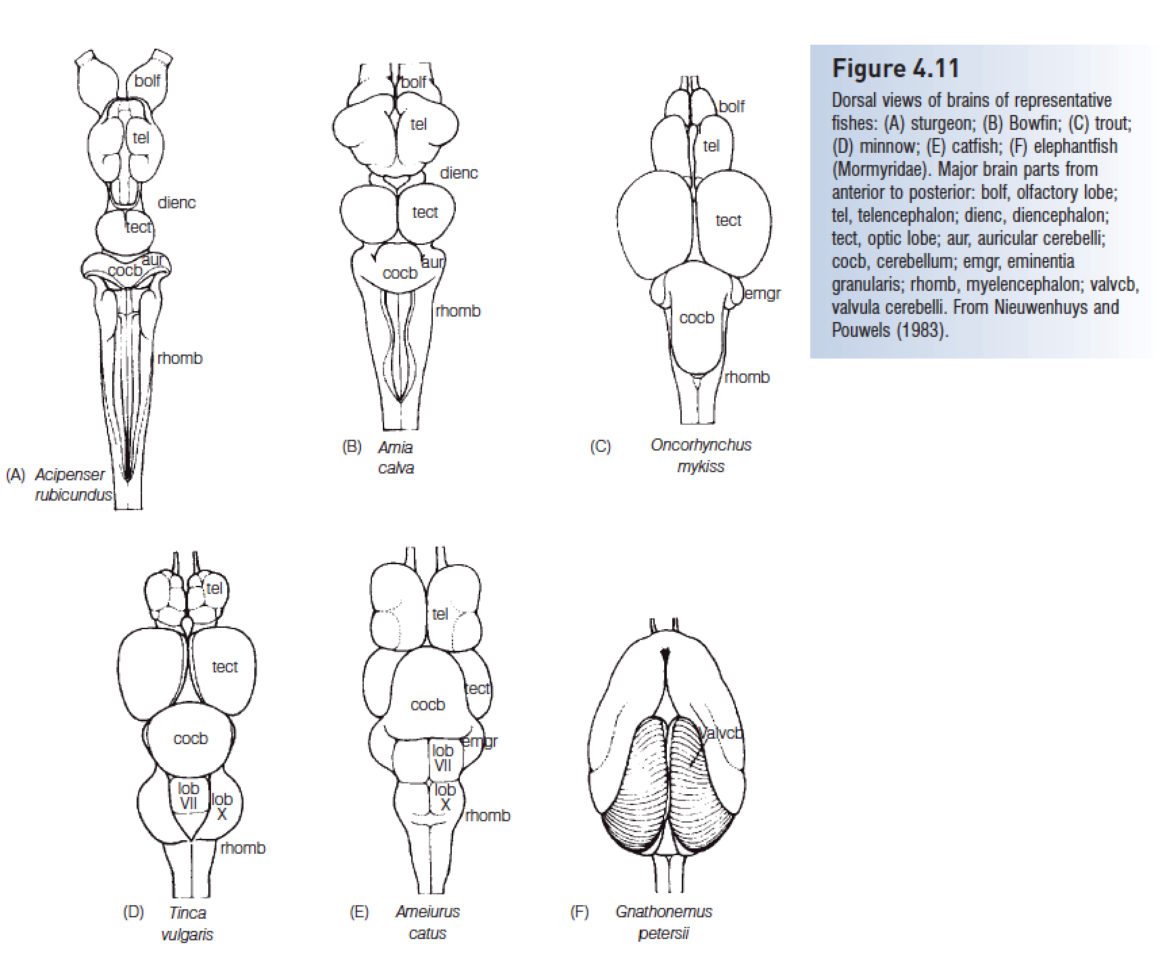
The brain can be divided into fi ve parts from anterior to posterior (Fig. 4.11).

Slide 7
Five parts of fish brain
The most anterior part is the telencephalon, or forebrain, which becomes the cerebrum of tetrapods. Its function in fishes is primarily associated with reception and passage of olfactory stimuli.

Slide 8
Five parts of fish brain
The diencephalon, or ‘tween brain, lies between the forebrain and the midbrain and is also known as the saccus dorsalis. It functions as a correlation center for incoming and outgoing messages regarding homeostasis and the endocrine system.

Slide 9
Five parts of fish brain
The mesencephalon, or midbrain, is important in vision. The optic nerve (cranial nerve II) brings impulses from the eyes and enters the brain here.
The midbrain is also a correlation center for messages coming from other sensory receptors. Fishes have two optic lobes, which are relatively large in sight-feeding species such as trouts and minnows

Slide 10
Five parts of fish brain
The metencephalon, or hindbrain, functions in maintaining muscular tone and equilibrium in swimming. The cerebellum, a large single lobe, is the largest component of the fish brain.
Cranial nerve IV (trochlear) runs from the metencephalon to the eye muscles. The metencephalon is small in lampreys (Petromyzontidae) and almost absent in hagfishes (Myxinidae).
In elephantfishes (Mormyridae), the cerebellum is hypertrophied to form the valvula cerebelli (Fig. 4.11F), which extend over the dorsal surface of the telencephalon. This large cerebellum is related to reception of electrical impulses.

Slide 11
Five parts of fish brain
The myelencephalon, brainstem, or medulla oblongata is the posterior portion of the brain and the enlarged anterior part of the spinal cord. Cranial nerves V through X arise here.
The myelencephalon serves as the relay station for all the sensory systems except smell (cranial nerve I) and sight (cranial nerve II). It contains centers that control certain somatic and visceral functions.
In bony fishes, it also contains respiratory and osmoregulatory centers

Slide 12
Peripheral nervous system
Cranial nerveI, the olfactory nerve, is a sensory nerve that runs from the olfactory bulb to the olfactory lobes.
The optic nerve (cranial nerve II) runs from the retina to the optic lobes.
As in other vertebrates, cranial nerves III (oculomotor), IV (trochlear), and VI (abducens) are somatic motor nerves that innervate the six striated muscles of the eye: IV, the superior oblique; VI, the external rectus; and III, the other four eye muscles.

Slide 13
Peripheral nervous system
Unlike in most other vertebrates, four cranial nerves (VII through X) innervate parts of the lateral line system. The trigeminal, V, is a mixed somatic sensory and motor nerve serving the anterior portion of the head.
Cranial nerve VII, the facial, and VIII, the acoustic, usually join to form the acousticofacialis nerve, which then subdivides into four groups of mixed nerves serving the temporal and branchial regions of the head.

Slide 14
Peripheral nervous system
Patterns of nerves, such as that of the ramus lateralis accessorius of the facial nerve (which innervates taste buds on the posterior head and body), have proved to be useful in assessing relationships of teleosts (Freihofer 1963).
The glossopharyngeal, IX, is a mixed nerve that supplies the gill region. It often fuses with cranial nerve X, the anterior ramus of the vagus. The vagus is a mixed nerve connected to the body lateral line and viscera.

Slide 15
Summary
The fish brain can be divided into five parts, from anterior to posterior: (i) the telencephalon, or forebrain, primarily associated with smell; (ii) the diencephalon, a correlation center for messages regarding homeostasis and the endocrine system; (iii) the mesencephalon, or midbrain, important in vision; (iv) the metencephalon, or hindbrain, which maintains muscle tone and equilibrium in swimming and has a large median lobe (cerebellum), which is the largest component of the fish brain; and (v) the myelencephalon, brainstem, or medulla oblongata, the posterior portion of the brain and enlarged anterior portion of the spinal cord that relays input for all sensory systems except smell and sight.
Fishes have small brains but sharks have larger brains than teleosts. The largest brains occur in elephant fishes (Mormyridae), which have a large proportion of their brain devoted to electroreception.

Slide 16
HWK
Homework 3.docx
  due on Oct 9
  No late hand-in will be graded
Read Chapter 6

Slide 17
Presentation for next week
(Oct 9)
吴天琪
  Explain what are tuberous receptors, and how do they work
陈子涵
  Describe the three types of photoreceptive glycoprotein (opsin) and their difference
杨任华
  Name two types of vision related structural adaptation

Slide 18
Presentation for next week
Sent me your ppt on Sunday (Oct 9).
Talk for 7 -10min

Slide 19
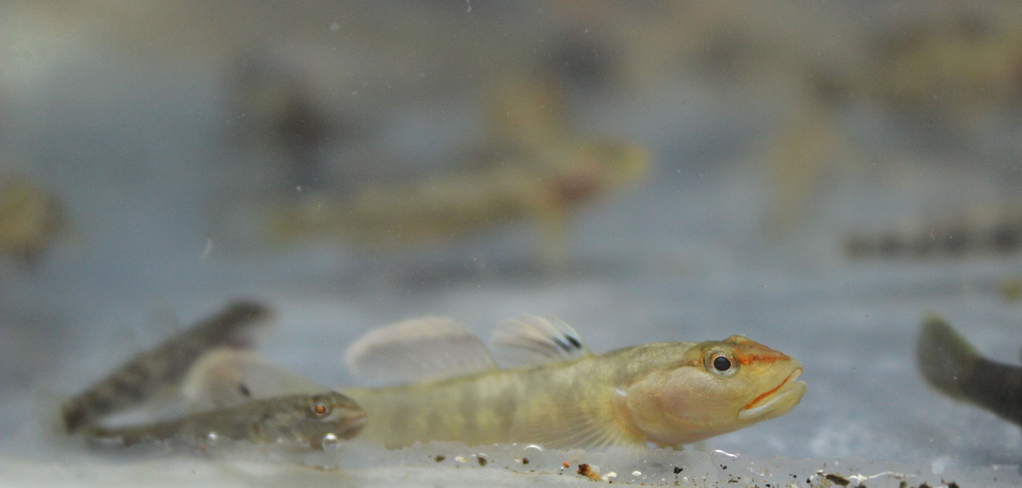
Have a nice week!
萧氏吻虾虎鱼（Rhinogobius xiaoi）广东揭东

