Slide 1
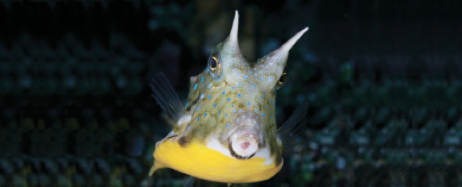
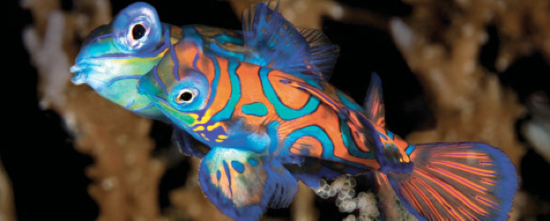
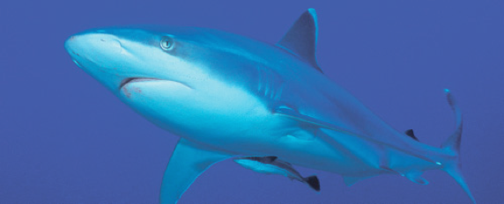
Lesson 6 Homeostasis
Ichthyology
Shanghai Ocean University
Fall, 2022

Slide 2
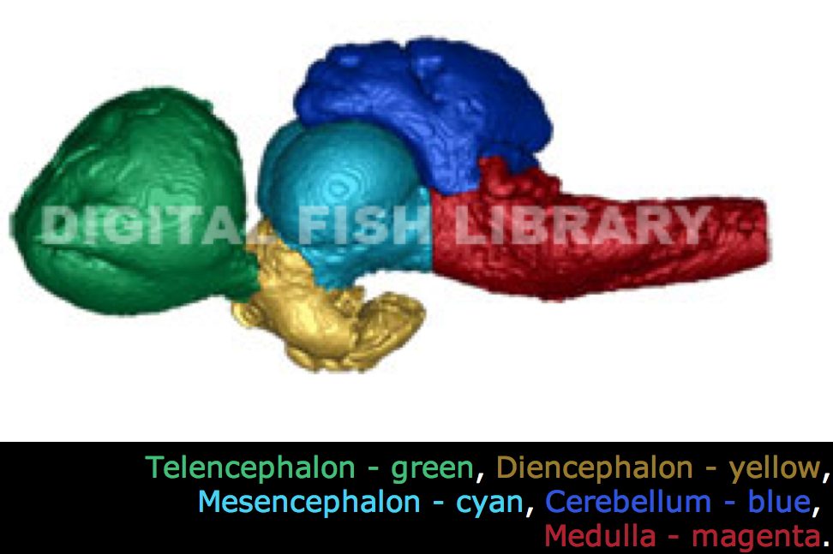
Coordination and control of regulation
Nervous systems
Direct, fast
Endocrine systems
Through hormones, slower
The nervous and endocrine systems can not be separated

Slide 3
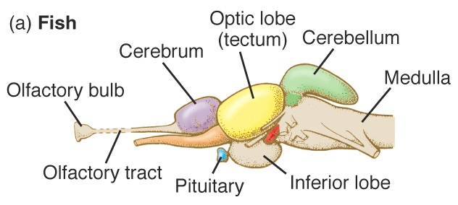
Fish brain
Hypothalamus - pituitary

Slide 4
The endocrine system
Many endocrine functions are ultimately controlled by the hypothalamus of the brain regulating the many functions of the pituitary which, in turn, helps regulate many other endocrine tissues in the body.
The pituitary has two main functional regions.
The posterior pituitary, or neurohypophysis, is continuous with the hypothalamus and consists primarily of the axons and terminals of neurons that originate in the hypothalamus.
The anterior pituitary, or adenophypophysis, lies in contact with the posterior pituitary, and in the actinopterygians the tissues fuse.

Slide 5
The pituitary
Neuroendocrine cells (neurons that function as endocrine cells) begin in the hypothalamus and extend into the posterior pituitary
Neurohypophysis where they release their chemicals, some of which are hormones that are released into blood vessels and trigger effects elsewhere in the body.
The hypothalamus controls the anterior pituitary (adenophypophysis) by releasing hormones delivered via blood vessels in some fishes, such as chondrichthyans, or by direct innervation as seen in some actinopterygians.

Slide 6
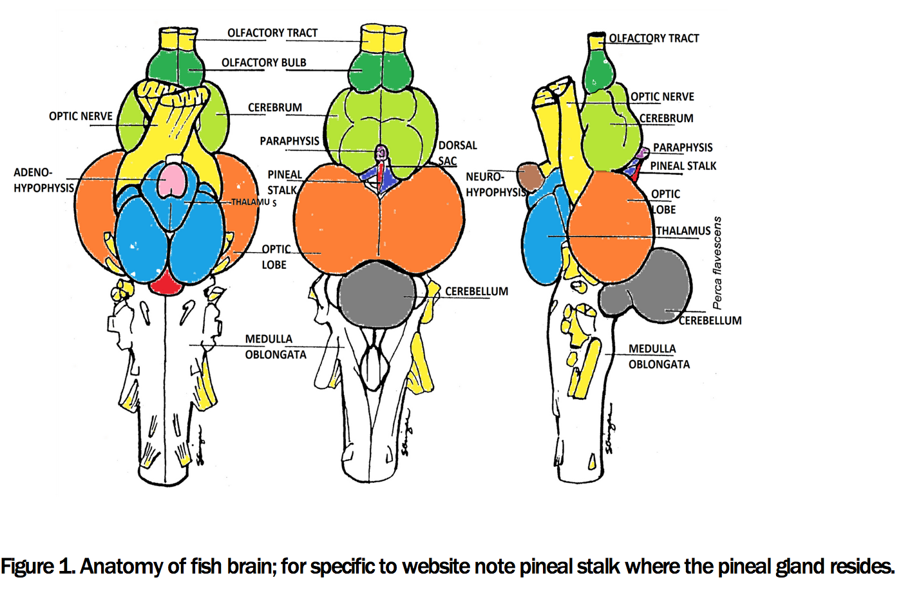
Cavefish brain

Slide 7
Pituitary hormones
The posterior pituitary
Vasopressin (also called arginine vasotocin), for example, plays an important role in osmoregulation (Takei & Loretz 2006).
Other chemicals regulate the function of cells of the adjacent anterior pituitary and intermediate lobe, and are sometimes referred to as releasing factors or releasing hormones.
The anterior pituitary, releases hormones that control elsewhere in the body, other endocrine tissues.
adrenocorticotropic hormone (ACTH), influences the production and release of cortisol from the interrenal tissue
thyroid-stimulating hormone (TSH), which stimulates the thyroid gland to release thyroxin
gonadotropins (which stimulate the gonads)
growth hormone (GH) which affects various tissues throughout the body

Slide 8
Urophysis
Fishes are the only jawed vertebrates known to possess a caudal neurosecretory system.
Located at the caudal end of the spinal cord, this region of neuroendocrine cells, the urophysis, is most highly developed in the ray-finned fishes
produces urotensins that help control smooth muscle contraction, osmoregulation, and the release of pituitary hormones

Slide 9
The endocrine system
The thyroid tissue of most fishes is scattered as small clusters of cells in the connective tissue of the throat region, as opposed to the rather discrete gland found in tetrapods.
When stimulated by TSH from the anterior pituitary, these cells produce thyroxin

Slide 10
刘方幸妍
Describe what does thyroxin do and give two examples in different species

Slide 11
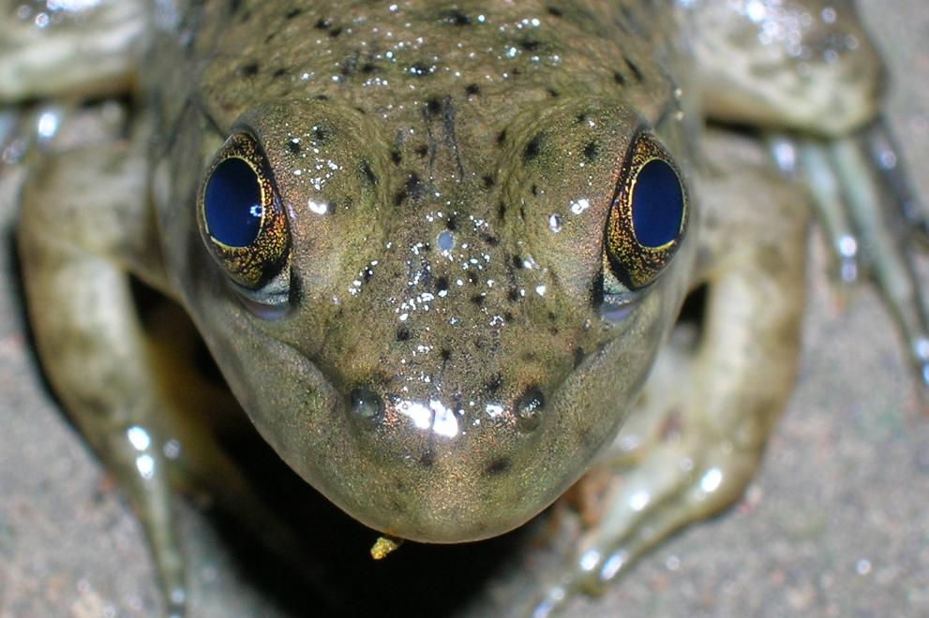
The pineal gland
near the top of the brain, produce melatonin regulate fish responses to daily and annual cycles of daylight (circadian rhythm).

Slide 12
Calcium balance
Maintaining proper, including regulating calcium uptake at the gills, involves several hormones, including stanniocalcin from the corpuscles of Stannius embedded in the kidney,
calcitonin produced by the ultimobranchial bodies in the back of the pharynx,
and prolactin and somatolactin from the anterior pituitary

Slide 13
Glucose metabolism
Glucose metabolism is influenced by insulin, glucagon, and somatostatin from cells within the pancreas.
Insulin enhances the transport of glucose out of the blood, promotes glucose uptake by liver and muscle cells.
Glucagon and related glucagon-like proteins seem to function in opposition to insulin, increasing blood glucose levels.
Somatostatin also helps elevate blood glucose levels by promoting metabolism of glycogen and lipids, and by inhibiting the release of insulin

Slide 14
A briefly summary
The endocrine system regulates most physiological systems associated with maintaining homeostasis.
Hormones also can have a large impact on other aspects of fish biology, including sexual development and reproductive behavior, which ultimately impact the stability of fish populations and aquatic communities.
This is one reason that there has been a growing concern over human-generated endocrine disrupting compounds and their effects on development and fish population stability

Slide 15
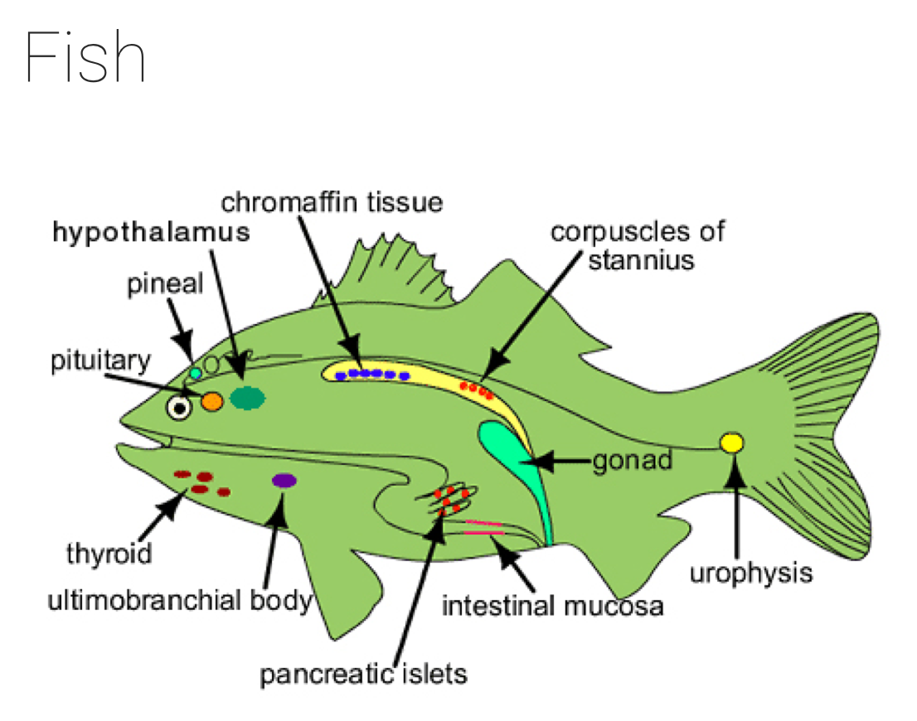

Slide 16
Chromaffin tissue of fishes
Contain adrenaline and noradrenaline. Injection of adrenaline and noradrenaline causes changes in blood pressure, bradycardia, branchial vasodilation, diuresis in glomerular teleosts and hyperventilation.
Intestinal mucosa:
The intestinal mucosa produces secretin and pancreozymin, which are controlled by nervous system and regulate pancreatic secretion.

