Slide 1
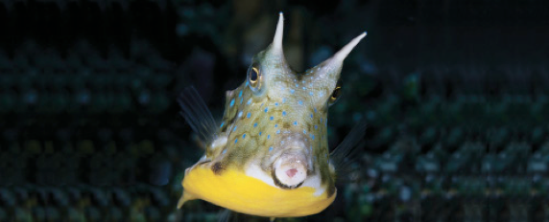
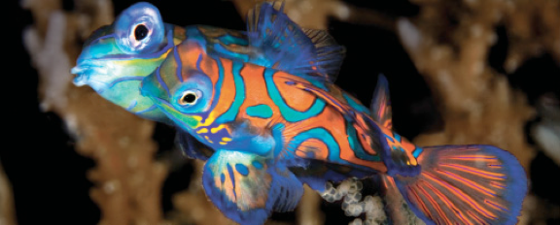
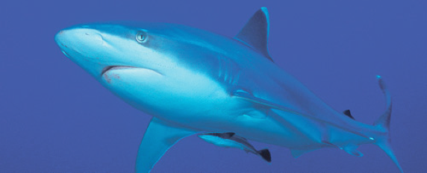
Lesson 6
Homeostasis
Ichthyology
Shanghai Ocean University
Fall, 2022

Slide 2
The autonomic nervous system
Involuntary physiological functions, such as control of internal organ function, are at least in part controlled by the autonomic nervous system or ANS
Neural signals from the central nervous system (brain and spinal cord) travel to ganglia of the ANS that are located either along the spinal cord or near or within the target organs. Signals then travel from these ganglia to the target tissues.
The ANS often works together with the endocrine system to control involuntary physiological functions such as heart rate, blood pressure, blood flow through the gills, and many functions of the gastrointestinal system that are important to digestion and nutrition.

Slide 3
The autonomic nervous system
The ANS also controls gas bladder volume, and therefore fish buoyancy, by regulating the absorption and secretion of gases and blood flow to various parts of the gas bladder
The dispersion and aggregation of pigment in melanophores is also partly controlled by the ANS, along with melanophore-stimulating hormone from the anterior pituitary

Slide 4
Temperature relationships
Most fishes are ectothermic because they lack any mechanism for heat production and retention. In addition, when blood flows through the gills it becomes the same temperature as the surrounding water due to the thin gill membranes
interesting exceptions of heat production or conservation in some fishes, a condition often referred to as either heterothermy or regional endothermy

Slide 5
Thermal Regulation
Can fish maintain body temperature?
Yes, to a certain degree.
Both physiological and behavioral mechanisms exist.
Why regulate body temperature?

Slide 6
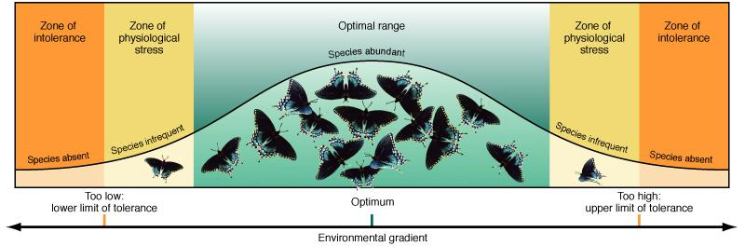
Thermal Regulation
Why regulate body temperature?
Answer = optimum growth, feeding, physiological function, etc.
Too low
Optimum Temperature
Too high

Slide 7
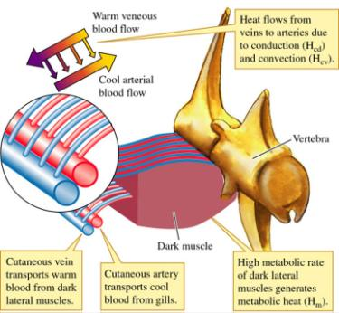
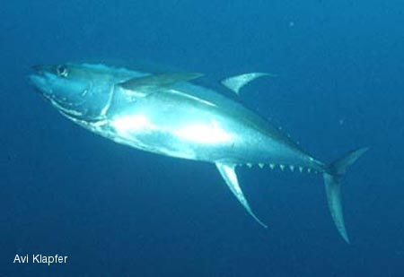
Thermoregulation by tunas
Large Swimming Muscles
  Equipped with blood vessels that function as countercurrent heat-exchangers.
    Keep body temperature above that of surrounding water.

Slide 8
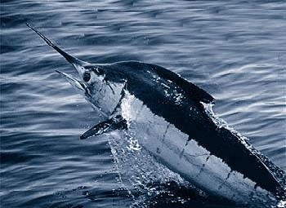
Thermoregulation
or ocular muscles that have become modified into “heater organs”. In all cases the heat is retained by a rete – a modification of the circulatory system that forms a countercurrent exchange mechanism. In Swordfish (Xiphiidae) and marlins (Istiophoridae) the superior rectus eye muscle, and in the Butterfly Mackerel (Scombridae) the lateral rectus eye muscle, have lost the ability to contract and instead produce heat when stimulated by the nervous system.

Slide 9
Temperature adaptation
Many physiological adjustments are the result of switching on or off genes that are responsible for the manufacture of particular proteins.
For example, acute heat stress initiates the synthesis of stress proteins, also known as heat shock proteins or HSPs, which maintain the structural integrity of proteins that otherwise would become denatured at higher temperatures, thereby allowing them to function biochemically

Slide 10
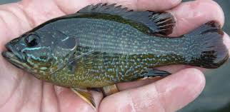
Temperature adaptation
To compensate for the decreased rate of biochemical reactions at low temperatures, fishes may increase the concentration of intracellular enzymes by altering the rate of enzyme synthesis, degradation, or both. Increased cytochrome c concentration in Green Sunfish (Centrarchidae) that were moved from 25 to 5°C is due to a greater reduction in the degradation rate than in the rate of synthesis

Slide 11
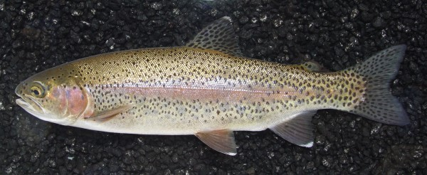
Temperature adaptation
In some fishes alternative enzymes (termed isozymes) may be produced to catalyze the same reaction more efficiently at different temperatures. Isozymes are regulated by switching on or off the different genes that control their production. Rainbow Trout (Salmonidae) acclimated to 2 versus 18°C exhibit different forms of acetylcholinesterase, an enzyme important to proper nerve function because it breaks down the neurotransmitter acetylcholine

Slide 12
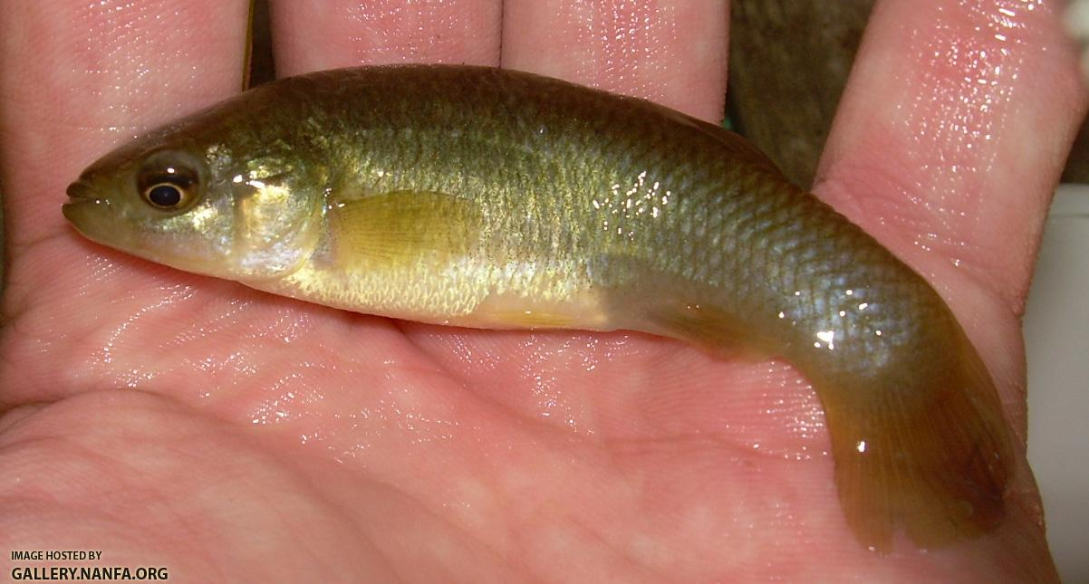
Temperature relationships
Mummichog (Cyprinodontidae) along the east coast of the United States exhibit two allozymes of lactate dehydrogenase, an important enzyme in carbohydrate metabolism. In Maine, the frequency of the allele for the form more effective at colder temperatures is nearly 100%, and the frequency decreases progressively in populations further to the south (Place & Powers 1979). In Florida, the alternative allele, which codes for the form more effective at higher temperatures, has a frequency approaching 100%.

Slide 13
High temperature
may cause structural degradation (denaturation), resulting in partial or complete loss of function.
Decreased oxygen availability due to limited gas solubility.
When combined with elevated oxygen demand due to increased metabolic rate and a temperature-induced Bohr effect that interferes with hemoglobin function

Slide 14
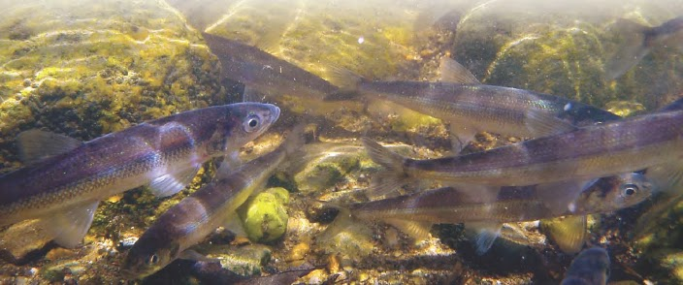
low temperature
Probably the greatest potential danger at very low temperatures is intracellular formation of ice crystals which can puncture cell membranes and organelles, leading to cell death.
Glycoproteins, can bring the freezing point of some Antarctic fishes, well below the freezing point, function by adhering to small ice crystals as they begin to form preventing growth of the seed crystal.
Rainbow Smelt produce glycerol to increase the osmotic concentration of the blood and intracellular fluids, thereby further decreasing the freezing point

Slide 15
Osmoregulation
One of the most important homeostatic functions of living organisms is proper regulation of the internal osmotic environment. Deviation from the normal range can jeopardize proper physiological function through water loss or gain
Fishes that can tolerate only small changes in the solute concentration of their external environment are referred to as stenohaline, whereas those with the ability to osmoregulate over a wide range of environmental salinities are euryhaline.

Slide 16
Osmoregulation in different types of fishes
王雷
  Explain osmoregulation in elasmobranchs, freshwater and marine teleosts.

Slide 17
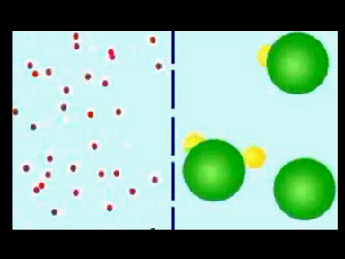
Osmoregulation – maintaining internal salt/water balance
Again, optimum functionality!
Why is it such a challenge?
Osmosis – free movement of water from high to low concentrations.
Notes:
Osmosis is the movement of water across a selectively permeable membrane from an area of high concentration of free water to an area of free water to an area of lower concentration of free water. It is affected by solute concentrations. For instance, think of the various salts and trace elements in seawater as being the green and yellow substances on the right side of the image here. Simply put, more free water molecules are free to strike the pores on the left side, and when they do, many will diffuse through. Free water molecules will continue to move across the membrane in both directions, indefinitely. At some point, an equilibrium will be reached, such that an equal concentration of free water will occur on both sides and the moevement between the sides will be equal.
Think of animal cells, though. They have structural limitations. If the internal concentration of water in a cell is less than that of the surrounding water, water will continue to move in and could burst the cells if an equilibrium isn’t reached. This would be like throwing a marine organism into fresh water. Conversely, if an organism has a higher internal concentration of water than the surrounding medium, then water will flow out of the cells and they will essentially shrivel up (i.e., dehydrate). At the extreme, this is called crenation and will destroy the cells. Imagine putting a strictly freshwater fish into highly concentrated saltwater. It probably wouldn’t last very long.
If the fluids in a cell become too concentrated or too dilute, important biochemical functions may be severely disrupted, leading to death of the organism.
How do fishes deal with these challenges???

Slide 18
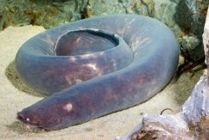
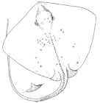
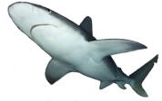

Strategies for ionic regulation
Osmoconformers – same natural internal salt concentration as seawater
Osmoregulators – regulate internal salt concentration
  Isosmotic – actively maintain same concentration as seawater
Elasmobranchs – sharks, skates, and rays
Notes:
Hagfishes are the only vertebrates that have a ‘natural’ internal salt (ion) concentration similar to that of seawater; therefore, they are osmoconformers – they don’t have to “do” anything to osmoregulate, at least not nearly to the degree that other fishes do.
Elasmobranchs are the first type of osmoregulators. They maintain an internal salt concentration equal to that of seawater, but in order to do so, they have to hold onto organic salts: urea and trimethylamine oxide (TMAO). You don’t need to remember that name… just that sharks internal salt concentration is maintained by holding onto urea and TMAO, wastes that they would normally excrete in much greater quantities. Now… I just mentioned on the previous slide that the bull shark can tolerate fresh water. In order to do so, it ramps up its excretion of urea to 20x its excretion rate in marine water.

Slide 19
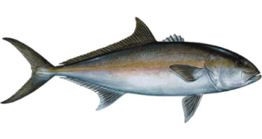
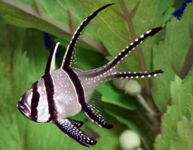
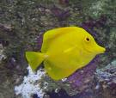
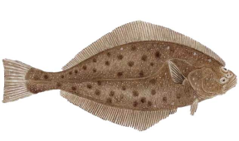
Strategies for ionic regulation
2. Osmoregulators – regulate internal salt concentration
  Hyposmotic – actively maintain lower salt concentration than surrounding water
Most marine bony fishes – maintain approximate 1/3 concentration of seawater
How?
Drink large amounts
Pump sodium and chloride ions out via gills and magnesium and sulfate ions out via kidneys

Slide 20
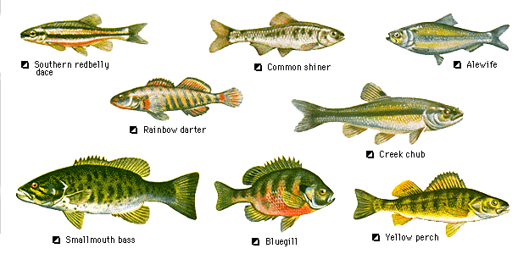
Strategies for ionic regulation
2. Osmoregulators – regulate internal salt concentration
  Hyperosmotic – actively maintain higher salt concentration than surrounding water
Freshwater teleosts (basically all ray-finned, bony fishes except sturgeons, bowfins, and gars)
How?
Constantly take on water produce a lot of urine
Do lose salts via urine, but are able to maintain higher concentration than surrounding water

