Slide 1
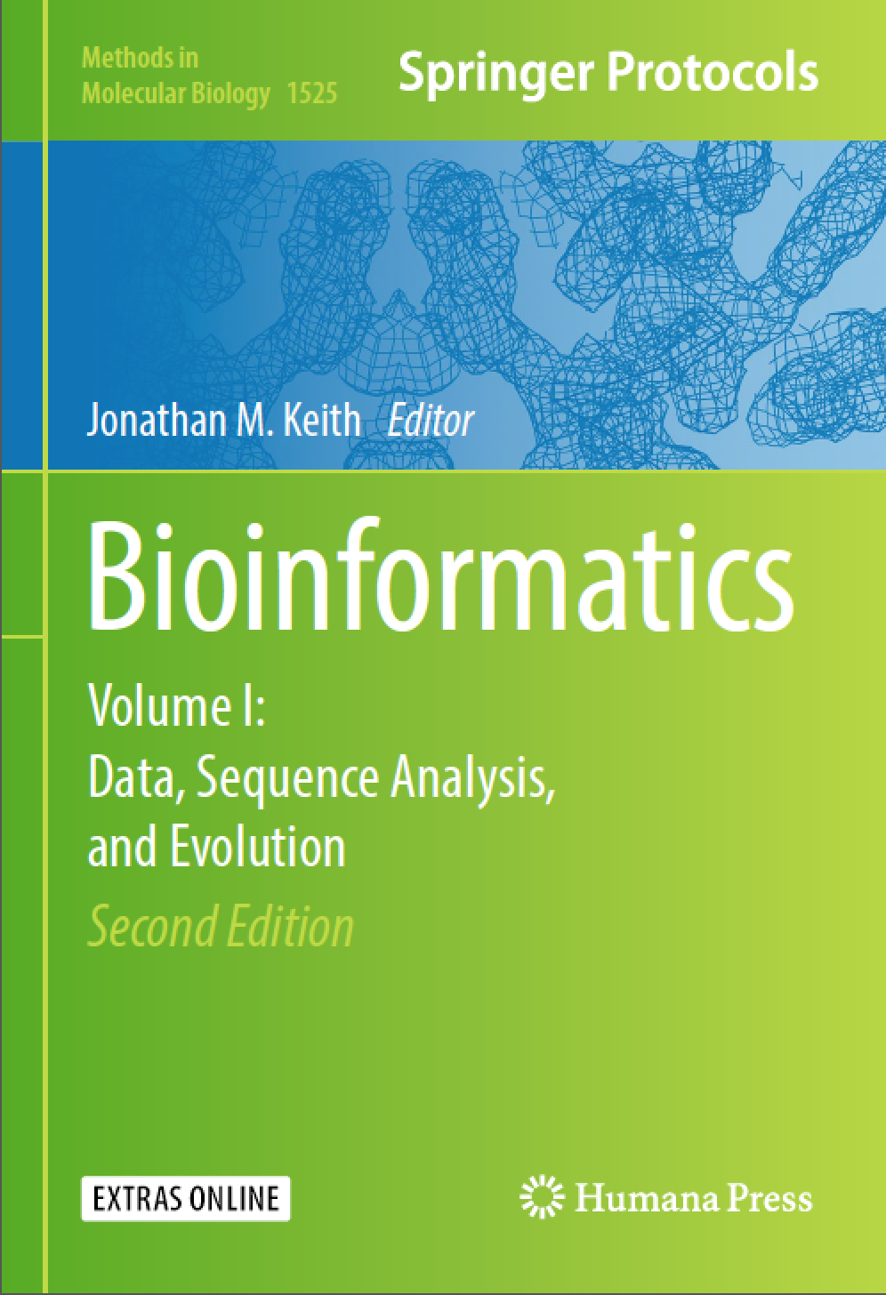
Intro to Bioinformatics
Fall 2022

Slide 2
Contact Information
Instructor: 李晨虹
Office: 水产与生命学院，A411
Email: chli@shou.edu.cn
Mobile: 15692161233

Slide 3
Course objectives:
1) To learn common tools that could be used for data interpretation.
2) To understand well-known algorithms used for solving bioinformatics problems

Slide 4
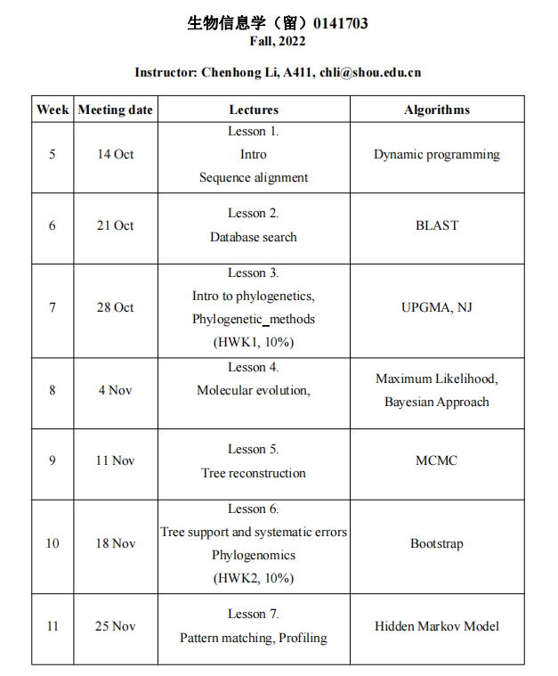

Slide 5
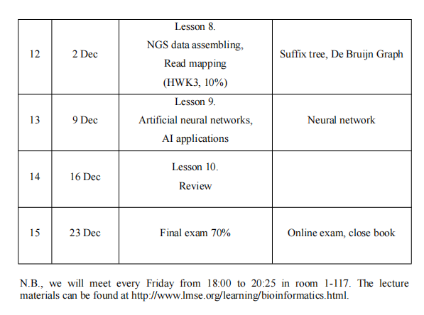

Slide 6
http://www.lmse.org/learning/bioinformatics.html
Class Schedule

Slide 7
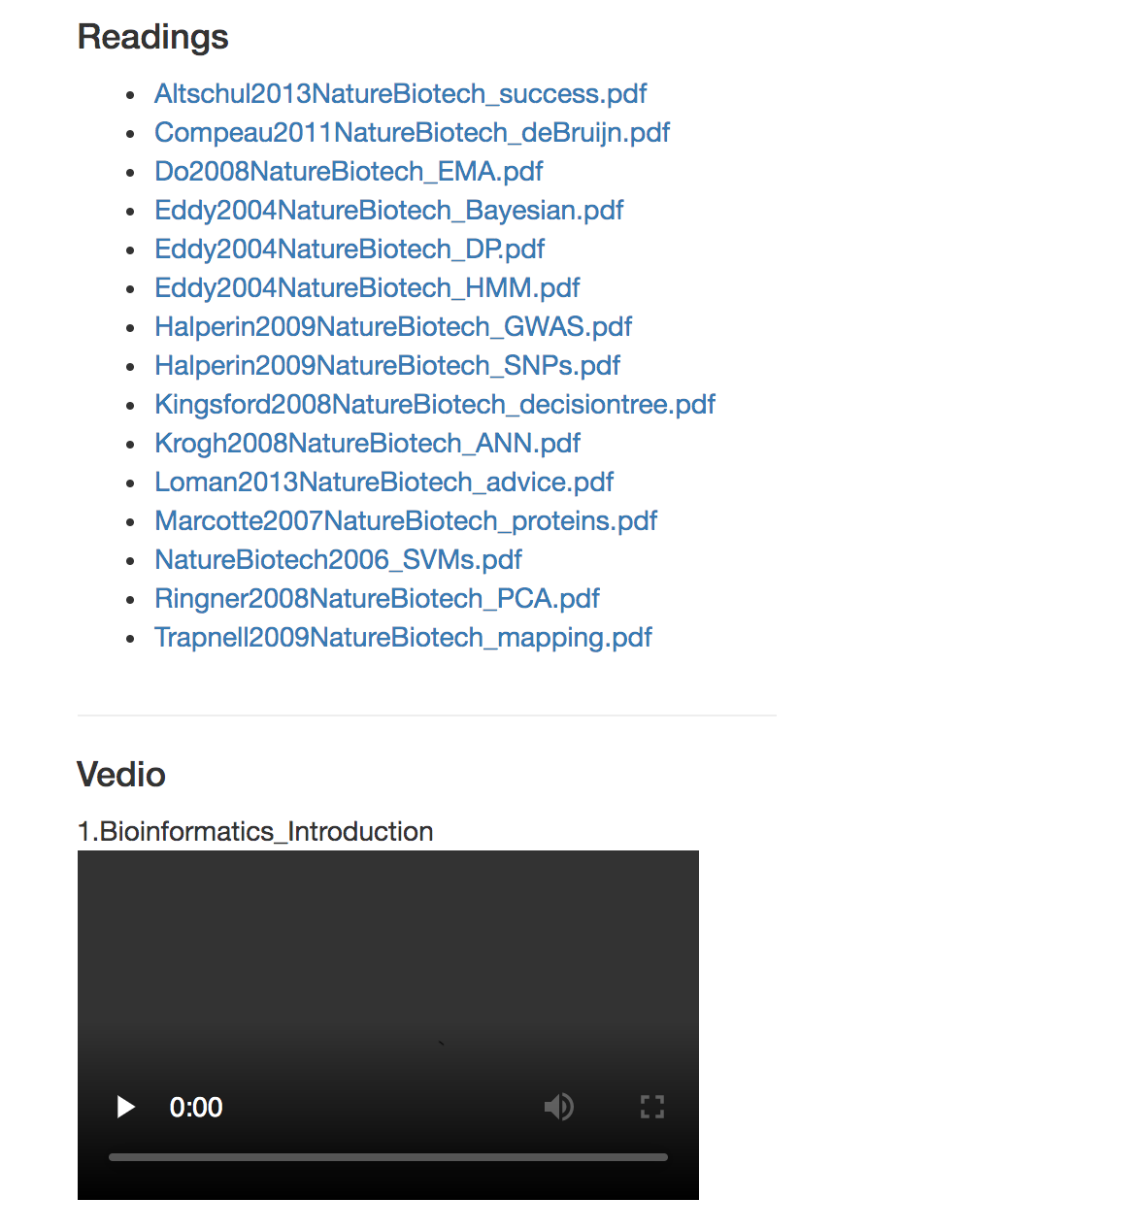

Slide 8
Grading/Evaluation
Homework: 30% total, 3 assignments 10% (each assignment). Print your copy and hand in it to me before the class (send to me through email if you are not on campus).
Final: 70% of grade
Do not copy other’s work!!!

Slide 9
助教：胡健涛

Slide 10
So what is Bioinformatics?
Higgs and Atwood define it as “The use of Computational methods to study biological data” (a bit vague)
When pressed not to be vague they elaborate to:
“Development of computational methods for studying the structure function and evolution of genes proteins and whole genomes.” (better)

Slide 11
A distinction between Bioinformatics and computational Biology.
Computational biology: Development of algorithms and statistical models to analyze biological data. (Not restricted to sequence strings)
Bioinformatics: The collection, storage management and analysis of biological information associated with genetic data. Primarily centered around DNA and protein sequence information.

Slide 12
Information science, the study of the processing, management, and retrieval of information

Slide 13
Major research areas of Bioinformatics:
Sequence analysis
Genome annotation
Computational evolutionary biology
Literature analysis
Analysis of gene expression
Analysis of regulation
Analysis of protein expression
Analysis of mutations in cancer
Comparative genomics
Network and systems biology
High-throughput image analysis
Structural bioinformatic approaches

Slide 14
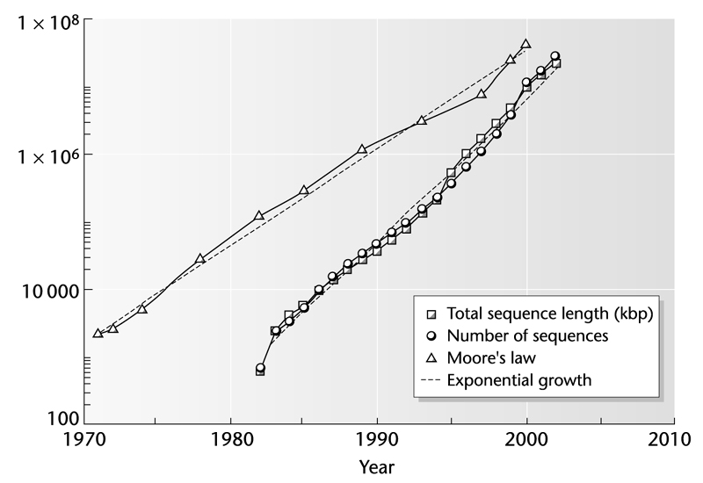
Rate of growth of Genbank compared to rate of growth of # transistors in personal computer chips (from Higgs and Attwood)

Slide 15
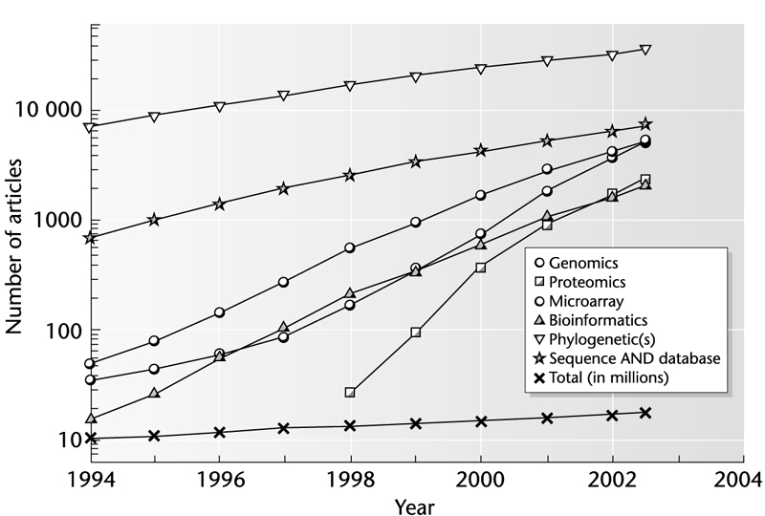
Cumulative # scientific articles with different key words in the abstract (from Higgs and Attwood 2004)

Slide 16
The components of Bioinformatics
Structural biology
Data Bases
Molecular biology
Bioinformatics
Computer Science
Genomics
Statistics
Biochemistry

Slide 17
Current interest in bioinformatics…
Bioinformatics leverages high throughput data to save time and money. (Can test thousands of ideas without having to set up expensive experiments)
Field requires a knowledge of biology, computer science & statistics.
Currently demand for bioinformaticians outstrips supply as few people adequately trained in both fields.

Slide 18
The other reason

Slide 19
A beginner’s guide to bioinformatics
Layer 1 – Using web to analyze biological data
Layer 2 – Ability to install and run new programs
Layer 3 – Writing own scripts for analysis in PERL, python or R
Layer 4 – High level coding in C/C++/Java for implementing existing algorithms or modifying existing codes for new functionality
Layer 5 – Thinking mathematically, developing own algorithms and implementing in C/C++/Java

Slide 20
Three level of learning in this class
Layer 1 – Understand the algorithms
Layer 2 – Learn the implementation of the algorithms to solve biological questions
Layer 3 – application, learn how to use scripts and software

Slide 21
Bioinformatics Resources
ISCB: http://www.iscb.org/
NCBI: http://ncbi.nlm.nih.gov/
http://www.bioinformatics.org/
Journals
Bioinformatics
BMC Bioinformatics
Genome Research
Nucleic Acid Research
…

