Slide 1
SEQUENCE ALIGNMENT

Slide 2
Given a sequence, what can we find out about it?
One thing we can do is to compare it to other sequences that are well characterized - presumably similar sequences will have similar properties (transitivity).
Underlying premise is that organisms evolve through accumulation of mutations (point mutation, insertion, and deletion). Sequence similarity may indicate recency of common ancestry, and can suggest functional and structural similarity of more distantly related genes.

Slide 3
How do we recognize sequence similarity?
Simplest way is to line up sequences side by side, count number of matches, divide by length
e.g.: ACGTATGT sequence similarity = 6/8 = 0.75
ACATACGT
But: ACGTACGT sequence similarity = 1/8 = 0.125
AGTACGTA
However, ACGTACGT- sequence similarity = 7/9 = 0.78 A-GTACGTA
Reflects fact that sequences can evolve by 3 different mechanisms:
(1) substitution: replacement of one residue by another
(2) insertion: insertion of one or more residues
(3) deletion: removal of one or more residues

Slide 4
Three mechanisms
AGTACGTA
substitution
AGTGCGTA
AGTACGTA
deletion
AGT- CGTA
G
AGTACGTA
insertion
AGTAGCGTA

Slide 5
Generally can't distinguish between insertion and deletion as an insertion in one string can be accommodated by a gap in the second string… insertions and deletions are collectively referred to as "indels".
The "-" characters are called "gaps"

Slide 6
Sequence
evolution
AGTACGTA
AGTGCGTA
AGTACCTA
AGTGCGCA
TGTGCGTA
AGTACCTA
ATTACCTA
CGTACTA
ATTACCTT
TGTGCGCA
TGTGCGTC
AGTACTA
ATTACCTA
AGTGCGCA
TGCGCGTA
C
TGTGCGCA
ATGCGCA
TGTGCGTC
TGCGCGTA
CGTACTA
ACGTACTA
ATTACCTT
ATTACCTA
T-GTGCGCA
A--TGCGCA
T-GTGCGTC
T-GCGCGTA
C-GTA-CTA
ACGTA-CTA
A-TTACCTT
A-TTACCTA
Need to find the alignment that
best reflects what happened…
data
alignment

Slide 7
We want to create an alignment that reflects what TRULY happened. In other words we want each element in the string to align to its homologous counterpart.
Homology is the fundamental cornerstone underlying all sequence comparison. (similarity = proxy for homology)
Unfortunately this isn’t always obvious…

Slide 8
Multiple Sequence Alignment (MSA)
RRV
KRV
KRSEP
KSEV
K>R
V>P
-R
KRSEV
KRV
-S
+E
KRSV
Evolutionary history
for 4 extant sequences

Slide 9
Multiple Sequence Alignment (MSA)
Given…
RRV
KRV
KRSEP
KSEV
RRV
K>R
V>P
-R
KRV
KRSEP
KRSEV
KSEV
KRV
-S
+E
KRSV
RRV
RR--V
KRV
KR--V
Can guess…
KRSEP
KRSEP
KSEV
K-SEV

Slide 10
Multiple Sequence Alignment (MSA)
But if only given ff 3 …
RRV
KRV
KRSEP
KSEV
RRV
K>R
V>P
-R
KRV
KSEV
KRV
KRSEV
-S
+E
KRSV
RRV
RR-V
Our guess may
be flawed …
KRV
KR-V
KSEV
KSEV
RR--V
KR--V
KRSEP
N.B. “R” now assumed to be homologous to “S”
K-SEV

Slide 11
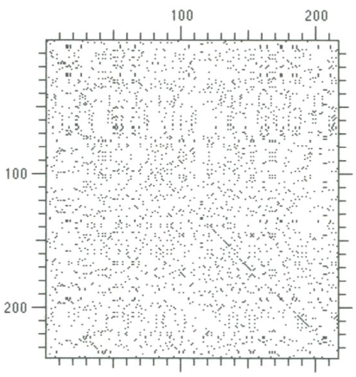
“dot plots”
Good way to explore all possible mechanisms that might account for sequence similarity.
They allow us to visualize all possible alignments at once, giving us an overall sense of the structure in the data

Slide 12
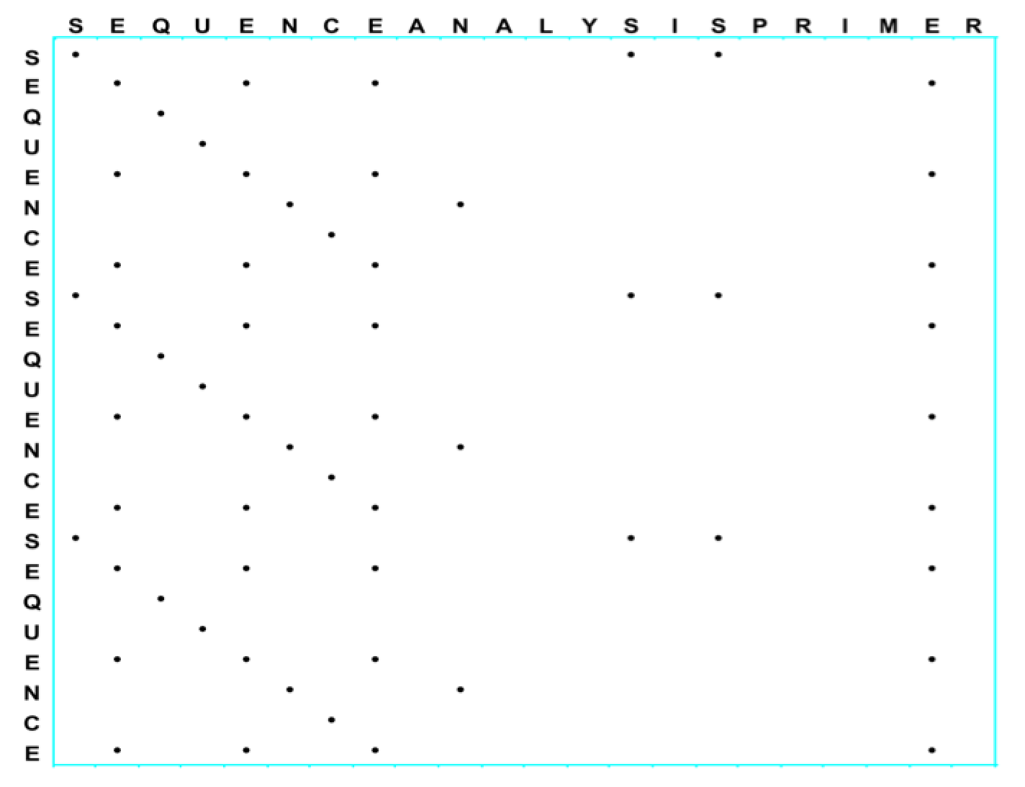
Dot plots allow us to readily (visually) pick out features such as duplications or direct repeats in alignments
The ‘duplication’ here is seen as a distinct column of diagonals; whenever you see either a row or column of diagonals in a dotplot, you are looking at direct repeats.

Slide 13
Interpretation
Dot plots are useful to show:
Alternate paths through the matrix - suboptimal solutions
Parallel diagonals off the main diagonal -repeated elements
Reverse diagonals (perpendicular to diagonal) – inversions
Reverse diagonals crossing diagonals (Xs) - palindromes

Slide 14
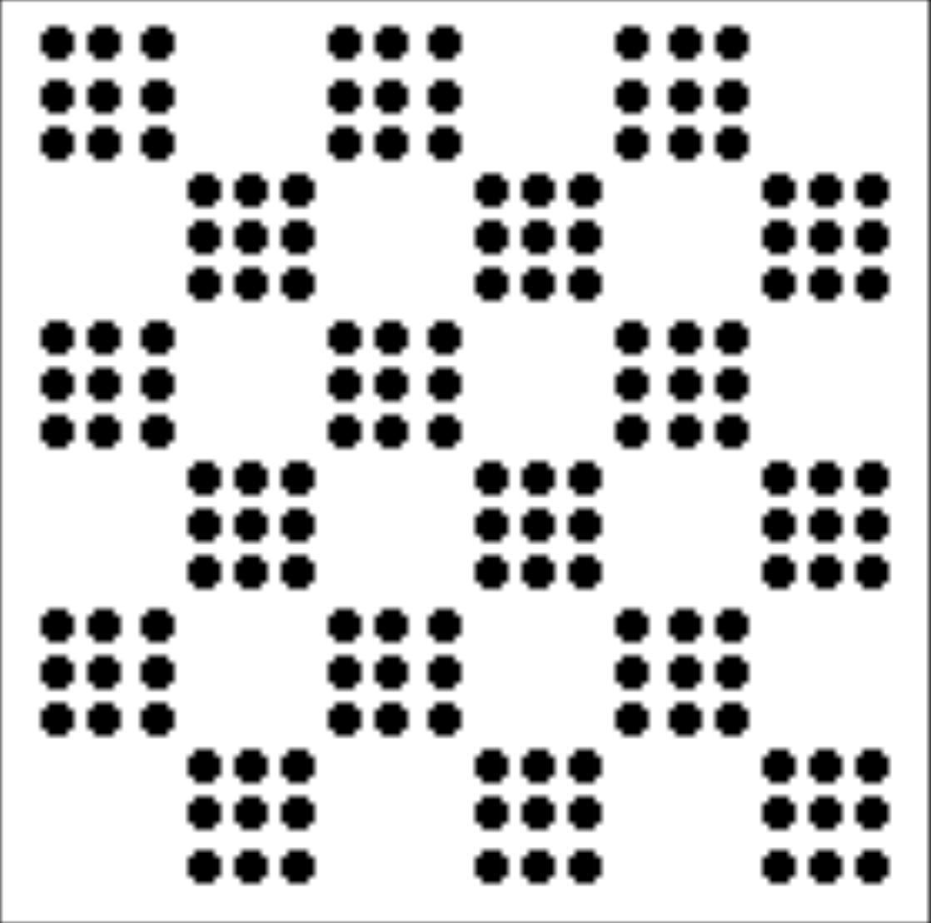
Often useful to dot plot sequences against themselves to explore internal structure
^{aaaaaaaaa bbbbbbbbb}
^{abcdefghi abcdefghi}
^{aaaaaaaa bb aaaaaaaa}
^{abcdefghiabczydefghi}
^{Repeat runs}
^{Repeat motifs}
^{Insertion into a poly a}
^{Insertion into a motif}
^{aaabbbaaabbbaaabbb}
^{Alternating repeats}

Slide 15
In practice, dot plots are often cluttered
Extraneous dots reflect‘noise’ and are due to the ‘random’ matches in the sequences. We can amplify the signal in such alignments use sliding-window filters
A dot is placed at a location only if some fraction of the next K sites are identical. (Can weight matches according to any scoring protocol)

Slide 16
filtering…
before
after

Slide 17
Filtering
Employ a window and a threshold
compare character by character within a window (have to choose window size)
require certain fraction of matches within window in order to display “a dot”

Slide 18
Word Size Algorithm
T A C G G T A T G
A C A G T A T C
Word Size = 3
C T A T G A C A T A C G G T A T G
T A C G G T A T G
A C A G T A T C
✴
T A C G G T A T G
A C A G T A T C
T A C G G T A T G
A C A G T A T C
✴

Slide 19
Window stringency Algorithm
Threshold of “2 out of 3” warrants an entry in dot plot
T A C G G T A T G
A C A G T A T C
✴
C T A T G A C A T A C G G T A T G
T A C G G T A T G
A C A G T A T C
✴
✴
✴
T A C G G T A T G
A C A G T A T C
✴
✴
✴
T A C G G T A T G
A C A G T A T C
✴

Slide 20
Window / Stringency with a biologically based scoring system
Score = 11
PTHPLASKTQILPEDLASEDLTI
✴
PTHPLAGERAIGLARLAEEDFGM
Scoring Matrix Filtering
Score = 11
Matrix: PAM250
Window = 12 Stringency = 9
PTHPLASKTQILPEDLASEDLTI
✴
PTHPLAGERAIGLARLAEEDFGM
Score = 7
PTHPLASKTQILPEDLASEDLTI
PTHPLAGERAIGLARLAEEDFGM

Slide 21
example
Dotplot (Window = 130 / Stringency = 9)
Hemoglobin β-chain
Hemoglobin α-chain

Slide 22
Example 2
Dotplot (Window = 18 / Stringency = 10)
Hemoglobin β-chain
Hemoglobin α-chain

Slide 23
Considerations
The window/stringency method is more sensitive than the word size method (ambiguities are permitted).
The smaller the window, the larger the weight of nonspecific matches.
With large windows the sensitivity for short sequences is reduced.
Insertions/deletions are not treated explicitly.

