Slide 1
Given two sequences that are similar, but different, how do we establish which regions are homologous - or correspond to the “same” piece?
eg. given two similar sequences:
ATGCGTCGTT
ATGCGTCGT
Plot elements of string1 vs string 2

Slide 2
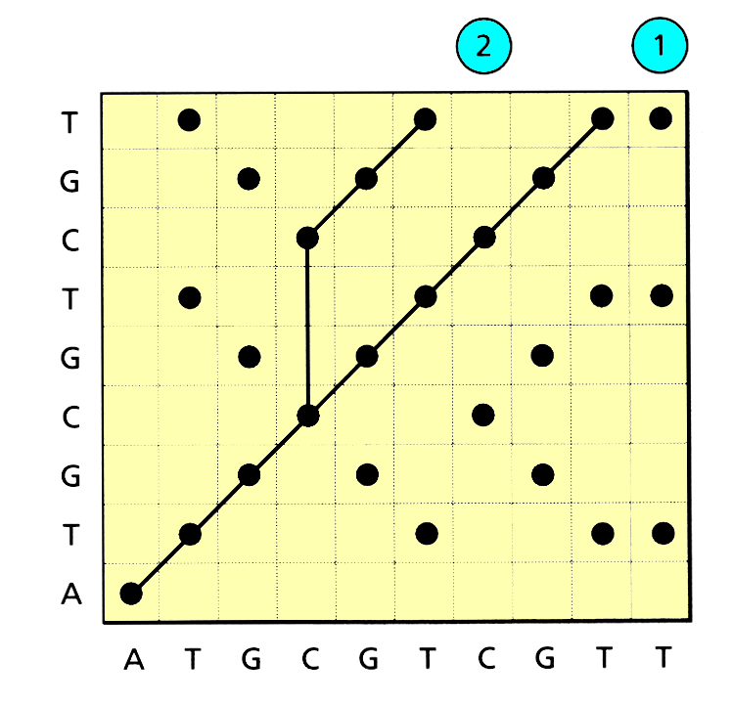
Dot is placed in each cell if the 2 sequences have the same element for a given pair of sites
ATGCGTCGT
ATGCGTCGT
ATGCGTCGTT
ATG - - - CGTCGTT
Two possible paths through plot are shown, implying 2 separate alignments. Matching runs show up as diagonal lines.

Slide 3
Gaps in the sequence correspond to the vertical “kinks “ in the graph
consequence of an insertion or deletion (indel) in the sequence.

Slide 4
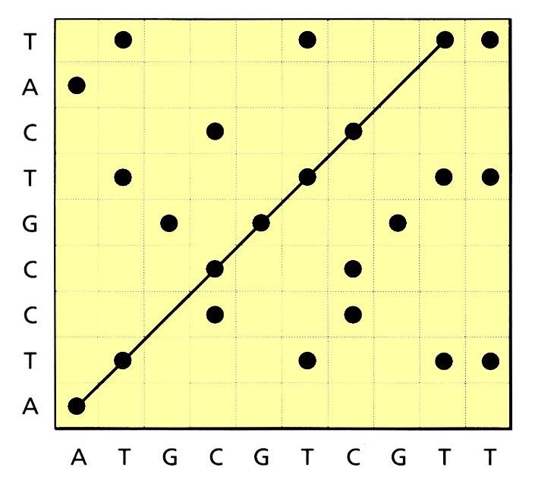
ATGCGTCGTT
ATCCGTCAT
Dot plot for two sequences that are different but have no gaps

Slide 5
Consider ff. 2 sequences
ATGCGTCGTT
x
x
ATCCGTCAT-
The sequences differ at 3rd and 8th posns.
Possible to align any two sequences by postulating some combination of gaps and substitutions. By counting the number of these events (or some function of them) we can compute a “cost” for a particular alignment.
cost of an alignment D = s + wg
s = no of substitutions
g = total length of any gaps
w = gap penalty (cost of gap relative to a substitution)

Slide 6
Choosing a gap penalty makes implicit assumptions about how the sequences have evolved.
If indels are thought to be rare then W (the gap penalty) should be large (and vice versa).
Basic task of sequence alignment is to find the alignment with the lowest overall cost.
This will often depend on the gap penalty - If gap penalty is low alignments w/ large numbers of gaps will be favoured. By contrast high values of w will favour alignments that introduce substitutions to explain mis-matches.

Slide 7
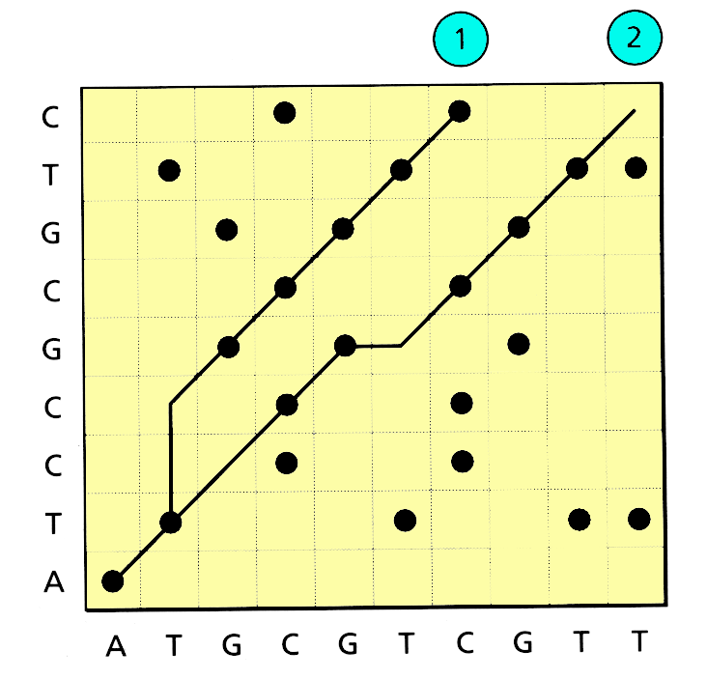
Two alternative alignments & corresponding dot plots
path 1
path 2
AT - - GCGTCGTT
ATGCGT CGTT
ATCCGCGTC
ATCCG - CGTC
COST
COST
D = s + wg
D = s + wg
(for gap cost =1)
(for gap cost =1)
D = 0 + 1x2 = 2
D = 2 + 1x1 = 3

Slide 8
Things change with a different gap cost
eg. when gap cost is 3 (rather than 1)
AT - - GCGTCGTT
ATGCGT CGTT
ATCCGCGTC
ATCCG - CGTC
COST
COST
D = s + wg
D = s + wg
(for gap cost =3)
(for gap cost =3)
D = 0 + 3x2 = 6
D = 2 + 3x1 = 5

Slide 9
Alignment varies with gap cost (i.e. our assessment of homology varies with gap cost)
How do we know a reasonable gap cost?
Have to use knowledge of biology
eg. if it is a protein coding gene we know that gaps should only be permissible in multiples of 3. (so that each gap corresponded to the insertion of deletion of one or more codons)

Slide 10
ALIGNMENT OF PROTEIN SEQUENCES
Alignment of protein seqs different to that of nucleotide sequences.
Alphabet for proteins = 20 ; nucleotides =4
For nuc. sequences a mismatch between seqs. is often scored as “1” (nucs are either same or different)
For Amino acids need to take into account the possible pathways in which one aminoacid may be replaced by another.
eg Cysteine (TGT) > tyrosine (TAT) involves single change, but Cysteine (TGT) > methionine (ATG) requires 3 changes
Aligning cysteine with tyrosine is less costly than aligning it with methionine

Slide 11
Cost of every pair of possible amino acids defines a cost matrix that can be used to score alignments.
Best known cost matrix is the DAYHOFF MATRIX

Slide 12
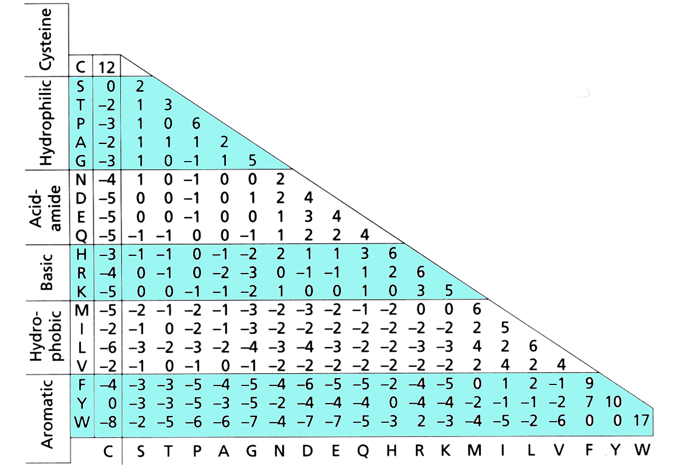
PAM 250 DAYHOFF MATRIX (1978)
+ve score = freq. replacment
- ve score = rare replacment
Matrix gives the ratio of the freq at which pair is observed in pairwise comparisons to that expected due to chance alone.

Slide 13
It is a waste to score all possible alignments
AT - - GCGTCGTT
ATGCGT CGTT
ATCCGCGTC
ATCCG - CGTC

Slide 14
Dynamic Programming
A relatively simple method for solving the problem.
Exact, relatively simple method for solving optimization problems that have “optimal substructure”: solution to the main problem can be found through finding optimal solutions to the subproblems.
Basic approach: build a table of solved subproblems that are then used to solve ever larger ones, until finally the complete problem has been solved. As long as each subproblem is solved correctly, the final complete problem will also be solved correctly.
Note: This is a general computational technique—widely used in many areas.
.

Slide 15
The rocks game
Two piles of rocks. 10 in each pile
Rules: each turn a player may remove one rock from both piles or one rock from a single pile. The player that takes the last rock wins.
Not clear at outset what winning strategy should be.
But consider a subset of the game in which there are only 2 rocks in each pile
.

Slide 16
The rocks game (cntd.)
For 2+2 game, its clear that second player has advantage:
If first player takes one rock from each pile, second player takes remaining rocks and wins
If first player takes one rock from one pile, second player takes one rock from same pile. As a result, there will be only one pile left containing 2 rocks. The first player can only remove one rock and is thus doomed to lose.
.

Slide 17
The rocks game (cntd)
For 3+3 game, it is less clear what strategy works as there are more paths that can be taken.
However, its easy to see that if the first player removes a rock from each pile we are now in the 2+2 game for which the outcomes have already been determined.
Can represent the strategies required as a matrix for any number of rocks..
.

Slide 18
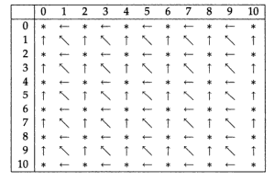
Pile A
i
Pile B
j
Entry in position i,j (ith row, jth column) describes the
moves that can be made in the I+j game for pile A & B.
⬅take one stone from pile A
⬆take one stone from pile B
take one stone from each pile
◉ don’t play the game against an opponent who has a clue!
.

Slide 19
Pile A
i
Pile B
j
Eg in 3+3 game we see a in 3rd row and 3rd column indicating
that player should remove a rock from each pile reducing problem
to 2+2 game which is marked * meaning that whoever makes first
move in 2+2 game is doomed to lose.
.
If opponent takes rock from pile A (⬅) leads to 2+1 game. Table
strategy indicates that we should remove second rock from pile
A, leaving 2 rocks in pile B.

Slide 20
Rocks game shows that a complex problem with many paths
can be broken down into sub-problems. If each sub-problem is
solved correctly, then we can solve the larger problems too.
This is the underpinning of Dynamic programming.
.

Slide 21
Rocks game shows that a complex problem with many paths
can be broken down into sub-problems. If each sub-problem is
solved correctly, then we can solve the larger problems too.
This is the underpinning of Dynamic programming.

Slide 22
Recursion:
c_{ij} = c_{i-1},_{j-1} + 1 if x_{i} = y_{j}
otherwise c_{ij} = max( c_{i},_{j-1} , c_{i-1},_{j})
i
0
1
j 0 1
Y_{j}
c_{i-1},_{j-1}
c_{i-1}
X_{i}
c_{j-1}
c_{ij}

Slide 23
c_{ij} = c_{i-1},_{j-1} + 1 if x_{i} = y_{j}
otherwise c_{ij} = max( c_{i},_{j-1} , c_{i-1},_{j})
In words:
If X and Y are a match, enter the value for cell c_{ij}
from diagonal cell immediately up and to the left, and add +1
i
0
1
j 0 1
Y_{j}
c_{i-1},_{j-1}
c_{i-1}
X_{i}
c_{j-1}
c_{ij}
+1

Slide 24
c_{ij} = c_{i-1},_{j-1} + 1 if x_{i} = y_{j}
otherwise c_{ij} = max( c_{i},_{j-1} , c_{i-1},_{j})
In words:
If not, enter which ever is greater, the value for the cell
immediately to the left or the cell immediately above.
i
0
1
j 0 1
Y_{j}
c_{i-1}
X_{i}
c_{j-1}
c_{ij}

Slide 25
Longest Common Subsequence (LCS) Example
j 0 1 2 3 4 5
i
0
1
2
3
4
Y_{j} C T G A C
X_{i}
A
C
GC
x = ACGC y = CTGAC

Slide 26
First, we must initialise starting conditions.
j 0 1 2 3 4 5
i
0
1
2
3
4
Y_{j} C T G A C
X_{i}
A
C
GC

Slide 27
First, we must initialise starting conditions.
j 0 1 2 3 4 5
i
0
1
2
3
4
Y_{j} C T G A C
X_{i}
A
C
GC
0
0
0
0
0
0
0
0
0
0
Alignment implied by starting conditions
ACGC-----
----CTGAC

Slide 28
if x_{i} = y_{j then} c_{ij} = c_{i-1},_{j-1} + 1
otherwise c_{ij} = max( c_{i},_{j-1} , c_{i-1},_{j})
Recursion:
j 0 1 2 3 4 5
i
0
1
2
3
4
Y_{j} C T G A C
X_{i}
A
C
GC
0 | 0 | 0 | 0 | 0 | 0
0
0
0
0

Slide 29
if x_{i} = y_{j then} c_{ij} = c_{i-1},_{j-1} + 1
otherwise c_{ij} = max( c_{i},_{j-1} , c_{i-1},_{j})
Recursion:
j 0 1 2 3 4 5
i
0
1
2
3
4
Y_{j} C T G A C
X_{i}
A
C
GC
0 | 0 | 0 | 0 | 0 | 0
0
0
0
0

Slide 30
if x_{i} = y_{j then} c_{ij} = c_{i-1},_{j-1} + 1
otherwise c_{ij} = max( c_{i},_{j-1} , c_{i-1},_{j})
Recursion:
j 0 1 2 3 4 5
i
0
1
2
3
4
Y_{j} C T G A C
X_{i}
A
C
GC
0 | 0 | 0 | 0 | 0 | 0
0 | 0
0
0
0

Slide 31
if x_{i} = y_{j then} c_{ij} = c_{i-1},_{j-1} + 1
otherwise c_{ij} = max( c_{i},_{j-1} , c_{i-1},_{j})
Recursion:
j 0 1 2 3 4 5
i
0
1
2
3
4
Y_{j} C T G A C
X_{i}
A
C
GC
0 | 0 | 0 | 0 | 0 | 0
0 | 0
0
0
0

Slide 32
if x_{i} = y_{j then} c_{ij} = c_{i-1},_{j-1} + 1
otherwise c_{ij} = max( c_{i},_{j-1} , c_{i-1},_{j})
Recursion:
j 0 1 2 3 4 5
i
0
1
2
3
4
Y_{j} C T G A C
X_{i}
A
C
GC
0 | 0 | 0 | 0 | 0 | 0
0 | 0 | 0
0
0
0

Slide 33
if x_{i} = y_{j then} c_{ij} = c_{i-1},_{j-1} + 1
otherwise c_{ij} = max( c_{i},_{j-1} , c_{i-1},_{j})
Recursion:
j 0 1 2 3 4 5
i
0
1
2
3
4
Y_{j} C T G A C
X_{i}
A
C
GC
0 | 0 | 0 | 0 | 0 | 0
0 | 0 | 0 | 0
0
0
0

Slide 34
if x_{i} = y_{j then} c_{ij} = c_{i-1},_{j-1} + 1
otherwise c_{ij} = max( c_{i},_{j-1} , c_{i-1},_{j})
Recursion:
j 0 1 2 3 4 5
i
0
1
2
3
4
Y_{j} C T G A C
X_{i}
A
C
GC
0 | 0 | 0 | 0 | 0 | 0
0 | 0 | 0 | 0 | 1
0
0
0

Slide 35
if x_{i} = y_{j then} c_{ij} = c_{i-1},_{j-1} + 1
otherwise c_{ij} = max( c_{i},_{j-1} , c_{i-1},_{j})
Recursion:
j 0 1 2 3 4 5
i
0
1
2
3
4
Y_{j} C T G A C
X_{i}
A
C
GC
0 | 0 | 0 | 0 | 0 | 0
0 | 0 | 0 | 0 | 1 | 1
0
0
0

Slide 36
if x_{i} = y_{j then} c_{ij} = c_{i-1},_{j-1} + 1
otherwise c_{ij} = max( c_{i},_{j-1} , c_{i-1},_{j})
Recursion:
j 0 1 2 3 4 5
i
0
1
2
3
4
Y_{j} C T G A C
X_{i}
A
C
GC
0 | 0 | 0 | 0 | 0 | 0
0 | 0 | 0 | 0 | 1 | 1
0 | 1
0
0

Slide 37
if x_{i} = y_{j then} c_{ij} = c_{i-1},_{j-1} + 1
otherwise c_{ij} = max( c_{i},_{j-1} , c_{i-1},_{j})
Recursion:
j 0 1 2 3 4 5
i
0
1
2
3
4
Y_{j} C T G A C
X_{i}
A
C
GC
0 | 0 | 0 | 0 | 0 | 0
0 | 0 | 0 | 0 | 1 | 1
0 | 1 | 1
0
0

Slide 38
if x_{i} = y_{j then} c_{ij} = c_{i-1},_{j-1} + 1
otherwise c_{ij} = max( c_{i},_{j-1} , c_{i-1},_{j})
Recursion:
j 0 1 2 3 4 5
i
0
1
2
3
4
Y_{j} C T G A C
X_{i}
A
C
GC
0 | 0 | 0 | 0 | 0 | 0
0 | 0 | 0 | 0 | 1 | 1
0 | 1 | 1 | 1
0
0

Slide 39
if x_{i} = y_{j then} c_{ij} = c_{i-1},_{j-1} + 1
otherwise c_{ij} = max( c_{i},_{j-1} , c_{i-1},_{j})
Recursion:
j 0 1 2 3 4 5
i
0
1
2
3
4
Y_{j} C T G A C
X_{i}
A
C
GC
0 | 0 | 0 | 0 | 0 | 0
0 | 0 | 0 | 0 | 1 | 1
0 | 1 | 1 | 1 | 1
0
0

Slide 40
if x_{i} = y_{j then} c_{ij} = c_{i-1},_{j-1} + 1
otherwise c_{ij} = max( c_{i},_{j-1} , c_{i-1},_{j})
Recursion:
j 0 1 2 3 4 5
i
0
1
2
3
4
Y_{j} C T G A C
X_{i}
A
C
GC
0 | 0 | 0 | 0 | 0 | 0
0 | 0 | 0 | 0 | 1 | 1
0 | 1 | 1 | 1 | 1 | 2
0
0

Slide 41
if x_{i} = y_{j then} c_{ij} = c_{i-1},_{j-1} + 1
otherwise c_{ij} = max( c_{i},_{j-1} , c_{i-1},_{j})
Recursion:
j 0 1 2 3 4 5
i
0
1
2
3
4
Y_{j} C T G A C
X_{i}
A
C
GC
0 | 0 | 0 | 0 | 0 | 0
0 | 0 | 0 | 0 | 1 | 1
0 | 1 | 1 | 1 | 1 | 2
0 | 1
0
x = ACGC y = CTGAC

Slide 42
if x_{i} = y_{j then} c_{ij} = c_{i-1},_{j-1} + 1
otherwise c_{ij} = max( c_{i},_{j-1} , c_{i-1},_{j})
Recursion:
j 0 1 2 3 4 5
i
0
1
2
3
4
Y_{j} C T G A C
X_{i}
A
C
GC
0 | 0 | 0 | 0 | 0 | 0
0 | 0 | 0 | 0 | 1 | 1
0 | 1 | 1 | 1 | 1 | 2
0 | 1 | 1
0
x = ACGC y = CTGAC

Slide 43
if x_{i} = y_{j then} c_{ij} = c_{i-1},_{j-1} + 1
otherwise c_{ij} = max( c_{i},_{j-1} , c_{i-1},_{j})
Recursion:
j 0 1 2 3 4 5
i
0
1
2
3
4
Y_{j} C T G A C
X_{i}
A
C
GC
0 | 0 | 0 | 0 | 0 | 0
0 | 0 | 0 | 0 | 1 | 1
0 | 1 | 1 | 1 | 1 | 2
0 | 1 | 1 | 2
0
x = ACGC y = CTGAC

Slide 44
if x_{i} = y_{j then} c_{ij} = c_{i-1},_{j-1} + 1
otherwise c_{ij} = max( c_{i},_{j-1} , c_{i-1},_{j})
Recursion:
j 0 1 2 3 4 5
i
0
1
2
3
4
Y_{j} C T G A C
X_{i}
A
C
GC
0 | 0 | 0 | 0 | 0 | 0
0 | 0 | 0 | 0 | 1 | 1
0 | 1 | 1 | 1 | 1 | 2
0 | 1 | 1 | 2 | 2
0
x = ACGC y = CTGAC

Slide 45
if x_{i} = y_{j then} c_{ij} = c_{i-1},_{j-1} + 1
otherwise c_{ij} = max( c_{i},_{j-1} , c_{i-1},_{j})
Recursion:
j 0 1 2 3 4 5
i
0
1
2
3
4
Y_{j} C T G A C
X_{i}
A
C
GC
0 | 0 | 0 | 0 | 0 | 0
0 | 0 | 0 | 0 | 1 | 1
0 | 1 | 1 | 1 | 1 | 2
0 | 1 | 1 | 2 | 2 | 2
0
x = ACGC y = CTGAC

Slide 46
if x_{i} = y_{j then} c_{ij} = c_{i-1},_{j-1} + 1
otherwise c_{ij} = max( c_{i},_{j-1} , c_{i-1},_{j})
Recursion:
j 0 1 2 3 4 5
i
0
1
2
3
4
Y_{j} C T G A C
X_{i}
A
C
GC
0 | 0 | 0 | 0 | 0 | 0
0 | 0 | 0 | 0 | 1 | 1
0 | 1 | 1 | 1 | 1 | 2
0 | 1 | 1 | 2 | 2 | 2
0 | 1
x = ACGC y = CTGAC

Slide 47
if x_{i} = y_{j then} c_{ij} = c_{i-1},_{j-1} + 1
otherwise c_{ij} = max( c_{i},_{j-1} , c_{i-1},_{j})
Recursion:
j 0 1 2 3 4 5
i
0
1
2
3
4
Y_{j} C T G A C
X_{i}
A
C
GC
0 | 0 | 0 | 0 | 0 | 0
0 | 0 | 0 | 0 | 1 | 1
0 | 1 | 1 | 1 | 1 | 2
0 | 1 | 1 | 2 | 2 | 2
0 | 1 | 1
x = ACGC y = CTGAC

Slide 48
if x_{i} = y_{j then} c_{ij} = c_{i-1},_{j-1} + 1
otherwise c_{ij} = max( c_{i},_{j-1} , c_{i-1},_{j})
Recursion:
j 0 1 2 3 4 5
i
0
1
2
3
4
Y_{j} C T G A C
X_{i}
A
C
GC
0 | 0 | 0 | 0 | 0 | 0
0 | 0 | 0 | 0 | 1 | 1
0 | 1 | 1 | 1 | 1 | 2
0 | 1 | 1 | 2 | 2 | 2
0 | 1 | 1 | 2
x = ACGC y = CTGAC

Slide 49
if x_{i} = y_{j then} c_{ij} = c_{i-1},_{j-1} + 1
otherwise c_{ij} = max( c_{i},_{j-1} , c_{i-1},_{j})
Recursion:
j 0 1 2 3 4 5
i
0
1
2
3
4
Y_{j} C T G A C
X_{i}
A
C
GC
0 | 0 | 0 | 0 | 0 | 0
0 | 0 | 0 | 0 | 1 | 1
0 | 1 | 1 | 1 | 1 | 2
0 | 1 | 1 | 2 | 2 | 2
0 | 1 | 1 | 2 | 2
x = ACGC y = CTGAC

Slide 50
if x_{i} = y_{j then} c_{ij} = c_{i-1},_{j-1} + 1
otherwise c_{ij} = max( c_{i},_{j-1} , c_{i-1},_{j})
Recursion:
j 0 1 2 3 4 5
i
0
1
2
3
4
Y_{j} C T G A C
X_{i}
A
C
GC
0 | 0 | 0 | 0 | 0 | 0
0 | 0 | 0 | 0 | 1 | 1
0 | 1 | 1 | 1 | 1 | 2
0 | 1 | 1 | 2 | 2 | 2
0 | 1 | 1 | 2 | 2 | 3
x = ACGC y = CTGAC

Slide 51
Traceback path following arrows back to start to the left, up or diagonal
j 0 1 2 3 4 5
i
0
1
2
3
4
Y_{j} C T G A C
X_{i}
A
C
GC
0 | 0 | 0 | 0 | 0 | 0
0 | 0 | 0 | 0 | 1 | 1
0 | 1 | 1 | 1 | 1 | 2
0 | 1 | 1 | 2 | 2 | 2
0 | 1 | 1 | 2 | 2 | 3
LCS is CGC, obtained by traceback
AC-G-C
-CTGAC

Slide 52
“Longest Common Subsequence” (LCS) Problem
Remember, the LCS problem is actually a special case of the general alignment problem where mismatches are not allowed
AC-G-C
-CTGAC
.

