Slide 1
“Longest Common Subsequence” (LCS) Problem
Remember, the LCS problem is actually a special case of the general alignment problem where mismatches are not allowed
AC-G-C
-CTGAC
.

Slide 2
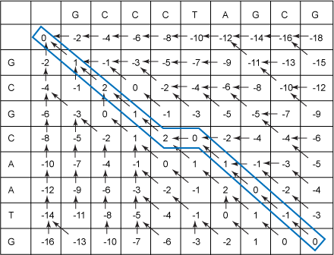
Global (Needleman Wunsch)
Match = 1 point
Mis-match = -1 point
Gap = -2 points

Slide 3
Can modify LCS to “score” mismatches and include “costs” for gaps.
This then becomes pairwise global alignment, Needleman Wunsch Algorithm.
The recursion is also modified for global pairwise alignment:
i
0
1
j 0 1
Y_{j}
c_{i-1},_{j-1}
c_{j-1}
X_{i}
c_{i-1}
c_{ij}
For LCS we had two stages (if then, if not then)
if x_{i} = y_{j} then c_{ij} = c_{i-1},_{j-1} + 1
otherwise c_{ij} = max( c_{i},_{j-1} , c_{i-1},_{j})

Slide 4
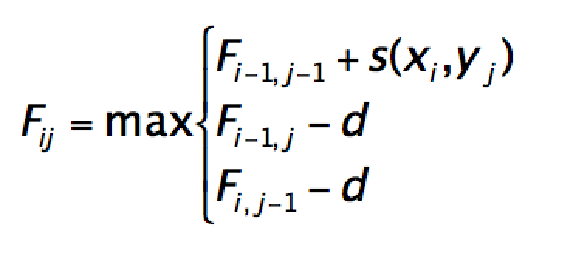
Recurrence formula for pairwise alignment (global)
Needleman and Wunsch (1970); Gotoh (1982)
With linear gap costs:
c_{i-1},_{j-1}
c_{j-1}
c_{i-1}
c_{ij}

Slide 5
Pairwise Alignment
Dynamic programming for sequence alignment proceeds similarly to the longest common subsequence (LCS) algorithm, except that recursion formula is modified to allow for the possibility of gap insertion.
Why gaps?
To accommodate the biological processes that result in insertion and/or deletion of residues in one sequence relative to another
DNA damage
Polymerase infidelity
Unequal crossing over
Slip-strand mispairing
Insertion of transposable elements

Slide 6
Gap-scoring systems
Gap penalties:
Constant: w_{x} = C
Linear (= “simple”, “length-proportional”): w_{x} = xd
Affine: w_{x} = d + (g – 1)e
Concave
Arbitrary
Dynamic programming variants mainly involve differences in how gaps are scored, and algorithmic adjustments that must consequently be made
Still an active research area

Slide 7
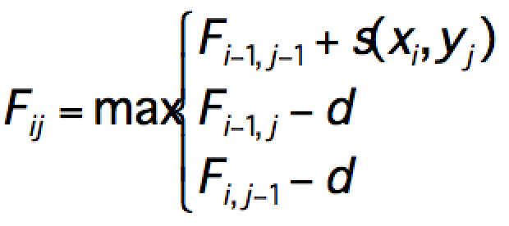
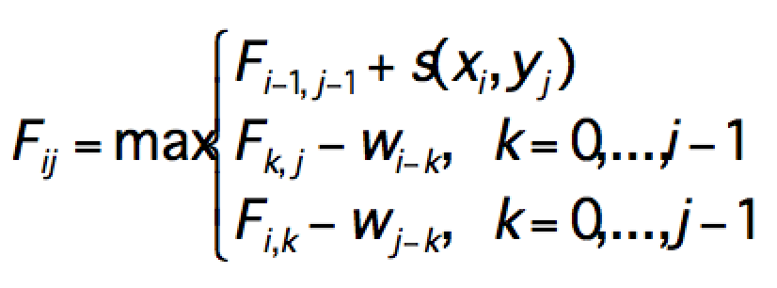
Recurrence formulas
Needleman and Wunsch (1970); Gotoh (1982)
Global with linear gap costs:
Global with more general gap costs:

Slide 8
Global Alignment Example
j 0 1 2 3 4 5
i
0
1
2
3
4
Y_{j} C T G A C
X_{i}
A
C
GC
x = ACGC y = CTGAC

Slide 9
First, we must initialise starting conditions.
j 0 1 2 3 4 5
i
0
1
2
3
4
Y_{j} C T G A C
X_{i}
A
C
GC

Slide 10
(gap penalty is -2, match is +3, mismatch-1 )
j 0 1 2 3 4 5
i
0
1
2
3
4
Y_{j} C T G A C
X_{i}
A
C
GC
0
-2
-4
-6
-8
-10
-2
-4
-6
-8
Alignment implied by starting conditions
ACGC-----
----CTGAC

Slide 11
gap = -2 match = +3 mismatch = -1
j 0 1 2 3 4 5
i
0
1
2
3
4
Y_{j} C T G A C
X_{i}
A
C
GC
0
-2
-4
-6
-8
-10
-2
-1
-4
-6
-8

Slide 12
gap = -2 match = +3 mismatch = -1
j 0 1 2 3 4 5
i
0
1
2
3
4
Y_{j} C T G A C
X_{i}
A
C
GC
0
-2
-4
-6
-8
-10
-2
-1
-3
-4
-6
-8

Slide 13
gap = -2 match = +3 mismatch = -1
j 0 1 2 3 4 5
i
0
1
2
3
4
Y_{j} C T G A C
X_{i}
A
C
GC
0
-2
-4
-6
-8
-10
-2
-1
-3
-5
-4
-6
-8

Slide 14
gap = -2 match = +3 mismatch = -1
j 0 1 2 3 4 5
i
0
1
2
3
4
Y_{j} C T G A C
X_{i}
A
C
GC
0
-2
-4
-6
-8
-10
-2
-1
-3
-5
-3
-4
-6
-8

Slide 15
gap = -2 match = +3 mismatch = -1
j 0 1 2 3 4 5
i
0
1
2
3
4
Y_{j} C T G A C
X_{i}
A
C
GC
0
-2
-4
-6
-8
-10
-2
-1
-3
-5
-3
-5
-4
-6
-8

Slide 16
gap = -2 match = +3 mismatch = -1
j 0 1 2 3 4 5
i
0
1
2
3
4
Y_{j} C T G A C
X_{i}
A
C
GC
0
-2
-4
-6
-8
-10
-2
-1
-3
-5
-3
-5
-4
1
-6
-8

Slide 17
gap = -2 match = +3 mismatch = -1
j 0 1 2 3 4 5
i
0
1
2
3
4
Y_{j} C T G A C
X_{i}
A
C
GC
0
-2
-4
-6
-8
-10
-2
-1
-3
-5
-3
-5
-4
1
-1
-6
-8

Slide 18
gap = -2 match = +3 mismatch = -1
j 0 1 2 3 4 5
i
0
1
2
3
4
Y_{j} C T G A C
X_{i}
A
C
GC
0
-2
-4
-6
-8
-10
-2
-1
-3
-5
-3
-5
-4
1
-1
-3
-6
-8

Slide 19
gap = -2 match = +3 mismatch = -1
j 0 1 2 3 4 5
i
0
1
2
3
4
Y_{j} C T G A C
X_{i}
A
C
GC
0
-2
-4
-6
-8
-10
-2
-1
-3
-5
-3
-5
-4
1
-1
-3
-5
-6
-8

Slide 20
gap = -2 match = +3 mismatch = -1
j 0 1 2 3 4 5
i
0
1
2
3
4
Y_{j} C T G A C
X_{i}
A
C
GC
0
-2
-4
-6
-8
-10
-2
-1
-3
-5
-3
-5
-4
1
-1
-3
-5
0
-6
-8

Slide 21
gap = -2 match = +3 mismatch = -1
j 0 1 2 3 4 5
i
0
1
2
3
4
Y_{j} C T G A C
X_{i}
A
C
GC
0
-2
-4
-6
-8
-10
-2
-1
-3
-5
-3
-5
-4
1
-1
-3
-5
0
-6
-1
-8

Slide 22
gap = -2 match = +3 mismatch = -1
j 0 1 2 3 4 5
i
0
1
2
3
4
Y_{j} C T G A C
X_{i}
A
C
GC
0
-2
-4
-6
-8
-10
-2
-1
-3
-5
-3
-5
-4
1
-1
-3
-5
0
-6
-1
0
-8

Slide 23
gap = -2 match = +3 mismatch = -1
j 0 1 2 3 4 5
i
0
1
2
3
4
Y_{j} C T G A C
X_{i}
A
C
GC
0
-2
-4
-6
-8
-10
-2
-1
-3
-5
-3
-5
-4
1
-1
-3
-5
0
-6
-1
0
2
-8

Slide 24
gap = -2 match = +3 mismatch = -1
j 0 1 2 3 4 5
i
0
1
2
3
4
Y_{j} C T G A C
X_{i}
A
C
GC
0
-2
-4
-6
-8
-10
-2
-1
-3
-5
-3
-5
-4
1
-1
-3
-5
0
-6
-1
0
2
0
-8

Slide 25
gap = -2 match = +3 mismatch = -1
j 0 1 2 3 4 5
i
0
1
2
3
4
Y_{j} C T G A C
X_{i}
A
C
GC
0
-2
-4
-6
-8
-10
-2
-1
-3
-5
-3
-5
-4
1
-1
-3
-5
0
-6
-1
0
2
0
-2
-8

Slide 26
gap = -2 match = +3 mismatch = -1
j 0 1 2 3 4 5
i
0
1
2
3
4
Y_{j} C T G A C
X_{i}
A
C
GC
0
-2
-4
-6
-8
-10
-2
-1
-3
-5
-3
-5
-4
1
-1
-3
-5
0
-6
-1
0
2
0
-2
-8
-3

Slide 27
gap = -2 match = +3 mismatch = -1
j 0 1 2 3 4 5
i
0
1
2
3
4
Y_{j} C T G A C
X_{i}
A
C
GC
0
-2
-4
-6
-8
-10
-2
-1
-3
-5
-3
-5
-4
1
-1
-3
-5
0
-6
-1
0
2
0
-2
-8
-3
-2

Slide 28
gap = -2 match = +3 mismatch = -1
j 0 1 2 3 4 5
i
0
1
2
3
4
Y_{j} C T G A C
X_{i}
A
C
GC
0
-2
-4
-6
-8
-10
-2
-1
-3
-5
-3
-5
-4
1
-1
-3
-5
0
-6
-1
0
2
0
-2
-8
-3
-2
0

Slide 29
gap = -2 match = +3 mismatch = -1
j 0 1 2 3 4 5
i
0
1
2
3
4
Y_{j} C T G A C
X_{i}
A
C
GC
0
-2
-4
-6
-8
-10
-2
-1
-3
-5
-3
-5
-4
1
-1
-3
-5
0
-6
-1
0
2
0
-2
-8
-3
-2
0
1

Slide 30
gap = -2 match = +3 mismatch = -1
j 0 1 2 3 4 5
i
0
1
2
3
4
Y_{j} C T G A C
X_{i}
A
C
GC
0
-2
-4
-6
-8
-10
-2
-1
-3
-5
-3
-5
-4
1
-1
-3
-5
0
-6
-1
0
2
0
-2
-8
-3
-2
0
1
3

Slide 31
Traceback
gap = -2 match = +3 mismatch = -1
j 0 1 2 3 4 5
i
0
1
2
3
4
Y_{j} C T G A C
X_{i}
A
C
GC
0
-2
-4
-6
-8
-10
-2
-1
-3
-5
-3
-5
-4
1
-1
-3
-5
0
-6
-1
0
2
0
-2
-8
-3
-2
0
1
3
Alignment implied
AC-G-C
-CTGAC

Slide 32
Local Sequence Alignment
Smith-Waterman Alignment Algorithm
Motivation: To find locally high scoring substrings that may be biologically significant

Slide 33
Global versus local alignments
Global: Alignment of optimal score for the full sequence length
-LGPSTKQFGKGSSSRIWDN | || | | | |
LLQPSRKFGKGAISRRGDD-
Local: highest scoring match between substrings from each sequence
FGKG ... |||| ....
FGKG

Slide 34
Local Sequence Alignment
Smith-Waterman Alignment Algorithm
Adds penalties to minimize the introduction of gaps
Two types of gap penalties:
Gap opening : initially assessed when the gap is opened
Gap extension : assessed on each successive extension of a gap
GO and GE can be chosen depending upon the desired sensitivity for introducing gaps in the alignment or estimated from 3D structural alignments

Slide 35
Gap Penalties: Example
Assume: gap opening (GO) penalty = -2; gap extension (GE) penalty = -1
C-T substitution penalty = -1; Score for match = +1
Which of these alignments is “better” — has a higher score?
AT-C-TA ATC--TA AT-C--TA
ATTTTTA ATTTTTA ATT-TTTA
4 matches, 1 mismatch,
2 gap openings (GO)
Score = + 4 - 1 - 2 - 2
Score = -1
4 matches, 1 mismatch,
1 GO, 1 GE
Score = + 4 - 1 - 2 - 1
Score = 0
4 matches, 3 GOs, 1 GE
Score = + 4 - 2 - 2 -2-1
Score = -3

Slide 36
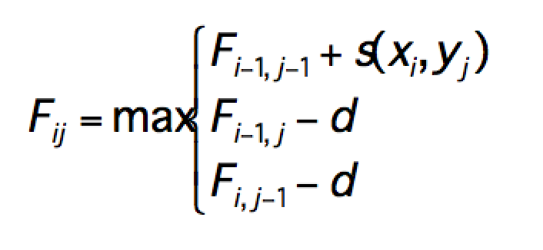
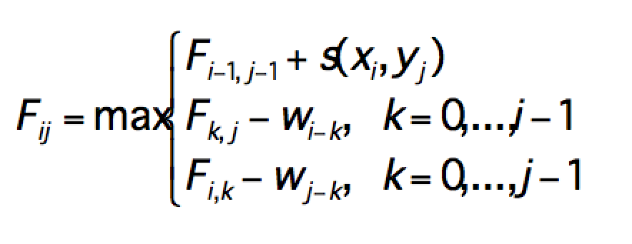
Recurrence formulas (global)
Remember Global Alignment?
Needleman and Wunsch (1970); Gotoh (1982)
Global with linear gap costs:
Global with more general gap costs:

Slide 37
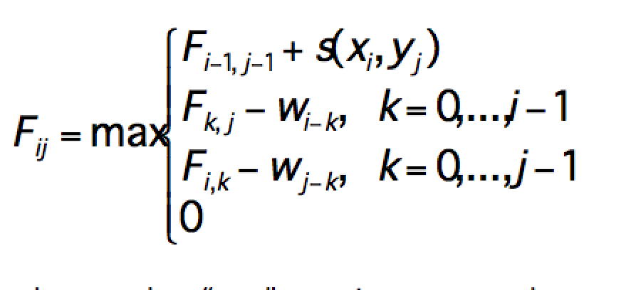
Recurrence formulas (local)
Now we have an addition for Smith Waterman:
Local with linear gap costs:
Local with more general gap costs:
In local, traceback stops when “zero” score is encountered

Slide 38
Global (Needleman Wunsch)
Summary:
Match = 1 point
Mis-match = -1 point
Gap = -2 points

Slide 39
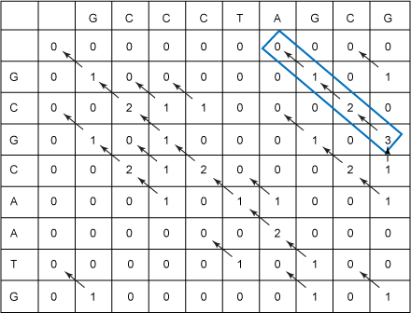
Local (Smith Waterman)
Summary:
Match = 1 point
Mis-match = -1 point
Gap = -2 points

Slide 40
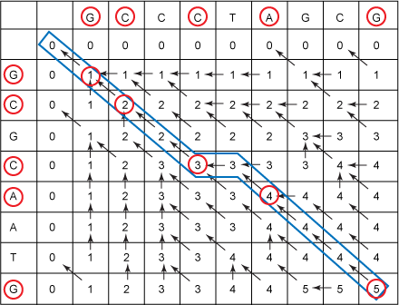
Longest Common Subsequence
Summary:
Match = 1 point

