Slide 1
Multiple Sequence Alignment (MSA)

Slide 2
Review from (Dynamic Programming)
Biological Problem: Determine Similarity between 2 sequences
Data: (1) input data: 2 DNA/RNA/AA sequences
(2) supportive data: scoring matrix, gap open/
extension penalty
Model: Dynamic Programming
Algorithm: Needleman-Wunsch (global),
Smith-Waterman (local)

Slide 3
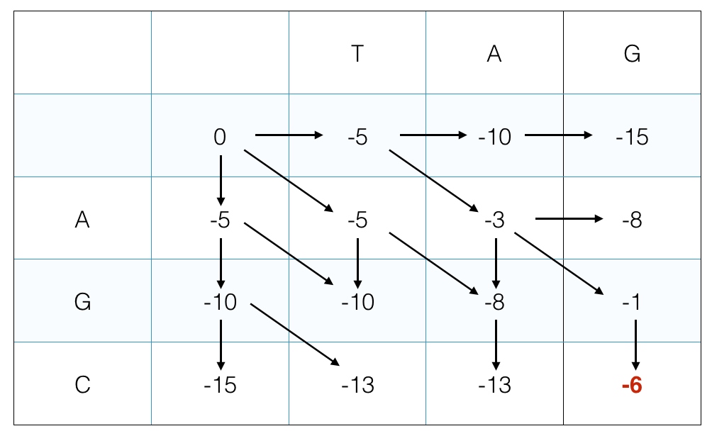
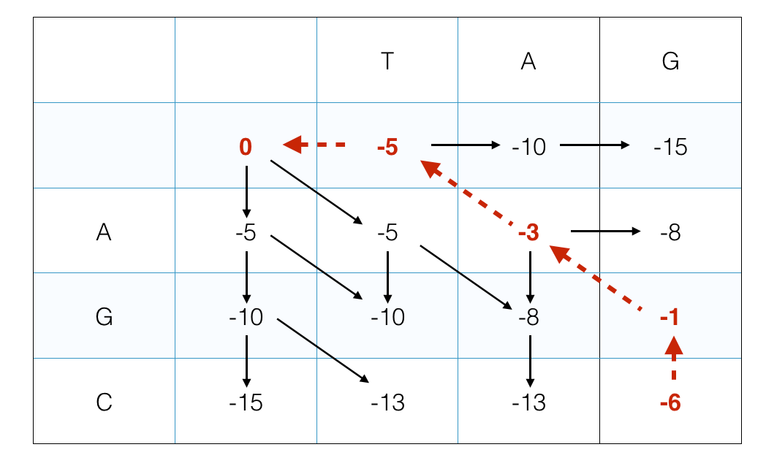
Needleman-Wunsch(global) Algorithm

Slide 4
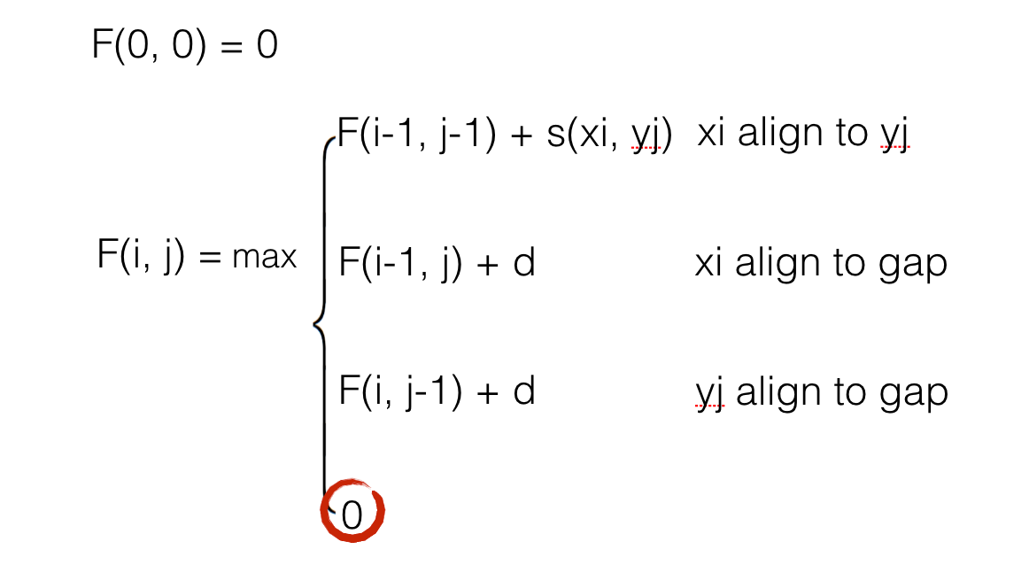
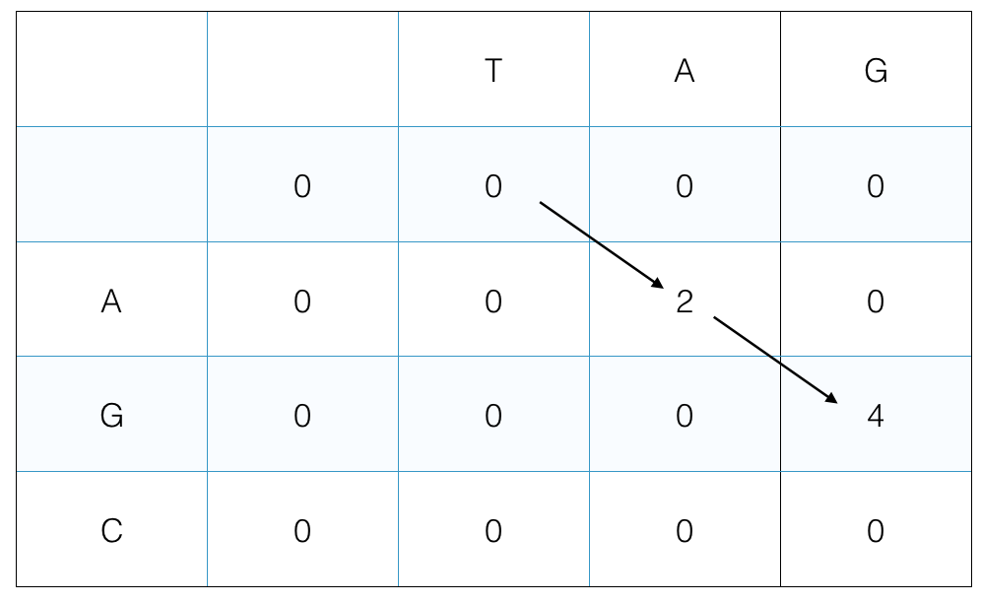
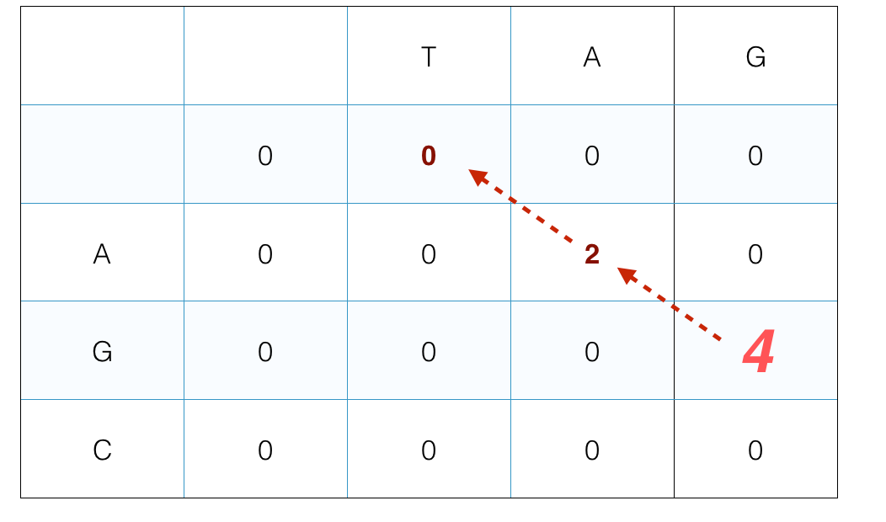
Smith-Waterman(local) Algorithm

Slide 5
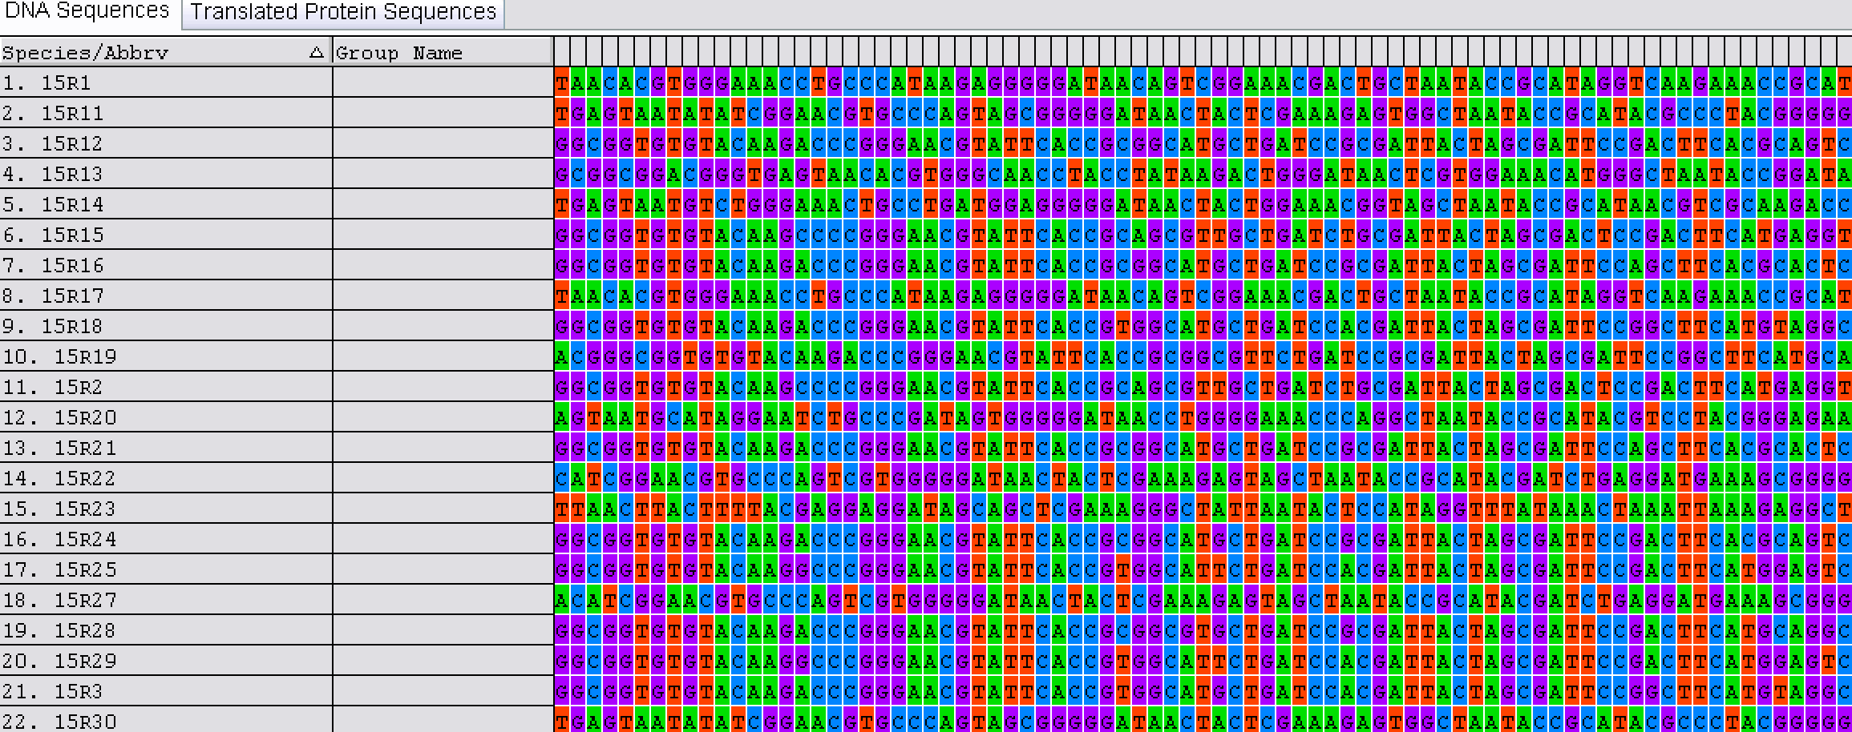
In most of analysis involves in
Bunch of sequences

Slide 6
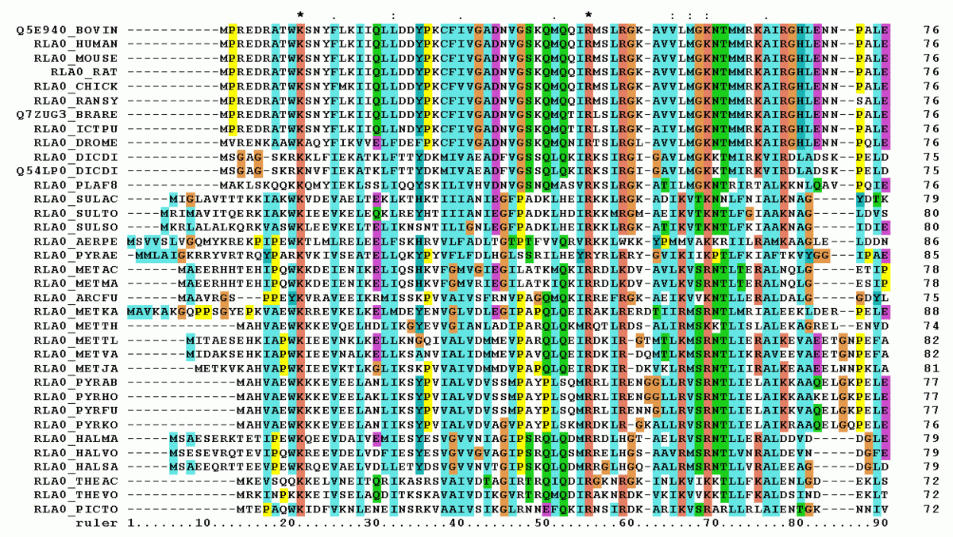

Slide 7
Biological Problem: Determine similarity among multiple sequences
Data:
Input data: multiple DNA/RNA/AA sequences
Supportive data: scoring matrix,gap open/extension penalty
Model: Dynamic Programming
Algorithm: Global/Local Algorithm

Slide 8
Global Algorithm
(i-1, j-1)
Xi
(i,j-1)
For 2 sequences
Yj
Fill the cell with the highest score added from 3 edges
(i+1,j)
(i,j)
(i-1, j-1,k-1)
Xi
(i,j-1,k-1)
Yj
(i-1,j,k-1)
(i,j,k-1)
For 3 sequences
Zk
Fill the cell with the highest score added from 7 edges
(i,j-1,k)
(i-1, j-1,k)
(i-1,j,k)
(i,j,k)

Slide 9
Global Algorithm
Easy to Infer…
F(0,0,0) = 0
F(i-1,j-1,k-1) + s(xi,yj,zk)
Cube diagonal: no indels
F(i,j,k-1) + d(i,j)
Edge diagonal: two indels
F(i,j-1,k) + d(i,k)
F(i,j,k) = max
F(i-1,j,k) + d(j,k)
F(i,j-1,k-1) + s(yj,zk) + d(i)
F(i-1,j,k-1) + s(xi,zk) + d(j)
Face diagonal: one indel
F(i-1,j-1,k) + s(xi,yj) + d(k)

Slide 10
Global Algorithm
For 2 sequences
Fill the cells in 2-d grids
Same Strategy
start
For 3 sequences
Fill the cells in 3-d cube
end

Slide 11
For more sequences
2 sequences:
edges: 3
cells: (length(seq1)+1)*(length(seq2)+1) time complexity: 3*n^2;O(n^2)
3 sequences:
edges:7
cells: (length(seq1)+1)*(length(seq2)+1)*(length)
time complexity: 7*n^3;O(n^3)
k sequences:
edges:2^k - 1
cells: (length(seq1)+1)*(length(seq2)+1)*…* (length(seqk)+1)
time complexity: (2^k-1)*n^k;O((2n)^k))
…

Slide 12
Scoring system in Global Algorithm(Sum of Pairs)
2 sequences:
Infer score from scoring matrix or gap penalty
 | A | T | C | G
A | 2 | -5 | -5 | -3
T | -5 | 2 | -3 | -5
C | -5 | -3 | 2 | -5
G | -3 | -5 | -5 | 2
IMPRACTICAL!!!!!!
3 sequences:
Sum up the score XY+XZ+YZ
k sequences:
Sum up the score from k(k-1)/2 or O(k^2) sequences pairs

Slide 13
Think in More Biological Way…
Why similarity and dissimilarity exist among multiple sequence?
CCG
ACG
TTCG
ATCGC
A->C
A->T
+C
ATCG
ACG
seq1
seq2
seq3
seq4
-T
- C C G -
- A C G -
T T C G -
A T C GC
Indel and substitution in evolutionary process
ATCG

Slide 14
Progressive multiple sequences alignment (implemented in clustalW)
seq1
seq2
seq3
seq4
C C G
A C G
T T C G
A T C GC
seq1 CCG
seq2 ACG
seq2 - ACG
seq3 TTCG
Pairwise Alignment
———>
seq1 - CCG
seq3 TTCG
seq2 - ACG -
seq4 ATCGC
seq1 - CCG -
seq4 ATCGC
seq3 TTCG -
seq4 ATCGC
 | 1 | 2 | 3 | 4
1 | - | 0.67 | 0.50 | 0.40
2 |  | - | 0.50 | 0.40
3 |  |  | - | 0.6
4 |  |  |  | -
Distance matrix
———>
Build Guide Tree
by Distance Matrix
———>
Neighbour joining tree
match positions/total positions

Slide 15
Progressive multiple sequences alignment (implemented in clustalW)
seq1
seq2
Align between seq and
profile or profiles
———>
——>
seq3
seq4
Insert gaps in the same positions of sequences belonged to a profile
profile1 seq1 CCG
seq2 ACG
profile1 seq1 - CCG -
seq2 - ACG -
Align 2 Profiles
——>
profile2 seq3 TTCG
seq4 ATCGC
profile2 seq3 TTCG -
seq4 ATCGC

Slide 16
Weighting factor
Contributions of sequences to the MSA score are weighted by their evolutionary distance.
weighting factor
0.2
A
0.2+0.3/2=0.35
0.3
0.1
B
0.1+0.3/2=0.25
0.5
C
0.5
Used as multiplication factors in alignment scores

Slide 17
Scoring Matrix
Scoring matrix are dynamically chosen(e.g protein)
sequence identity | matrix
80-100% | blosum80
60-80% | blosum60
40-60% | blosum40
<30% | blosum30

Slide 18
Distance associated gap penalties
For pairs of sequences, gap penalties are adjusted based on:
(1) genetic distance between sequences (higher opening penalty for more closely related sequences)
(2) physical difference in sequence lengths (Log of the length of the shortest seq used as a scaling factor to increase the GOP with increasing length)

Slide 19
Position-specific gap penalties
1 Lower penalties where gaps already occur to encourage openings in subsequent alignments
2 Increase penalties adjacent to gapped positions. If there is no gap opened, GOP is increased if position is within 8 residues of an existing gap. This discourages gaps that are too close together
3 Decrease gap penalties in stretches of (5) hydrophilic residues to encourage gaps in loops rather than in core regions. Default hydrophyllic residues are D, E, G, K, N, Q, P, R, S
4 Employs empirically derived residue specific gap penalties

Slide 20
Divergent Sequences
The most divergent sequences are usually the most difficult to align.
The guide tree can be overriden, for instance by deferring joining two branches if they are too dissimilar, until more information has been added by processing other branches.
align later
Ai
Bj
Ck
Dl
Em

Slide 21
Problems lie in clustalw
the close related sequence alignments are locked, and won’t change in sequences/profile or profile/profile alignments

Slide 22
Problems lie in clustalw
(2) vulnerable to prior knowledge(guide tree)
seq1
seq1
seq3
seq2
seq2
seq3
seq4
seq4
seq1 - C C G -
seq3 T T C G -
seq1 - CCG -
seq2 - ACG -
seq2 A - C G -
seq4 AT C GC
seq3 TTCG -
seq4 ATCGC

Slide 23
Some other frequently used MSA tools

Slide 24
MAFFT(Multiple Alignment using Fast Fourier Transform)
An alignment tool offers various alignment strategies, classified into 3 types
the progressive method
(b) the iterative refinement method with the weighted sum-of-pairs (WSP) score
(c) the iterative refinment method using both the WSP and consistency scores
speed a>b>c
accuracy a<b<c

Slide 25
ClustalO(O stands for Omega)
Clustalo provide precise MSA for more than 10,000 sequences rapidly without dropping accuracy by improved guide tree construction and progressive alignment

Slide 26
ClustalO(O stands for Omega)
project sequences to t dimensional spaces to construct matrix rapidly
Build Distance Matrix(modified version of mBed)
Constructing Guide Tree(UPGMA, K-means etc.)
Progressive Alignment(external HMM profile alignment)
Iteration
improve accuracy by introduce preexisting alignments

