Slide 1
Evolutionary models

Slide 2
Methods
Distance based Characters based
Algorithmic
UPGMA, NJ Maximum parsimony
Optimization
Minimum evolution Maximum likelihood
Bayesian analysis
Others!!!

Slide 3
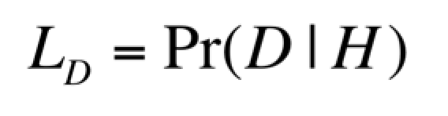
Likelihood function

Slide 4
Given two explanations for a particular outcome which should we choose?
The explanation that makes the observed outcome more likely...
More formally if given some data D and a hypothesis H the likelihood of those data is given by L_{D} = Pr (D | H)
Which is the probability of D given H.

Slide 5

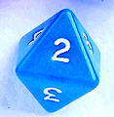

Three dice example...
Maximum Likelihood
6 face die
8 face die
12 face die
A person rolls two dice and obtains the score “14”
Which pair of dice are the most likely to have yielded this result?
Equivalent to: which tree is most likely to have yielded these sequences?

Slide 6
Maximum Likelihood
How many ways of obtaining the score “14” are there for each pair?
+
+
+
6 + 8
2 + 12
3 + 11
4 + 10
5 + 9
6 + 8
2 + 12
3 + 11
4 + 10
5 + 9
6 + 8
7 + 7
8 + 6
1
5
7

Slide 7
Maximum Likelihood
What is the probability of any single outcome for each of the three sets of pairs?
+
+
+
1/6 x 1/8
1/6 x 1/12
1/8 x 1/12
= 1/48
= 1/ 72
= 1/96

Slide 8
Maximum Likelihood
Now multiply ways of obtaining the score “14” by the probability of any single outcome to get the likelihood.
+
+
+
1/48 x 1
1/ 72 x 5
1/96 x 7
0.0208
0.0694
0.0729
maximum likelihood

Slide 9
In the context of molecular phylogenetics ...
Maximum Likelihood
L_{D} = Pr (D | H)
Likelihood _{D} = probability of Data
given Hypothesis
D is the set of sequences being compared
H is a phylogenetic tree…
We want to find the likelihood of obtaining the observed data given the tree.
The tree that makes the data the most probable outcome is the Maximum Likelihood estimate of the phylogeny.

Slide 10

Basic evolutionary models
Topology and branch length
Substitution matrix
r_{TC} (= r_{CT}), r_{TA} (= r_{AT}), r_{TG} (= r_{GT})
r_{CA} (= r_{AC}), r_{CG} (= r_{GC})
r_{AG} (= r_{GA})
Stationary base frequencies
f_{T}, f_{C}, f_{A}, f_{G},
Taxa 1
Taxa 2
Taxa 3
Taxa 4
Taxa 5

Slide 11
The likelihood of a given tree
Given a model of sequence evolution and proposed tree structure, likelihood the known sequences would have evolved on that tree can be calculated.

Slide 12
Important to distinguish between likelihood and probability
Maximum Likelihood
Probabilities sum to 1, likelihoods do not.
Given a tree and a model, could work out probability of obtaining all possible data sets(which is infinite). The sum of these probabilities would = 1
But we are interested in just one data set - the one we observed
n.b. the likelihood is not the probability that the tree is the true tree, merely the probability that the tree gave rise to the DATA.

Slide 13
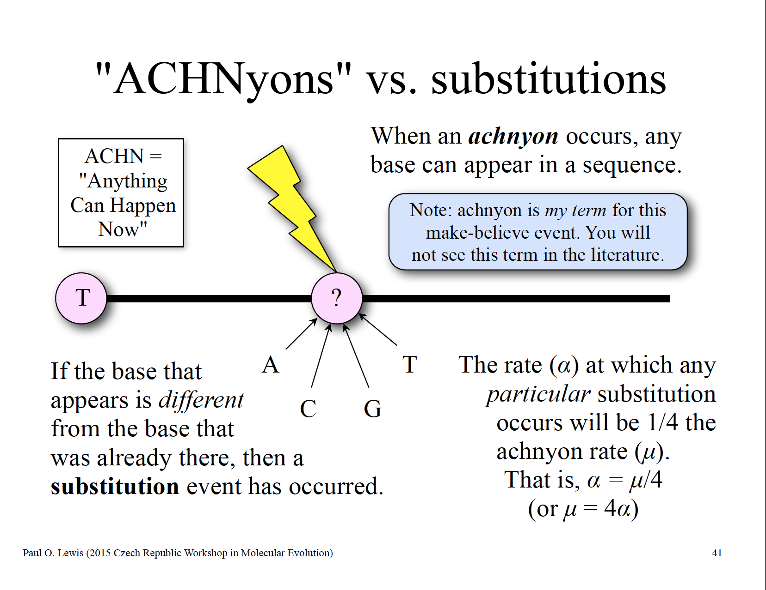

Slide 14
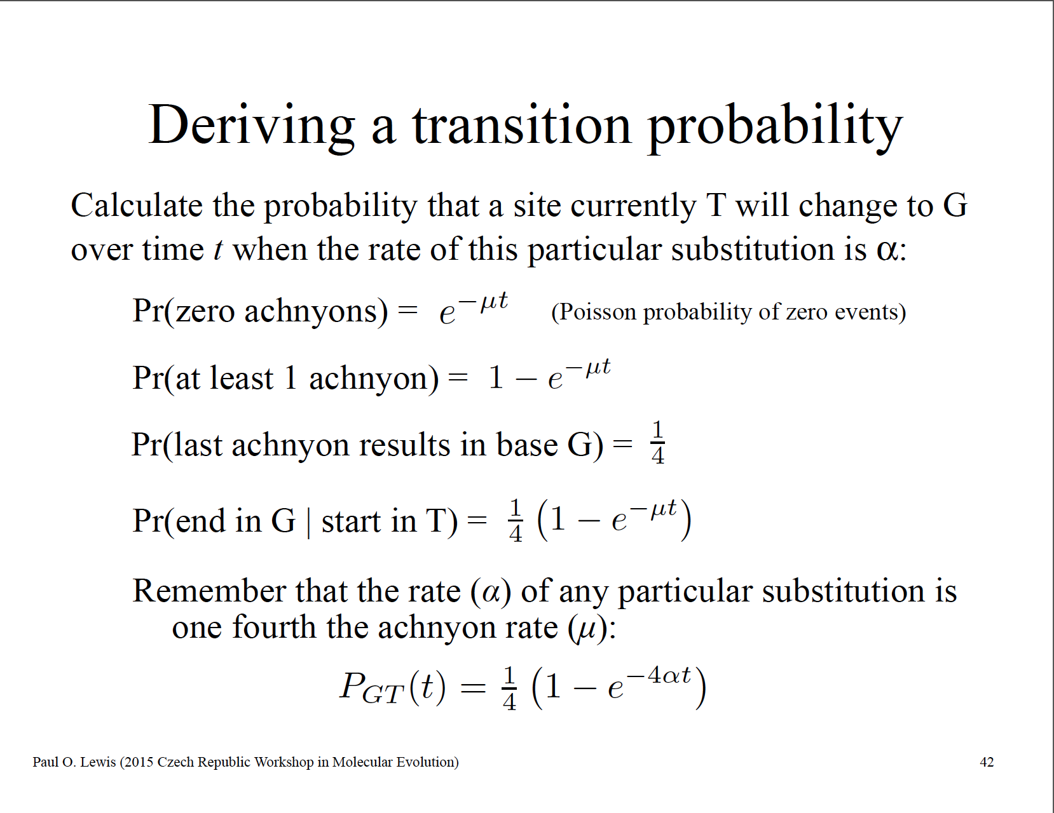

Slide 15
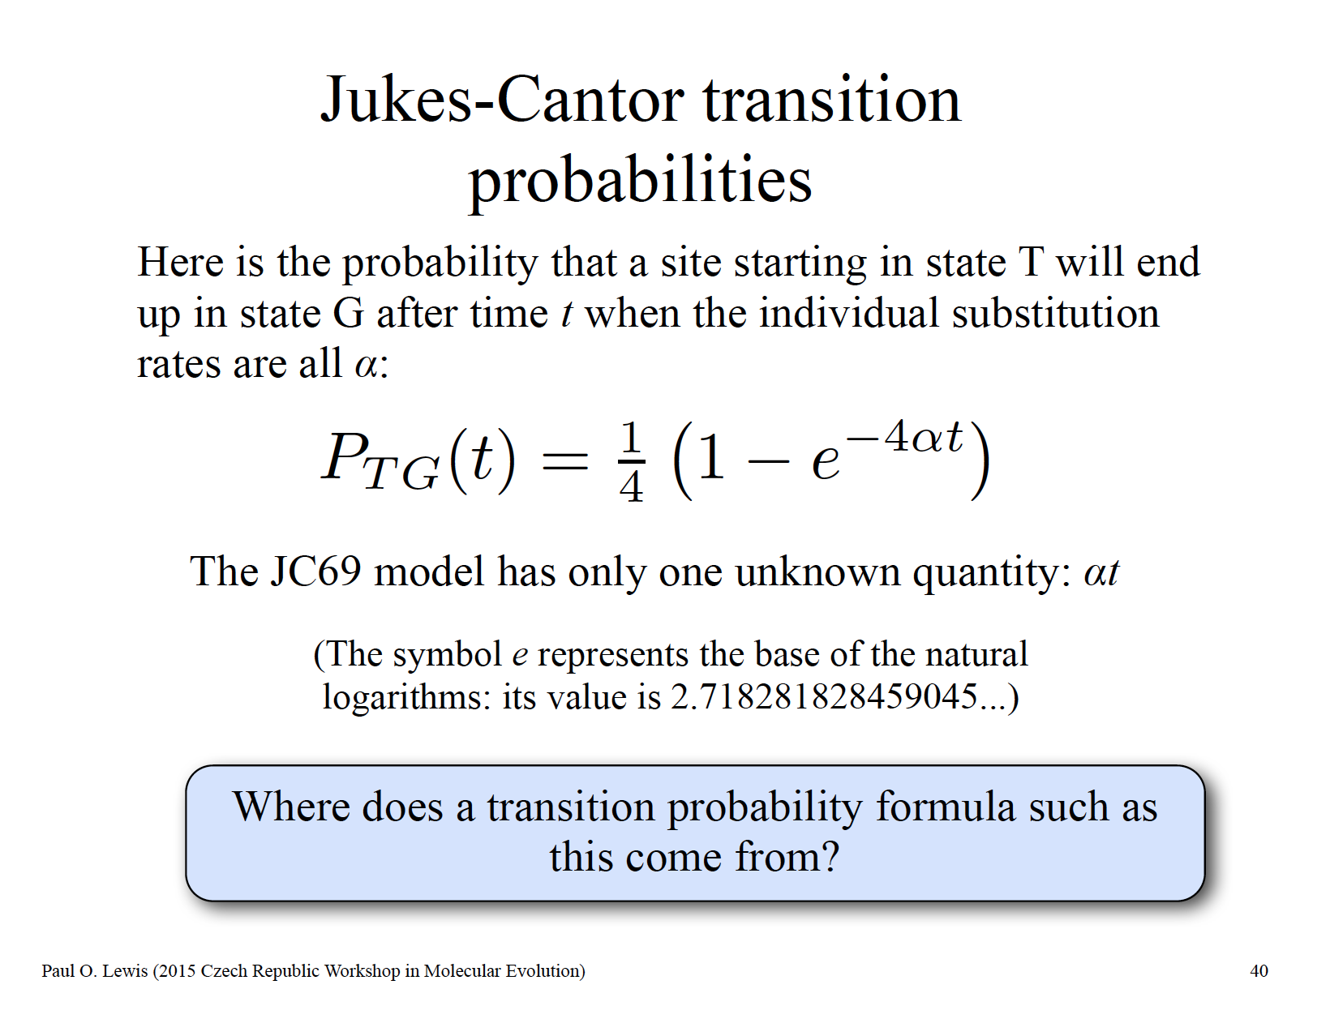

Slide 16
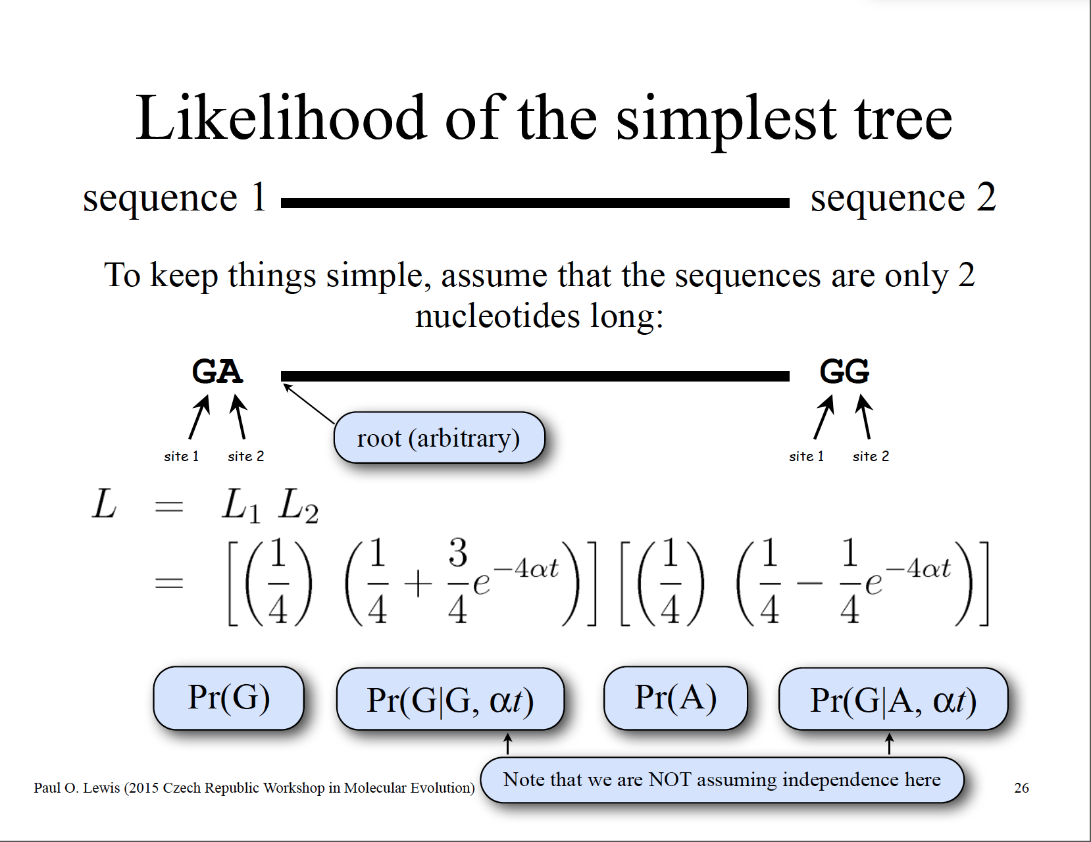

Slide 17
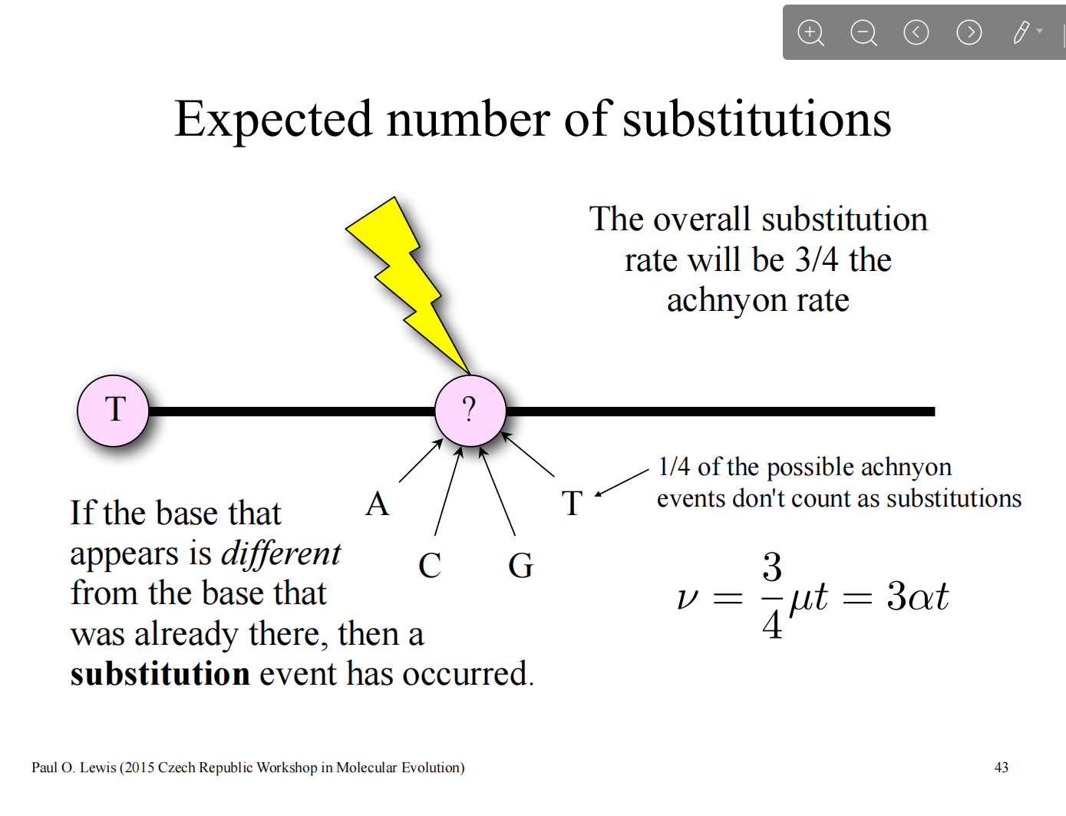

Slide 18
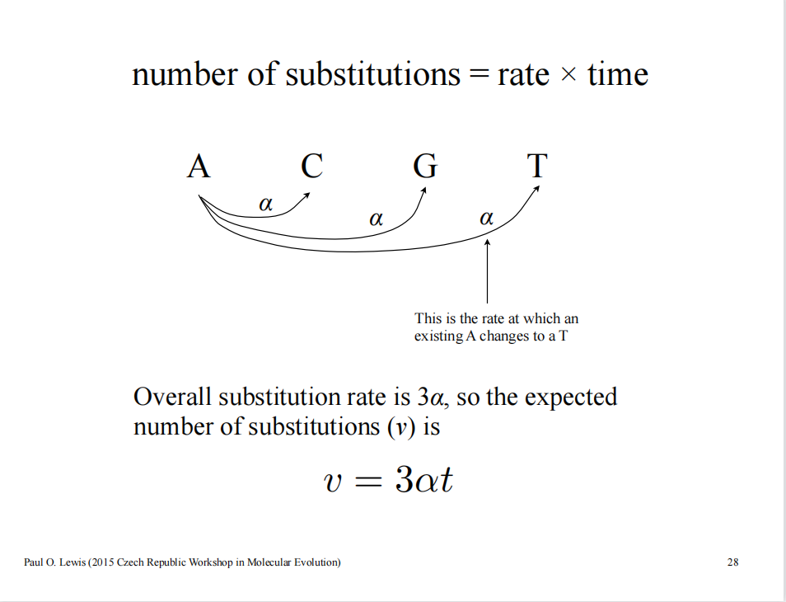

Slide 19
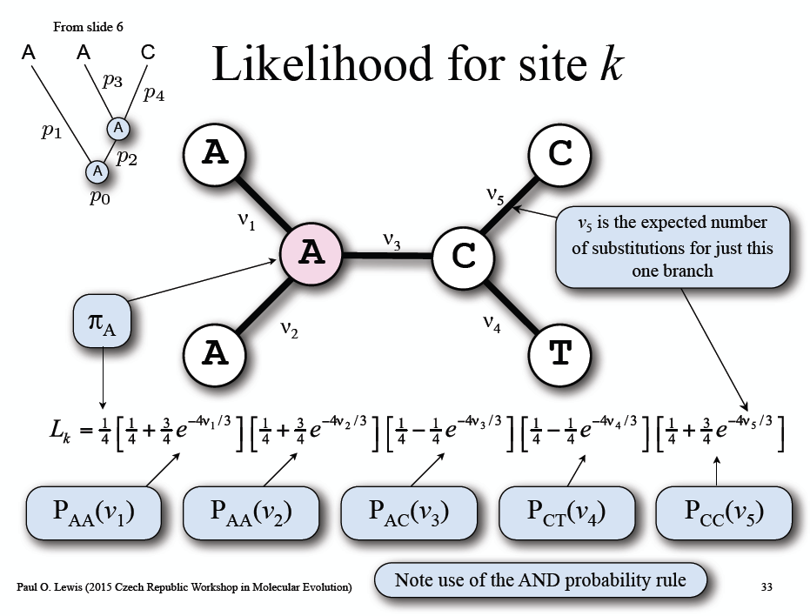
The likelihood of a given tree
For more sites (in assumption of JC model)

Slide 20
Prerequisite Knowledge
Model of DNA Evolution
pAA pAC pAG pAT
pCA pCC pCG pCT
pGA pGC pGG pGT
pTA pTC pTG pTT
Pt=
Pij means the probability of start with base i and with base j at the end of time interval t
f=[fA fC fG fT]
means the equilibrium frequency of A,T,C,G

Slide 21
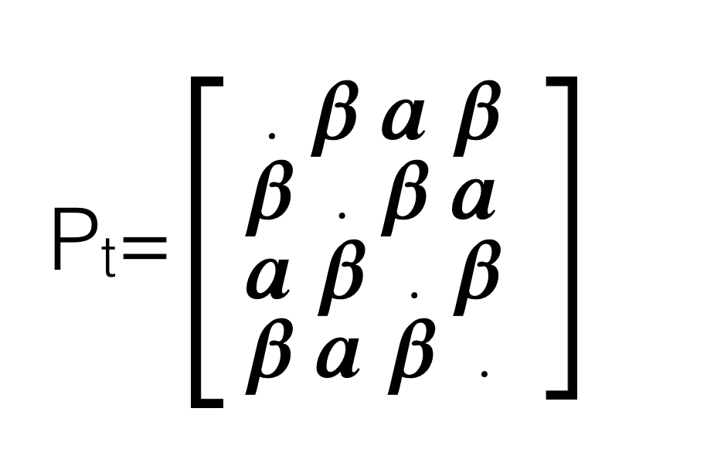
Model of DNA Evolution
Jukes-Cantor(JC)
. 𝒂 𝒂 𝒂
𝒂 . 𝒂 𝒂
𝒂 𝒂 . 𝒂
𝒂 𝒂 𝒂 .
Pt=
f=[1/4 1/4 1/4 1/4]
Kimura’s 2Parameters(K2P)
f=[1/4 1/4 1/4 1/4]
𝒂=transition
𝜷=tranversion

Slide 22
Model of DNA Evolution
Felsenstein(1981) (F81)
. 𝛑C𝒂 𝛑G𝒂 𝛑T𝒂
𝛑A𝒂 . 𝛑G𝒂 𝛑T𝒂
𝛑A𝒂 𝛑C𝒂 . 𝛑T𝒂
𝛑A𝒂 𝛑C𝒂 𝛑G𝒂 .
𝛑i isthe composition of i th
base averaged over sequences
Pt=
f=[𝛑A 𝛑C 𝛑G 𝛑T]
Hasegawa, Kishino and Yano(HKY)
. 𝛑C𝜷 𝛑G𝒂 𝛑T𝜷
𝛑A𝜷 . 𝛑G𝜷 𝛑T𝒂
𝛑A𝒂 𝛑C𝜷 . 𝛑T𝜷
𝛑A𝜷 𝛑C𝒂 𝛑G𝜷 .
Pt=
f=[𝛑A 𝛑C 𝛑G 𝛑T]

Slide 23
Model of DNA Evolution
General Times-Reversible model(GTR)
. 𝛑Ca 𝛑Gb 𝛑Tc
𝛑Aa . 𝛑Gd 𝛑Te
𝛑Ab 𝛑Cd . 𝛑Tf
𝛑Ac 𝛑Ce 𝛑Gf .
a-f means 6 possible substitution has its own probability
Pt=
f=[𝛑A 𝛑C 𝛑G 𝛑T]

Slide 24
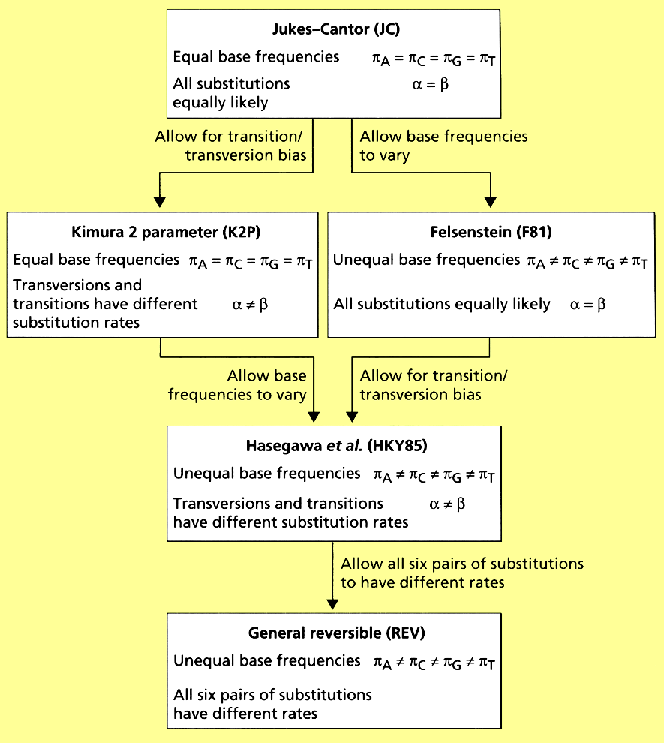
Summary Comparison of Models

