Slide 1
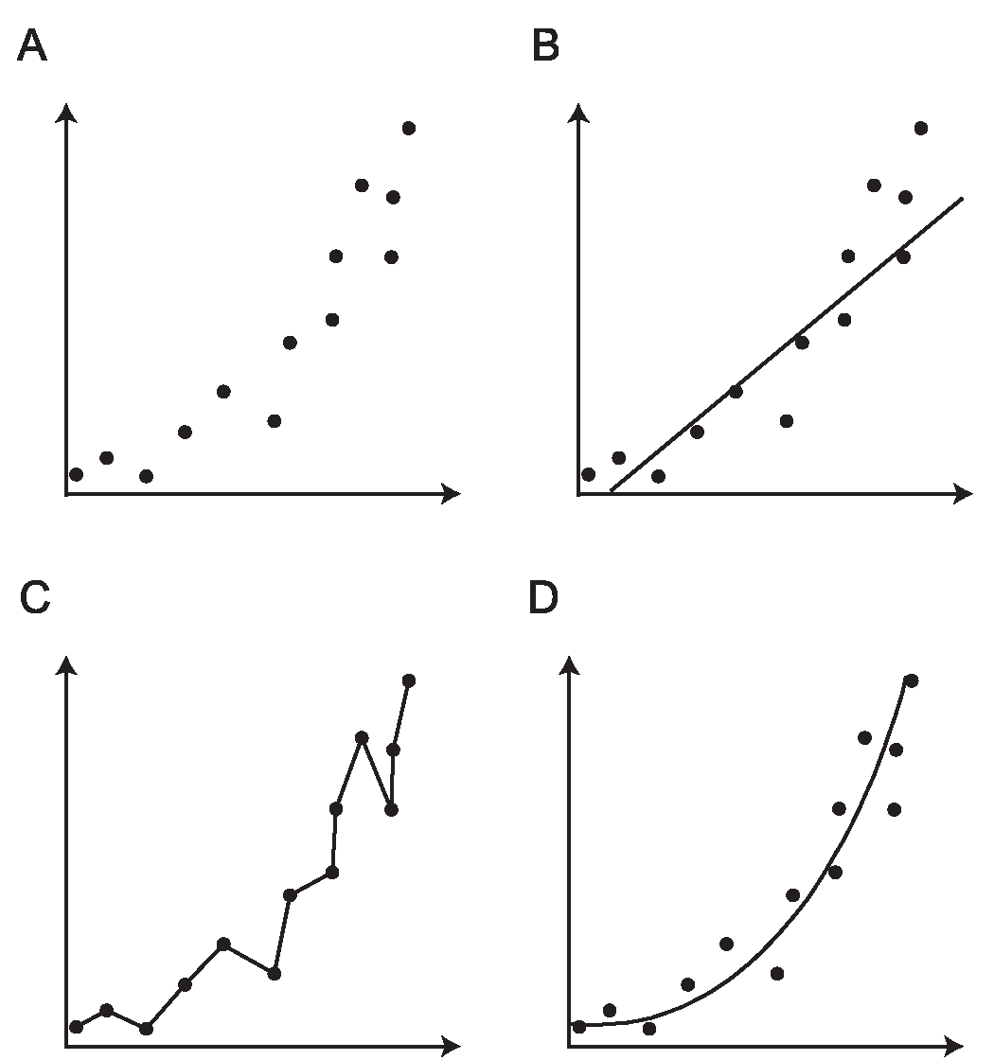
Model selection

Slide 2
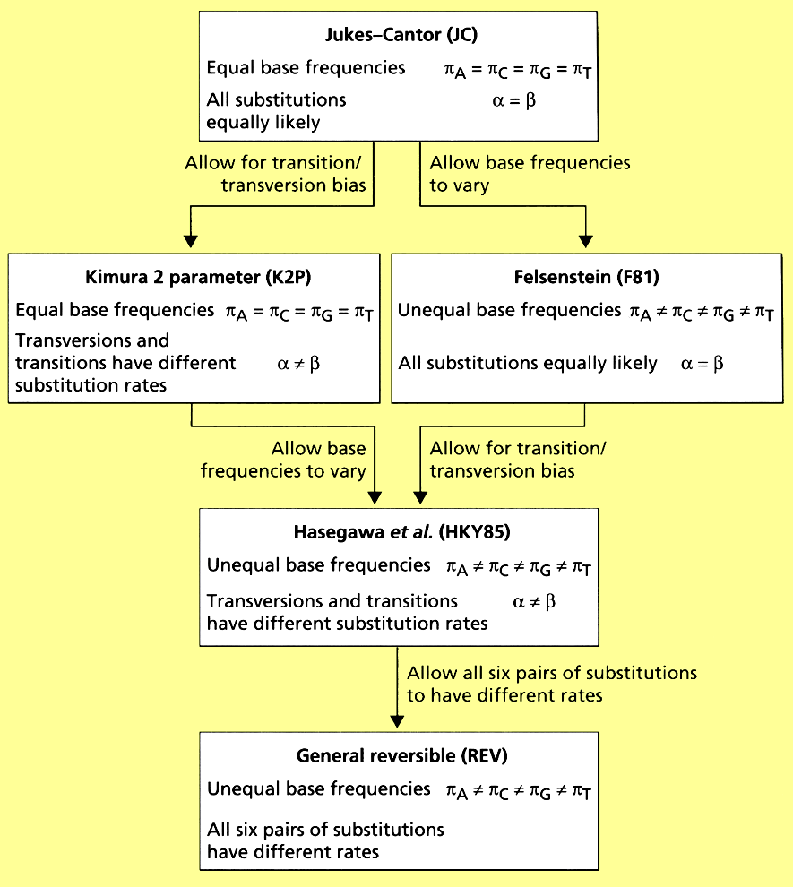
Summary Comparison of Models

Slide 3
Given the range of models, how do we choose among them?
Choose the most realistic. This means adding parameters.
But adding parameters comes at a cost. We must estimate each parameter from our data. The more parameters we add the greater the uncertainty in our estimates - because we are “spreading the data more and more thinly”
Hence a very realistic model may end up with a large sampling error and loose statistical power
Ideally we want the simplest model we can get away with that still yields a reasonable estimate....

Slide 4
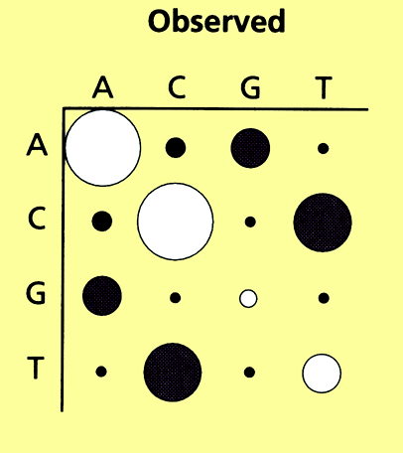
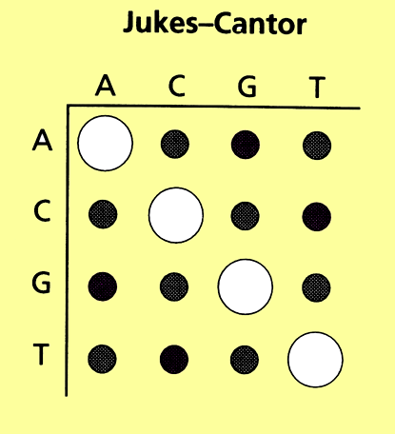
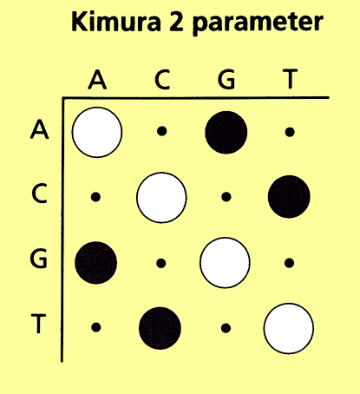
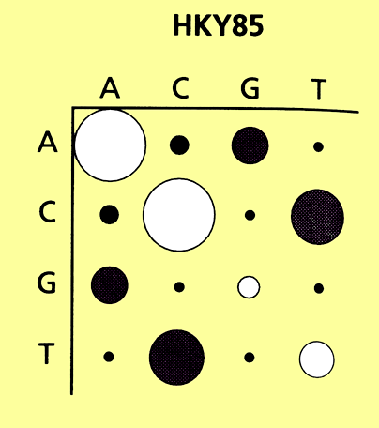
Tamura (1994) aligned and compared chimp and human MtDNA sequences.
Contrasted the observed patterns of difference with those predicted by each of the models.......
307 out of 1333 sites differed between the 2 sequences.
p = 307/1333 = 0.23. (JC distributes these changes evenly etc.)
d = - ³/₄ln (1-⁴/₃p)

Slide 5
Based on visual inspection it looks as though
HKY85 > K2P > JC
*
*
This is borne out by statistical tests using Likelihood scores.

Slide 6
Likelihood ratio tests.
Can test alternative hypotheses for same data.
Likelihood ratio statistic is the ratio of the log-likelihood of the alternative hypothesis (H₁) to the null hypothesis (H₀)
Δ = log L₁ - log L₀
where L₁ is the maximum likelihood of the alt hypothesis, L₀ is the maximum likelihood of the null hypothesis
Can determine significance from X² tables when H₁ is a subset of H_{0.} ie when hypotheses are nested because 2Δ is distributed approx like X²

Slide 7
Is the model valid?
Given the dependence of Likelihood on an explicit model how do we know if model is reasonable?
One way is to see how well a model+tree fit the observed data relative to the theoretical best fit L_{MAX} using a Likelihood ratio test.
Δ = log L_{max} - log L_{tree}

Slide 8
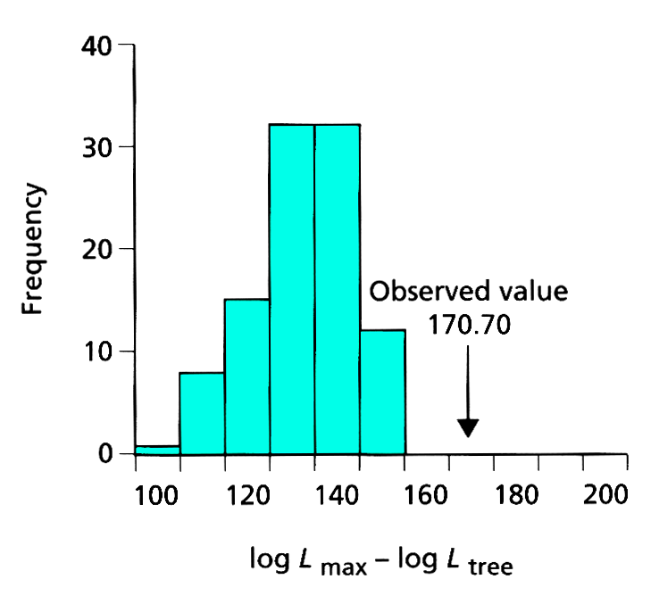
Example: test HKY85 model’s fit to hominoid data set
observed value of log L_{max} - log L_{tree} is outside of expected distribution.....
Thus the HKY model can be rejected for these data

Slide 9
Can we improve the model?
Turns out that if we add among site rate variation to the HKY model the fit of the data to the tree+ model is significantly improved
Note that while HKY + G is better than HKY alone, both models result in trees of the same topology.
Thus the tree topology is robust to violation of the assumptions of the model, but the branch lengths can be greatly affected by choice of model.

Slide 10
Testing molecular clocks....
If sequences are evolving at diff. rates then ultrametric tree will be poor representation of relationships among the sequences....
but if rates were constant, an ultrametric tree would be no worse than an additive tree
Can test with the likelihood ratio test...
2 Δ = log L _{no clock} - log L_{clock}

Slide 11
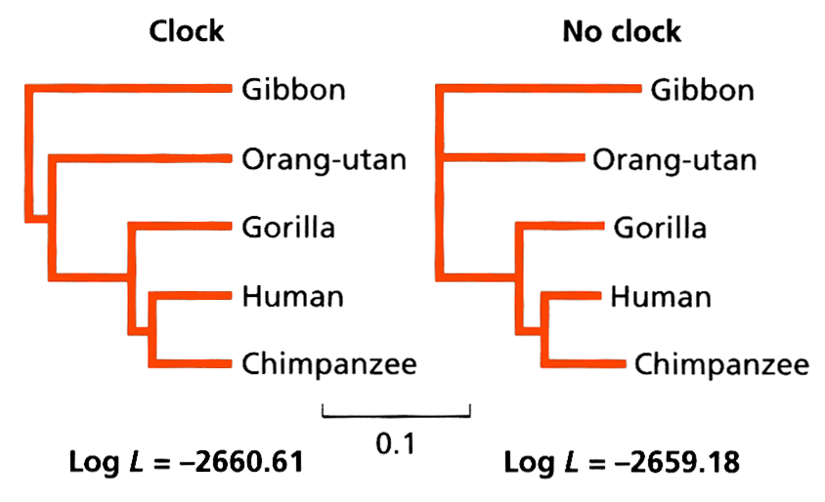
Two tree have the same topology...
2 Δ = log L _{no clock} - log L_{clock}
2 Δ = 2 (-2659.18 - (-2660.61))
value 2.86 compared with X² distribution (for 2 degrees of freedom) NOT SIGNIFICANT Data is consistent w/ mol. clock
note two trees with diff assumptions roughly line up

Slide 12
Comparing Phylogenetic Trees
Can also use likelihood ratio test to evaluate merits of diff topologies.
Given 2 trees can ask if one tree is significantly more likely to have given rise to the data than the other.
Kishino & Hasegawa (1989) proposed a test: Given 2 trees, the diff. in log-likelihoods is computed by taking each site in turn, and finding the difference in log likelihoods for that site on the two trees.
If the sum of the log likelihood differences are not significantly diff from zero, the two trees are not significantly different.

Slide 13
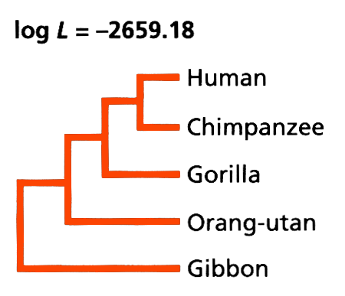
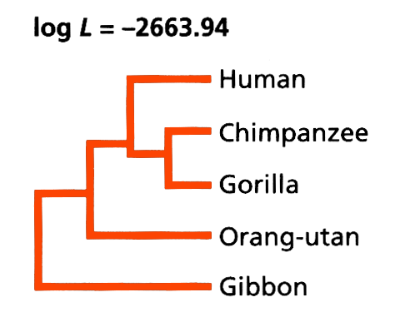
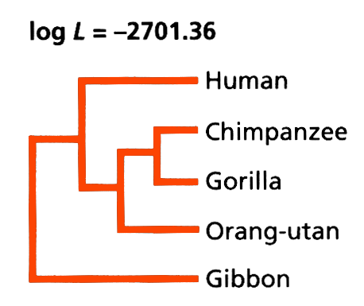
K H Test: example
A
B
C
KH test cannot distinguish between A & B Δ = - 4.76 + 7.97
but can reject “c” (great ape monophyly) Δ = - 42.18 + 14.62
N.B can do a similar test using parsimony called Templeton test

Slide 14
Maximum Likelihood is appealing because it can incorporate explicit models of sequence evolution
Maximum Likelihood
THREE challenges:
(A) For a given topology, which branch lengths make the data most likely
(B) which of all of the possible topologies is the most likely
(C) which of the parameters in transition matrix is the most likely

Slide 15
Markov chain
A Markov chain is a model in which changes in states
follow transition probabilities.
It is a stochastic system, i.e. random process
The probability of the next state depends on the current state,
but can also have a chain with memory
The probability of moving to another state follows a
probability distribution
But it can stay in the same locality, where locality may be in
space or time

Slide 16
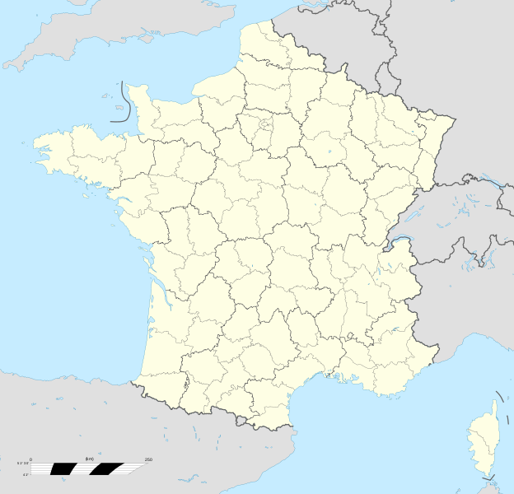
Markov chain Monte Carlo
Monte Carlo: town in Monaco famous for its casino (including the European Poker Tour and World Backgammon Championship)
Relevance ?
both operate on random processes

Slide 17
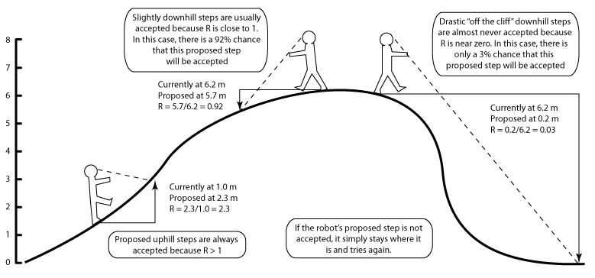
MCMC Robot
http://marple.eeb.uconn.edu/mcmcrobot/?page_id=24

Slide 18

Basic evolutionary models
Topology and branch length
Substitution matrix
r_{TC} (= r_{CT}), r_{TA} (= r_{AT}), r_{TG} (= r_{GT})
r_{CA} (= r_{AC}), r_{CG} (= r_{GC})
r_{AG} (= r_{GA})
Stationary base frequencies
f_{T}, f_{C}, f_{A}, f_{G},
Taxa 1
Taxa 2
Taxa 3
Taxa 4
Taxa 5

