Slide 1
Bayesian analysis

Slide 2
Objections to Likelihood
Requires an explicit model of evolution - (both a strength and a weakness)
What model should we use and what parameters in the model eg ts/tv ratio?
Dilemma. If we knew the probabilities for change we could estimate the tree, but in order to know the probabilities of change we need to know the tree.
One approach is to use the combination of model and parameters that maximizes likelihood, but this is computationally time consuming.

Slide 3
What is Bayesian statistics? (Eddy, 2004, NatureBiotech)
We want to infer something from observed data, but the inference depends on uncertain parameters or missing data in a probability model.
In phylogenetic analysis, the probability of an evolutionary tree given some observed DNA sequences is conditional on a multiple alignment, an evolutionary model, and branch lengths on the tree, all of which are subject to substantial uncertainty, but for which traditional methods try to make single point estimates.

Slide 4
What is Bayesian statistics? (Eddy, 2004, NatureBiotech)
Using Bayesian methods, we can instead integrate over varying degrees of uncertainty in different aspects of the analysis.
The robustness of Bayesian methods in the face of partial information and poorly determined parameters lets us use more complicated, more realistic probability models.

Slide 6
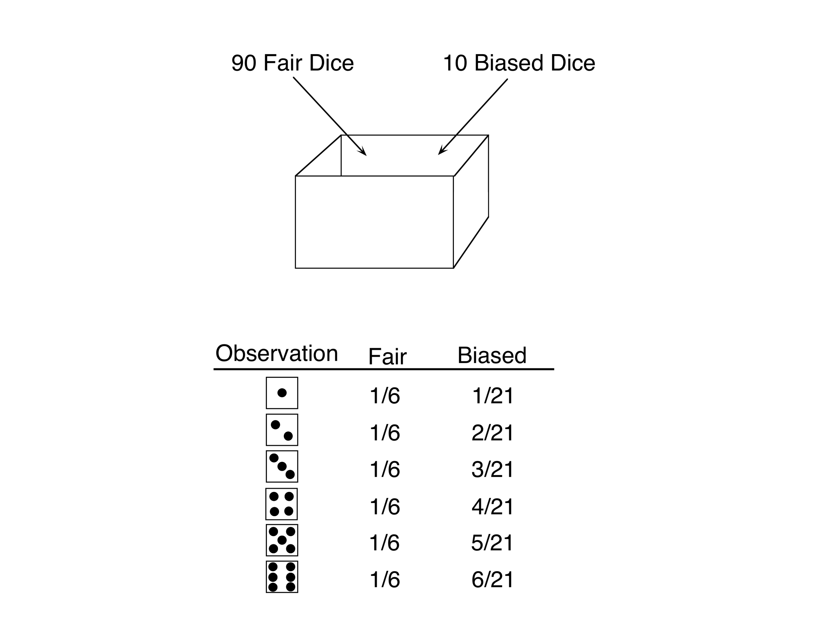

Slide 10
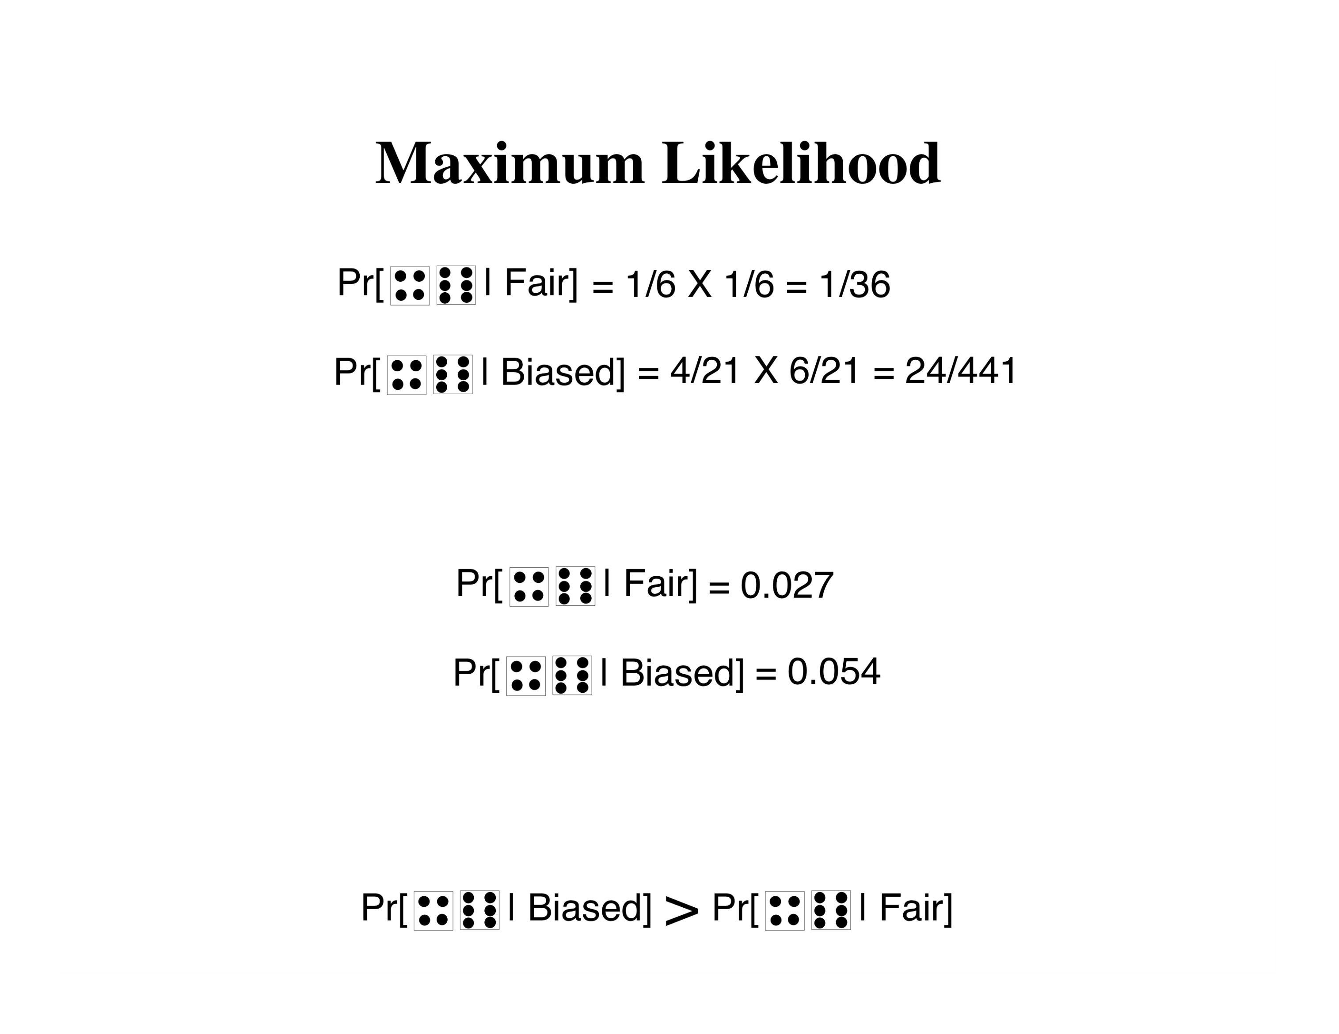

Slide 13
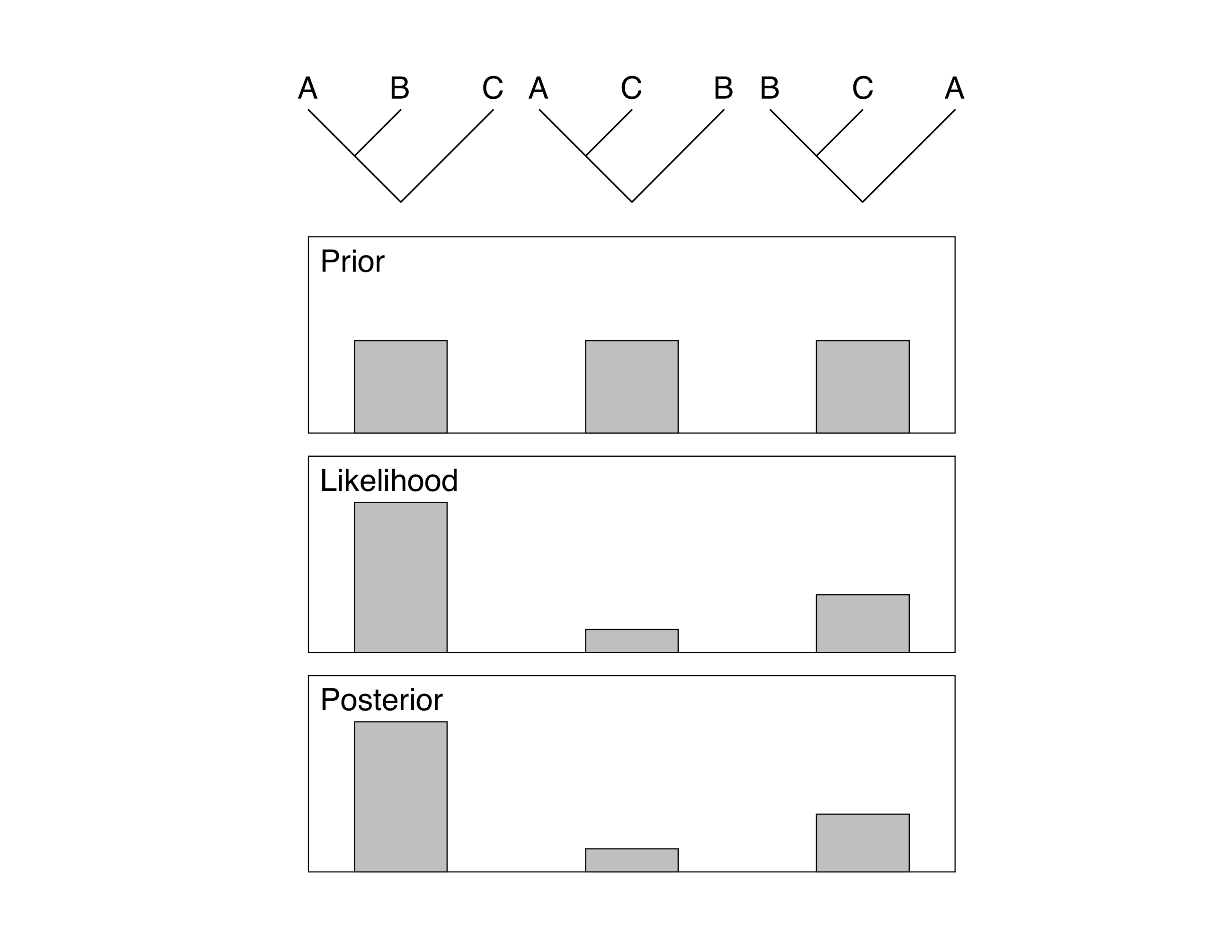

Slide 15
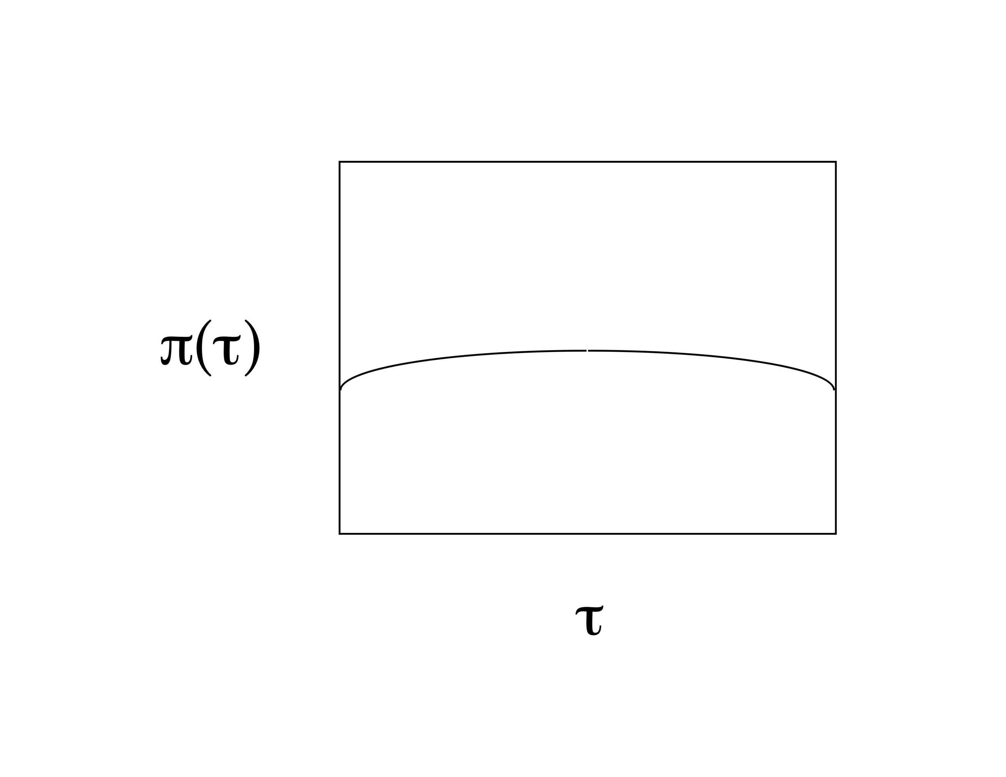

Slide 16
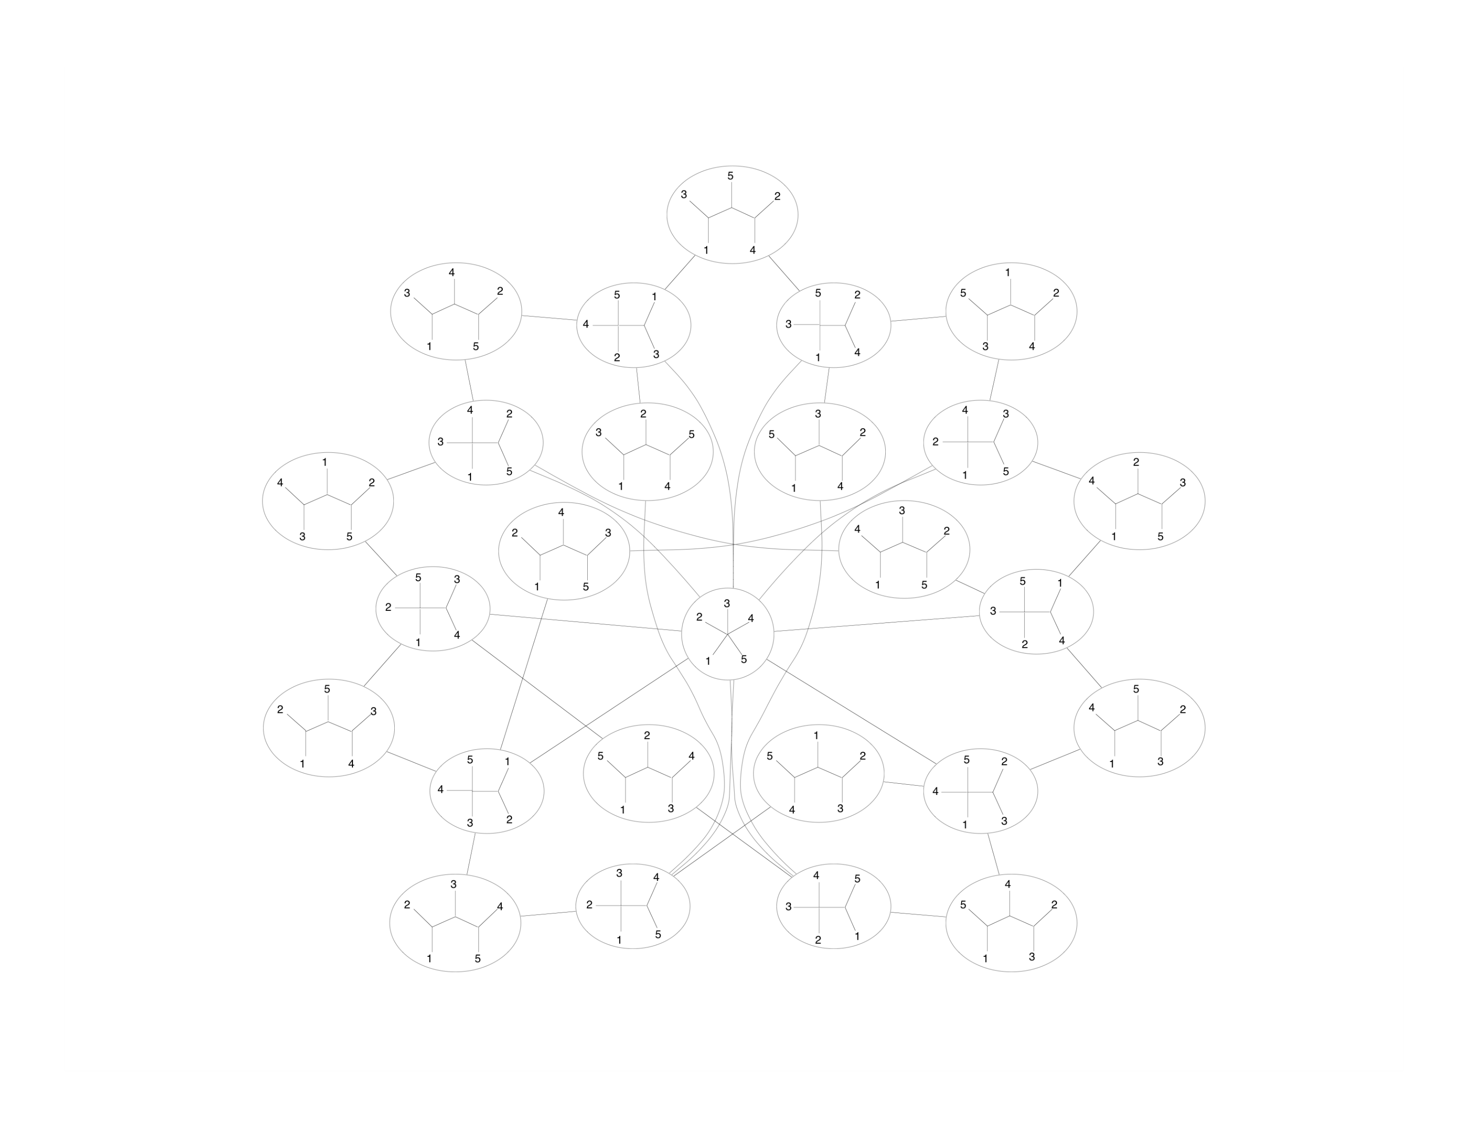

Slide 17
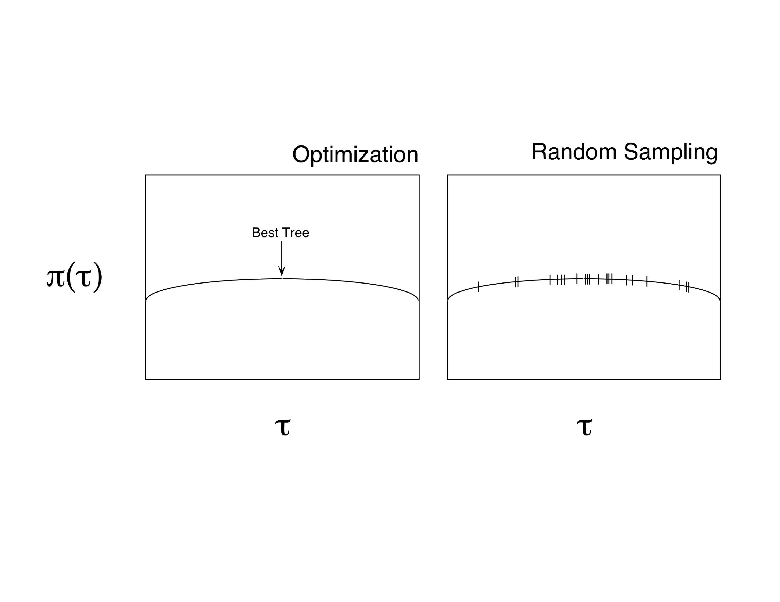

Slide 19
