Slide 1
Putting confidence limits on phylogenies

Slide 2
Most scientific measures are accompanied by some estimate of precision.
For example.... 25 + 0.2 cms
Phylogenies should also be accompanied by some indication of confidence limits
One reason for a poor estimate is sampling error
As a consequence, estimates of phylogeny based on samples will be accompanied by error.

Slide 3
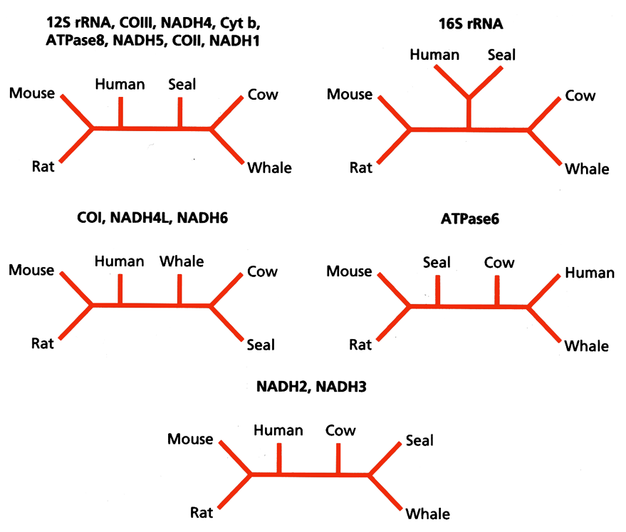
The effect of sampling error can be seen by comparing the trees that result for different genes in the mitochondrion.
Phylogenies for the same 6 mammals based on 15 different mitochondrial genes

Slide 4
Taxon sampling.
Just as we may have limited samples of DNA so we may also have limited samples of taxa.
In the mammalian example, only 6 taxa were used - a small fraction of the total number of extant mammals
Inferred relationships among species can change if additional sequences are added
For clades with a good fossil record, morphological data may prove superior to molecular data if the evidence from extinct taxa are crucial to recovering the phylogeny.

Slide 5
Estimating the sampling error using the non-parametric bootstrap
A good way to measure sampling error is to take multiple samples from the popn. being studied and compare the estimates from the different samples.
The spread of the estimates gives an indication of the sampling error. i.e. how much our conclusions would vary depending on the samples we took.

Slide 6
bootstrap contd...
The n.p. bootstrap invokes the same underlying principal, but rather than re-sample replicates from the population we re-sample pseudoreplicates from the data.
For each pseudoreplicate we derive an estimate of the parameter we are trying to measure (like mean height of population). The variation among the estimates derived from each pseudoreplicate provides a measure of the sampling error.

Slide 7
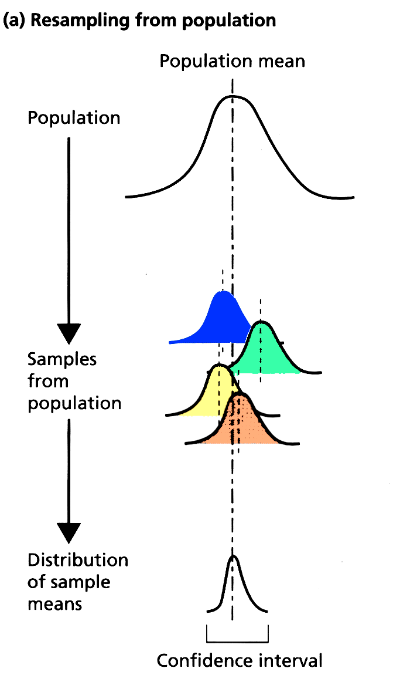
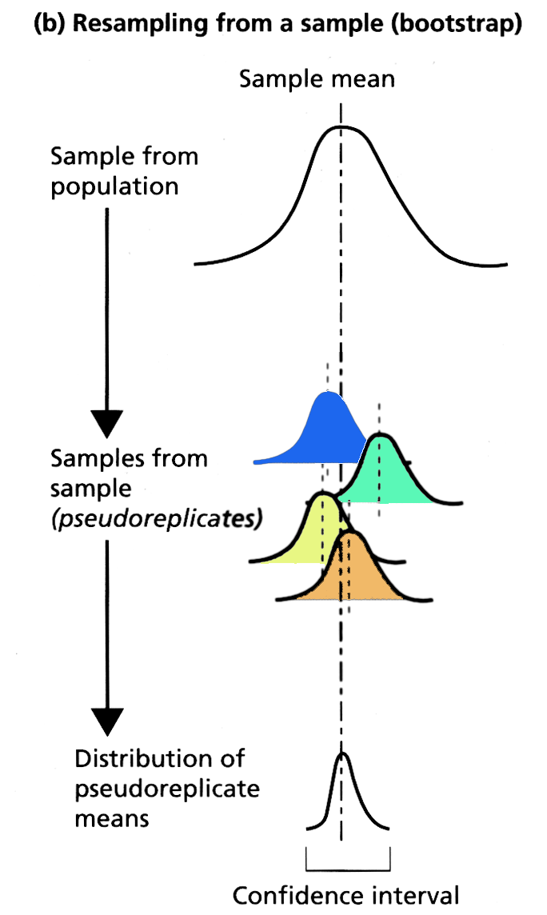
Comparison of methods for estimating sampling error of the estimate of population mean

Slide 8
The bootstrap can be applied to phylogenies
Used to give us a “feel” for how good our inferred tree is
Procedure:
Generate pseudoreplicates from the sequences.
by sampling columns at random w/ replacement until we have a new (fake) data set with the same number of sites as the original
a
a
a
a
gggg
ctct
gggg
cccc
ttcc
gttt
a
a
a
a
agag
gaaa
tcct
original data
2
0
1
0
2
0
3
0
1
1
1
a
a
a
a
a
a
a
a
ctct
cccc
cccc
gttt
gttt
gttt
agag
gaaa
tcct
pseudoreplicate 1

Slide 9
Bootstrap contd.
Estimate the phylogeny for the pseudo-replicate data set
a
a
a
a
a
a
a
a
ctct
cccc
cccc
gttt
gttt
gttt
agag
gaaa
tcct
pseudoreplicate 1
Repeat the process of generating pseudo replicates and estimating its tree a large number of times (100-10,000 times)
This set of trees contains info. on the sampling error.

Slide 10
Because sampling is with replacement, some sites may occur more than once in the pseudoreplicate while others may not be represented at all.
a
a
a
a
gggg
ctct
gggg
cccc
ttcc
gttt
a
a
a
a
agag
gaaa
tcct
original data
2
0
1
0
2
0
3
0
1
1
1
a
a
a
a
a
a
a
a
ctct
cccc
cccc
gttt
gttt
gttt
agag
gaaa
tcct
pseudoreplicate 1
Each pseudoreplicate resembles original data in that it contains ONLY sites found in that data set, but differs in the frequency of the sites represented.

Slide 11
For 100 bootstrap replicates of a hominoid mtDNA data set, three topologies are obtained
The split {orang,gibbon} {human,chimp, gorilla} occurs in all 100 bootstrap replicates (i.e. has 100% bootstrap support).
However, there is a conflict between the relationships among the African apes {human,chimp, gorilla}
This suggests these data lack the information to discriminate among the three hypotheses of relationship

Slide 12
Bootstrap consensus
For small number of taxa, it is feasible to show the kinds of trees resulting from bootstrap replications
For larger numbers of taxa we merely use a consensus tree to summarize the information collectively from each replicate
O
A
E
D
C
B
55
85
100
100

Slide 13
Parametric bootstrap
Cross between a simulation and a bootstrap.
Would like to know if the tree resulting from an analysis is erroneous due to an intrinsic bias in the data.
Involves generating artificial data sets with a computer, but using the tree that was generated from the initial data with a particular model in mind.

Slide 14
Parametric bootstrap contd.
Example: 18s rRNA subjected to parsimony analysis suggests birds and mammals are each others closest living relatives. Morphology and fossil data suggest this is incorrect. (Birds & Crocs sister-taxa w/ morphology)
Possible reason for the conflict is long branch attraction between birds and mammals.
Would like to know: If the traditional tree (bird-croc) is indeed correct, what are the chances that we could mistakenly conclude that the bird-mammal tree was best for these data?
To test this, Huelsenbeck et al 1996 simulated the evolution of 18s on the 3 possible trees for 4 taxa to see how often the various tree-building methods recovered the correct tree.

Slide 15
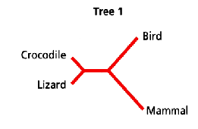
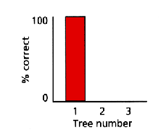
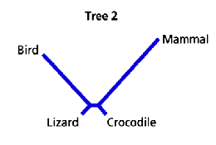
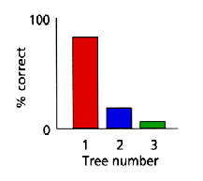
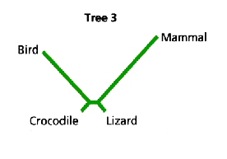
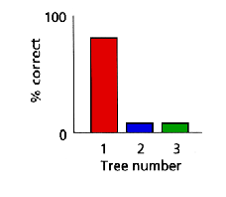
Huelsenbeck et al 1996
Assumed tree
Freq. of each tree
recovered
Estimated branch lengths and ts/tv ratio from original data when applied to each of the possible trees for 4 taxa
Used the parameters they obtained to generate 1000 artificial data sets same size as original.
Results show that no matter which topology the sequences were evolved on, tree 1 was recovered 85% of the time.
So even if tree 3 is correct as suggested by morphology, the 18s data would likely support tree 1.

