Slide 1
Sources of error in phylogenetic reconstruction
Sampling error
Systematic errors

Slide 2
Sampling errors
Stochastic errors
Often being a problem with small sampling sizes
e.g. standard error of estimation of population mean decreases with sampling size
se = sd
√ n

Slide 3
Systematic errors
Systematic caused by incorrect modeling.
Lead to inconsistency, which means that more data will converge to the wrong answer.
Usually resulted from under-parameterized models.

Slide 4
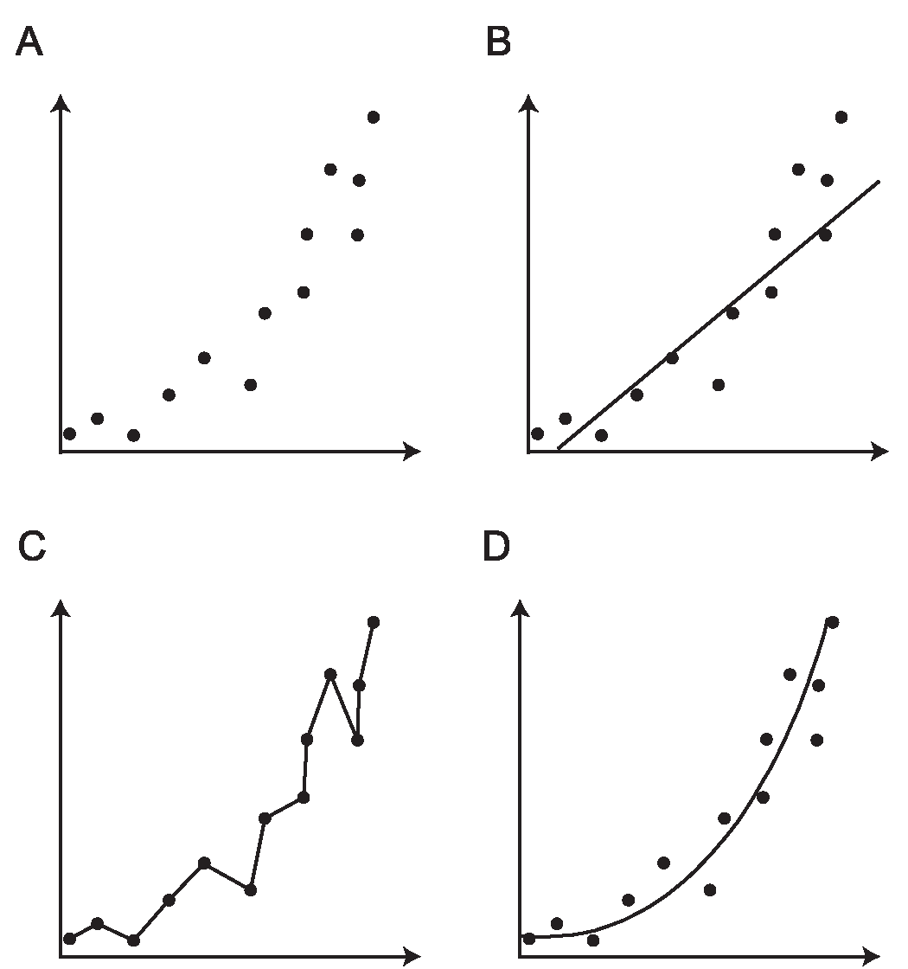
An Illustration of the General Properties of Model Selection (Pybus OG ,2006)
(A) A hypothetical dataset consisting of thirteen points plotted on two axes.
(B) A simple model, represented by a straight line through the points.
(C) A very complex model, which fits the data almost perfectly but has too many parameters.
(D) A model with an intermediate number of parameters represented by a curve. This fits the data well but still has relatively few parameters and therefore has greater explanatory power.

Slide 5
Systematic errors: analytical factor
Long-branch attraction
Non-stationarity
Among site rate variation
Heterotachy
etc.

Slide 6
Basic evolutionary models
Topology and branch length
Substitution matrix
r_{TC} (= r_{CT}), r_{TA} (= r_{AT}), r_{TG} (= r_{GT})
r_{CA} (= r_{AC}), r_{CG} (= r_{GC})
r_{AG} (= r_{GA})
Stationary base frequencies
f_{T}, f_{C}, f_{A}, f_{G},
Taxa 1
Taxa 2
Taxa 3
Taxa 4
Taxa 5

Slide 7
Assumptions in basic models
The evolution of characters follows a Markov model with Poisson distribution, but some evidence suggest the overdispersed point process fits the data better .
Each site evolves independently and according to the identical process, so called “i.i.d.” process.
Molecular clock assumption describes the evolutionary rate as constant along the evolutionary process.

Slide 8
i.i.d. assumption
Each site evolves independently and according to the identical process, so called “i.i.d.” process.

Slide 9
Assumptions in basic models
Q...... Are these assumptions reasonable?

Slide 10
INDEPENDENCE?
We assume that change at one site has no effect on other sites. Frequently violated. eg. Ribosomal RNA
A substitution in a stem region can result in a pair of nucleotides that cannot “Watson-Crick pair” correctly, reducing stability of the structure.
Often we find that single changes are accompanied by compensatory changes.
Clearly violates the independence assumption.
Weight differently for stem and loop sites

Slide 11
Identical or variation in rates of substitution among sites?
All of the methods presented assume that each site in a sequence is equally likely to undergo substitution.
If rates of substitution vary, can have considerable influence on sequence divergence (i.e. how much change we estimate to have occurred)
Consider the case where some sites are free to vary while others are constrained to be invariant

Slide 12
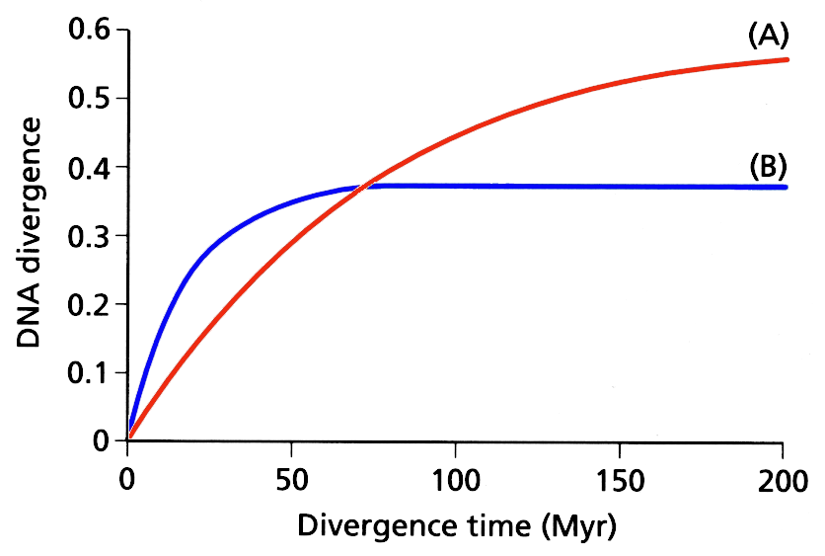
If a large proportion of sites are not free to vary then paradoxically, sequences that evolve at a fast rate can appear to show less sequence divergence than more slowly evolving sequences that have fewer constraints.
(A)
rate of subst. 0.5%/Myr: 80% of sites free to vary
(B)
rate of subst. 2%/Myr: 50% of sites free to vary

Slide 13
In reality sites show a range of probabilities of distribution of rates
Challenge is to develop a tractable model of the rate variation
Most widely used approach uses the “gamma distribution”
Gamma distrib has a shape parameter α that specifies range of rate variation among sites
small values of α result in L-shaped distrib. larger values smaller range of rates.
when α > 1 distribution is “bell shaped”

Slide 14
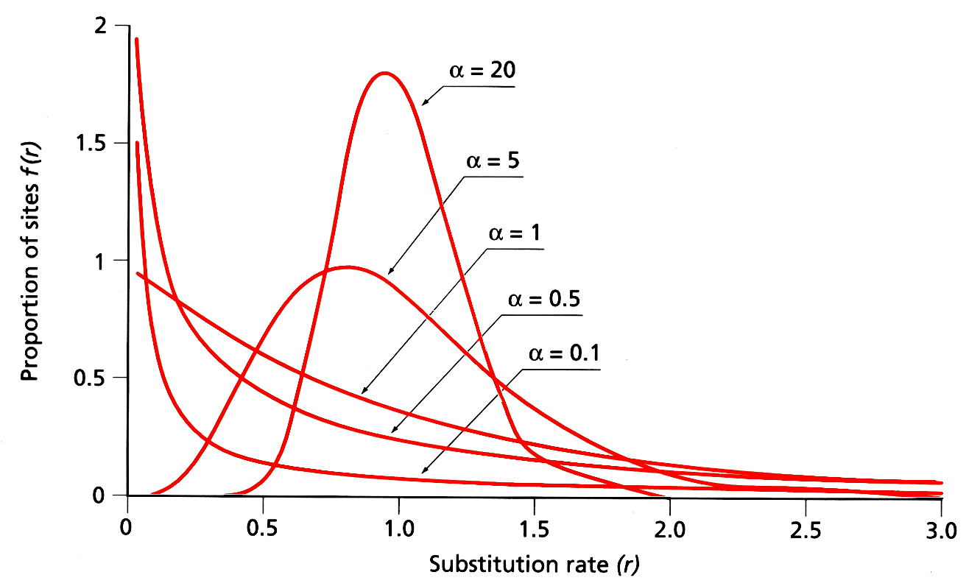
Estimates of alpha vary from nuclear and mitochondrial genes vary between 0.16 (12sRNA) - 1.37 (prolactin)
note. Values of α from first & 2nd codon positions tend to be smaller than
those from 3rd codon positions

Slide 15
Can modify models of evolutionary change to include the gamma distribution - typically represented by the symbol Γ
HKY + Γ

Slide 16
Base Composition Equilibrium?
Assumes that base composition is roughly the same over the collection of sequences.
Deviations from this assumption occur commonly and often lead to misleading inferences.
When constructing trees there is a tendency to cluster sequences together that have similar base compositional profiles.
Explicitly modeling the non-stationary process

Slide 17
Compositional bias (non-stationary)
“Compositional bias can result in the artefactual grouping of species with similar nucleotide composition, because most methods assume the homogeneity of the substitution process and the constancy of sequence composition (stationarity) through time ” (Delsuc et al. 2005).
A
50%
B
70%
C
70%
D
50%
A
50%
B
70%
C
70%
D
50%
50%

Slide 18
Long branch attraction
A
C
A
C
“Intuitively, with long branches leading to speices A and C, the probability of parallel changes that arrive at the same state becomes greater than the probability of an informative single change in the interior branch of the tree” (Felsenstein, 2004).
B
D
B
D

