Slide 1
Pattern matching
Pairwise alignment is not the best way to diagnose a sequence as a member of gene family
Results can be dominated by irrelevant matches
Sequence similarity can’t be directly used as a proxy for functional homology
Know examples of sequences of a given class can be used to determine if an unknown sequence belongs to the same family

Slide 2
Pattern
A pattern can be more or less anything that is unique to the sequences of the class of interest.
Patterns describe features that are common to all member of the class.
Patterns have to be sufficiently flexible to account for some degree of variation.

Slide 3
A good method should have high sensitivity, i.e., it should correctly identify as many true-positive members of the family as possible.
It should also have high selectivity, i.e., very few false-positive sequences should be incorrectly predicted to be members of the family

Slide 4
Position specific scoring matrix (PSSM)
Matching any given amino acid at a given position.
Not only matching is important, but also where (which position) the matching is also is important.

Slide 5
Three different methods
Regular expressions
Fingerprints
Blocks

Slide 6
Regular expressions (regexs)
The simplest pattern-recognition method
Used by PROSITE (Falquet et al. 2002)

Slide 7
Definition of regexs

Slide 8
Permissive regex

Slide 9
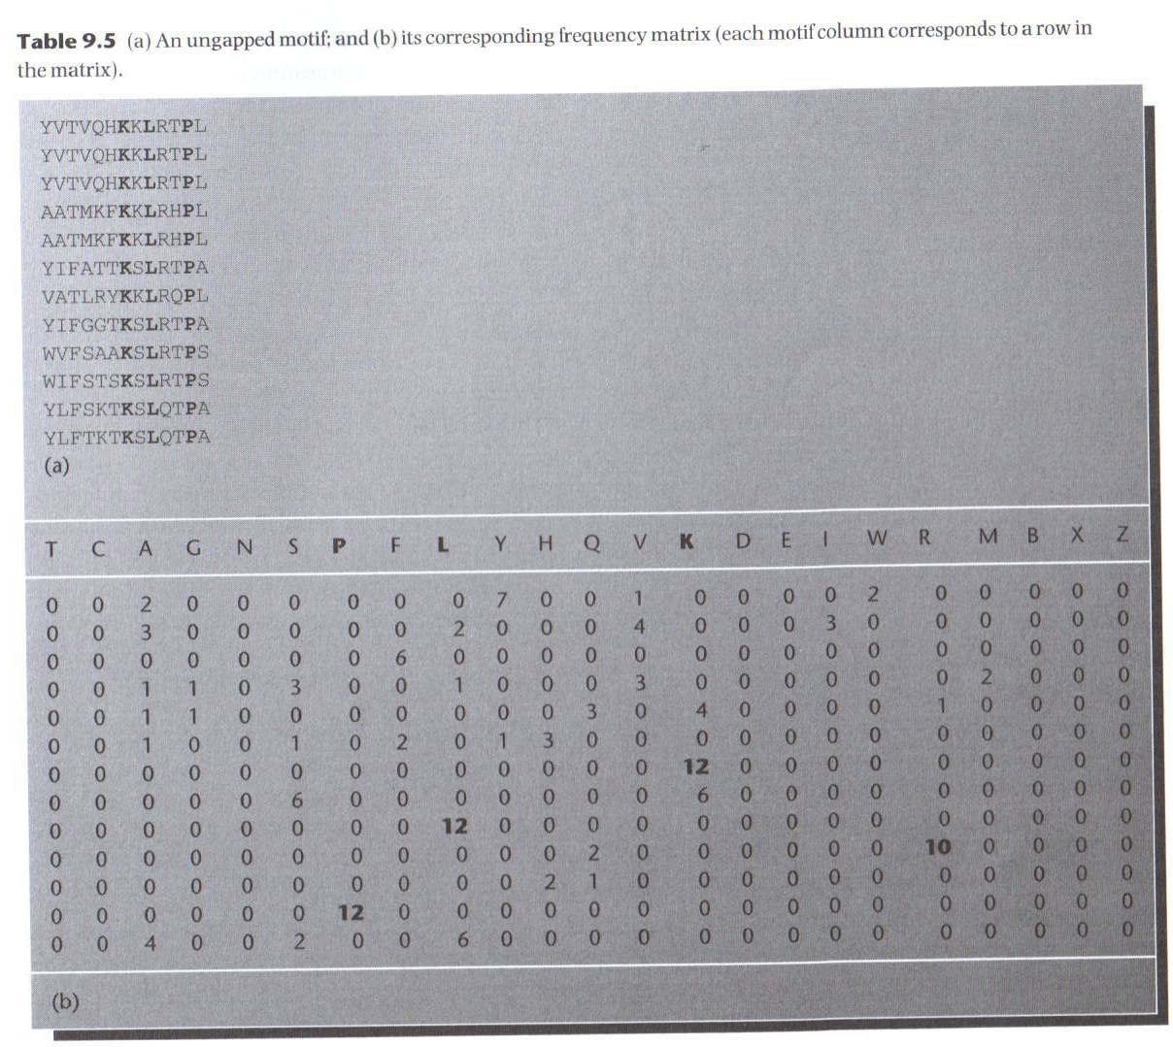
Fingerprints

Slide 10
Fingerprint
Used in PRINTS (Attwood et al., 2003)

Slide 11
Its diagnostic power is refined by iterative scanning of a SWISS-PROT/TrEMBL.
Full diagnostic potency deriving from the mutual context provided by motif neighbours.

Slide 12
Blocks
BLOCKS database
Reduce multiple contribution to residue frequencies from groups of closely related sequences.
Each cluster is treated as a single segment and assigned a weight

Slide 13
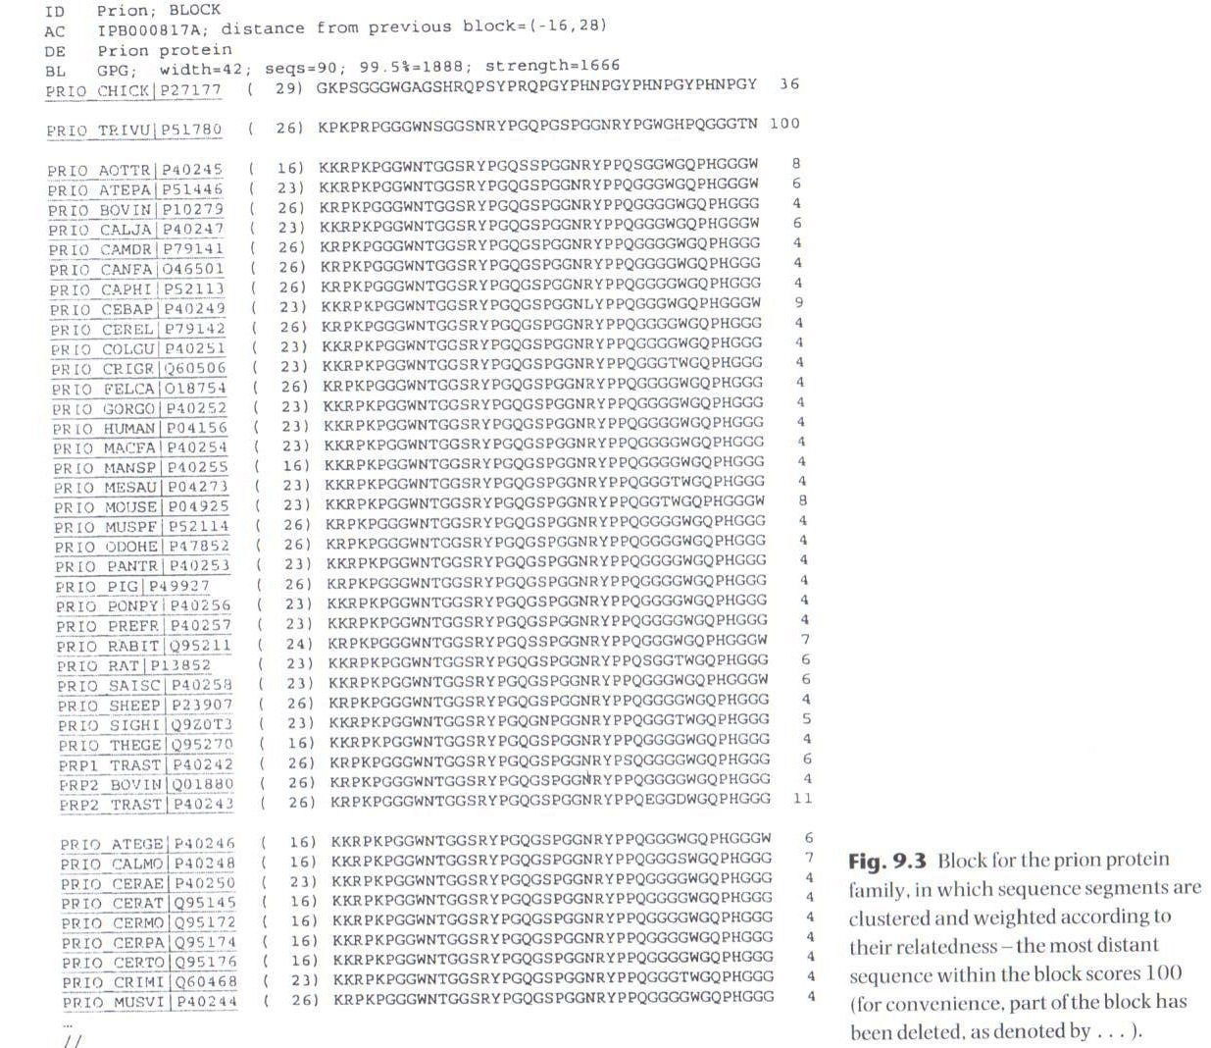

Slide 14
Profiles
By contrast with motif-base pattern-recognition techniques, an alternative approach is to distil the sequence information within complete alignments into scoring tables, or profiles.
Help in diagnostic sequences with high divergence.

Slide 15
Pfam

Slide 16
PROSITE

Slide 17
