Slide 1
Hidden Markov model

Slide 2
Applications
Speech recognition
Machine translation
Gene prediction
Sequences alignment
Time Series Analysis
Protein folding
…

Slide 3
Markov Model
A system with states that obey the Markov assumption is called a Markov Model
A sequence of states resulting from such a model is called a Markov Chain.

Slide 4
An example

Slide 5
Hidden Markov model
A hidden Markov model (HMM) is a statistical Markov model in which the system being modeled is assumed to be a Markov process with unobserved (hidden) states.

Slide 6
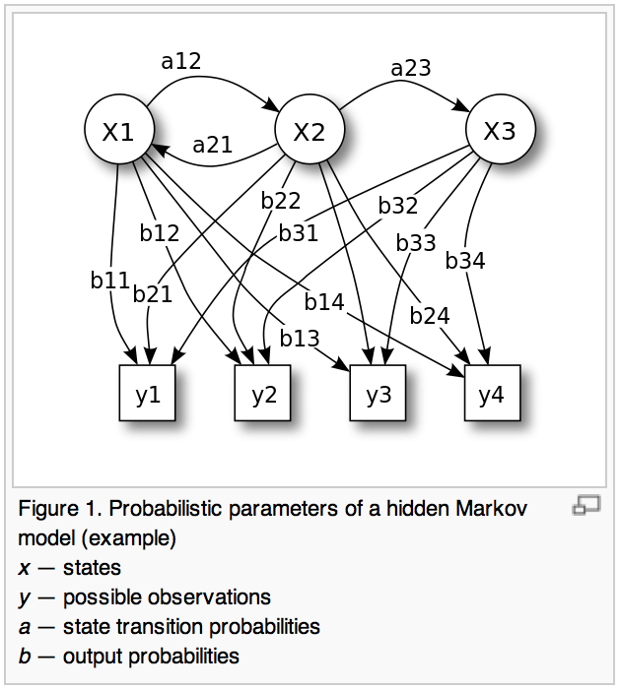

Slide 7
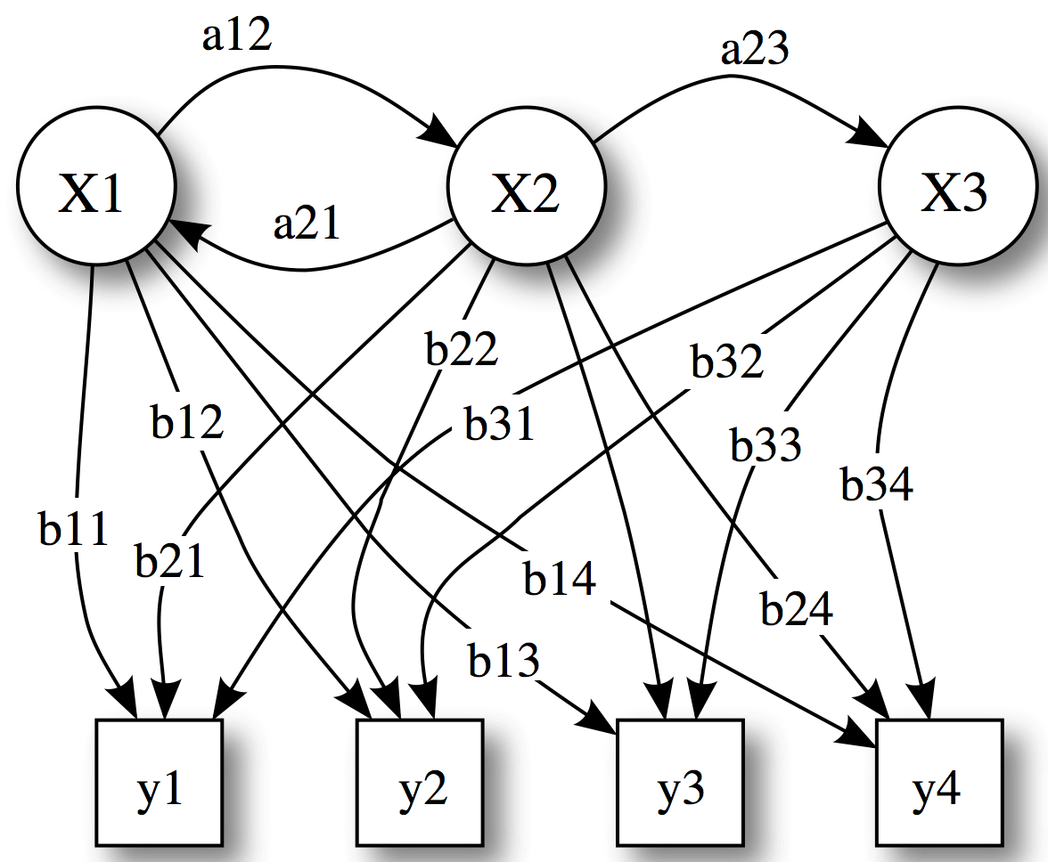
Notice that only the observations y are visible, the states x are hidden to the outside. This is where the name Hidden Markov Models comes from

Slide 8
Hidden Markov Models
Components:
Observed variables
Emitted symbols
Hidden variables
Relationships between them
Represented by a graph with transition probabilities
Goal: Find the most likely explanation for the observed variables

Slide 9
The occasionally dishonest casino
A casino uses a fair die most of the time, but occasionally switches to a loaded one
Fair die: Prob(1) = Prob(2) = . . . = Prob(6) = 1/6
Loaded die: Prob(1) = Prob(2) = . . . = Prob(5) = 1/10, Prob(6) = ½
These are the emission probabilities
Transition probabilities
Prob(Fair → Loaded) = 0.01
Prob(Loaded → Fair) = 0.2
Transitions between states obey a Markov process

Slide 10
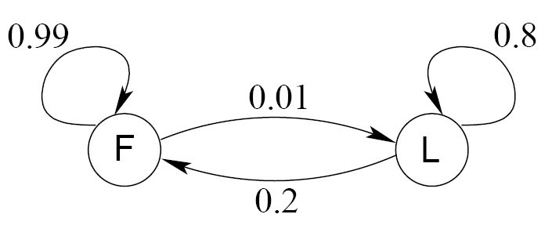
An HMM for the occasionally dishonest casino

Slide 11
The occasionally dishonest casino
Known:
The structure of the model
The transition probabilities
Hidden: What the casino did
FFFFFLLLLLLLFFFF...
Observable: The series of die tosses
3415256664666153...
What we must infer:
When was a fair die used?
When was a loaded one used?
The answer is a sequence FFFFFFFLLLLLLFFF...

Slide 12
Making the inference
Model assigns a probability to each explanation of the observation: P(326|FFL) = P(3|F)·P(F→F)·P(2|F)·P(F→L)·P(6|L) = 1/6 · 0.99 · 1/6 · 0.01 · ½
Maximum Likelihood: Determine which explanation is most likely
Find the path most likely to have produced the observed sequence
Total probability: Determine probability that observed sequence was produced by the HMM
Consider all paths that could have produced the observed sequence

Slide 13
Notation
x is the sequence of symbols emitted by model
x_{i} is the symbol emitted at time i
A path, π, is a sequence of states
The i-th state in π is π_{i}
a_{kr} is the probability of making a transition from state k to state r:
e_{k}(b) is the probability that symbol b is emitted when in state k

Slide 14
A “path” of a sequence
1
1
1
1
…
1
2
2
2
2
2
…
2
0
0
…
…
…
…
K
K
K
K
…
K
x₁
x₂
x₃
x_{L}

Slide 15
The occasionally dishonest casino

Slide 16
The most probable path
The most likely path π* satisfies
To find π*, consider all possible ways the last symbol of x could have been emitted
Let
Then

Slide 17
The Viterbi Algorithm
Initialization (i = 0)
Recursion (i = 1, . . . , L): For each state k
Termination:
To find π*, use trace-back, as in dynamic programming

Slide 18
Viterbi: Example
x
ε
6
2
6
B
1
0
0
0
(1/6)×(1/2)
= 1/12
(1/6)×max{(1/12)×0.99,
(1/4)×0.2}
= 0.01375
(1/6)×max{0.01375×0.99,
0.02×0.2}
= 0.00226875
π
F
0
(1/2)×(1/2)
= 1/4
(1/10)×max{(1/12)×0.01,
(1/4)×0.8}
= 0.02
(1/2)×max{0.01375×0.01,
0.02×0.8}
= 0.08
L
0

Slide 19
Total probabilty
Many different paths can result in observation x.
The probability that our model will emit x is
Total Probability
If HMM models a family of objects, we want total probability to peak at members of the family. (Training)

Slide 20
Total probabilty
Pr(x) can be computed in the same way as probability of most likely path.
Let
Then
f
(
i
)
=
e
(
x
)
∑
f
(
i
−
1
)
a
k
k
i
r
rk
r
and

Slide 21
The Forward Algorithm
Initialization (i = 0)
Recursion (i = 1, . . . , L): For each state k
Termination:

Slide 22
Estimating the probabilities (“training”)
Baum-Welch algorithm
Start with initial guess at transition probabilities
Refine guess to improve the total probability of the training data in each step
May get stuck at local optimum
Special case of expectation-maximization (EM) algorithm
Viterbi training
Derive probable paths for training data using Viterbi algorithm
Re-estimate transition probabilities based on Viterbi path
Iterate until paths stop changing

