Slide 1
Profile HMMs
Model a family of sequences
Derived from a multiple alignment of the family
Transition and emission probabilities are position-specific
Set parameters of model so that total probability peaks at members of family
Sequences can be tested for membership in family using Viterbi algorithm to match against profile

Slide 2
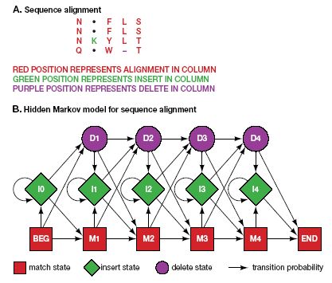
Profile HMMs

Slide 3
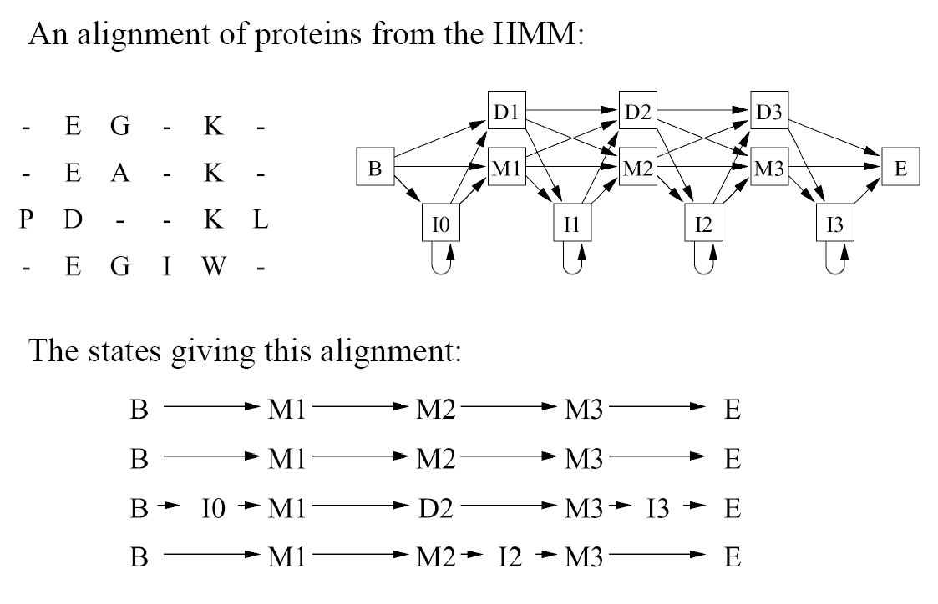
Profile HMMs: Example
Note: These sequences could lead to other paths.

Slide 4
A Characterization Example
How could we characterize this (hypothetical) family of nucleotide sequences?
Keep the Multiple Alignment
Try a regular expression
[AT] [CG] [AC] [ACTG]* A [TG] [GC]
But what about?
T G C T - - A G G vrs
A C A C - - A T C
Try a consensus sequence:
A C A - - - A T C
Depends on distance measure
Example borrowed from Salzberg, 1998

Slide 5
HMMs to the rescue!
Emission Probabilities
Transition probabilities

Slide 6
Insert (Loop) States

Slide 7
Scoring our simple HMM
#1 - “T G C T - - A G G” vrs: #2 - “A C A C - - A T C”
Regular Expression ([AT] [CG] [AC] [ACTG]* A [TG] [GC]):
#1 = Member #2: Member
HMM:
#1 = Score of 0.0023% #2 Score of 4.7% (Probability)
#1 = Score of -0.97 #2 Score of 6.7 (Log odds)
Notes:
Mention NULL model assumes equal chance of each nucleotide in a model of the same length.

Slide 8
Pfam
“A comprehensive collection of protein domains and families, with a range of well-established uses including genome annotation.”
Each family is represented by two multiple sequence alignments and two profile-Hidden Markov Models (profile-HMMs).
A. Bateman et al. Nucleic Acids Research (2004) Database Issue 32:D138-D141

Slide 9
Methods for Characterizing a Protein Family
Objective: Given a number of related sequences, encapsulate what they have in common in such a way that we can recognize other members of the family.
Some standard methods for characterization:
Multiple Alignments
Regular Expressions
Consensus Sequences
Hidden Markov Models

Slide 10
Aligning and Training HMMs
Training from a Multiple Alignment
Aligning a sequence to a model
Can be used to create an alignment
Can be used to score a sequence
Can be used to interpret a sequence
Training from unaligned sequences

Slide 11
Training from an existing alignment
This process what we’ve been seeing up to this point.
Start with a predetermined number of states in your HMM.
For each position in the model, assign a column in the multiple alignment that is relatively conserved.
Emission probabilities are set according to amino acid counts in columns.
Transition probabilities are set according to how many sequences make use of a given delete or insert state.

Slide 12
Remember the simple example
Chose six positions in model.
Highlighted area was selected to be modeled by an insert due to variability.
Can also do neat tricks for picking length of model, such as model pruning.

Slide 13
Training from unaligned sequences
One method:
Start with a model whose length matches the average length of the sequences and with random emission and transition probabilities.
Align all the sequences to the model.
Use the alignment to alter the emission and transition probabilities
Repeat. Continue until the model stops changing
By-product: It produced a multiple alignment
Notes:
It’s actually more complicated than that, there’s probabilities to consider and such.

Slide 14
Training from unaligned continued
Advantages:
You take full advantage of the expressiveness of your HMM.
You might not have a multiple alignment on hand.
Disadvantages:
HMM training methods are local optimizers, you may not get the best alignment or the best model unless you’re very careful.
Can be alleviated by starting from a logical model instead of a random one.

