Slide 1
Analysis of Next Generation Sequencing Data

Slide 2
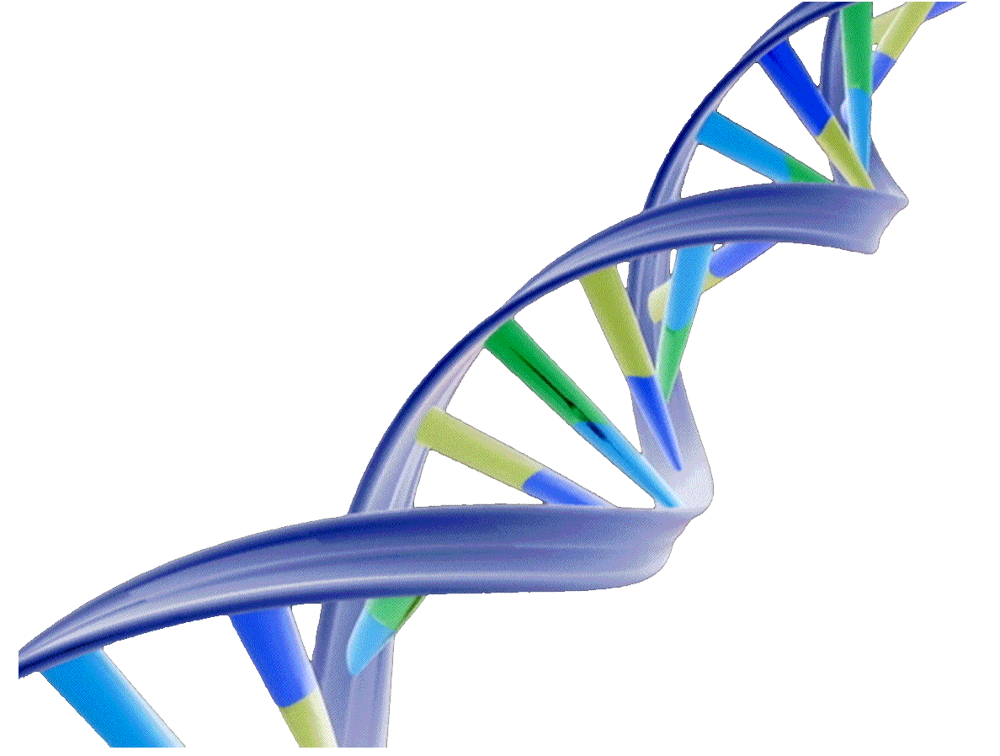
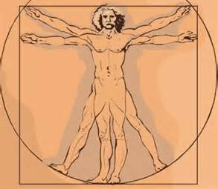
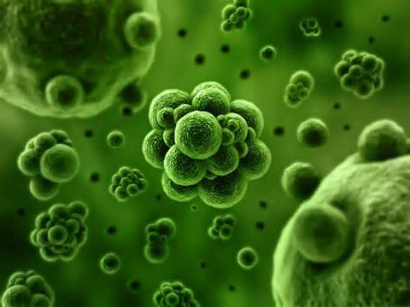
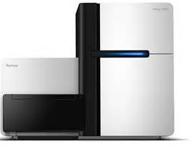
What’s sequencing

Slide 3
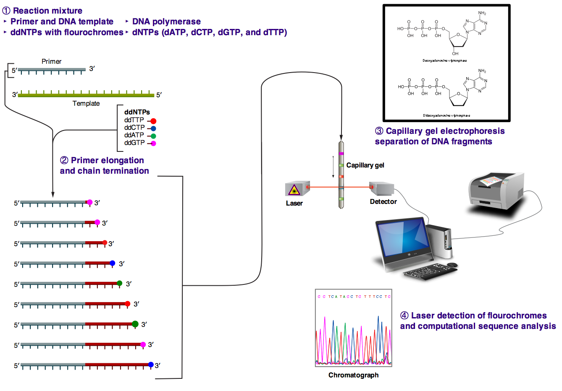
First generation sequencing(Sanger)

Slide 4
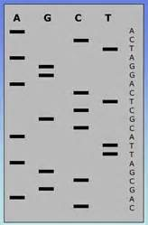
First to Next Gen
shorter reads
high throughput
lower cost

Slide 5
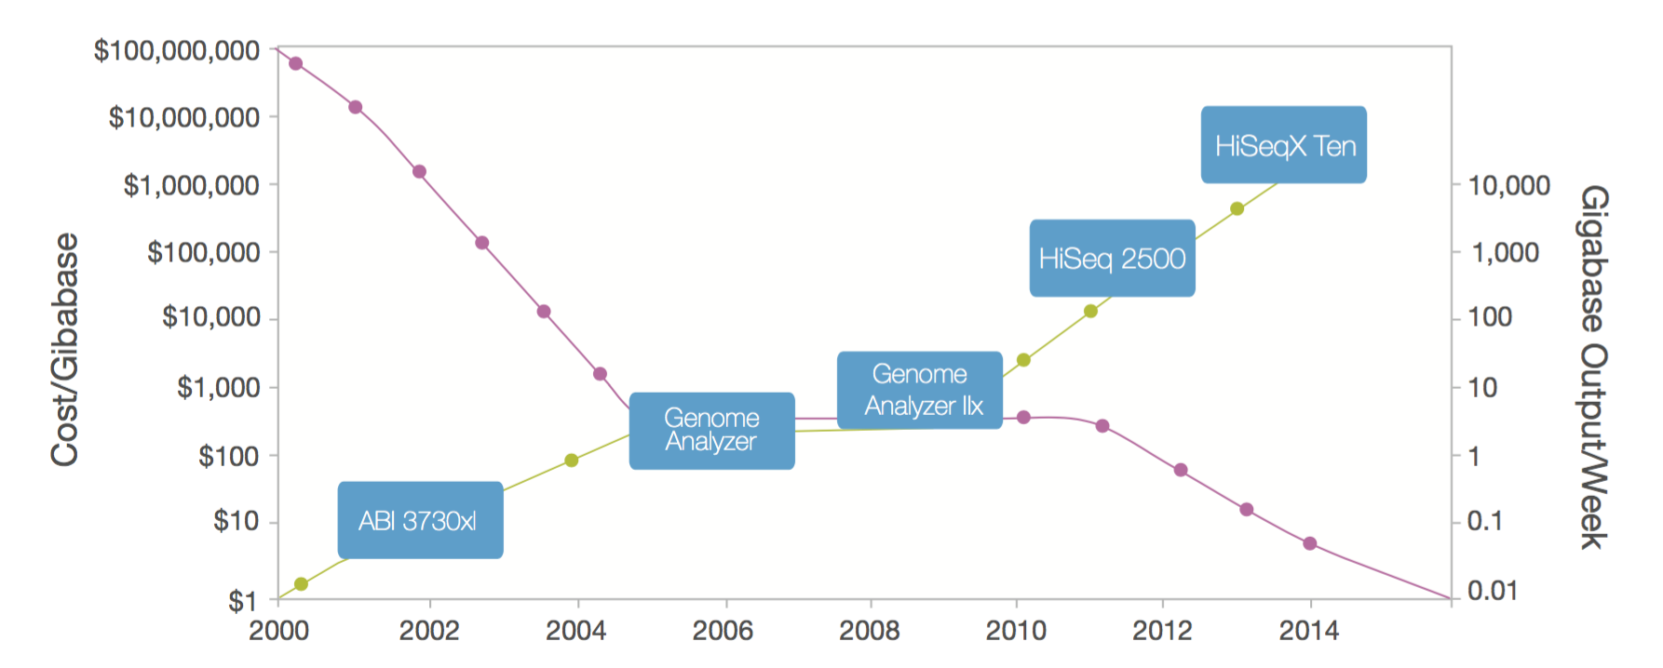
Constant Dramatic Rise of Data Output and Falling Cost

Slide 6
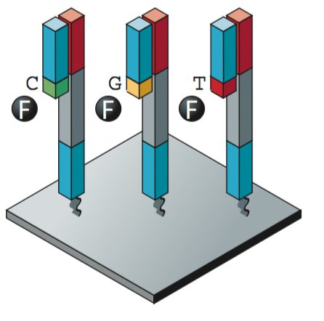
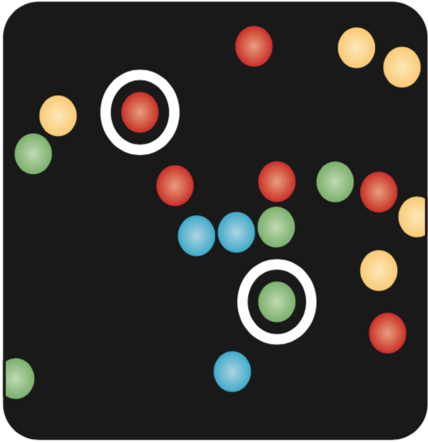
Next generation sequencing
Template Preparation
Sequencing
Imaging

Slide 7
Template Preparation
Shear DNA
Blunt and Repair
Ligase with Adapter

Slide 8
Template Preparation
Clonally Amplified Templates(emPCR) Roche/454, Life/APG, Polonator,Ion Torrent
Mix beads with DNA in oil-aqueous emulsion
Amplification
Immobilize the beads-DNA complex to the slide

Slide 9
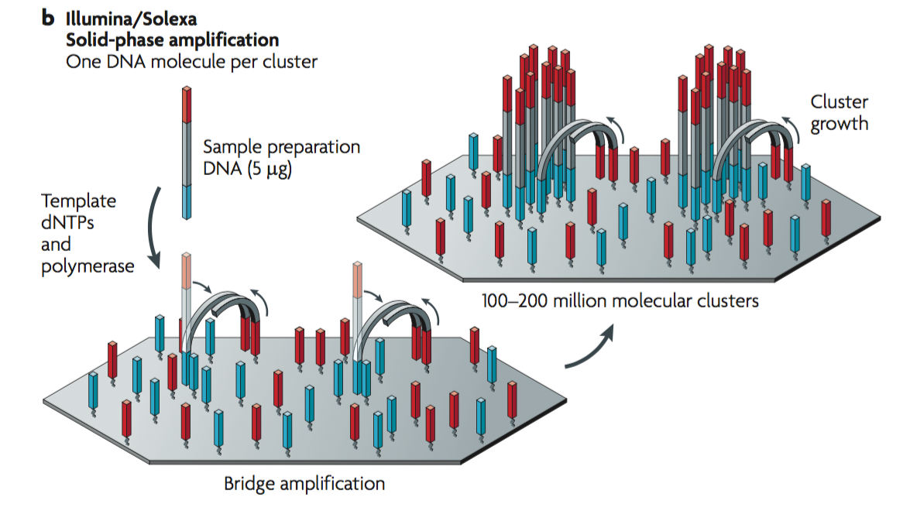
Template Preparation
Clonally Amplified Templates(Bridge Amplification) Illumina/Solexa

Slide 10
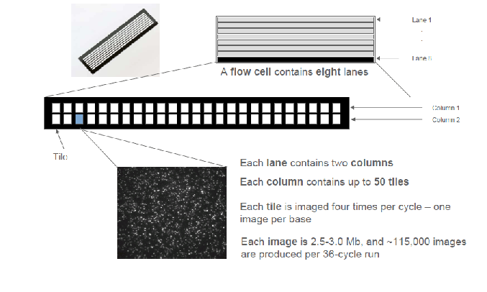
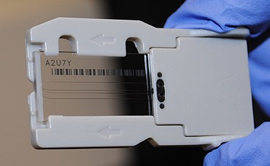
Flow cell

Slide 11
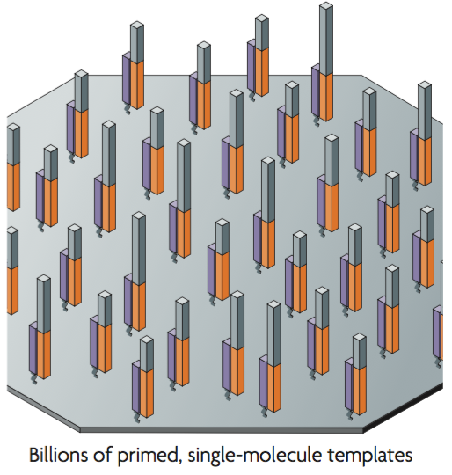
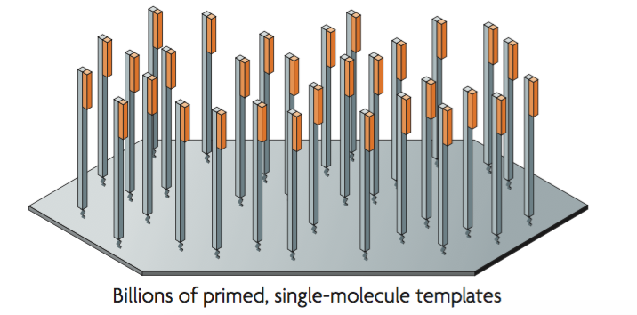
Template Preparation
Single molecular templates(Primer/Template Immobilize to Glass Slide) Helicos BioSciences

Slide 12
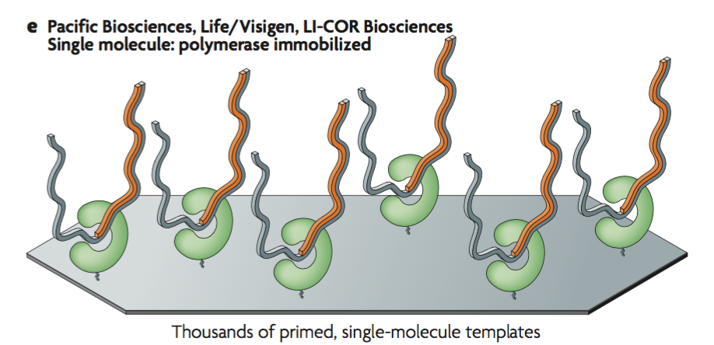
Template Preparation
Single Molecular Templates(Primer/Template Immobilize to Polymerase) Pacific Biosciences, Life/Visigen, LI-COR Biosciences

Slide 13
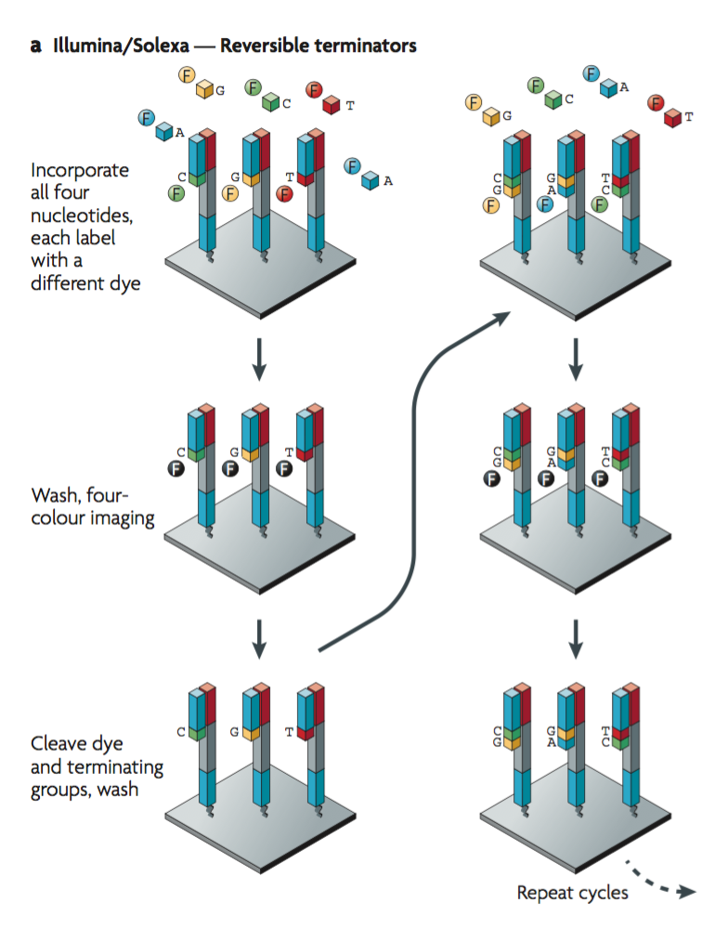
Sequencing and Imaging
Cyclic Reversible Termination(Clonally Amplified Templates ) Illumina/Solexa

Slide 14
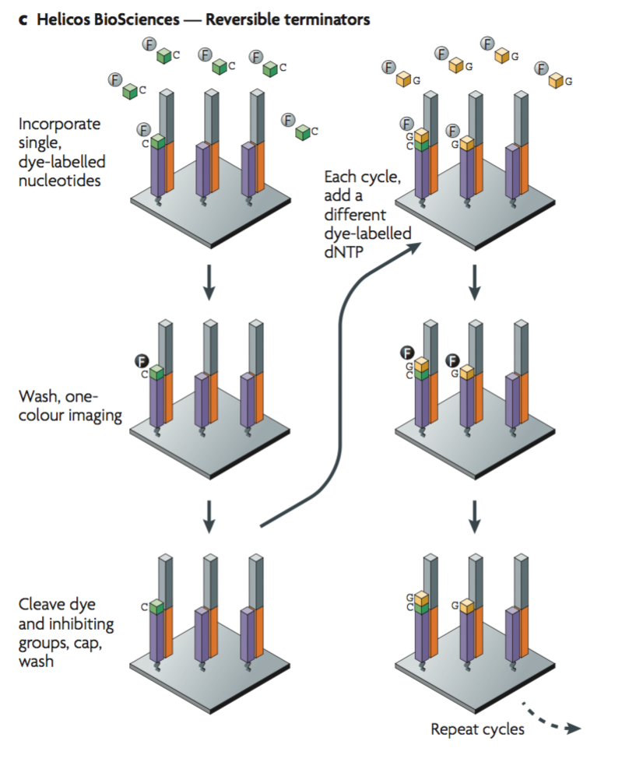
Sequencing and Imaging
Cyclic Reversible Termination(Single Molecular Templates)
Helicos BioSciences

Slide 15
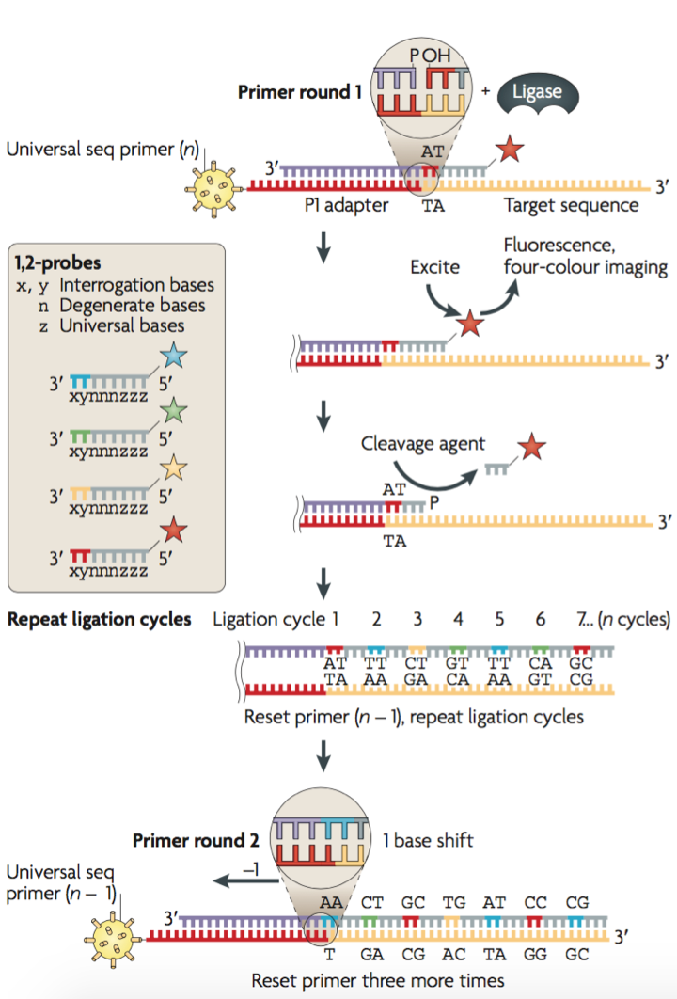
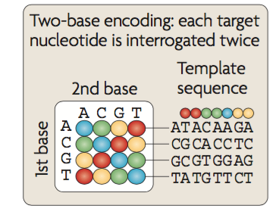
Sequencing and Imaging
Sequencing by ligation(Clonally Amplified Templates ) Life/APG

Slide 16
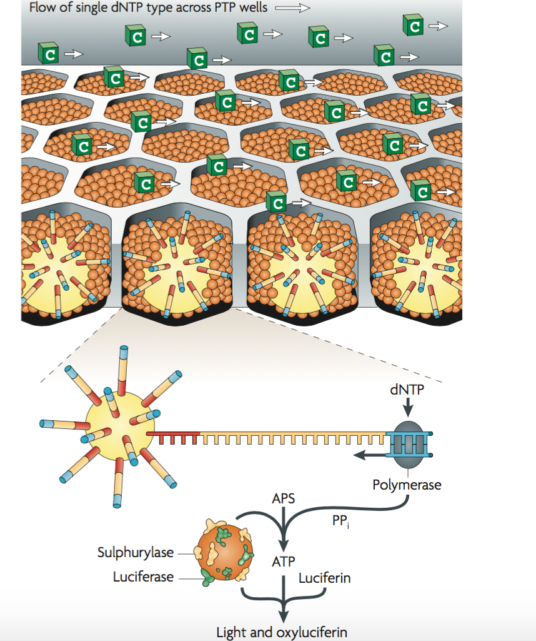
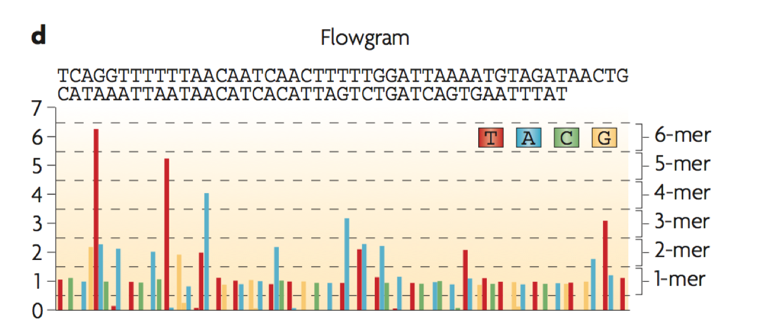
Sequencing and Imaging
Pyrosequencing(Clonally Amplified Templates) Roche/454

Slide 17
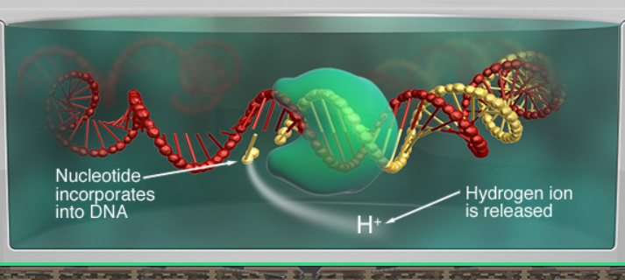
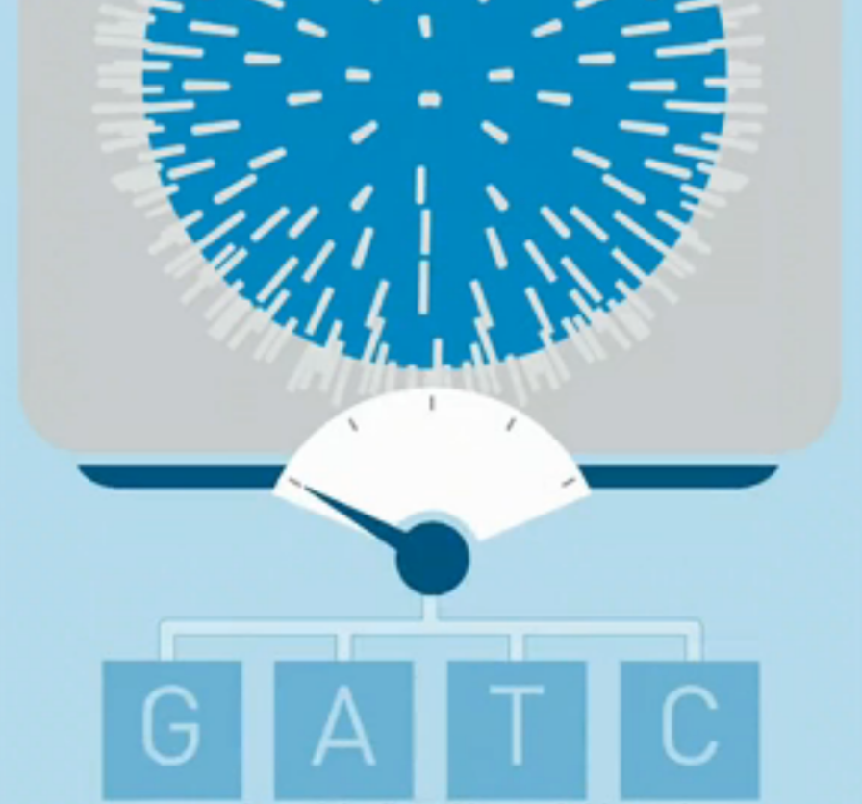
Sequencing and Imaging
Semiconductor Sequencing(Clonally Amplified Templates) Ion Torrent
The change of pH converts into voltage.
Different bases can release different amount of ion, resulting in various voltage, then the bases are called.

Slide 18
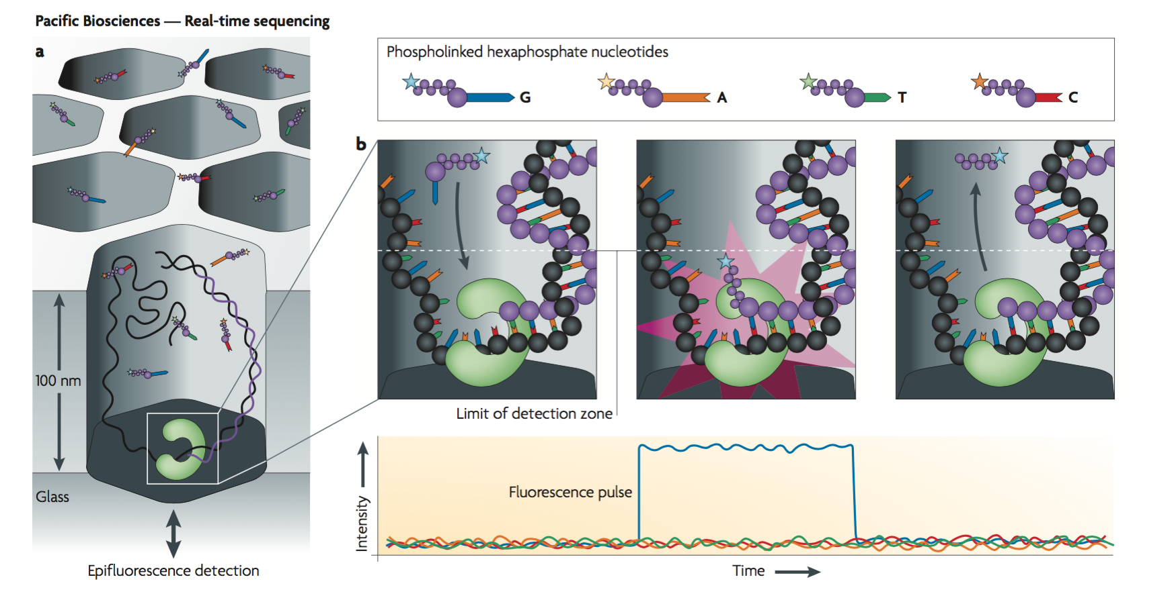
Sequencing and Imaging
Real-time Sequencing(Single Molecular Templates) Pacific Biosciences

Slide 19
Some More Advanced Technique

Slide 20
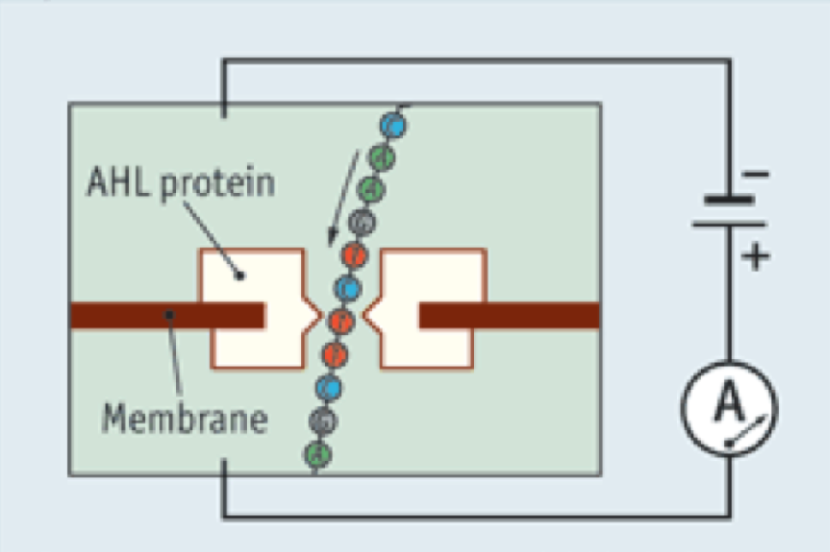
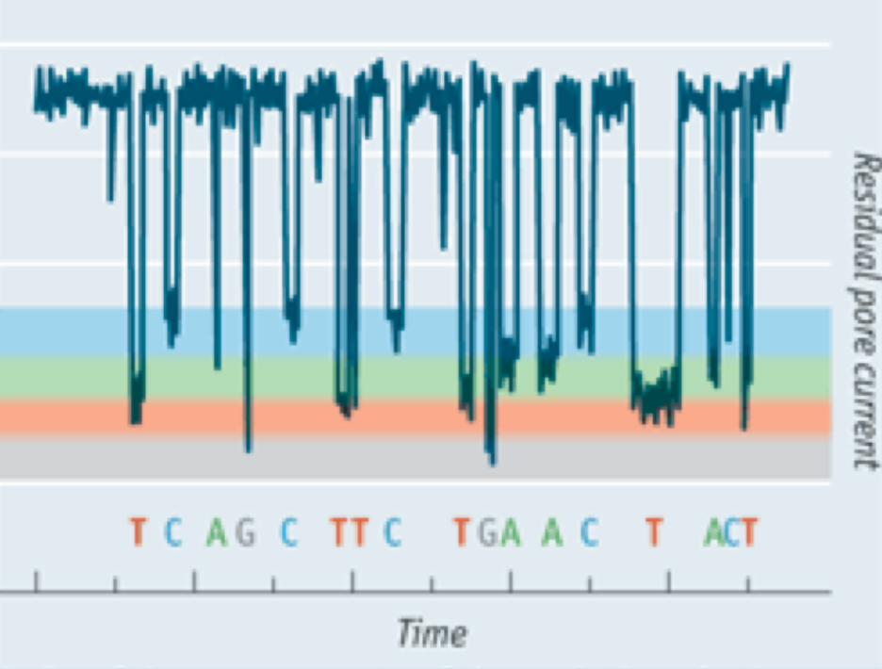
Nanopore
A voltage applied across the membrane draws a strand of DNA through the pore.
As the bases pass the pore, tiny but distinctive change of the electric flow can be recorded.

Slide 21
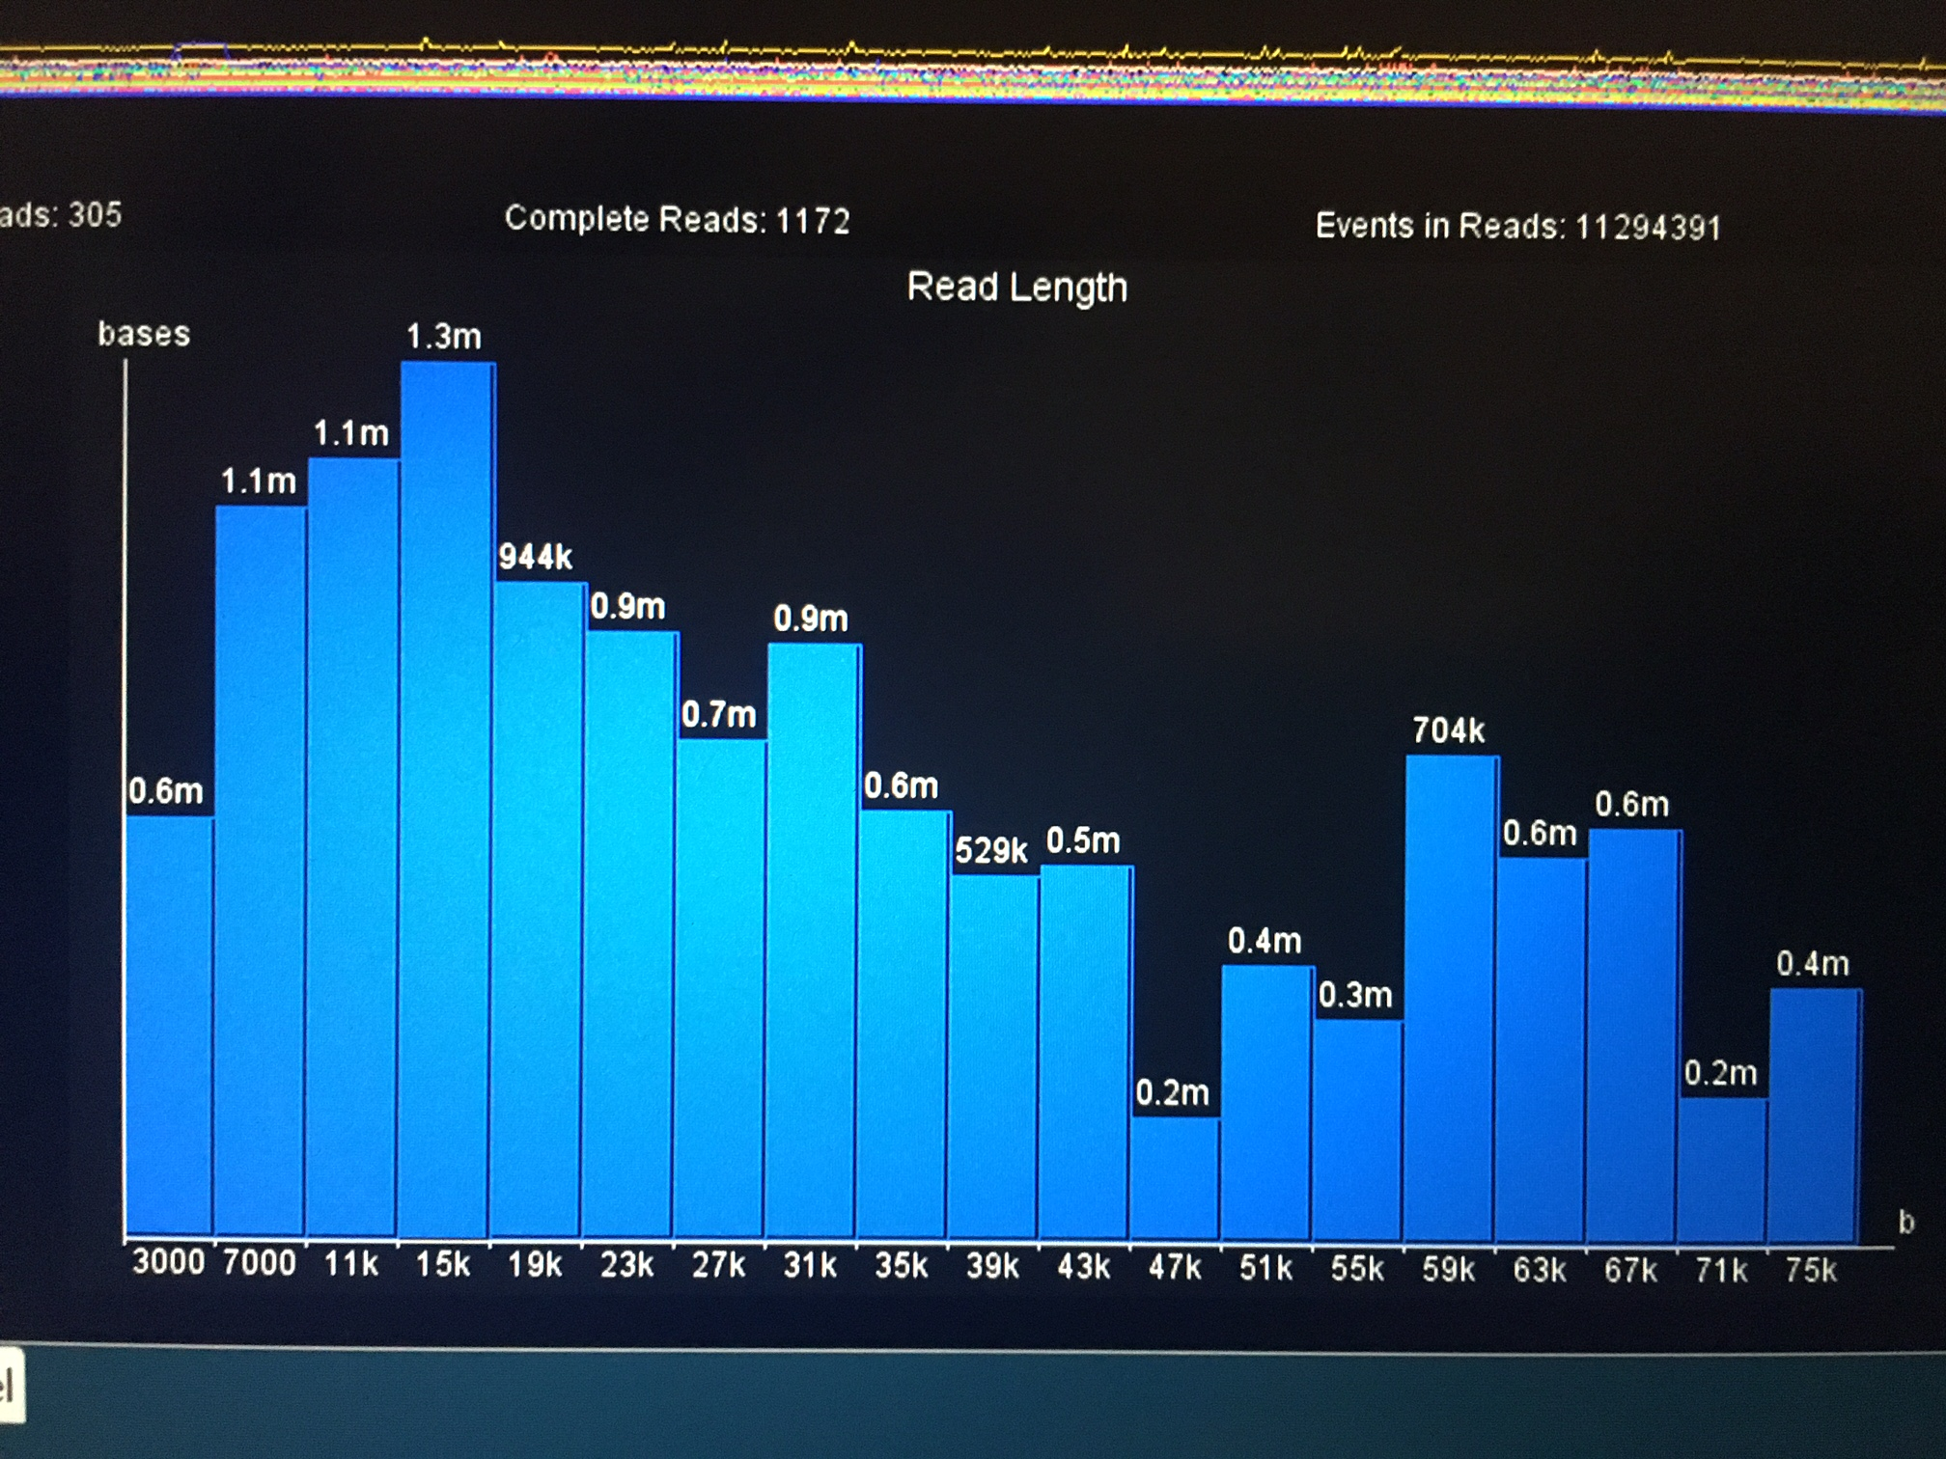
Tuatara genomic DNA with Nanopore

Slide 22
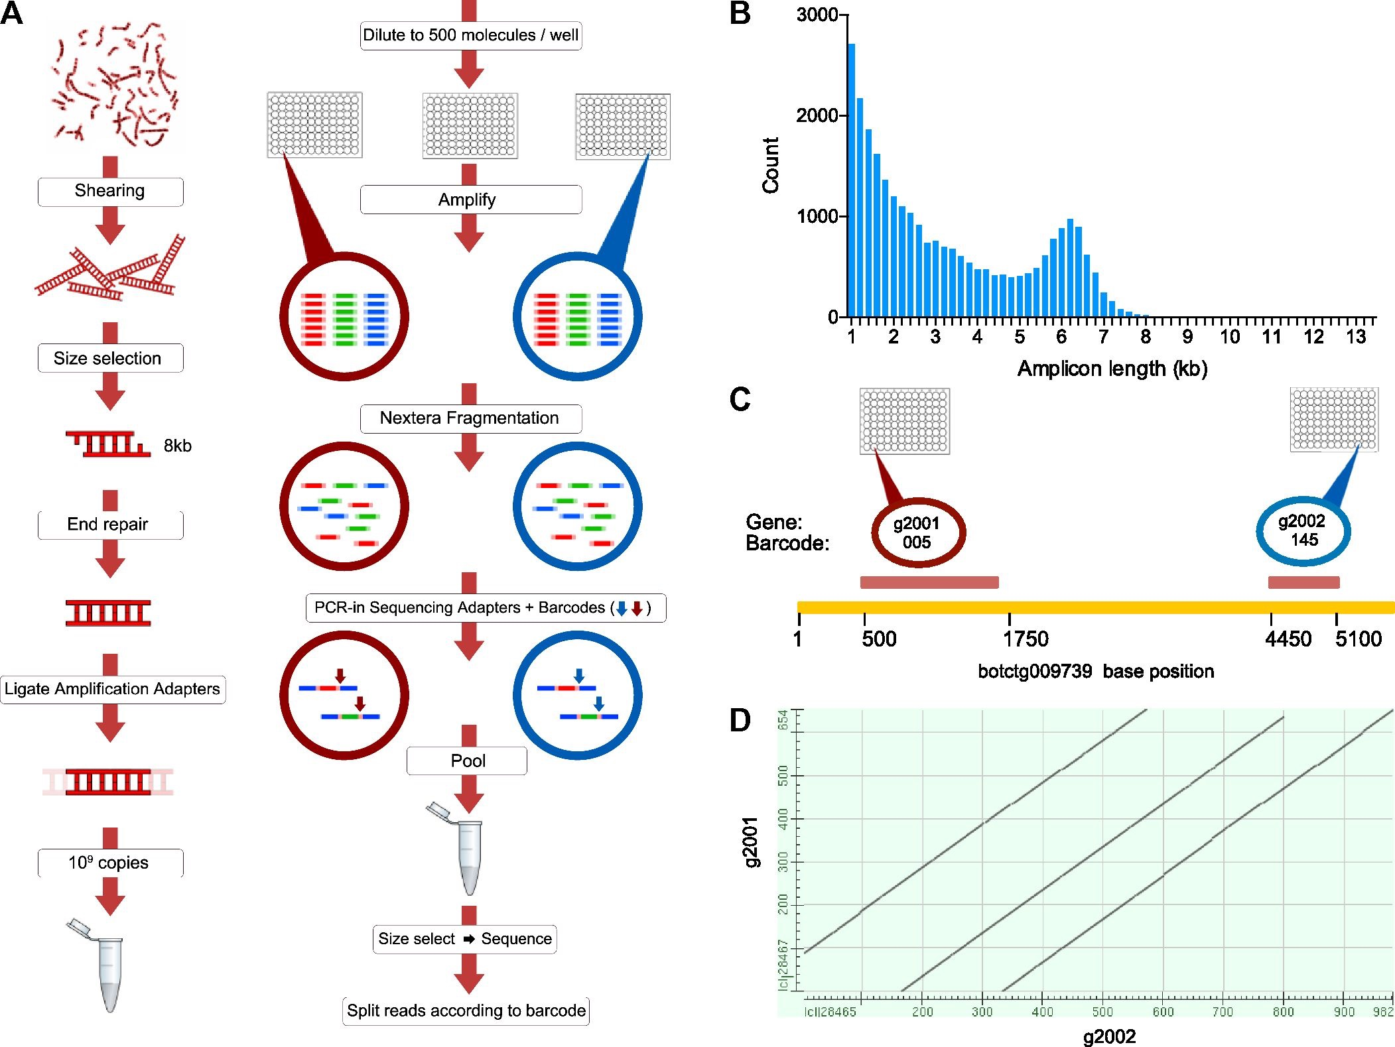
Whole-genome Molecular Haplotyping of Single Cells

Slide 23
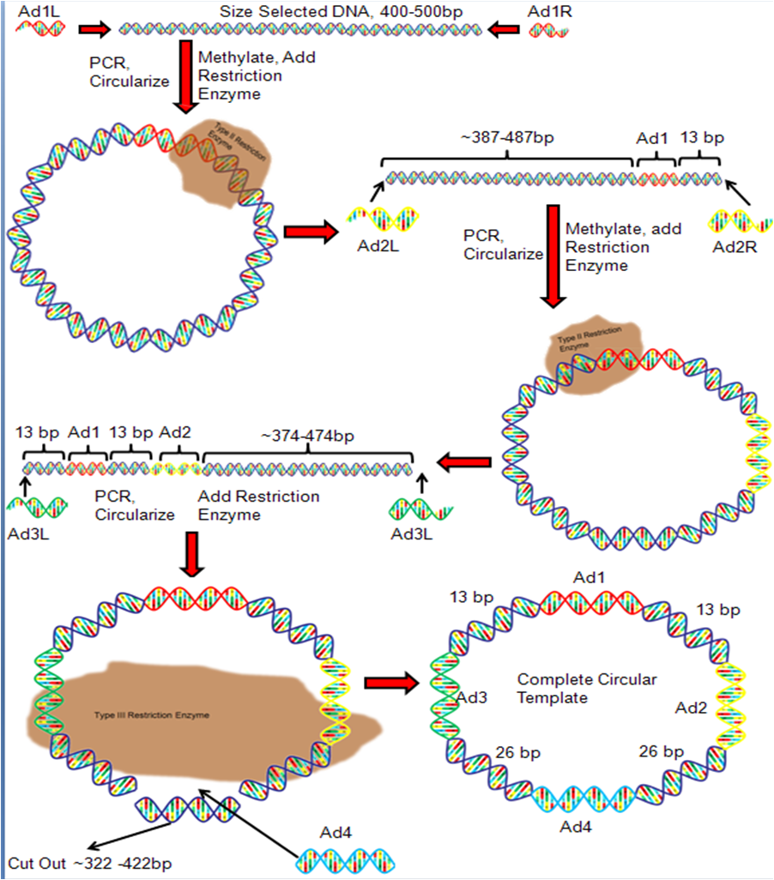
Nanoball

Slide 24
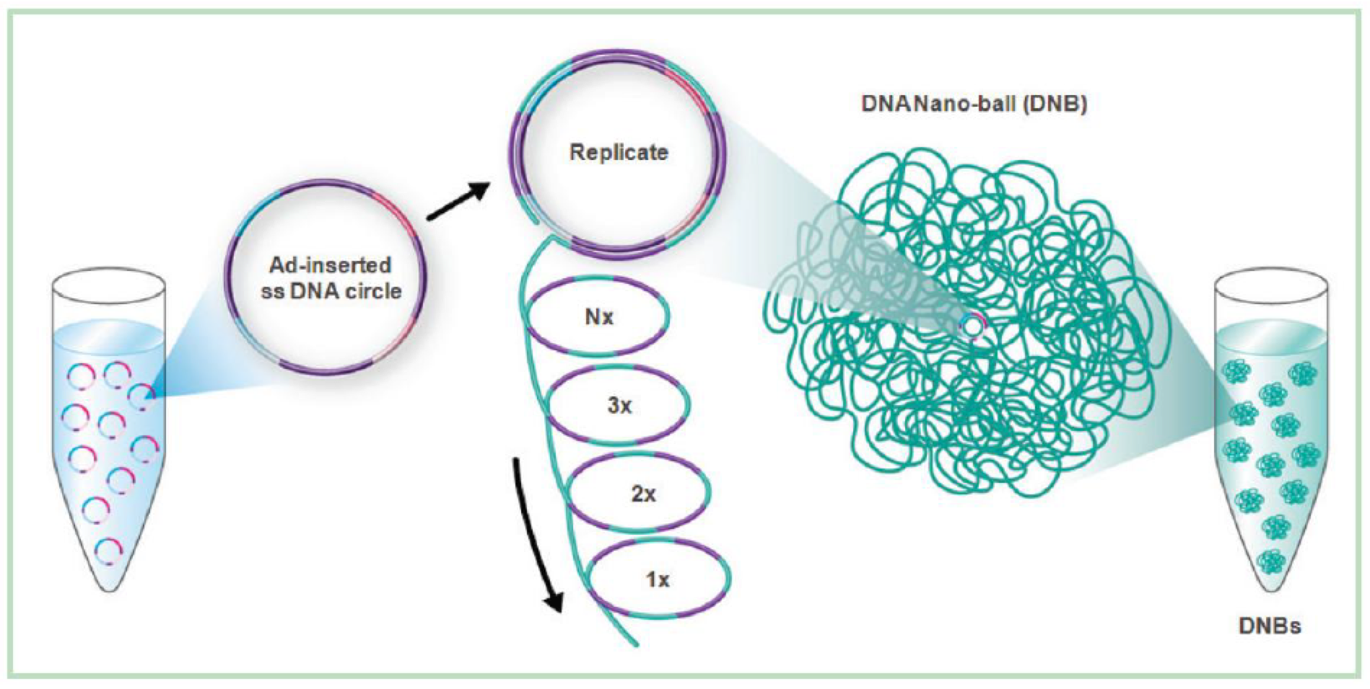
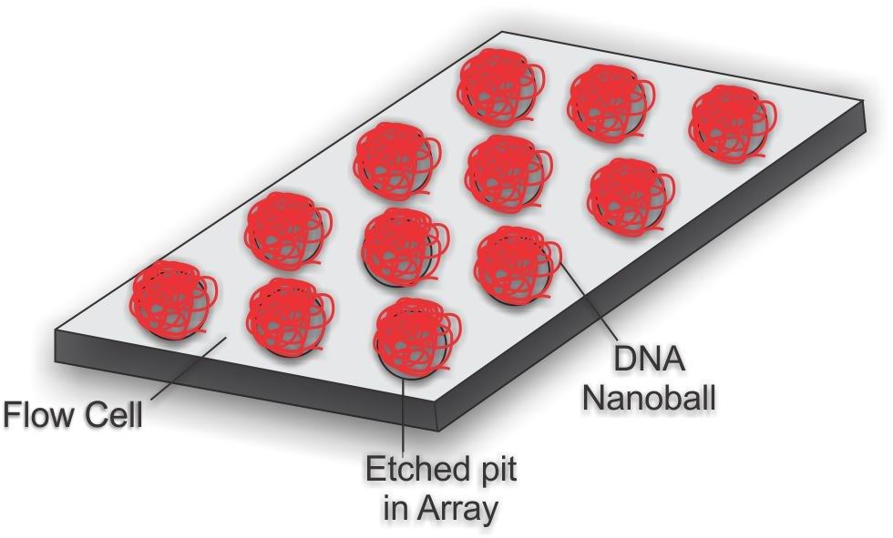
Nanoball

Slide 25
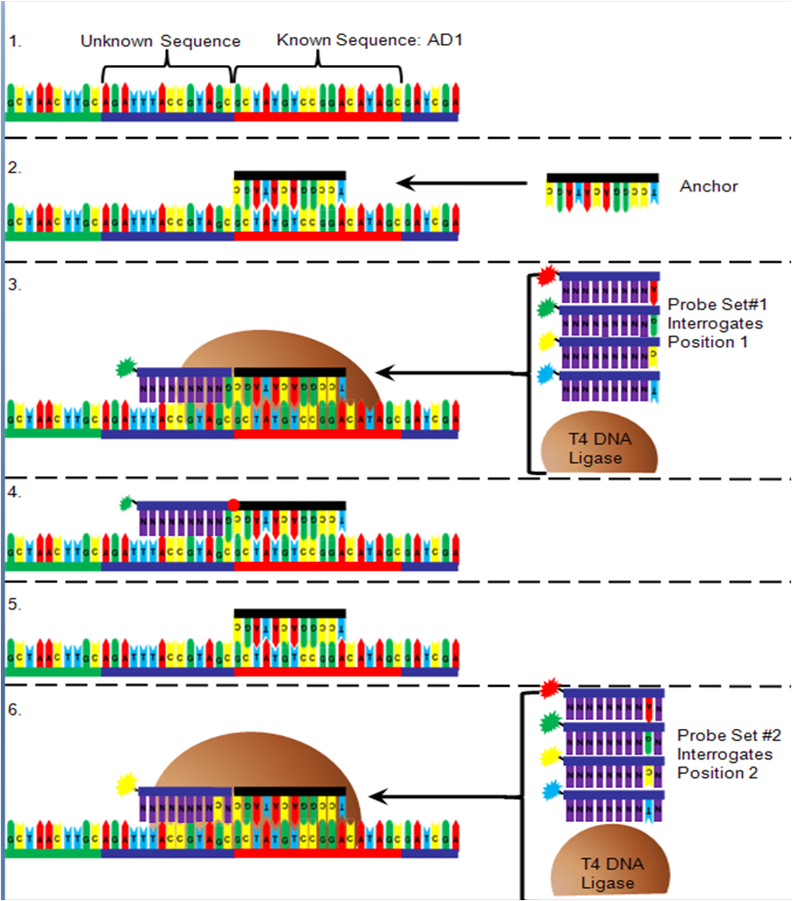
Nanoball

Slide 26
MGI
https://en.mgitech.cn/products/

