Slide 1
What’s the NGS data look like??

Slide 2
Read type
single end reads
pair-end/mate-pair reads
strobe reads(PacBio)

Slide 3
Raw reads
FASTQ
  @EAS139:136:FC706VJ:2:2104:15343:197393 1:Y:18:ATCACG
  GATTTGGGGTTCAAAGCAGTATCGATCAAATAGTAAATCCATTTG
  +
  !''*((((***+))%%%++)(%%%%).1***-+*''))**55CCF

Slide 4
Raw reads
  @EAS139:136:FC706VJ:2:2104:15343:197393 1:Y:18:ATCACG
  GATTTGGGGTTCAAAGCAGTATCGATCAAATAGTAAATCCATTTG
  +
  !''*((((***+))%%%++)(%%%%).1***-+*''))**55CCF
Line 1 begins with a '@' character and is followed by a sequence identifier and an optional description (like a FASTA title line).
Line 2 is the raw sequence letters.
Line 3 begins with a '+' character and is optionally followed by the same sequence identifier (and any description) again.
Line 4 encodes the quality values for the sequence in Line 2, and must contain the same number of symbols as letters in the sequence.

Slide 5
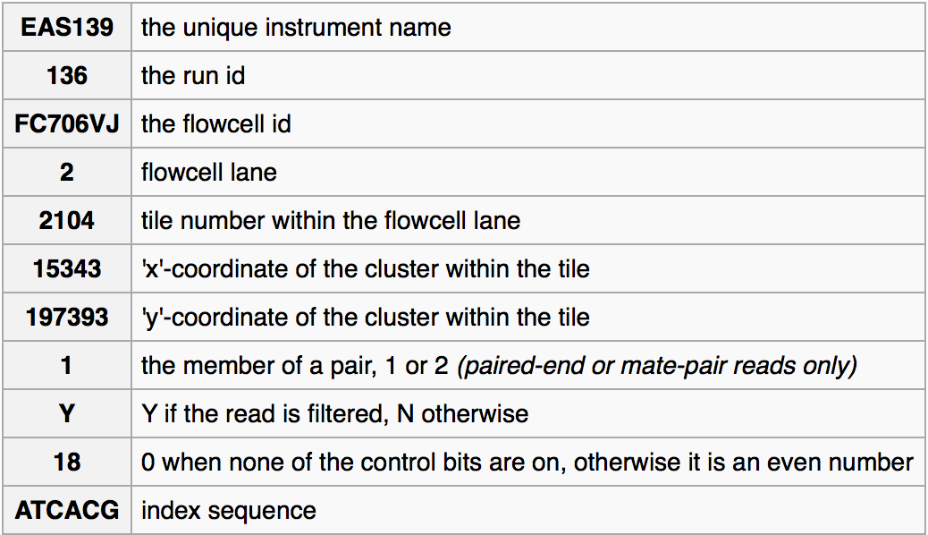
What’s the header mean?
  @EAS139:136:FC706VJ:2:2104:15343:197393 1:Y:18:ATCACG

Slide 6

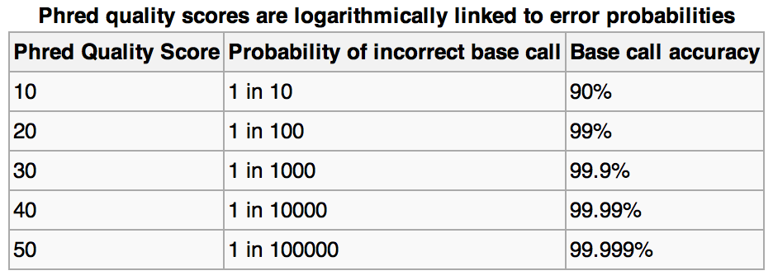
Quality Score
@EAS139:136:FC706VJ:2:2104:15343:197393 1:Y:18:ATCACG
GATTTGGGGTTCAAAGCAGTATCGATCAAATAGTAAATCCATTTG
+
!''*((((***+))%%%++)(%%%%).1***-+*''))**55CCF
Phred quality scores are defined as a property which is logarithmically related to the base-calling error probabilities.
encoded a Phred quality score from 0 to 62 using ASCII 64 to 126

Slide 7
Two very useful sites
http://seqanswers.com/
  SEQanswers, all about next-gen sequencing
http://biostars.org/
  BioStar, a Q&A site where you can find answers, and ask questions.

Slide 8
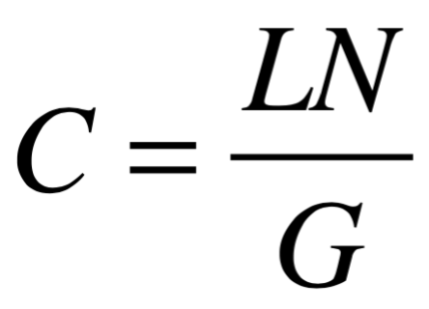
Theoretical/Expected Coverage
The theoretical/expected coverage(C) is the average number of times that each nucleotide is expected to be sequenced given a certain number of randomly distributed reads of a given length
where L is the read length, N is the number of reads and G is the haploid genome length.

Slide 9
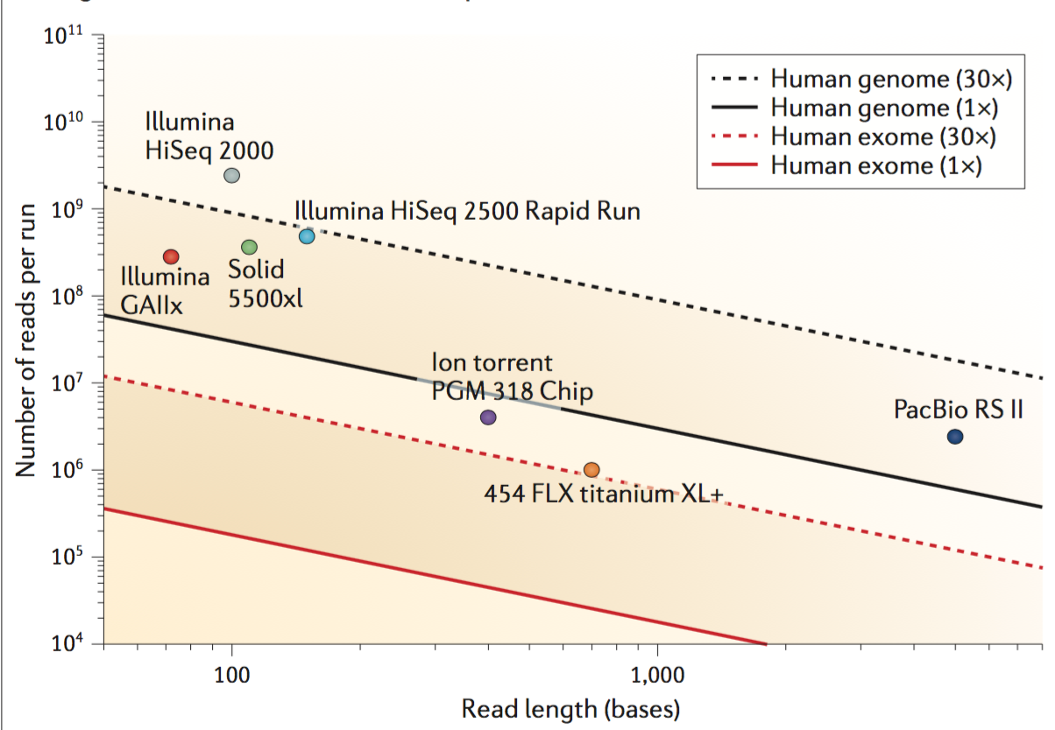
Do Not Need Extremely High Coverage
Depends on the sequencer and objective

Slide 10
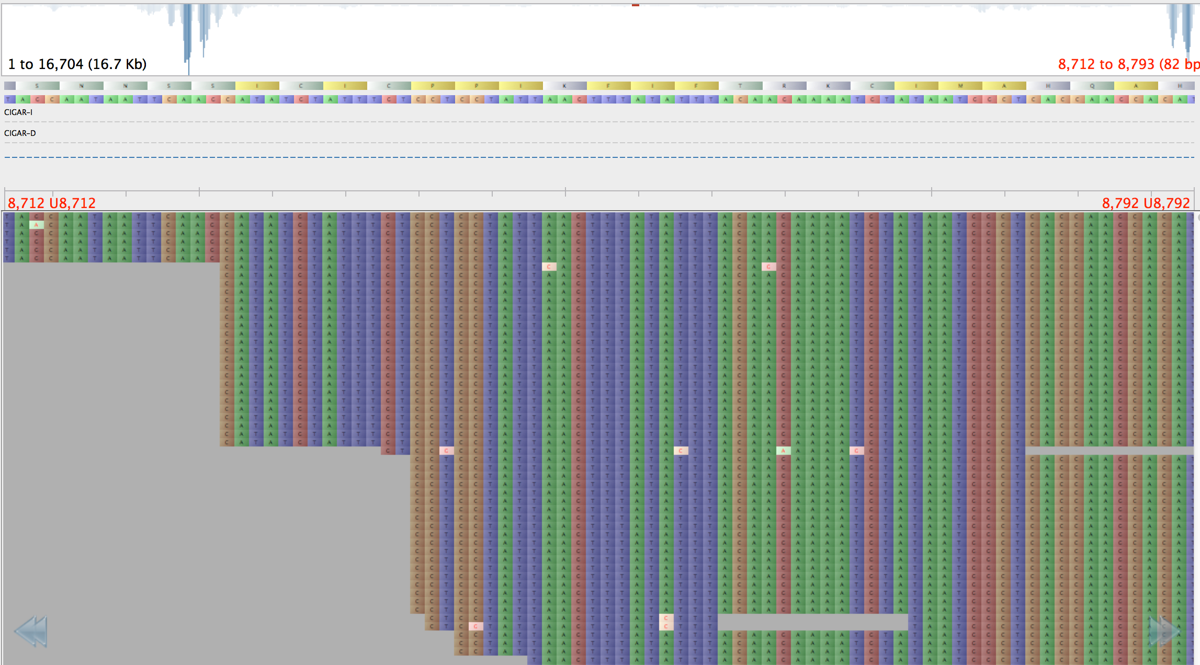
Nature of NGS Data
Huge amounts of overlapping short reads
Reads coverage is not uniform distribution
Various quality

Slide 11
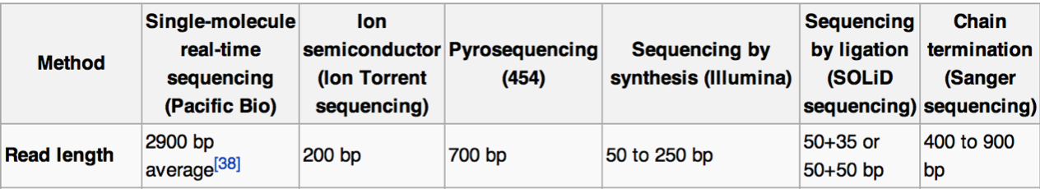
Since the nature of NGS sequencing, short reads need to be assembled.

Slide 12


That’s What We Do Right Now

Slide 13
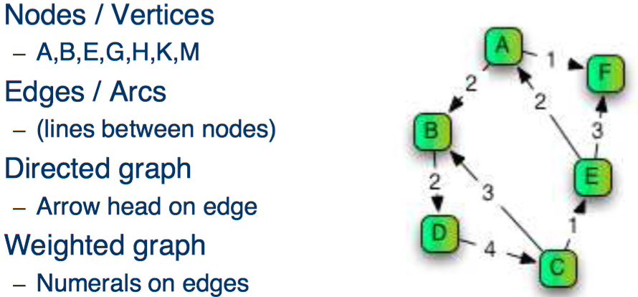
Prerequisite Knowledge
What’s Graph?

Slide 14
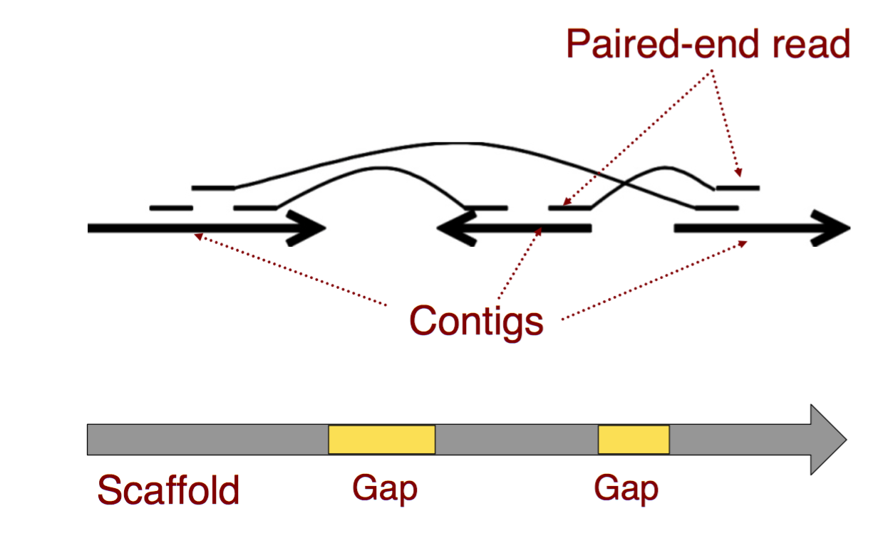
Prerequisite Knowledge
What’s Reads/Contig/Scaffold

Slide 15
Strategies of Assembly
Without reference genome – de novo assembling
With reference genome – mapping

Slide 16
Without reference genome – de novo assembling

Slide 17
OLC(Overlap Layout Consensus)
Overlap: Find all overlaps between reads
Layout: Build, then simplify the graph
Consensus: Traverse the graph

Slide 18
Show an Extremely Simple Example in an Extremely Naive Way!!!

Slide 19
What counts as “overlapping” ?
Minimum overlap length eg. 20bp
Minimum %identity across overlap eg. 95%
Choice depends on total sequence length and expected error rate
Thresholds can be set for evaluate the overlap

Slide 20
Overlap
read1: ATGCATGCT
read1: ATGCATGCT - -
read2: GCATGCTAA
read2: - -GCATGCTAA
read2: GCATGCTAA
read2:GCATGCTAA - - - - -
read3: TAAGCGGA
read3: - - - - - - TAAGCGGA
read3: TAAGCGGA
read3: TAAGCGGA- - -
read4: CCGTCCGC
RCread4: - - -GCGGACGG
Reverse Complement
GCGGACGG

Slide 21
Layout
“Score” between Pairwise Reads
 | 1 | 2 | 3 | 4
1 | -
2 | 64 | -
3 | 6 | 23 | -
4 | 0 | 6 | 45 | -

Slide 22
Layout
1
read
Forward Overlap
2
3
Reverse Complement Overlap
4
Thicker for stronger evidence of overlap

Slide 23
Consensus
AT
1
GCATGCT
3
ATGCATGCTAATAAGCGGACGG
2
TAA
AA
GCGGA
4
CGG

Slide 24
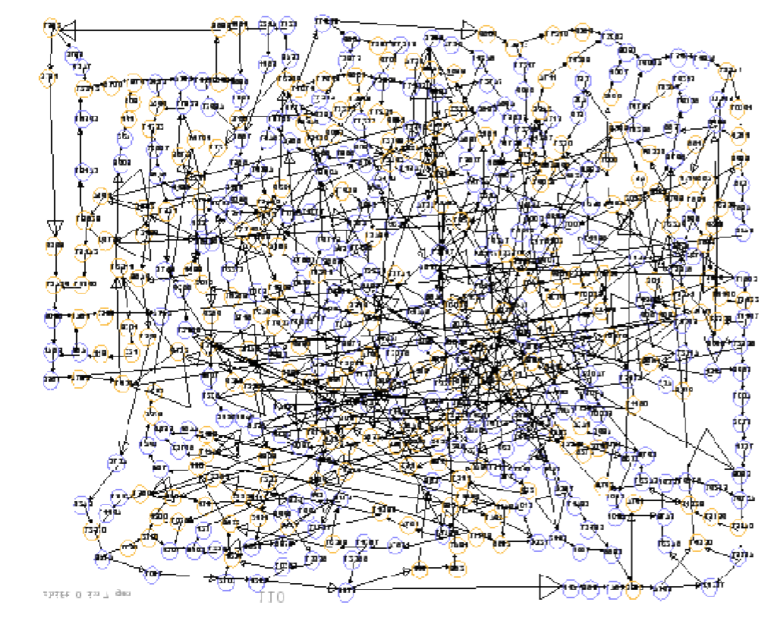
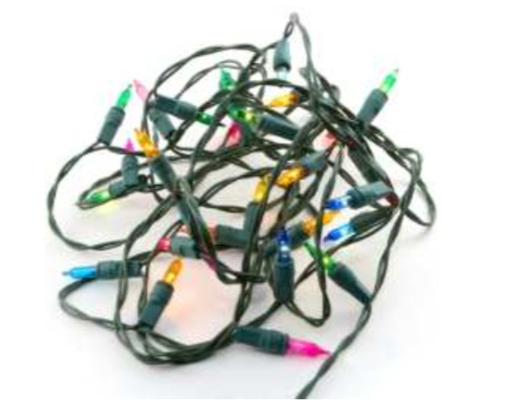
In Real Case

Slide 25
De Bruijn Graph
>seq1
TTCTAAGT
>seq2
CGATTCTA
CGA
GAT
ATT
TTC
TCT
CTA
TAA
AAG
AGT

Slide 26
De Bruijn Graph
>seq1
TTCTAAGT
>seq2
CGATTCTA
>seq3
CGATTGTAAGT
CGA
GAT
ATT
TTC
TCT
CTA
TAA
AAG
AGT
CGA
GAT
ATT
AAG
AGT
TTG
TGT
GTA

Slide 27
De Bruijn Graph
>seq1
TTCTAAGT
>seq2
CGATTCTA
>seq3
CGATTGTAAGT
CGA
GAT
ATT
TTC
TCT
CTA
TAA
AAG
AGT
TTG
TGT
GTA

Slide 28
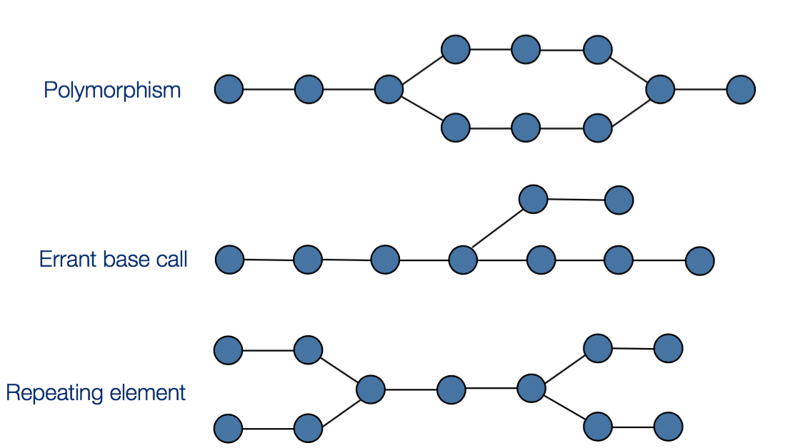
De Bruijn Graph
Common Structure

Slide 29
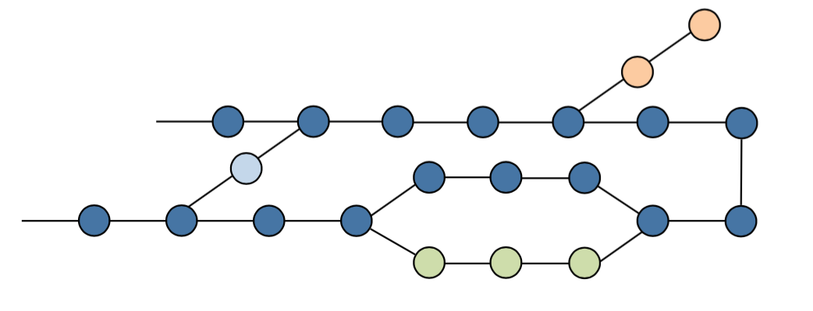
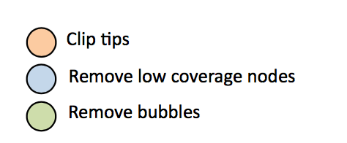
De Bruijn Graph

Slide 30
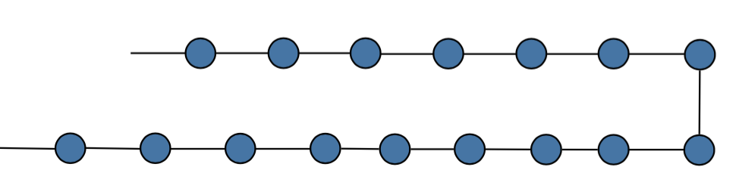
De Bruijn Graph

Slide 31
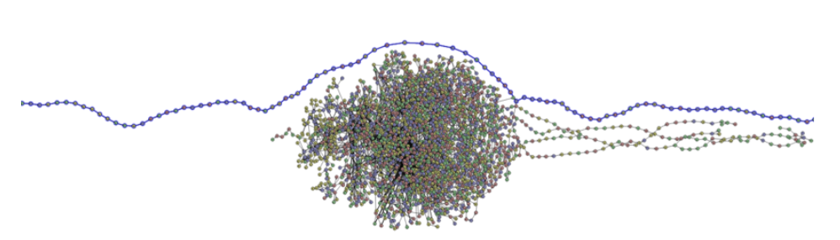
In Real Case

Slide 32
Assemble Quality Measurement
Number of contigs
The lower the better
Contig sizes
The larger the better (up to the size of the genome), usually given in maximum, minimum and average lengths.
Total size
Should be close to expected genome size
N*
* represent for a positive integer. See details in next slide

Slide 33
i.e N50
The N50 of a set of contigs is the size of the largest contig for which half the total size is contained in that contigs and those larger.
An example:
7 contigs totalling 20 units: 7, 4, 3, 2, 2, 1, 1
N50 is 4 ,as 7+4=11 ,which is > 50% of 20.
Higher N50 may mean better assembles, while erroneously large contigs with unrelated reads may also have high N50.

Slide 34
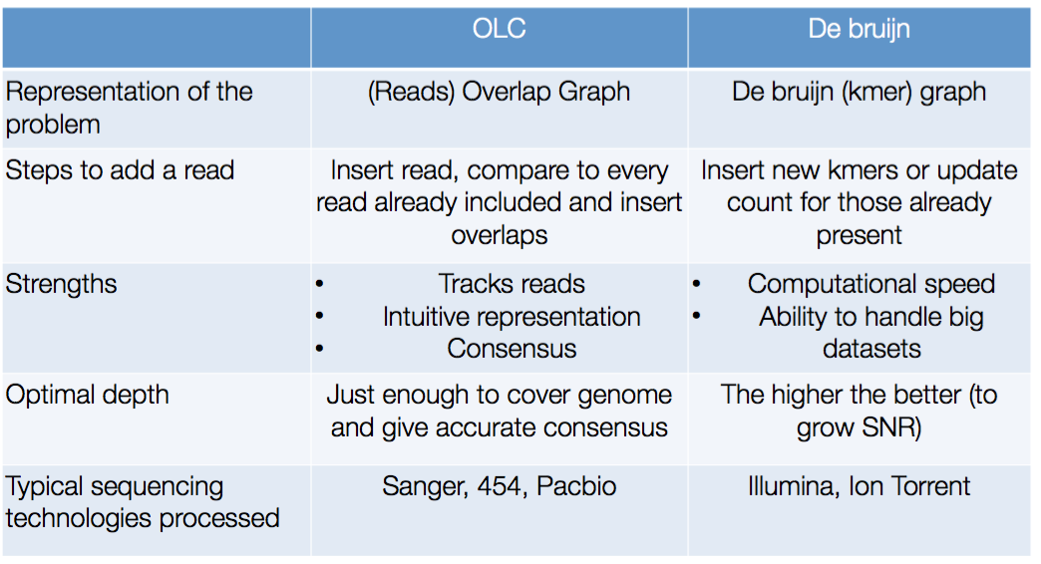
OLC vs. De Bruijn

Slide 35
  Sophisticated Problems in Real Cases
Read errors
introduce false edges and nodes
Non-haploid organisms
heterozygosity causes lots of detours
Repeats
if longer than read length causes nodes to be shared, locality confusion

