Slide 1
With reference genome – mapping

Slide 2

What’s Mapping?

Slide 3
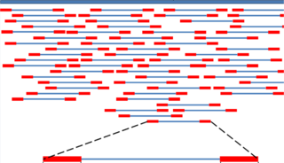
What’s Mapping?
Reference Sequence
Sequence Alignment?
Reads

Slide 4
What about in BLAST way?
query
query
database seq
database seq
Seeding
Find position having hits with seeds
Filter scattered seeds
query
query
database seq
database seq
Extending
Extend till the threshold
That’s make sense!!!

Slide 5
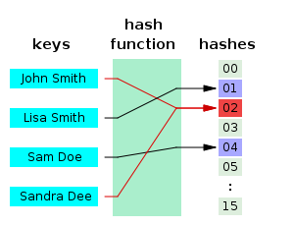
Some Other Tricks
Hash
Elements in each block should be averagely distributed

Slide 6
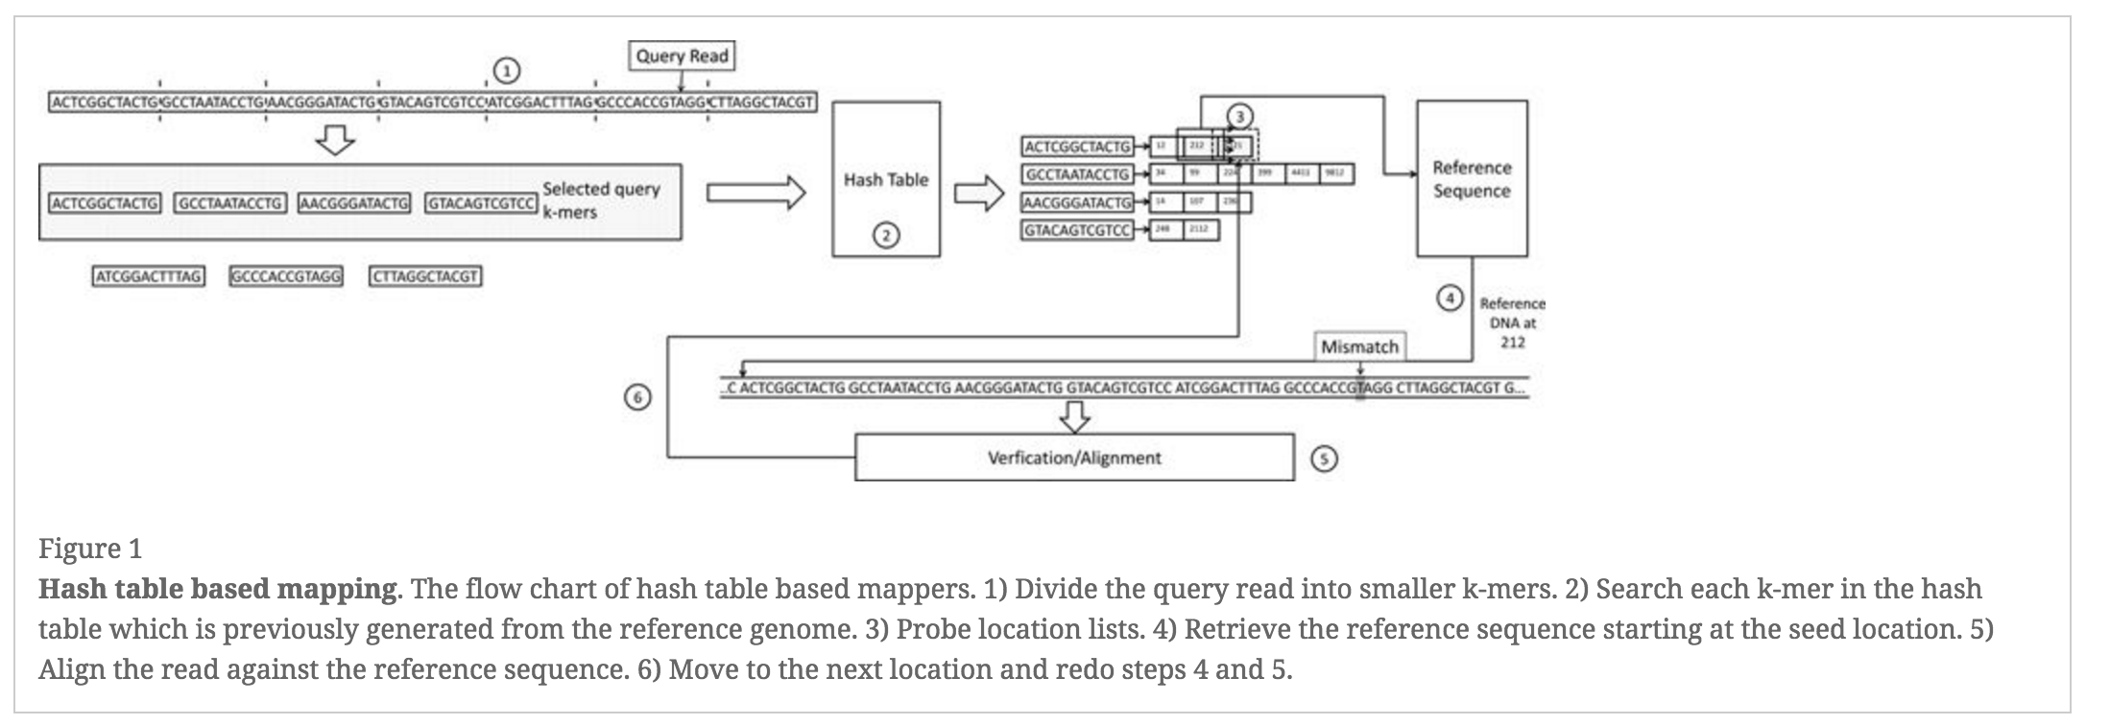
Hash table based mapping

Slide 7
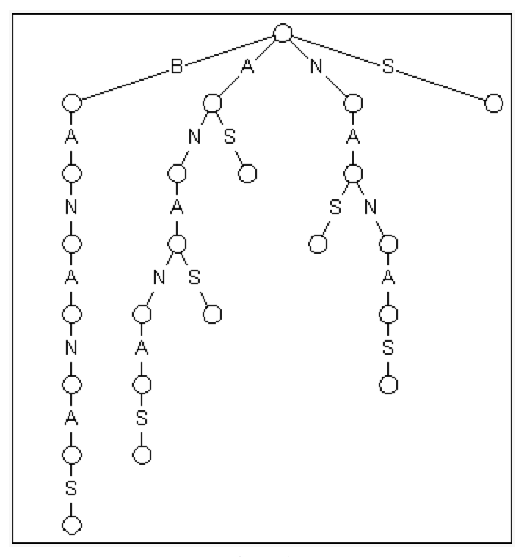
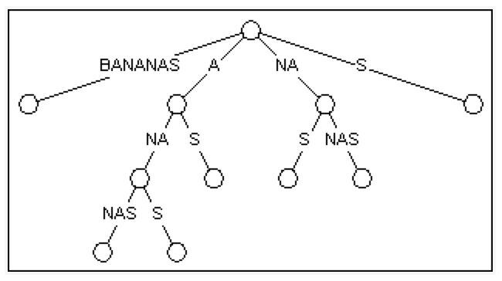
Suffix tree
Suffix trees allow particularly fast implementations of many important string operations in linear time M*O(1).
Only requires M character comparisons

Slide 8

Burrows Wheeler transform
The Burrows–Wheeler transform (BWT, also called block-sorting compression), is an algorithm used in data compression techniques such as bzip2.
Why is that great?
It tends to be easy to compress a string that has runs of repeated characters.
The transformation is reversible, without needing to store any additional data.

Slide 9
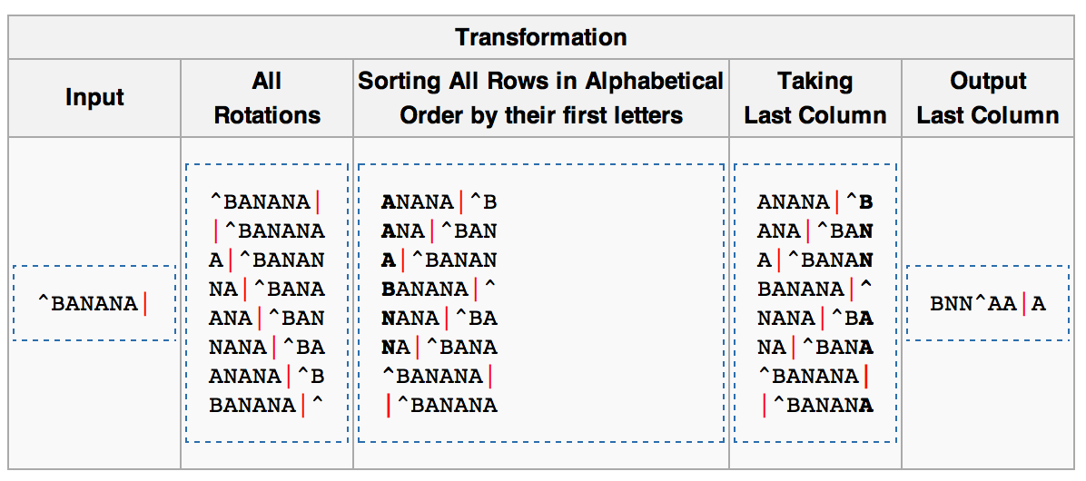

Burrows Wheeler transform

Slide 10
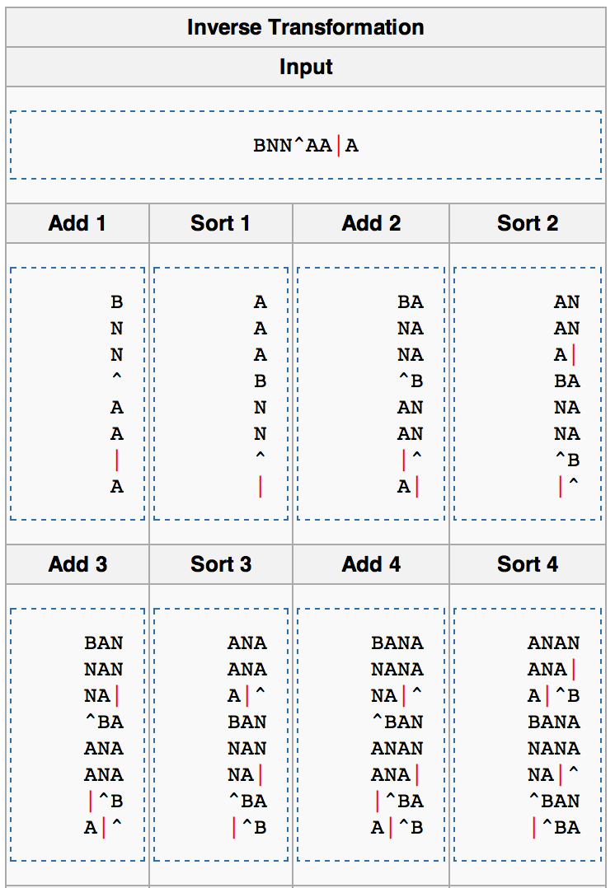
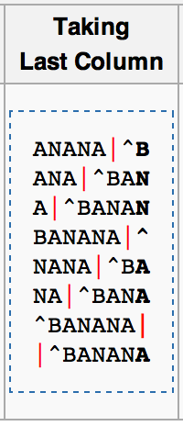
Burrows Wheeler transform

Slide 11
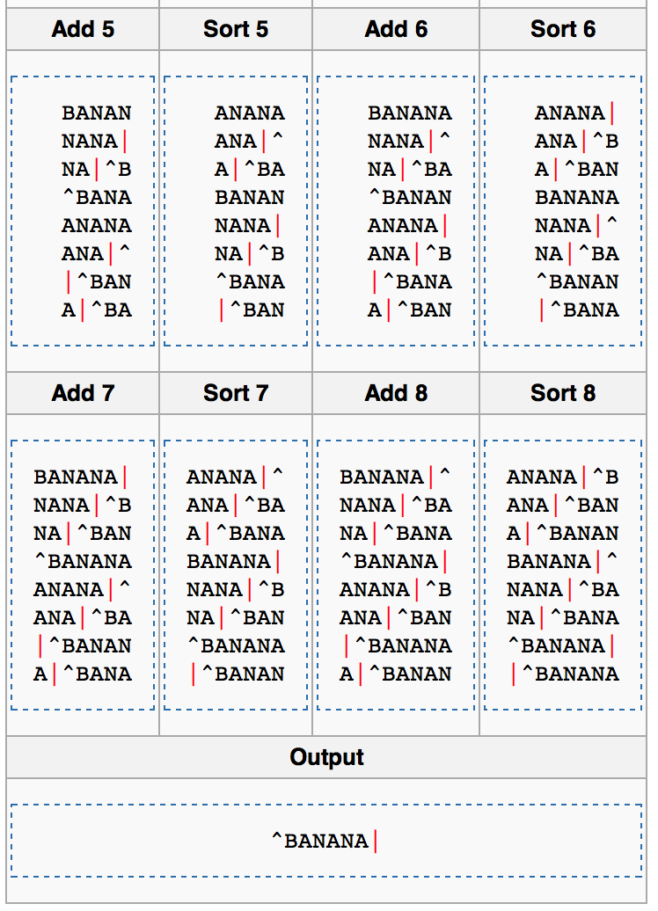
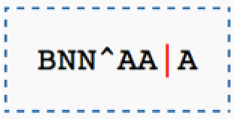
Burrows Wheeler transform

Slide 12
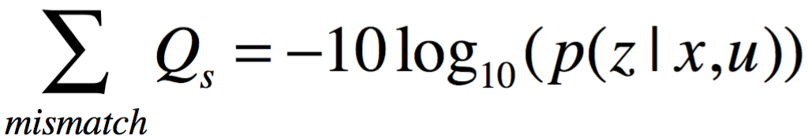
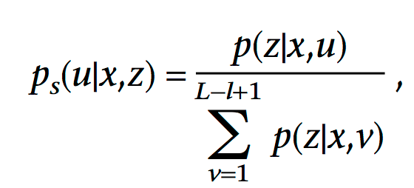
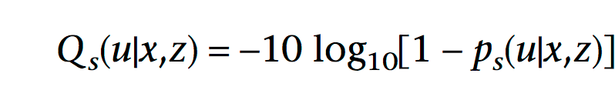
Mapping Quality
Given reference sequence z (length L), a read sequence x (length l), u is the alignment position of x on z, the probability that z actually coming from the position u is p(z|x,u)

Slide 13
Mapping Quality
Quality Score(Qs) A=30 T=20 C=20 G=30
Reference Genome: A T C G G C T A
p(z|x,u)
p(u|x,z)
Qs
A T C G
1
0.999
30
A T C G
10⁻⁷
9.999*10⁻⁸
4.342*10⁻⁷
A T C G
10⁻¹⁰
9.999*10⁻¹¹
4.342*10⁻¹⁰
A T C G
10⁻⁸
9.999*10⁻⁹
4.342*10⁻⁸
A T C G
10⁻¹⁰
9.999*10⁻¹¹
4.342*10⁻¹⁰

Slide 14
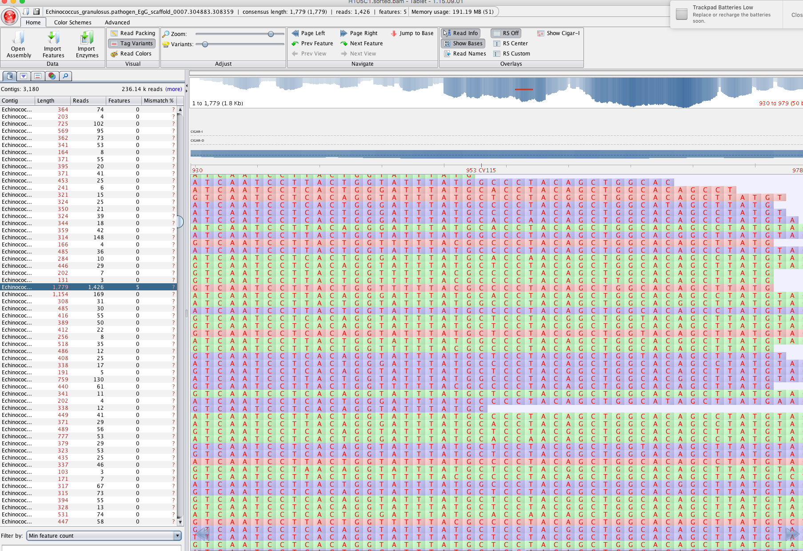
After Mapping
Many more technique details!!!!

Slide 15
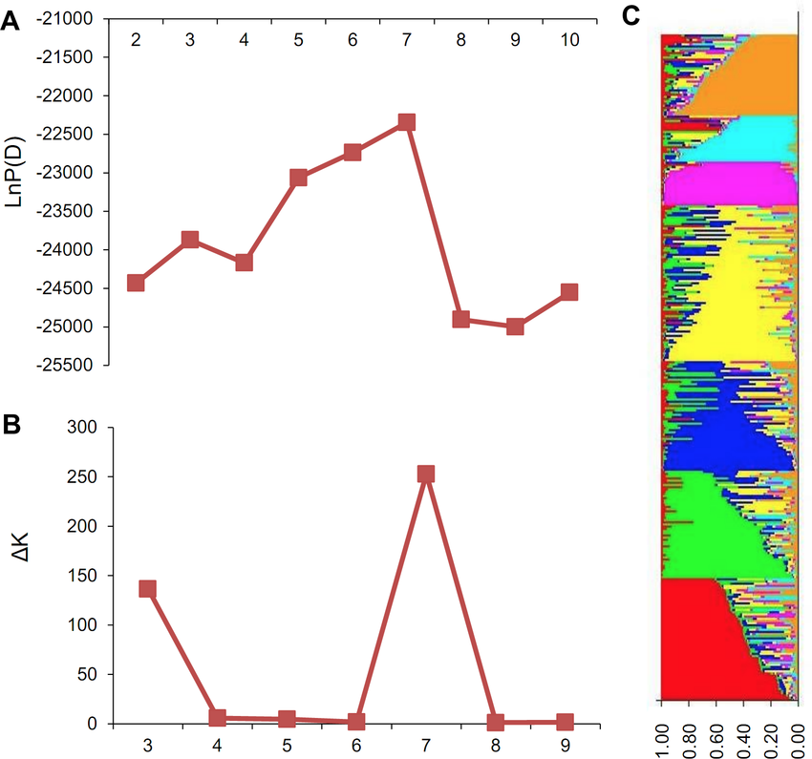
Population structure analysis

