Slide 1
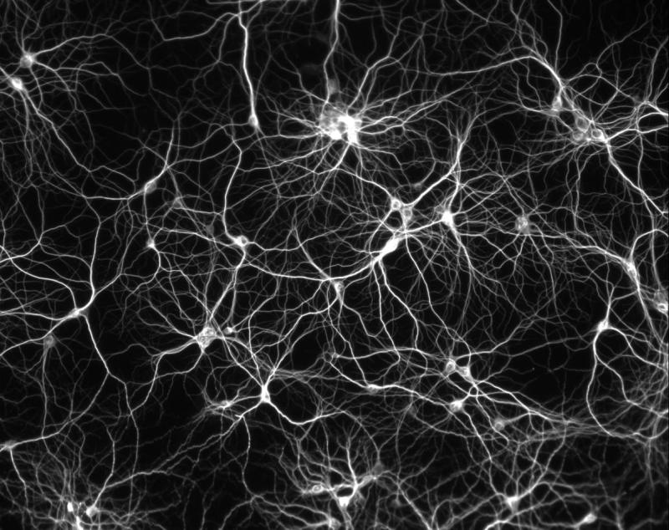
Artificial neural networks

Slide 3
The human brain
Possesses many advantages over a digital computer.
Complex task
Robust
Ability to learn
Notes:
We can quickly recognize a face, even when seen from the side in bad lighting in a room full of other objects. We can easily understand speech, even that of an unknown person in a noisy room. Despite years of focused research, computers are far from performing at this level. The brain is also remarkably robust; it does not stop working just because a few cells die. Compare this to a computer, which will not normally survive any degradation of the CPU (central processing unit). But perhaps the most fascinating aspect of the brain is that it can learn. No programming is necessary; we do not need a software upgrade, just because we want to learn to ride a bicycle.

Slide 4
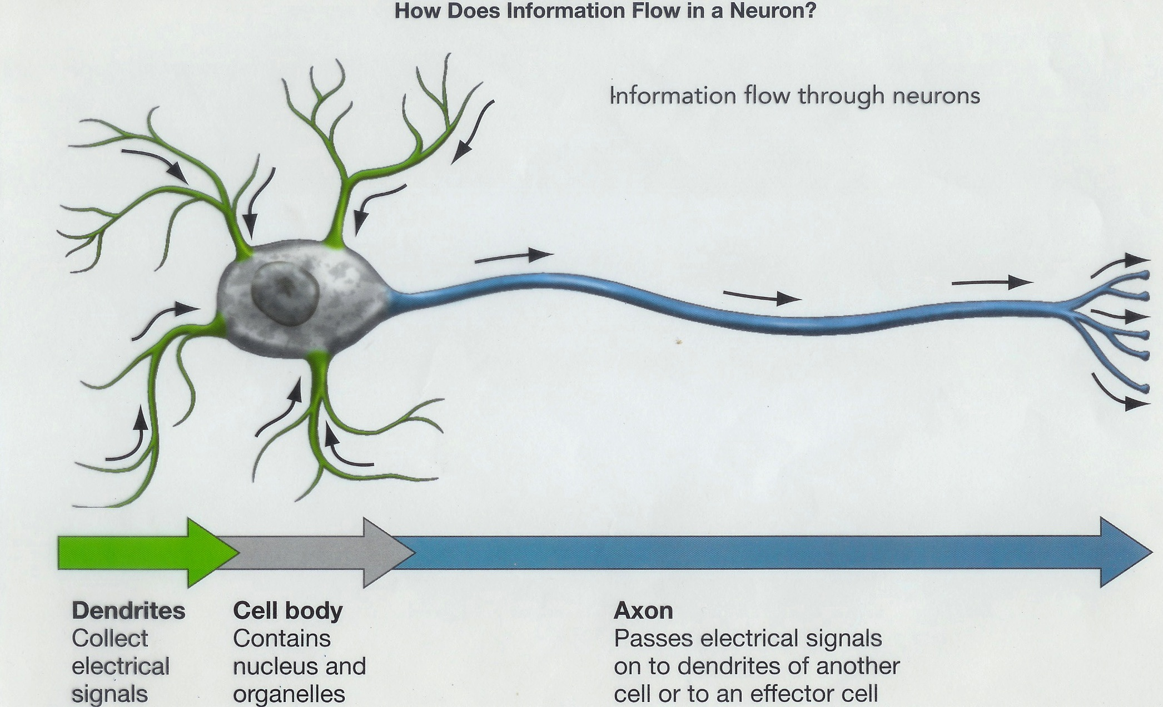
The computations of the brain are done by a highly interconnected network of neurons, which communicate by sending electric pulses through the neural wiring consisting of axons, synapses and dendrites.

Slide 5
Perceptrons
In 1943, McCulloch and Pitts modeled a neuron as a switch that receives input from other neurons and, depending on the total weighted input, is either activated or remains inactive.
The weight, by which an input from another cell is multiplied, corresponds to the strength of a synapse—the neural contacts between nerve cells. These weights can be both positive (excitatory) and negative (inhibitory).
It was shown that networks of such model neurons have properties similar to the brain: they can perform sophisticated pattern recognition, and they can function even if some of the neurons are destroyed.

Slide 6
The model neuron
A model neuron is referred to as a threshold unit and its function is illustrated in Figure 1a.
It receives input from a number of other units or external sources, weighs each input and adds them up. If the total input is above a threshold, the output of the unit is one; otherwise it is zero.
The points in input space satisfying this condition define a so called hyperplane.

Slide 7
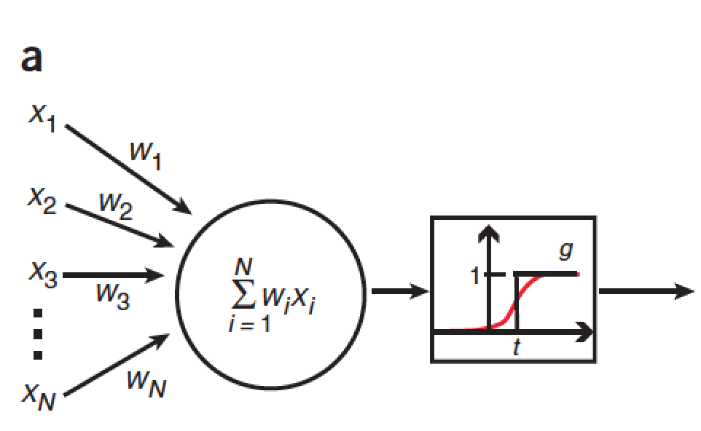
Figure 1 Artificial neural networks. (a) Graphical representation of the McCulloch-Pitts model neuron or threshold unit.

Slide 8
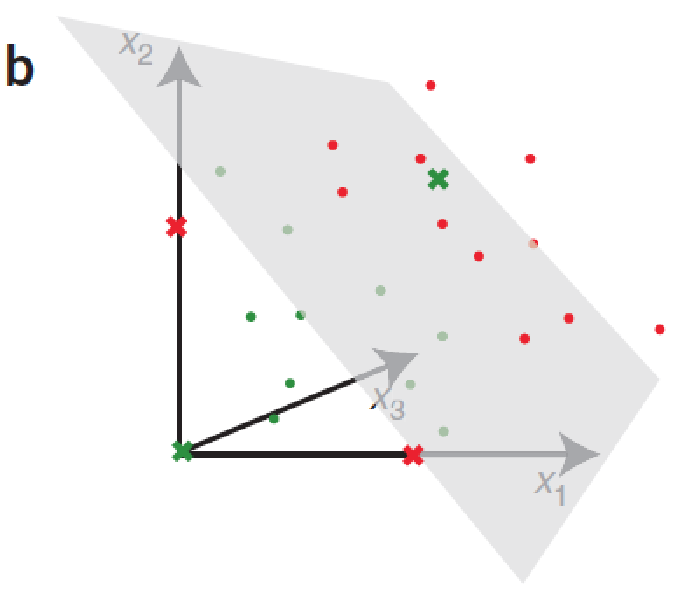
Figure 1 Artificial neural networks. (b) Linear separability. In three dimensions, a threshold unit can classify points that can be separated by a plane.

Slide 9
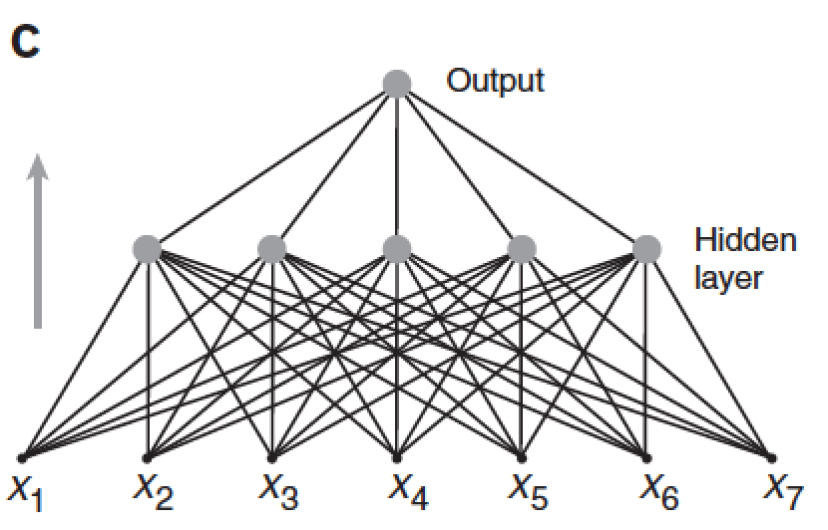
Figure 1 Artificial neural networks. (c) Feed-forward network.

Slide 10
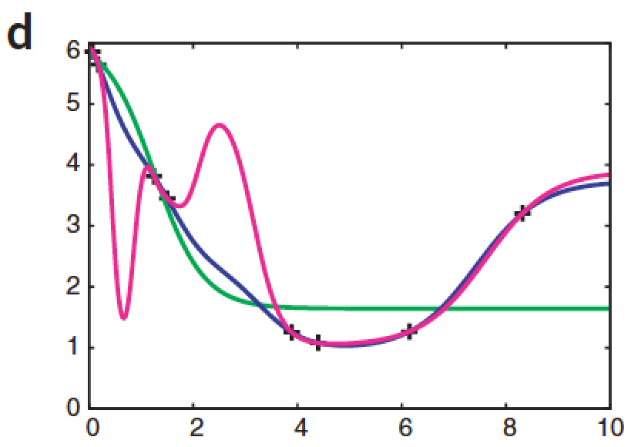
Figure 1 Artificial neural networks. (d) Over-fitting.

Slide 11
Learning
If the classification problem is separable, we still need a way to set the weights and the threshold, such that the threshold unit correctly solves the classification problem.
This can be done in an iterative manner by presenting examples with known classifications, one after another. This process is called learning or training, because it resembles the process we go through when learning something.

Slide 12
Learning
Simulation of learning by a computer involves making small changes in the weights and the threshold each time a new example is presented in such a way that the classification is improved.
During training, the hyperplane moves around until it finds its correct position in space, after which it will not change so much.

Slide 13
An example
Of two classes of cancer, only one responds to a certain treatment, you decide to try to use gene expression measurements of tumor samples to classify them.
Assume you measure gene expression values for 20 different genes in 50 tumors of class 0 (nonresponsive) and 50 of class 1 (responsive).
On the basis of these data, you train a threshold unit that takes an array of 20 gene expression values as input and gives 0 or 1 as output for the two classes, respectively.
If the data are linearly separable, the threshold unit will classify the training data correctly.

Slide 14
Feed-forward network
But many classification problems are not linearly separable. We can separate the classes in such nonlinear problems by introducing more hyperplanes; that is, by introducing more than one threshold unit.
This is usually done by adding an extra (hidden) layer of threshold units each of which does a partial classification of the input and sends its output to a final layer, which assembles the partial classifications to the final classification (Fig. 1c).
Such a network is called a multi-layer perceptron or a feed-forward network.

Slide 15
either a highly expressed gene 1 and a silent gene 2 or a silent gene 1 and a highly expressed gene 2;
if neither or both of the genes are expressed, it is a class 0 tumor. ‘exclusive or’ function, nonlinearly separable
In this case, it would be necessary to use a multi-layer network to classify the tumors.

Slide 16
Figure 1 Artificial neural networks. (c) Feed-forward network.

Slide 17
Back-propagation
Back-propagation is a learning algorithm works for feed-forward networks with continuous output.
Training starts by setting all the weights in the network to small random numbers. Now, for each input example the network gives an output, which starts randomly.
We measure the squared difference between this output and the desired output—the correct class or value. The sum of all these numbers over all training examples is called the total error of the network.
If this number was zero, the network would be perfect, and the smaller the error, the better the network.

Slide 18
Back-propagation
By choosing the weights that minimize the total error, one can obtain the neural network that best solves the problem at hand.
This is the same as linear regression, where the two parameters characterizing the line are chosen such that the sum of squared differences between the line and the data points is minimal.
This can be done analytically in linear regression, but there is no analytical solution in a feed-forward neural network with hidden units.
In back-propagation, the weights and thresholds are changed each time an example is presented, such that the error gradually becomes smaller.

Slide 19
Back-propagation
In back-propagation, a numerical optimization technique called gradient descent makes the math particularly simple.
There are some learning parameters (called learning rate and momentum) that need tuning when using back-propagation, and there are other problems to consider.

Slide 20
Over-fitting
Over-fitting occurs when the network has too many parameters to be learned from the number of examples available, that is, when a few points are fitted with a function with too many free parameters.
There are many ways to limit over-fitting (apart from simply making small networks), but the most common include averaging over several networks, regularization and using methods from Bayesian statistics

Slide 21
Cross-validation
To estimate the generalization performance of the neural network, one needs to test it on independent data, which have not been used to train the network.
This is usually done by cross-validation, where the data set is split into, for example, ten sets of equal size. The network is then trained on nine sets and tested on the tenth, and this is repeated ten times, so all the sets are used for testing.
This gives an estimate of the generalization ability of the network; that is, its ability to classify inputs that it was not trained on.

