Slide 1
Extensions and applications
Both the simple perceptron with a single unit and the multi-layer network with multiple units can easily be generalized to prediction of more than two classes by just adding more output units.
Any classification problem can be coded into a set of binary outputs. In the above example, we could, for instance, imagine that there are three different treatments, and for a given tumor we may want to know which of the treatments it responds to.
This could be solved using three output units—one for each treatment—which are connected to the same hidden units.

Slide 2
Extensions and applications
Neural networks have been applied to many interesting problems in different areas of
Science
Medicine
Engineering
and in some cases, they provide state-of-the-art solutions.

Slide 3
DNA barcoding

Slide 4
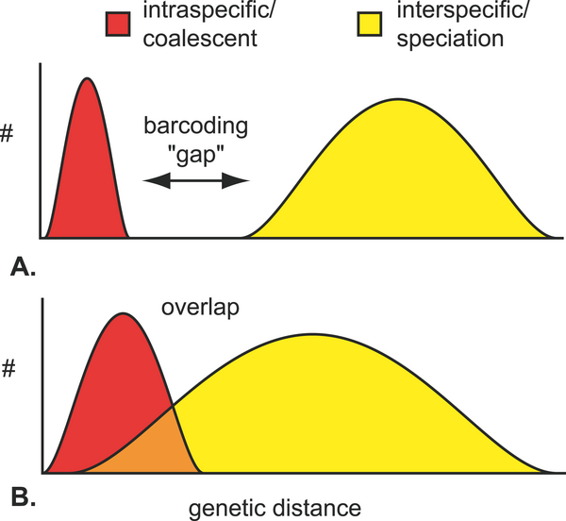
Biology
Use DNA sequence to identify species
Popular methods, comparing similarity between unknown sequence and sequence of known species
Blast
Tree based method

Slide 5
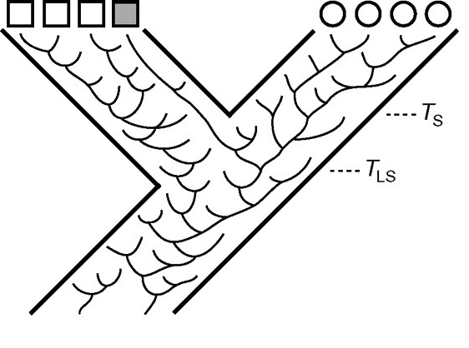
Biology
High error rate when species are affected by incomplete lineage sorting

Slide 6
Method using neural networks

Slide 7
Method using neural networks

Slide 8
Method using neural networks
simulation studies indicate that the success rates of species identification depend on the divergence of sequences, the length of sequences, and the number of reference sequences.
Particularly in cases involving incomplete lineage sorting, this new BP-based method appears to be superior to commonly used methods for DNA-based species identification.

Slide 9
Applications of Neural Networks in Protein Bioinformatics
Prediction of protein structure including secondary structure
Prediction of binding sites and ligands
Prediction of protein properties such as physicochemical proteins, localization in the host organism, etc.

Slide 10
Predict protein structure PSIPRED (Jones 1999)
Architecture of PSIPRED algorithm. The algorithm is two-stage and includes two 3-layer FNNs, where the output of the first stage network feeds into the input to the second stage network. In the first stage, a window of 15 positions over the PSSM profile generated by the PSI-BLAST program from the input protein sequence is used. Each position in the input is represented by a vector of 21 values (the ith AA in the window is represented as mi,1mi,2 . . . mi,21). The 21 15 values are fed into the input layer.

Slide 11
Predict protein structure
The output layer in the first stage NN contains three nodes that represent the probabilities of forming helix, strand, and coil structures (the predicted probabilities for the central AA in the window are represented as y8,1, y8,2, and y8,3). These probabilities, using a window of 15 positions, are fed into the second-stage NN. The output from the second-stage NN is the final prediction that represents the probabilities of three types of the secondary structure: z8,1, z8,2, and z8,3.

Slide 12
Artificial intelligence

Slide 14
考试日期(开卷考试)
19:00-20:30, 23 Dec, Friday, Final Exam 70% Online exam, open book
25 Dec, Sun, handin your homework 3

Slide 15
考试规则
1.考试时，请各位同学将自己的姓名备注为“学号+名字”；
2.正式考试时，未开摄像头，一经发现，扣20分；
3.摄像头必须对准电脑屏幕，并且保准双手露出。如若没有，扣5分；
4.不允许交头接耳，例如考试时坐在一起，看对方屏幕，讨论问题。如若发现，扣10分；
5.发现使用微信，QQ等可以交流的社交软件，扣10分；
6.切屏3次，自动提交试卷。
（考试时，全程有多名监考人员，请各位遵守考场规则，不要有侥幸心理）

