Slide 1
ABBA-BABA
Notes:
1. Then we can start to learn the ABBA-BABA.

Slide 2
D statistic
the D statistic, to test for admixture between three closely related populations.The expectation of D was derived under a simple model of admixture with constant population size
Notes:
2. In the ABBA-BABA method ,the main calculation is D statistic .the D statistic is to test for admixture between three closely related populations.The expectation of D was derived under a simple model of admixture with constant population size

Slide 3
null hypothesis
P1
P2
P3
O
Notes:
3. First of all ,we can imagine that there are four population,p1,p2,p3 and the outgroup O. There is no gene flow between P3 and P1 or P2 since they have split. This is the null hypothesis.

Slide 4
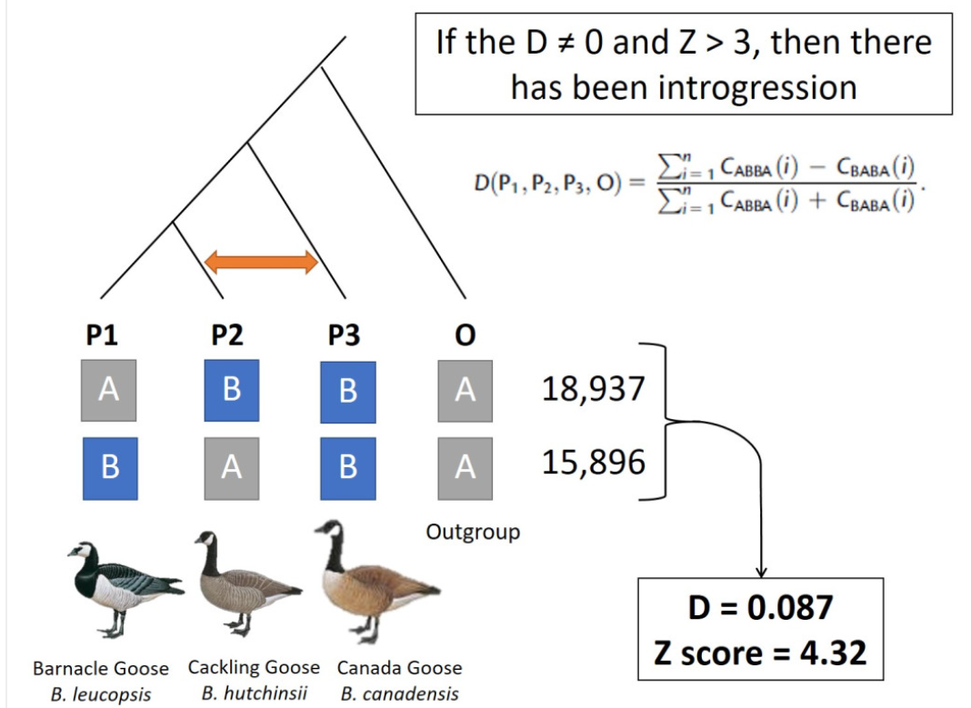
ABBA-BABA
Notes:
4. We hypotheses there are two allele gene A and B. The outgroup O only have A and the P3 only have B. In the null hypothsis, A and B gene frequency is the same in P1 and P2. But if there is a gene flow between P3 and P2 , the P2 will show more B allele. So the allele in P1, P2,P3,O is ABBA. Similarly, if there is a gene flow between P3 and P1, the P1 will show more B . And the allele in P1,P2,P3,O is BABA. We now define C parameter to count the number of ABBA and BABA . So the D statistic is in this formula. In this formula , if the ABBA frequency is the same as the BABA ,the D value is 0. If the model close to ABBA ,the D value will close to 1, If the model close to BABA ,the D value will close to minus 1 .Z score is to test whether the D Value is significant.

Slide 5
Abba-baba
Notes:
5. This is the simplest model in the ABBA BABA. There are a lot of hard model to understand, if you want or know ,you can find the article to study by yourself.

Slide 6
https://github.com/shenglin-liu/ABBA_BABA
https://mirrors.tuna.tsinghua.edu.cn/CRAN/
Notes:
6. ABBA BABA is a R package ,and it can be downloaded at github website, and you can download R in the second link.

Slide 7
Function list:
# vcf2ab : Generate input file for ABBA BABA test from small VCF file.
# vcf2ab.big : Generate input file for ABBA BABA test from big VCF files.
# vcf2ab.core : Core function for vcf2ab.big.
# DSeq : Calculates sequence-based D statistics.
# DGeno : Calculates genotype-based D statistics.
# abba.baba : Run ABBA BABA test.

Slide 8
# introgressed : Calculate introgression rate.
# fSeq : Calculate sequence-based fHom from P3 to P2.
# fGeno : Calculate genotype-based fHom from P3 to P2.
# abba.baba2 : My version of ABBA BABA test.
# slidingWindow : Run ABBA BABA tests in sliding windows.
# popBatch : Run a batch of ABBA BABA tests for population data.

Slide 9
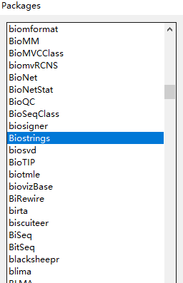
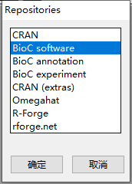
Choose repositories
Install packages

Slide 10
THANK YOU!

