Slide 1
Approximate Bayesian computation (ABC)
Reporter
Anirban Sarker
Lab of Molecular Systematics and Ecology

Slide 2
Population genetics is a subfield of genetics that deals with genetic differences within and between populations.
ABC is a group of methods, that is suitable to solve the problems, arise in population genetics along with other fields.

Slide 3
ABC constitutes a class of computational methods rooted in Bayesian statistics.
Bayesian statistics is a theory in the field of statistics, in which the evidence about the true state of the world is expressed in terms of degrees of belief , as known as Bayesian probabilities.
Instead of frequency or propensity of some phenomenon

Slide 4
History
The term Bayesian derives from the name of Thomas Bayes.
He was a great mathematician, philosopher and theologian of 18 th century.
The term ABC was established by Mark Beaumont et al.
Bayesian phylogenetic methods were introduced in the 1990s.

Slide 5
The estimation of demographic parameters from genetic data often requires the computation of likelihoods.
But the situation changed recently with the advent of ABC algorithms allowing one to obtain parameter posterior distributions based on simulations not requiring likelihood computations.

Slide 6
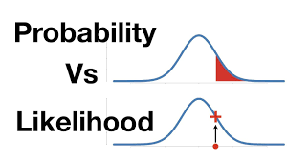
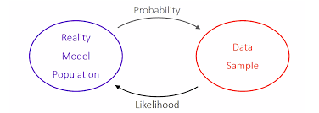
Probability describes the plausibility of observed data assumed to be described by a statistical model, without reference to any observed data.
whereas likelihood describes the plausibility of a parameter value of the statistical model assumed to describe the observed data.

Slide 7
Applications
Analysis of ecology or systems biology
Phylogeographic analysis of virus spread in humans
Inference of phylogeographic history and migration between species
Analysis of species diversification rates
Inference of phylogenetic relationships among species or populations.
Analysis of complex problems arising in biological sciences, e.g. in population genetics and systems biology.

Slide 8
What type of data we can use
DNA and amino acid sequence alignments
Morphological characters

Slide 9
Conceptual overview

Slide 10
Summary statistics
In order to evaluate the distance between the simulated data and the observed data, the data needs to be summarized in a quantitative form.
The choice of summary statistics, however, is a tough one.
Too few summary statistics may not capture the characteristics of the model, which leads to overall low power for parameter estimation.
Too many summary statistics, on the other hand, may introduce random noise.

Slide 11
Observed data: AABAAAAABBABBBBBBBBA
Summary statistic value: 6

Slide 12
Prior probability distribution

Slide 13
Conceptual overview

Slide 14
Example of ABC rejection algorithm
i |  | Simulated datasets (step 2) | Summary statistic (step 3) | Distance (step 4) | Outcome (step 4)
1 | 0.08 | AABAAAABAABAAABAAAAA | 8 | 2 | accepted
2 | 0.68 | AABBABABAAABBABABBAB
3 | 0.87 | BBBABBABBBBABABBBBBA
4 | 0.43 | AABAAAAABBABBBBBBBBA
5 | 0.53 | ABBBBBAABBABBABAABBB

Slide 15
Example of ABC rejection algorithm
i |  | Simulated datasets (step 2) | Summary statistic (step 3) | Distance (step 4) | Outcome (step 4)
1 | 0.08 | AABAAAABAABAAABAAAAA | 8 | 2 | accepted
2 | 0.68 | AABBABABAAABBABABBAB | 13 | 7 | rejected
3 | 0.87 | BBBABBABBBBABABBBBBA | 9 | 3 | rejected
4 | 0.43 | AABAAAAABBABBBBBBBBA | 6 | 0 | accepted
5 | 0.53 | ABBBBBAABBABBABAABBB | 9 | 3 | rejected

Slide 16
Conceptual overview

Slide 17
Choice of threshold level
At the time of choice, we should make good balance between bias and Monte Carlo error.
When value is 0, this is identical to algorithm.
When this is 3, is better than previous one upto 100,000 simulations.
But at the time of 5, bias dominates.

Slide 18
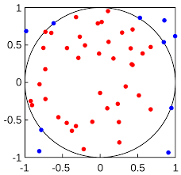
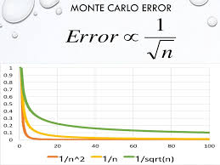
Monte Carlo integration & error
In mathematics, Monte Carlo integration is a technique for numerical integration using random numbers.
Points inside the circle is 40
Points inside the square is 50
Ratio: 40/50=0.8
Circle area: 4 X o.8= 3.2

Slide 19
Why we use ABC
The availability of user-friendly software for running sophisticated models of evolution.
The development of powerful models of data analysis.

Slide 20
Disadvantages
Bayesian phylogenetic models are complex.
Analyses are often conducted using default priors, which may not be appropriate and may lead to biased or incorrect results.
The priors and model assumptions made in those programs are not always clear to the user.

Slide 21
Challenges
First, data simulation, which is in the core of any ABC analysis, is specific to the model. Thus, many existing ABC software are specific to a particular class of models.
Second, an ABC analysis often follows a trial–error approach, where users experiment with different models, ABC algorithms or summary statistics.
Third, ABC is subject to intensive research, and many new algorithms have been published in the past few years .

Slide 22
ABC-softwares
DIY-ABC
abc R package
Easy ABC R package
ABC-SysBio
ABCtoolbox
msBayes
PopABC
ONeSAMP
ABC4F
2BAD
ELFI

Slide 23
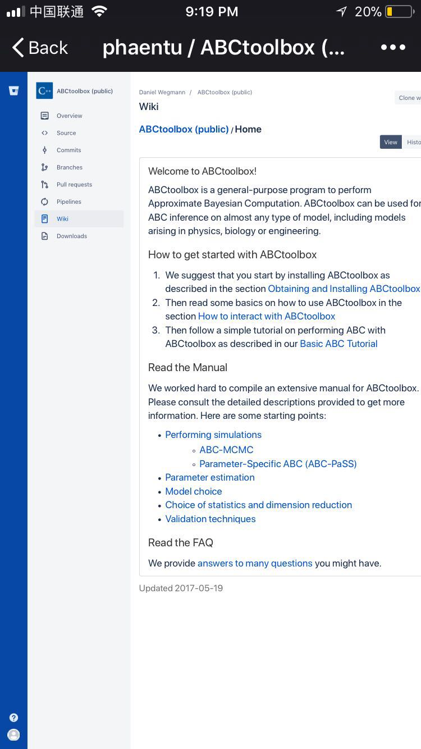
Web-address of ABCtoolbox
https://bitbucket.org/phaentu/abctoolbox-public/wiki/Home

Slide 24
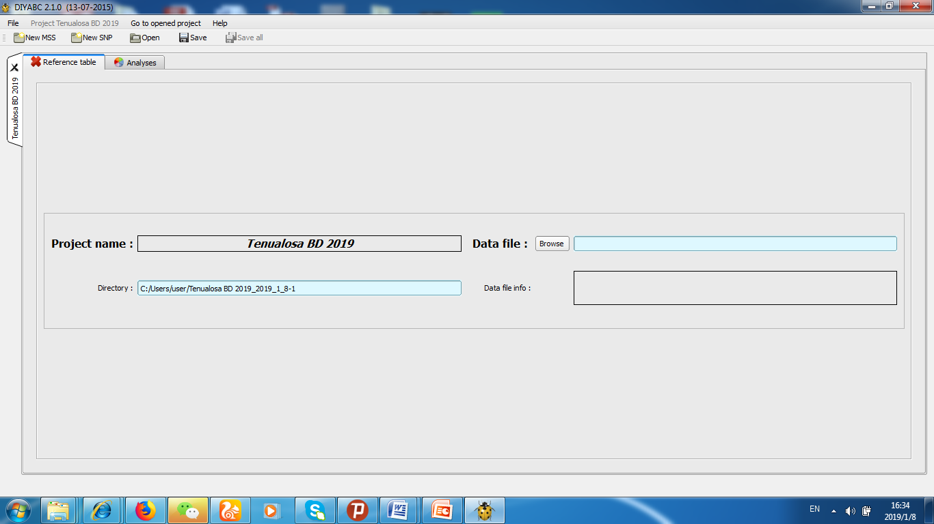

Slide 25
Thanks to all

