Slide 1
Workshop of 2020
Speaker : Fan Gong
Notes:
Good morning everyone, I am going to talk about some analysis methods in molecular biology.

Slide 2
Content
FDIST
Bayescan
PCA corrects for stratification in GWAS
Notes:
I got three methods, fdist, bayescan, PCA corrects for stratification in GWAS

Slide 3
FDIST
Notes:
first one FDist

Slide 4
F_{st}
F_{st} is develop from F statistics, reflecting the level of heterozygosity of population alleles, and used to measure the degree of population differentiation.
Notes:
to learn fdist, you should know fst first

Slide 5
F_{st}
If Fst in 0 ~ 0.05, means that the genetic differentiation between populations is very small, which can be ignored.
If Fst in 0.05 ~ 0.15, means moderate genetic differentiation between populations.
If Fst in 0.15 ~ 0.25, means large genetic differentiation between populations.
If Fst > 0.25, means great genetic differentiation between populations.
Notes:
the Fst equals HT minus HS and dividing HT
If you want to know more about this equation, I can give you an example use.
https://blog.csdn.net/u014182497/article/details/52672308
https://wenku.baidu.com/view/b19155ef70fe910ef12d2af90242a8956aecaa36.html

Slide 6
FDIST
Beaumont and Nichols(1996) proposed to obtain the distribution of F_{ST} across loci as a function of heterozygosity between populations by performing simulations under an finite island-model, and to specifically identify outlier loci as being those present in the tails of the generated distribution.
The approach of Excoffier et al. (2009) implemented in Arlequin(a software use to caculate FDIST) is similar to that in FDIST.
Notes:
Selection can also affect genetic diversity between populations, since a locus under balancing selection should show too even allele frequencies across populations and loci under local directional selection should show large differences between populations.
选择也会影响群体间的遗传多样性，因为平衡选择的基因座在群体间的等位基因频率太均匀，而局部定向选择的基因座在群体间的等位基因频率差异较大
Beaumont and Nichols(1996) proposed to obtain the distribution of F_{ST} across loci as a function of heterozygosity[hia ti ri z gò sity] between populations by performing simulations under an finite island-model, and to specifically identify outlier loci as being those present in the tails of the generated distribution.
Beaumont和Nichols（1996）提出，通过在有限岛模型下进行模拟，获得种群间杂合度函数全部loci的FST分布，并将离群基因座具体识别为出现在所生成分布尾部的离群点。
Beaumont [ˈboʊmɔnt]
Nichols [ˈnɪkəlz]
loci [ˈloʊkaɪ]
heterozygosity [hia ti ri z gò sity]
Excoffier[ex ke fi er]
Their approach was implemented in the FDIST computer program, with some modifications.

Slide 7
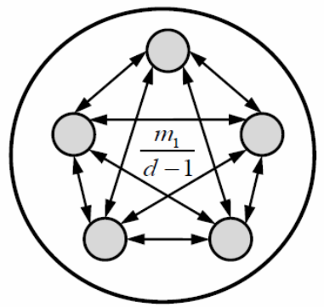
FDIST
One Group, in size N
d demes
receive on average Nm new immigrant genes per generation
In this way:
migration rate = m₁/(d-1)
Notes:
This approach also assumes a finite island model where d demes[deanwms] of size N receive on average Nm new immigrant genes per generation, randomly chosen from all the other demes. Under this model, one expects the following relationship between the parameters of the island model and FST, as（转到下一页）

Slide 8
FDIST
Mutations added under a given mutation model on top of the simulated coalescent tree.
Notes:
this
Mutations are then added under a given mutation model on top of the simulated coalescent[co li sen] tree to create genetic diversity, and to obtain the joint distribution of FST and heterozygosity[hia ti ri z gò sity] between populations.

Slide 9
FDIST after calibrating
The finite island model has been recently shown to lead to a large fraction of false positives, if populations samples belong to a hierarchically subdivided population or if some population samples have a recent shared history, such as after some range expansion over different continents (Excoffier et al. 2009).
Notes:
The finite island model has been recently shown to lead to a large fraction of false positives, if populations samples belong to a hierarchically[hi e wak ki cally] subdivided population or if some population samples have a recent shared history, such as after some range expansion over different continents (Excoffier et al. 2009).
In other to overcome this problem and to reduce the number of false positive loci, a hierarchical island model of population (as defined by Slatkin and Voelm, 1991) was used to model some heterogeneity[ˌhɛtərədʒɪˈniəti] in population affinities[əˈfɪnətiz].

Slide 10
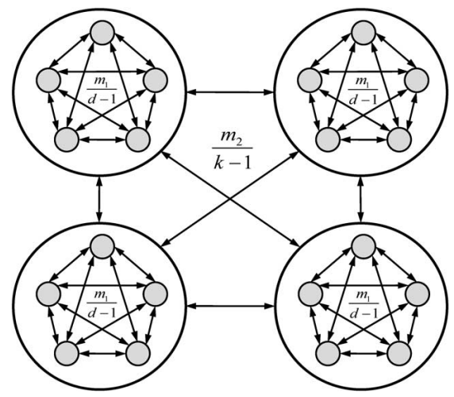
FDIST after calibrating
migration rate within groups m₁/(d-1)
migration rate between groups m₂/(k-1)
Notes:
This model shown above, where demes within groups exchange migrants at rate m1/(d-1) and demes between groups exchange migrants at rate m2/(k-1) (where d is the number of demes within each group, and k is the number of groups)
Now, the Fst look like this

Slide 11
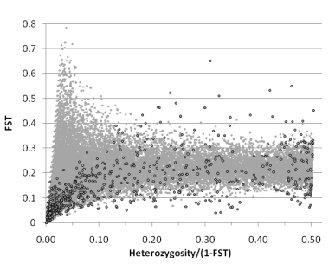
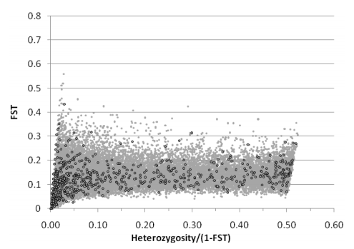
outliers
under infinite island model
(excess false positives）
under a hierarchical island model
Notes:
these two figures compare the two model, the left one is under infinite island model that have excess false positives, while the right one is under hierarchical[ˌhaɪəˈrɑːrkɪkl] island model.

Slide 12
BayeScan
Notes:
OK, now, it's time for bayescan

Slide 13
BayeScan
A program
Based on the multinomial-Dirichlet model
Identifying candidate loci under natural selection from genetic data
Notes:
BayeScan is a program that based on the multinomial[mul'tino mi ou]-Dirichlet['di ri clet] model, and aims at identifying candidate loci under natural selection from genetic data, using differences in allele frequencies between populations.

Slide 14
BayeScan
One of the scenarios covered consists of an island model in which subpopulation allele frequencies are correlated through a common migrant gene pool from which they differ in varying degrees.
The difference is measured by a subpopulation specific F_{ST} coefficient.
Notes:
One of the scenarios covered consists of an island model in which subpopulation allele[əˈliːl] frequencies are correlated through a common migrant gene pool from which they differ in varying[ˈveriɪŋ] degrees.
The difference in allele frequency between this common gene pool and each subpopulation is measured by a subpopulation specific FST coefficient.

Slide 15
BayeScan
Incorporates the uncertainty on allele frequencies due to small sample sizes.
Using different models to estimate allele frequencies.
Three types of data can be used in BayeScan:
codominant data (as SNPs or microsatellites);
dominant binary data (as AFLPs);
AFLP band intensity.
Notes:
BayeScan incorporates the uncertainty on allele frequencies due to small sample sizes.
In practice, very small sample size can be use, with the risk of a low power, but with no particular risk of bias.
Allele frequencies are estimated using different models depending on the type of genetic marker used.
three different types of data can be used: (i) codominant data (as SNPs or microsatellites[micro ˈsætəlaɪt]), (ii) dominant binary[ˈbaɪnəri] data (as AFLPs) and (iii) AFLP band intensity, which are neither considered as dominant nor codominant.

Slide 16
BayeScan
Selection is introduced by decomposing locus–population F_{ST} coefficients into a population-specific component (beta), shared by all loci and a locus-specific component (alpha) shared by all the populations using a logistic regression.
Locus-specific component be used (alpha significantly different from 0) → this locus is assumed that departured from neutrality.
α > 0, diversifying selection.
α < 0, balancing or purifying selection.
Notes:
Departure from neutrality at a given locus is assumed when the locus-specific component is necessary to explain the observed pattern of diversity.
A positive value of alpha suggests diversifying selection, whereas negative values suggest balancing or purifying selection.

Slide 17
BayeScan
For each locus, BayeScan calculates a posterior probability for the model including selection.
convenient to make decision in the context multiple testing.
In Bayesian statistics, model choice decision can be performed using the so-called “Bayes factors”.
Notes:
For each locus, BayeScan calculates a posterior[pɑːˈstɪriər] probability for the model including selection.
These probabilities are very convenient to make decision in the context multiple testing (testing a large number of markers simultaneously)
In Bayesian statistics, model choice decision can be performed using the so-called “Bayes factors”.

Slide 18
BayeScan
Given a problem in which we have to choose between two models M1(neutral) and M2 (selection).
on the basis of a data set N,
BF for model M2:
e.g.
BF=2 → the data favors model M2 over model M1 at odds of 2 to 1.
Notes:
Given a problem in which we have to choose between two models M1 and M2, on the basis of a data set N, the Bayes factor BF for model M2 is given by BF=P(N|M2)/P(N|M1).
The Bayes factor provides a scale of evidence in favor of one model versus another.
For example, BF=2 indicates that the data favors model M2 over model M1 at odds[ɑːdz] of two to one.

Slide 19
BayeScan
P(α≠0) | BF | log₁₀BF | Jeffreys' interpretation
0.50 → 0.76 | 1 → 3 | 0 →0.5 | Barely worth mentioning
0.76 → 0.91 | 3 →10 | 0.5 → 1 | Sustiantial
0.91 → 0.97 | 10 →32 | 1 → 1.5 | Strong
0.97 → 0.99 | 32 → 100 | 1.5 → 2 | Very Strong
0.99 → 1.00 | 100 → ∞ | 2 → ∞ | Decisive
Jeffreys' scale of evidence for Bayes factors
Notes:
This table gives Jeffreys' scale of evidence for Bayes factors:
不值一提
替代
强
很强
决定性的
For example, a Bayes factor of 3 corresponding to a posterior probability of 0.76, is already considered as being a “substantial” evidence for selection.

Slide 20
BayeScan
In the context of multiple testing, we need to incorporate our skepticism about the chance that each locus is under selection.
Done by
setting the prior odds for the neutral model:
using Posterior Odds instead of Bayes factors:
Notes:
In the context of multiple testing, we also need to incorporate our skepticism about the chance that each locus is under selection.
This is done in BayeScan by setting the prior[ˈpraɪər] odds[ɑːdz] for the neutral model and by using Posterior Odds instead of Bayes factors to make decisions:
PO indicate how more likely the model with selection is compared to the neutral model

Slide 21
BayeScan
Posterior probabilities directly allow the control of the False Discovery Rate (FDR).
FDR is defined as the expected proportion of false positives among outlier markers.
Reverse:
First, choosing a target FDR.
Then, looking for the highest posterior odds threshold achieving this FDR.
Notes:
A big advantage of posterior probabilities is that they directly allow the control of the False Discovery Rate (FDR).
FDR is defined as the expected proportion of false positives among outlier markers.
However, it is even more interesting to reverse the process by first choosing a target FDR, and then looking for the highest posterior odds threshold achieving this FDR.

Slide 22
BayeScan
For Reverse:
Define a q-value, which is the FDR analogue of the p-value.(BayeScan directly calculates q-values for each locus)
The q-value of given locus is the minimum FDR at which this locus may become significant.
e.g. q = 10%, means 10% outlier markers are expected to be false positives.
Notes:
In this context, we can define a q-value, which is the FDR analogue of the p-value
The q-value of given locus is the minimum FDR at which this locus may become significant.
If you choose, a q-value threshold of 10%, it means that 10% of the corresponding outlier markers are expected to be false positives.

Slide 23
PCA corrects for stratification in GWAS
Notes:
This method come from a paper of nature genetics, which full name is（转）

Slide 24
PCA
Principal components analysis corrects for stratification in genome-wide association studies
Alkes L Price, Nick J Patterson, Robert M Plenge, Michael E Weinblatt, Nancy A Shadick & David Reich
Notes:
Principal components analysis corrects for stratification in genome-wide association studies
For this method, I just explain briefly its principle , if you want to know more about it, please check this paper.

Slide 25
PCA
Population stratification can cause spurious associations in disease studies.
Population stratification: allele frequency differences between cases and controls due to systematic ancestry differences.
Stratification will be an increasing problem in the large-scale association studies of the future.
Notes:
Because the effects of stratification vary in proportion to the number of samples, stratification will be an increasing problem in the large-scale association studies of the future, which will analyze thousands of samples in an effort to detect common genetic variants of weak effect.

Slide 26
PCA
EIGENSTRAT
Three steps:
Apply PCA to genotype data to infer continuous axes of genetic variation.
Continuously adjust genotypes and phenotypes by amounts attributable to to ancestry along each axis, via computing residuals of linear regressions.
Compute association statistics using ancestry-adjusted genotypes and phenotypes.
Notes:
They call this method EIGENSTRAT, consist of three steps
First, apply principal components analysis to genotype data to infer continuous axes of genetic variation.
Intuitively, the axes of variation reduce the data to a small number of dimensions, describing as much variability as possible; they are defined as the top eigenvectors of a covariance matrix between samples
Second, continuously adjust genotypes and phenotypes by amounts attributable[重音在tri] to ancestry[an ces try] along each axis[ˈæksɪs], via[vi a] computing residuals of linear regressions[re 'gre sions]
intuitively, this creates a virtual set of matched cases and controls.
Third, compute association statistics using ancestry-adjusted genotypes and phenotypes.

Slide 27
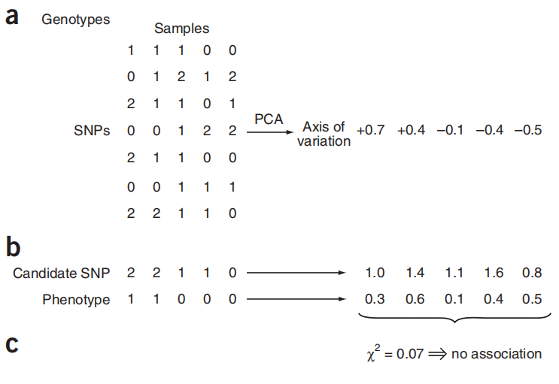
PCA
The EIGENSTRAT algorithm
Notes:
The EIGENSTRAT algorithm[ˈL gəˌrithəm], illustrated on simulated data.
(a) PCA is applied to genotype data to infer continuous axes of genetic variation; a single axis of variation is illustrated here.
(b) Genotype at a candidate SNP and phenotype are continuously adjusted by amounts attributable to ancestry along each axis, removing all correlations to ancestry.
(c) After ancestry adjustment, an association statistic between genotype at the candidate SNP and phenotype shows no significant association.
Zero-centered
Standardization

Slide 28
THANKS
Notes:
For fdist and bayescan, I just expained its principle, and I am working a useage for these two method, if you want get this usage, please contact me, thanks for your attention attendence.

