Slide 1
Population summary statistics & Arlequin
Anirban Sarker
Lab of Molecular Systematics and Ecology

Slide 2
When sequence data is assembled and aligned
SNP data is prepared

Slide 3
Population Summary Statistics
Population summary statistics is a way to summarize a set of observations of population, in order to communicate the largest amount of information as simply as possible.

Slide 4
How we can summarize a population
Number of haplotypes
Haplotype diversity
Nucleotide difference
Nucleotide diversity
Analysis of molecular variance (AMOVA)
Pairwise Fst calculation

Slide 5
Nucleotide diversity
The number of sequences in the sample
Frequency of the i th sequences
Nucleotide diversity
The number of nucleotide differences per nucleotide site between the i th and j th sequences
Frequency of the j th sequences
Notes:
Nucleotide diversity is the extent of nucleotide polymorphisms /ˌpɒlɪˈmɔːfɪzəm/ within a population, and is commonly measured through molecular markers such as microsatellite /ˌmaɪkrəʊˈsætəˌlaɪt/ sequences, mitochondrial DNA and SNPs data. One commonly used measure of nucleotide diversity was defined as the number of nucleotide difference per site between two DNA sequences in all possible pairs in the sample population, the nucleotide diversity is denoted by π. You need values of frequencies of the i th sequences, j th sequences, the number of nucleotide differences per nucleotide site between the i th and j th sequences and The number of sequences in the sample to calculate the nucleotide diversity.

Slide 6
AMOVA
Analysis of molecular variance (AMOVA), is a statistical model for the molecular variation in a single species.
The method was developed by Laurent Excoffier, Peter Smouse and Joseph Quattro.
Since developing AMOVA, Excoffier has written a program, Arlequin for running such analyses.

Slide 7
Calculation of AMOVA
CL_2048_1 Moheshkhali
CL_2048_2 Moheshkhali
CL_2048_3 Moheshkhali
CL_2050_1 Cox’s Bazar
CL_2050_3 Cox’s Bazar
CL_2050_4 Cox’s Bazar
CL_2050_5 Cox’s Bazar
CL_2050_7 Cox’s Bazar
CL_2050_8 Cox’s Bazar
CL_2050_10 Cox’s Bazar
DC_CL_1362-1 Dhal Char
DC_CL_1362-2 Dhal Char
CL_2312_1 Salalah
CL_2312_2 Salalah
CL_2312_3 Salalah
CL_2312_6 Salalah
CL_2312_7 Salalah
CL_2312_8 Salalah
CL_2312_9 Salalah
CL_2312_10 Salalah
For the implementation of AMOVA, requires two very basic components:
A distance matrix derived from the data (Pair wise differences)
(2) A separate table used to partition the data into different stratifications.

Slide 9
Data preparation for ARLEQUIN
VCF file to ARLEQUIN (.arp) file
We also can categorize the samples in different population

Slide 10
Connectivity between population genetics programs and format

Slide 12
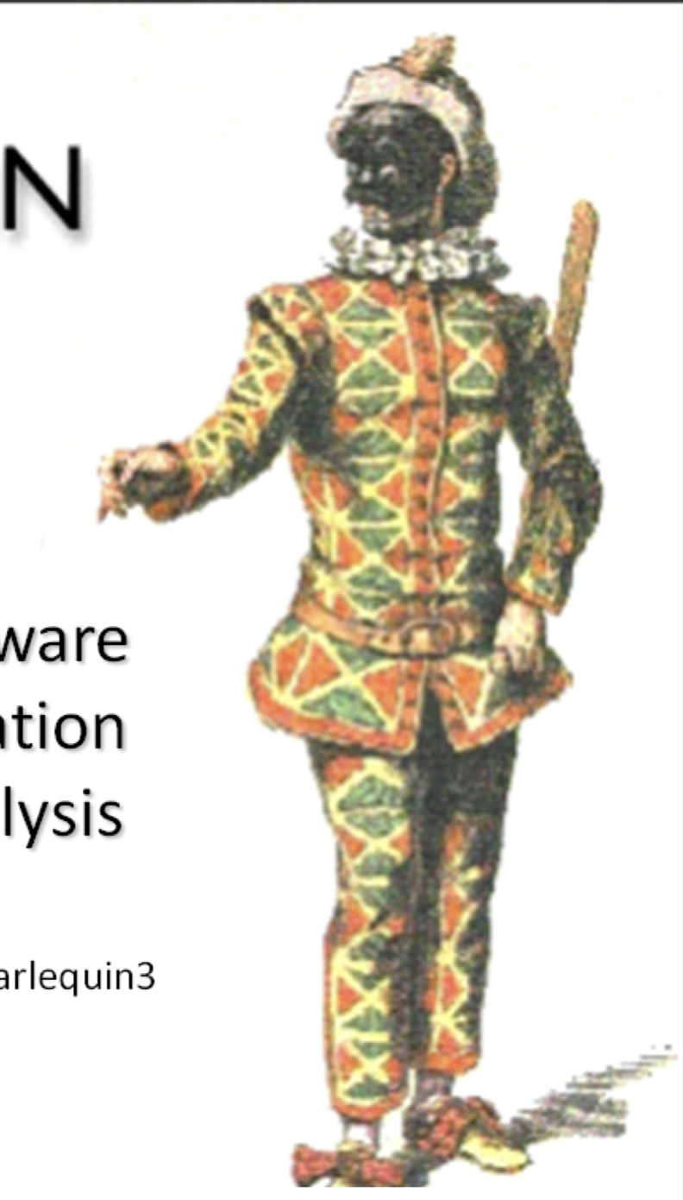
ARLEQUIN
Ver 3.5.2

Slide 13
Types of data are used in Arlequin
Sequence data
RFLP data
Microsatellite data
Standard data
Allele frequency data
Notes:
3.Allelic state of microsatellite loci 4. Molecular base of polymorphism is not particularly defined

Slide 14
System requirements
Windows XP/Vista/7
A minimum of 256 RAM and more to avoid swapping.
At least 50 MB free hard disk place

Slide 15
Usage for graphical version
Configuration
Preparing input files
Preparation
Loading project files into Arlequin
Selecting analyses to be performed on your data
Performing the analyses
Checking the results
Notes:
Arlequin present graphical version and console version which is more suitable for big data. And the graphical version only support windows。 Here is the usage for graphical version. There are six main steps and most of them are for preparation.

Slide 17
Arlequin Configuration

Slide 19
After that, open a new project

Slide 20
Prepare the project file by structure editor

Slide 22
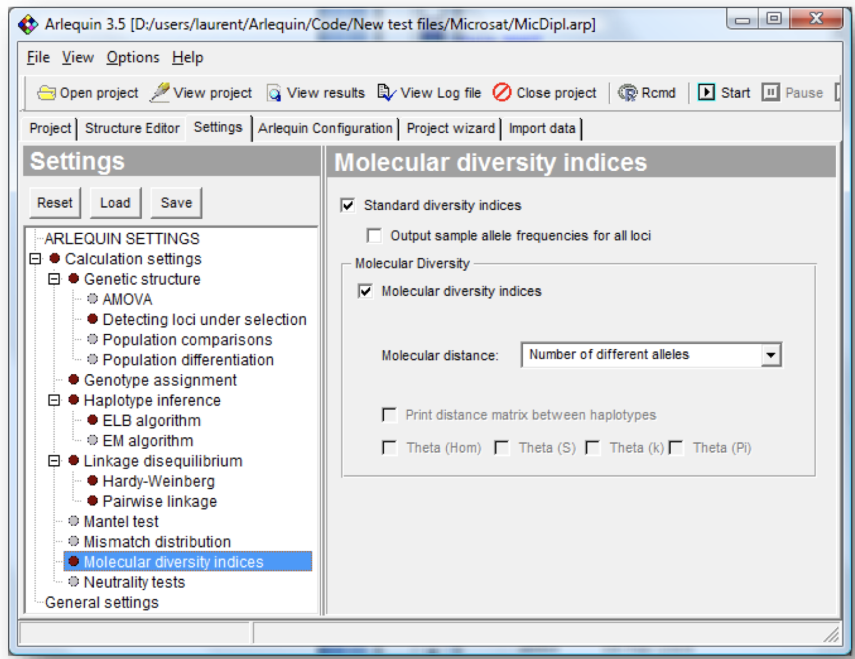
Selecting analyses to be performed on data
Notes:
Different analyses can be selected and their parameters tuned in the Settings tab. In the tree on the left side could select different types of computations you wish the set up. Depending on your selection, the right part of the tab dialog will show you different parameters to set up.

Slide 23
Start the analyses
Notes:
Finall, you just need to press the start button on the toolbar and wait for your results.

Slide 24
Results of analysis of molecular variance (AMOVA)

Slide 25
Pairwise Fst result

Slide 26
Pairwise differences (Fst) among populations
Fst P values significance level: 0.0500

Slide 27
Download software
http://cmpg.unibe.ch/software/arlequin35/Arl35Downloads.html
Manual
http://cmpg.unibe.ch/software/arlequin35/man/Arlequin35.pdf
Notes:
The more details about using Arlequin could be found from the link.

