Slide 1


species
what is the species？
Notes:
today i will talk about species delimitation with yours
so what is the spesies?
At present, the biological concept accepted by most scholars is that "species are natural populations that can mate freely and are reproductively isolated from each other".
We can see the species differentiation from the picture below,
The two species Shared a common ancestor, first isolated geographically, with no genetic communication between them.Long periods of geographic isolation have created reproductive isolation.

Slide 2
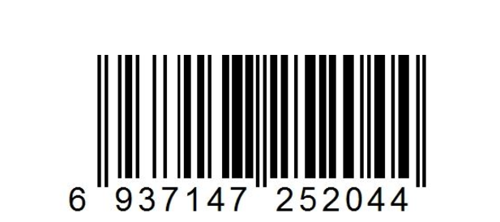
species delimitation
what is the species delimatation？
The process of dividing the boundaries of existing by a series of methods and means
Early species identification was by DNA barcode。
Notes:
we know what is the spescies, but what is the species delimitation?
it’s The process of dividing the boundaries of existing species by a series of methods and means
So what is a DNA barcode？
DNA barcoding is a method of identifying species from short fragments of DNA sequences.
Just like you go to the supermarket to buy things, the salesperson will know the goods by scanning the barcode（就像你去超市买东西，售货员会通过扫条形码得知商品）。

Slide 3
BFD(Bayes factor delimitation)
A method of species delimitation in a Bayesian framework using SNP data and the programs SNAPP and BEAST.
Bayes factor:
MLE( marginal likelihood estimate ) value
Notes:
today we wil talk BFD to delimitate species .
BFD is bayes factor delimitation which is A method of species delimitation in a Bayesian framework using the programs SNAPP and BEASt.
So what is bayes factor?
When we do model selection, we use the model‘s likelihood ratio. bayes is the ratio of the posterior probability to the prior probability（我们做模型选择的时候，用模型的似然率。bayes 是后验概率与前验概率的比值。）.
The general approach requires marginal likelihood estimation for each species delimitation model. Several different MLE approaches are available in BEAST. the models can be ranked from highest to lowest after we get the MLEvalues, and Bayes factors can be used to compare models. This approach, called Bayes factor delimitation (BFD).一般的方法需要对每个物种的界限模型进行边际似然估计。在BEAST中有几种不同的MLE方法。得到mlevalue后，可以对模型进行从高到低的排序，利用Bayes因子对模型进行比较。这种方法称为贝叶斯因子定界(BFD)。
The MLE we have talked about it yesterday and the day before yesterday.we can use the beast to get the MLEvalue.

Slide 4
The advantage of BFD
One advantage of BFD over other species ,delimitation approaches is the ability to integrate over species trees during the species delimitation procedure, which removes the constraint of specifying a guide tree that represents the true species relationships.
Another advantage is the ability to compare models that contain different numbers of species。
disadvantage
the user needs to predefine the number of species and sample assignments, and this prevents the method from searching among all possible species assignments.
Notes:
Everything has its advantages and disadvantages(第一句)
（在one advantage之后）In other words, with BFD you can estimate the species tree and evaluate the species delimitation model at the same time.
换句话说，使用BFD，您可以在评估物种树的同时评估物种定界模型,

Slide 5
model
three sample，
modle1 A B C D
modle2 A C B D
modle3 A BC D
modle4 ABC D
modle5 A B C D
Notes:
When we define bayes, many people may not understand（当我们定义bayes时候，可能许多人并没有理解）。Here I will explain with an example，
There are four individuals A.B.C.D. You can classify them according to their appearance or other characteristics. We think that A.B belongs to the same species, and this is the prior probability. When we use software to classify them, the result is the posterior probability. baye is the ratio of them（有A.B.C.D四个个体，你可以根据它们的外形或者其他特点进行分类。我们认为A.B属于同一物种，这就是先验概率。当我们用软件对他们进行物种界定之后的结果就是后验概率。baye就是两者的比值）. It will calculate different models and then get different values（它会对不同的模型进行计算，然后得出不同的值）
we assume that There are three samples .we want to know they belong to one or more species.
we assume that the modle1: ab is a species and c is another species,d is the outgroup,
the modle2 :ac is one species ,b is another species
the modle3 :bc is one species ,a is another species
the modle 4:abc is one species
the modle 5:a is the first species,b is the second ,c is the third . The software will distribute the data of each sample when we
Set the modle.
after we set the modle ,we will run the data with program.

Slide 6
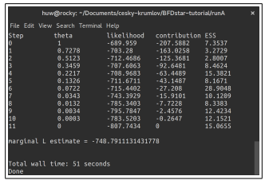
Notes:
you can make it with data which is downloaded from the website when you learn from the tutorial of BEAST。The steps and parameters have been described in detail by the tutorial.
here we can get the value of MLE .

Slide 7
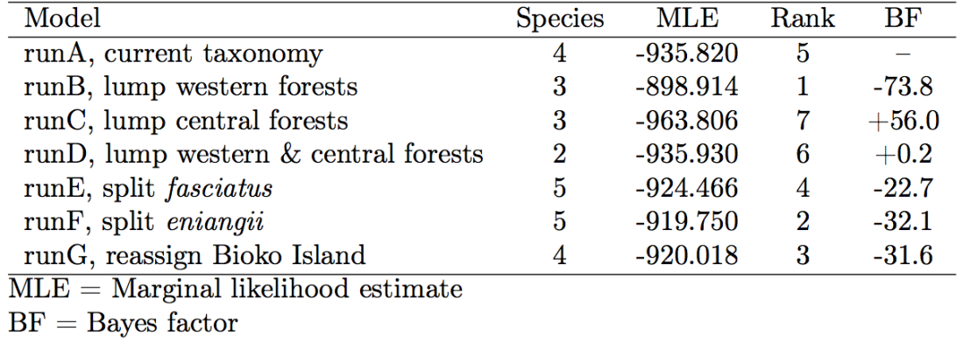
Notes:
after we have runed all the modles ,we can get a figure like this.
we can know which modle is the best one to delimitate species.

Slide 8
modle
BF=2*(MLE1-MLE2)
A negative BF value indicates support in favor of model1.
A positive BF value indicates support in favor of model 2.
0 < ln(BF) < 1 is not worth more than bare mention (1<BF<2.7)
1 < ln(BF) < 3 is positive evidence(2.7<BF<20)
3< ln(BF) < 5 is strong support(20<BF<148)
5< ln(BF) is decisive(148<BF)
Notes:
the bf is equal to the double of MLE1 subtract THE DOUBLE MLE2
A negative BF value indicates support in favor of model1.
A positive BF value indicates support in favor of model 2.
first we know the bf is negative or poaitive to know which modle is better .
the lnBF between 0 and 1 is mean BF belong to 1 to 2.7
the lnBF between 1and 3 is mean BF belong to 2.7 to 20
the lnBF between3 and 5 is mean BF belong to 20 to 148
the lnBF is greater than 5 is mean BF is greater than 148

Slide 9
What do we need in BFD analysis?
1.programs:We will be using the free, open-source software package, BEAST (Bayesian Evolutionary Analysis Sampling Trees; http://beast2.org), for estimating species trees. For this tutorial, you will need to use BEAST version 2.1 or better. The distribution comes with the BEAUTi, including SNAPP.
2.data: the data should be in binary format(necessary for SNAPP)
Notes:
我们需要软件包，下载完BEAST后，我们要进行BFD分析，还需要下载一些插件，比如SNAPP等，还有其他一些程序：programs tracer ，figTree
数据：这里所需要的数据是SNP数据，而且用SNAPP分析时文件格式需要是 二进制的.
We need download the software package and data. here we providethe linkage about the software packge.
you can search the tutorial on the web.

Slide 10
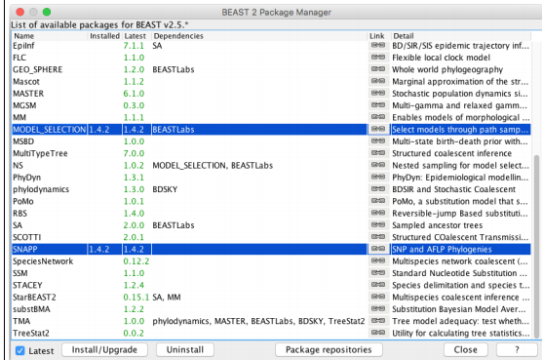
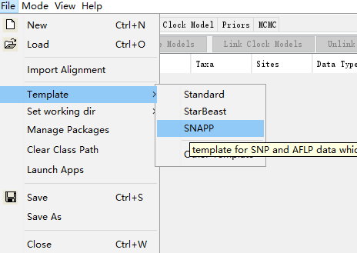
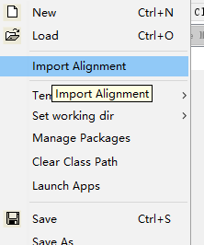
Notes:
You need to install model selection and snapp in best（你需要安装模型选择和SNAPP在besti）Choose the type of template(选择模板的类型) Alignment sequence(加入比对序列）

Slide 11
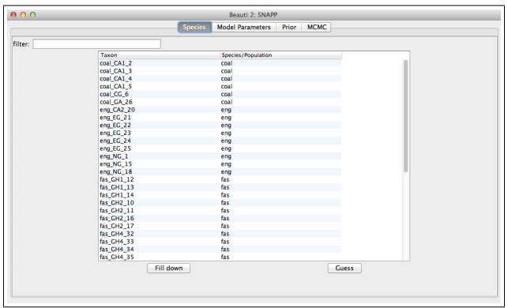
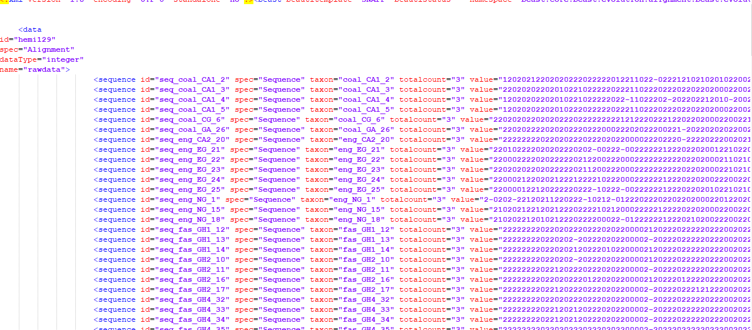
Notes:
After adding the alignment sequence, an interface like this will appear。
We set the parameters and save them in xml format。

Slide 12
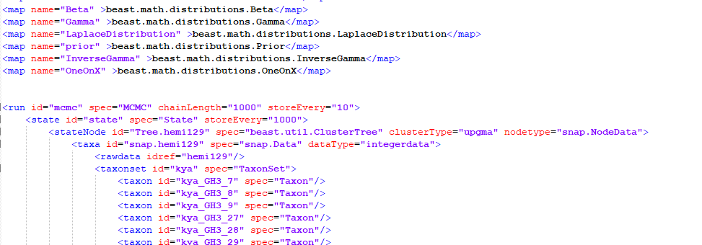
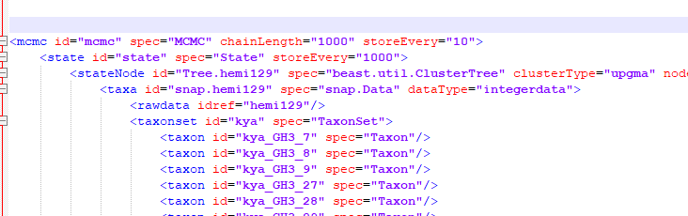
Notes:
Then we need to edit the text with a text editor（然后我们需要用文本编辑器对文本进行编辑）
Change run in the middle of the text to mcmc（把文本中间位置的run改成mcmc）

Slide 13
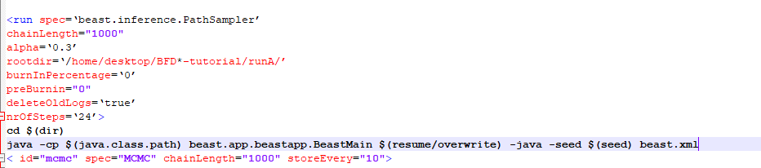

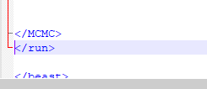
Notes:
Add mcmc before the last run of the text（在文本最后的run之前加上mcmc）

Slide 14
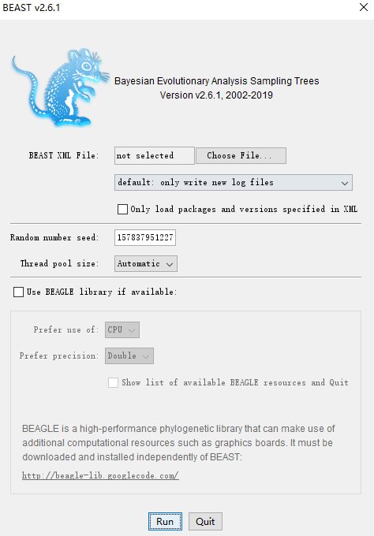

Slide 15
THANK YOU

