Slide 1
Estimating species tree
Qinwen Xue

Slide 2
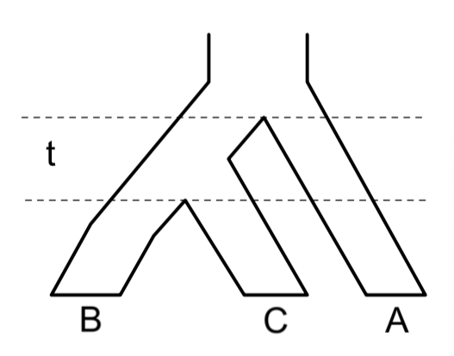
Conception
Species tree: phylogeny that displays a sequence of speciation events
Gene tree: phylogenetic history for an individual gene, that evolves “within” the speciation process

Slide 3
Conception
Species tree: phylogeny that displays a sequence of speciation events
Gene tree: phylogenetic history for an individual gene, that evolves “within” the speciation process
Speciation events

Slide 4
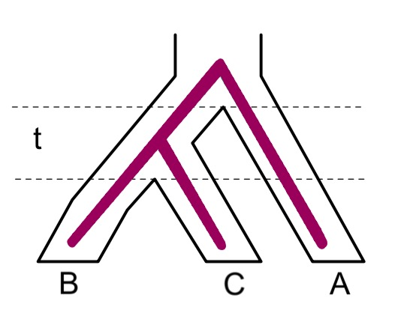
Conception
Species tree: phylogeny that displays a sequence of speciation events
Gene tree: phylogenetic history for an individual gene, that evolves “within” the speciation process

Slide 5
Conception
Species tree: phylogeny that displays a sequence of speciation events
Gene tree: phylogenetic history for an individual gene, that evolves “within” the speciation process
Coalescent events

Slide 6
Conception
Species tree: phylogeny that displays a sequence of speciation events
Gene tree: phylogenetic history for an individual gene, that evolves “within” the speciation process

Slide 7
Ancestral polymorphism and species trees

Slide 8
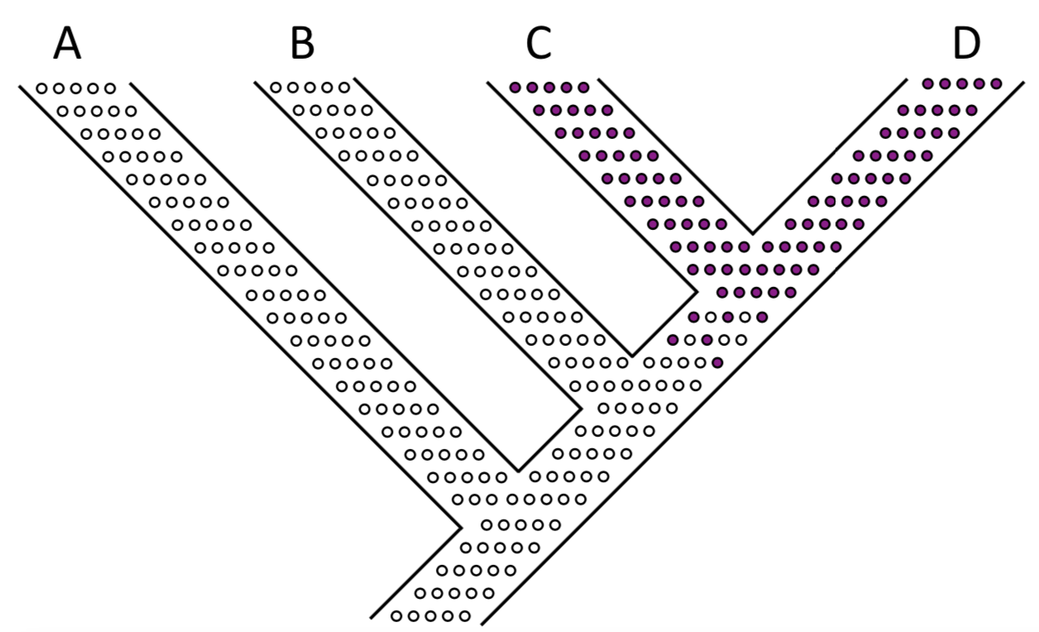

Slide 9
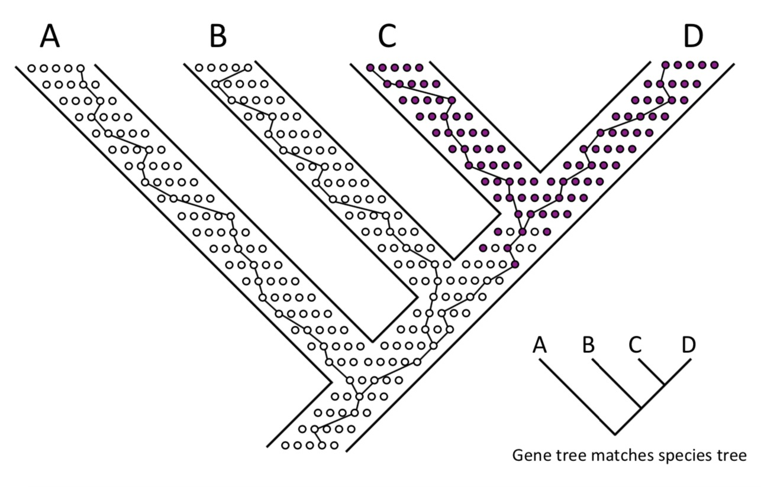

Slide 10
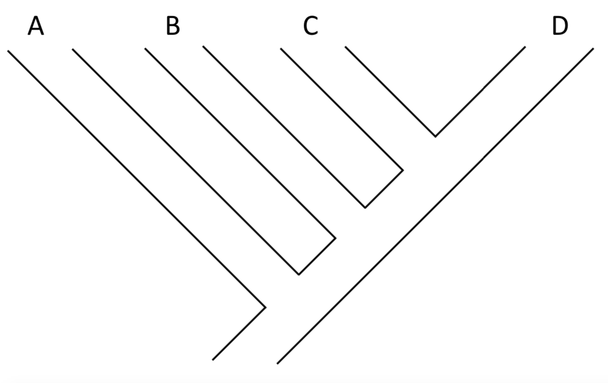

Slide 12
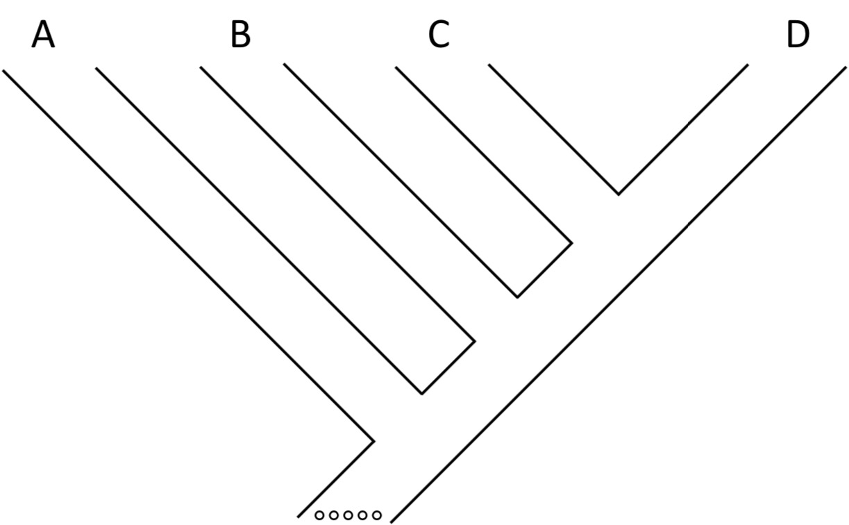

Slide 13
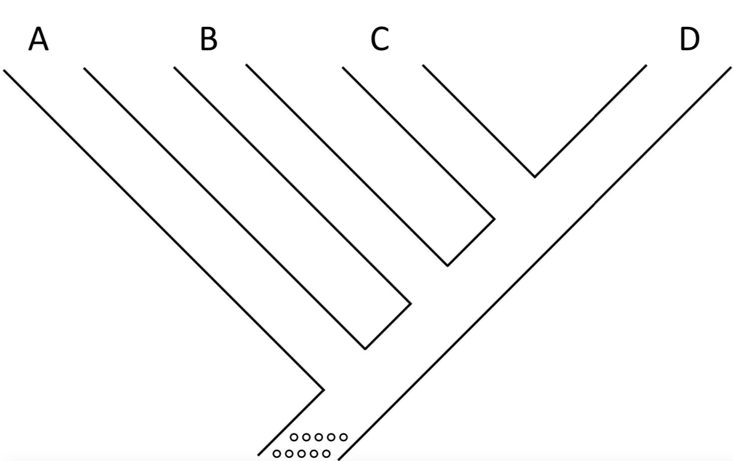

Slide 14
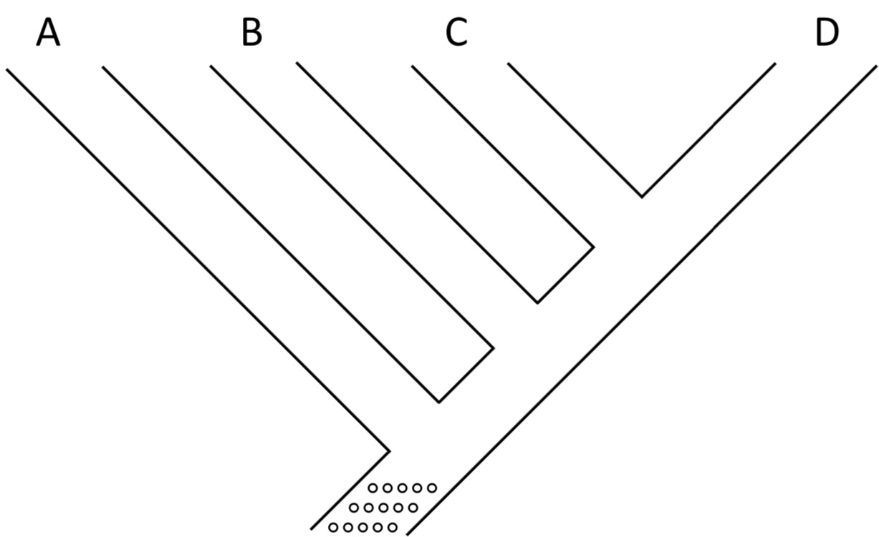

Slide 15
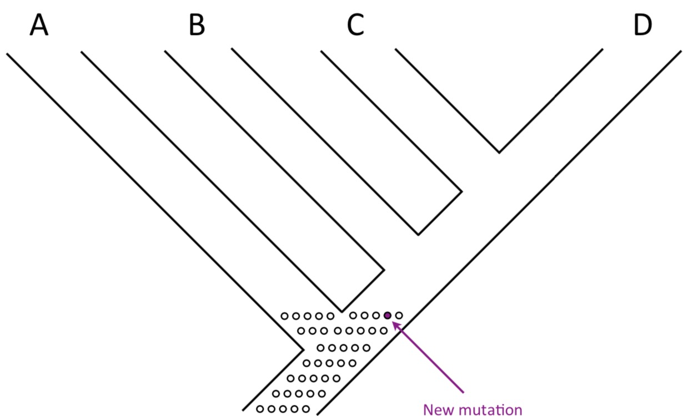

Slide 16
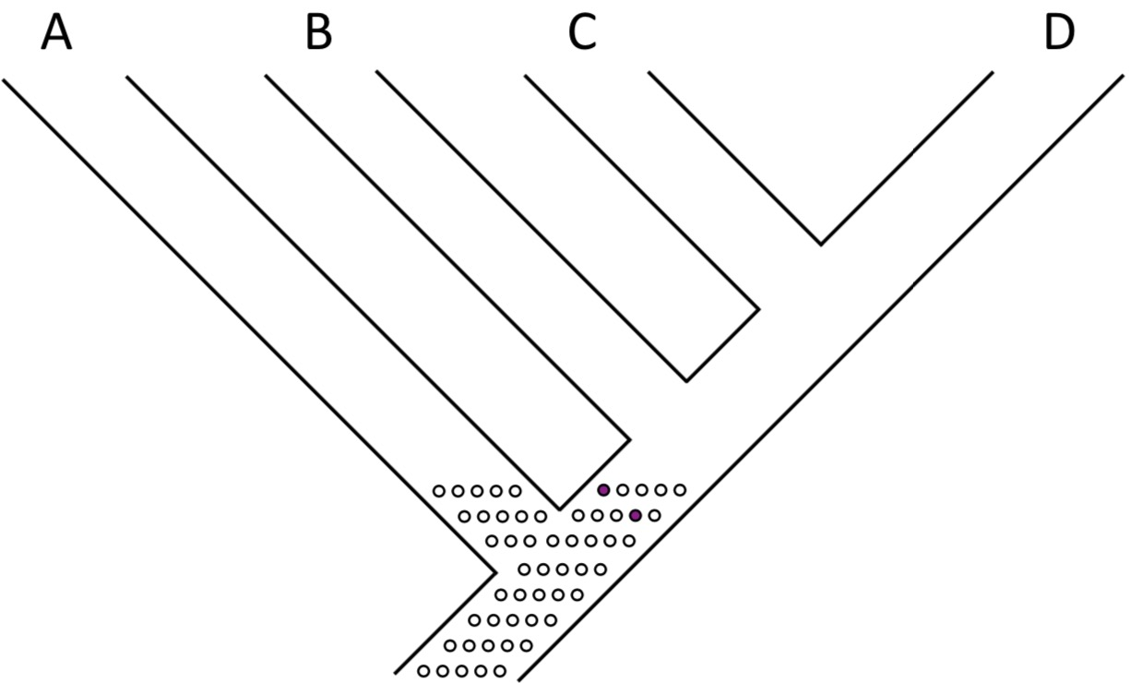

Slide 17
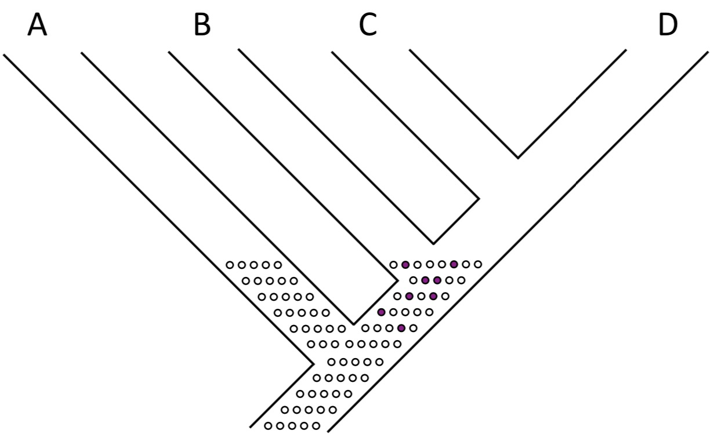

Slide 18
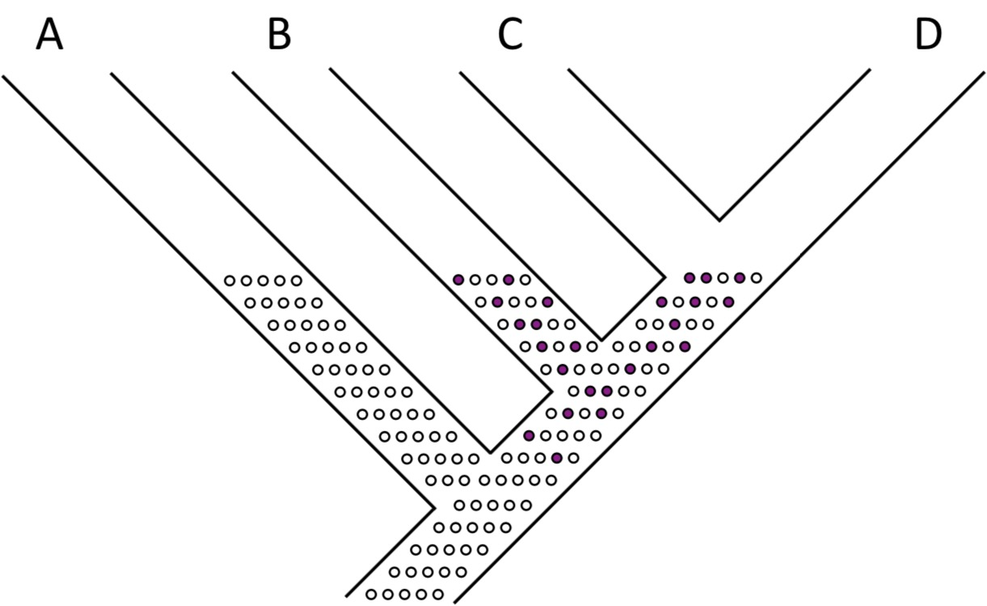

Slide 19
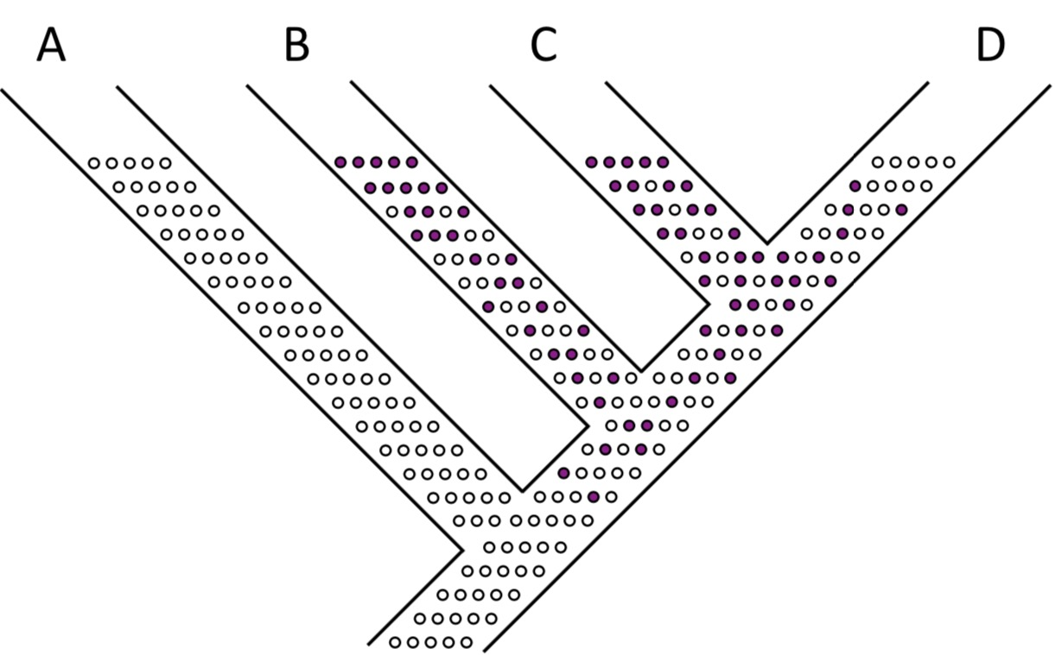

Slide 20
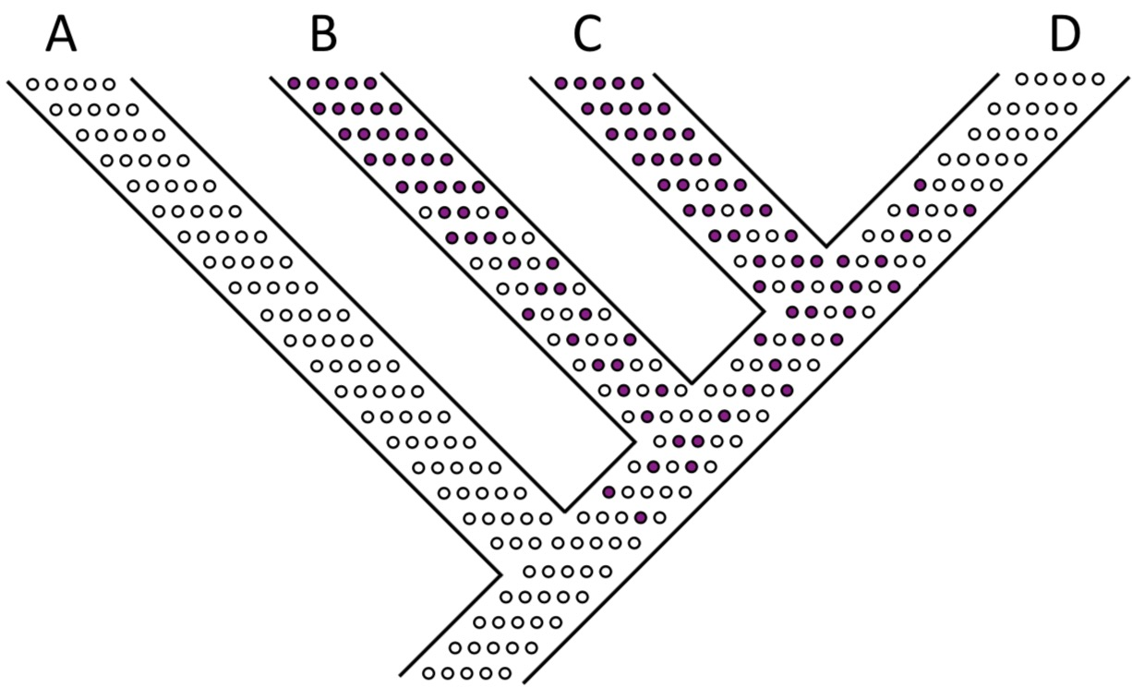

Slide 21
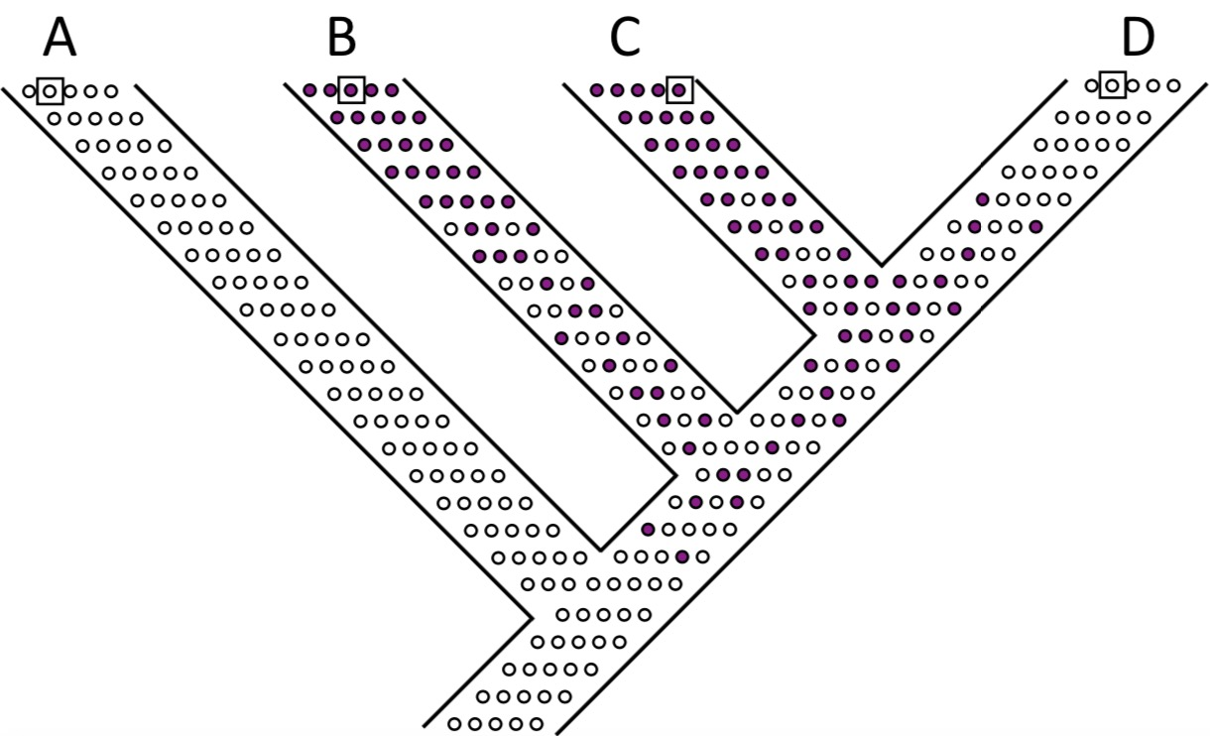

Slide 22
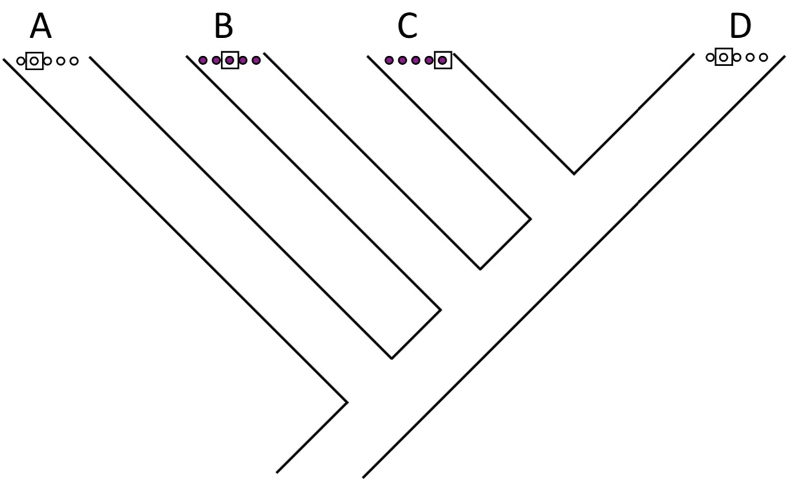

Slide 23
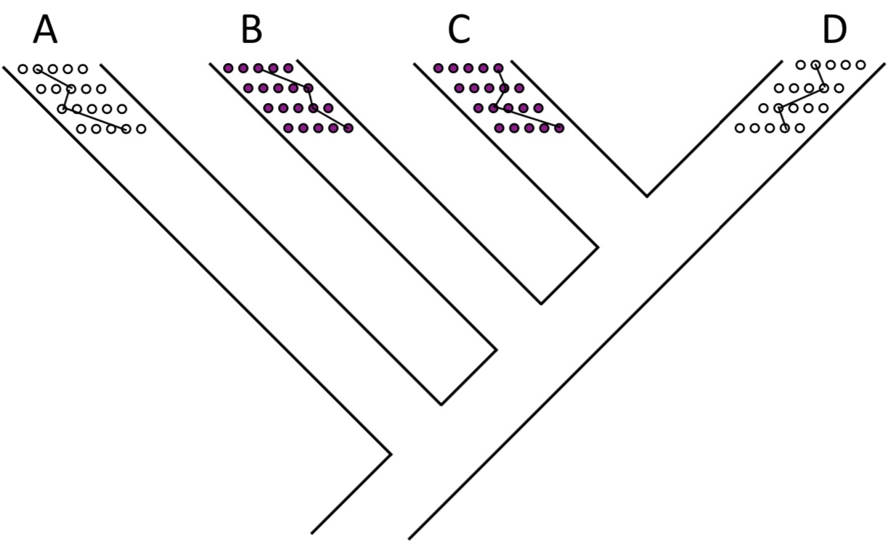

Slide 24
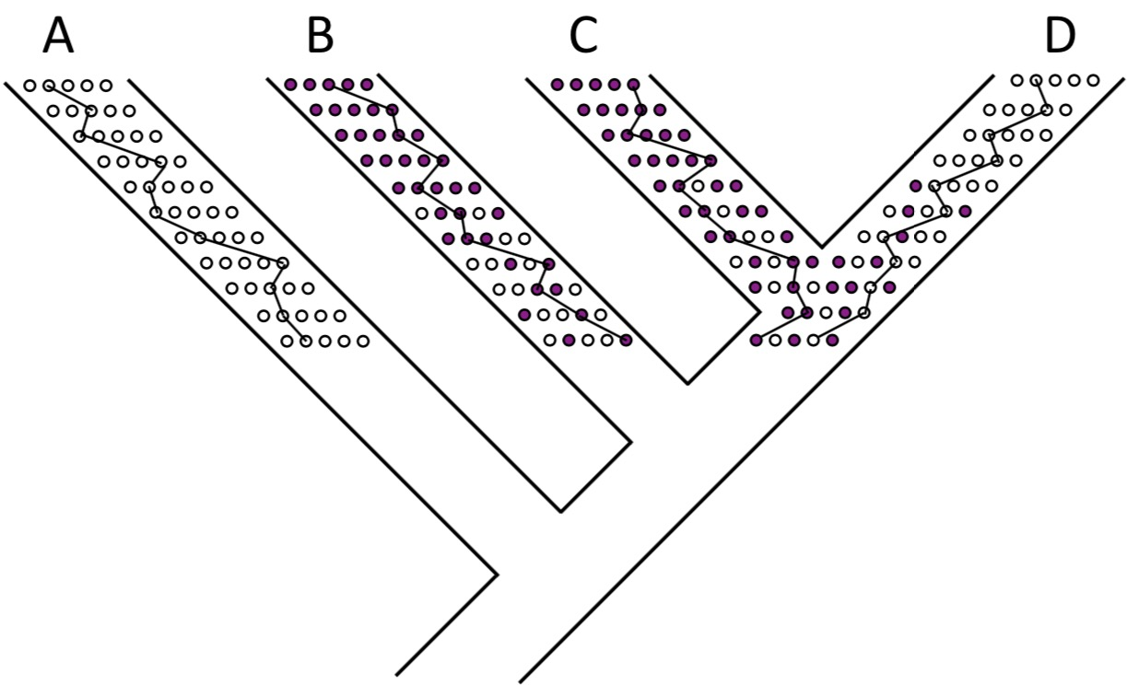

Slide 25
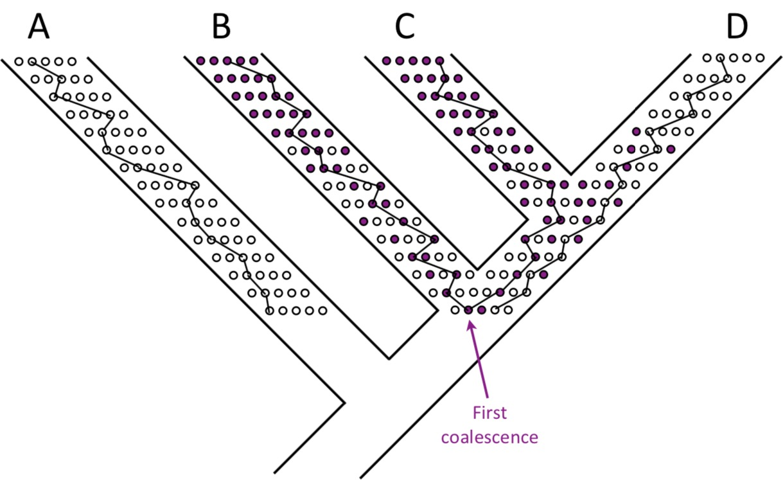

Slide 26
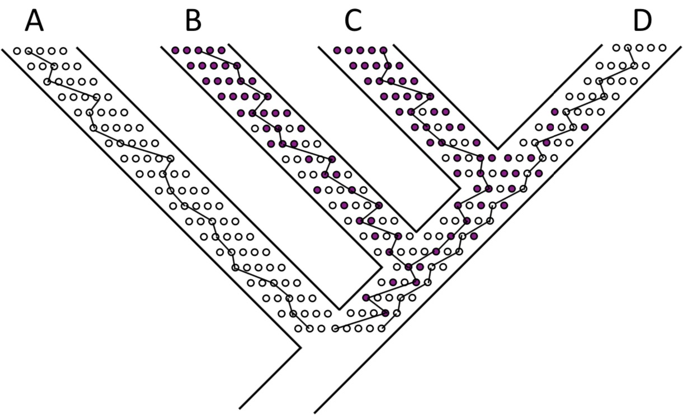

Slide 27
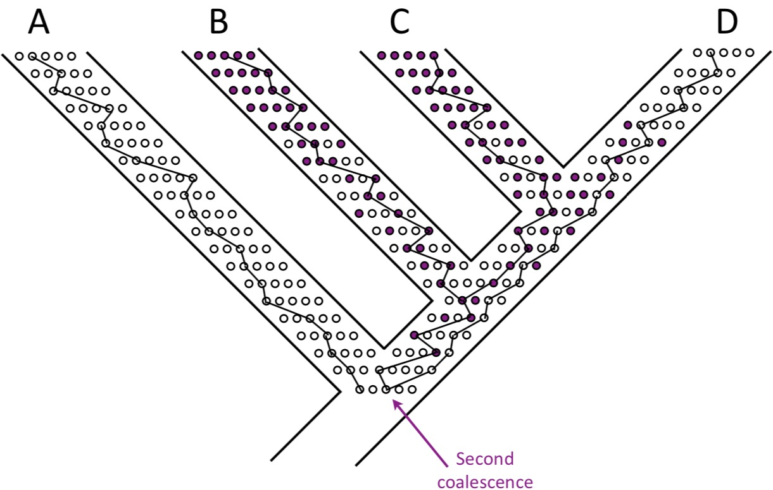

Slide 28
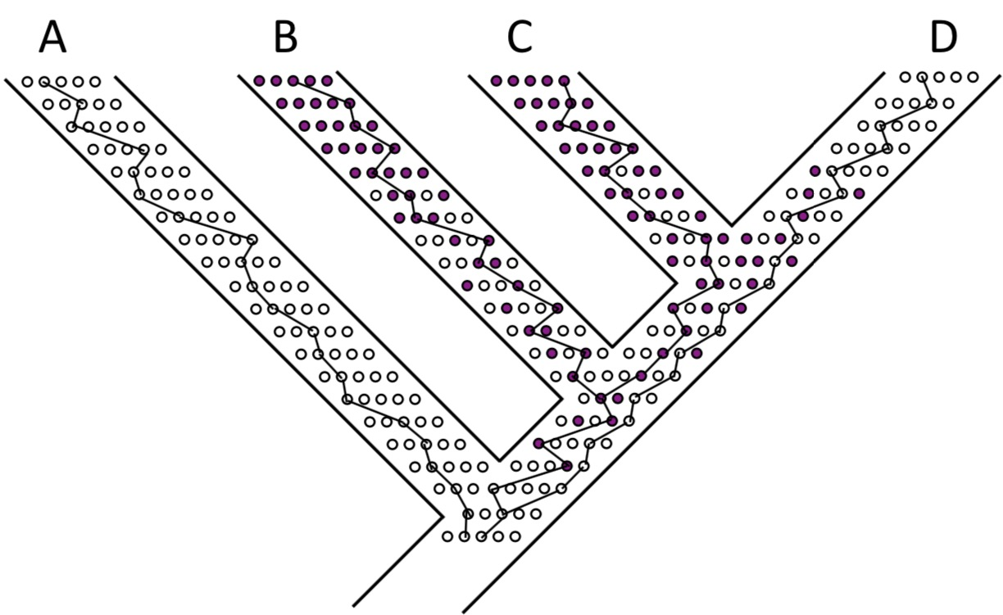

Slide 29
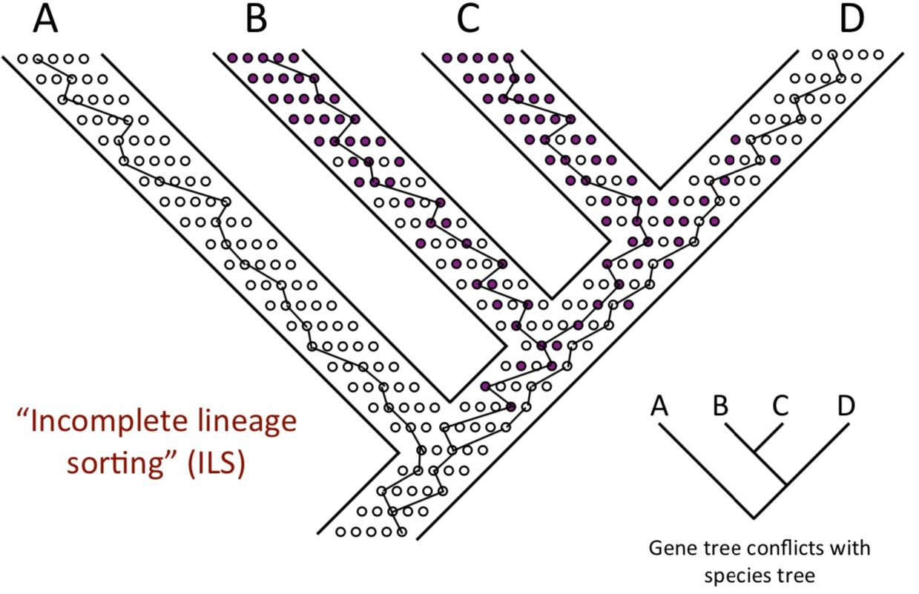

Slide 30
The multispecies coalescent model
Independence between branches—coalescent events that occur in one population are independent of what happens in other populations within the phylogeny.
Panmxia—within a population, all pairs of lineages are equally likely to coalesce.
Divergence is instantaneous and complete-–no gene flow occurs after speciation
ILS only—no other evolutionary processes (e.g., horizontal transfer, duplication and loss,…) have led to incongruence between gene trees and the species tree
No recombination within genes; free recombination between genes

Slide 31
Species tree estimating mothod

Slide 32
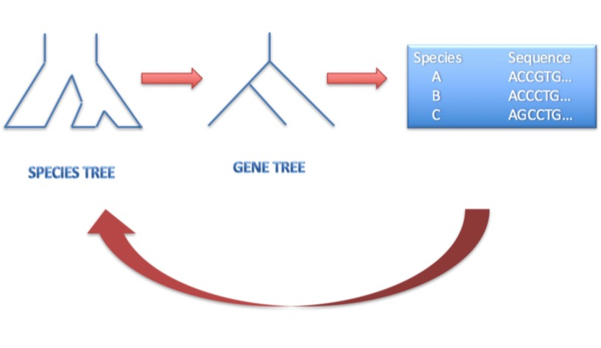
Base in coalescent model mothod for species tree estimating
Full data methods:
Fully Bayesian (integrate over gene trees within species trees, estimate posterior distribution of population sizes, branch lengths, and other model parameters in addition to the species tree):
BEST
BEAST
SNAPP
BPP
SVDQuartets

Slide 33
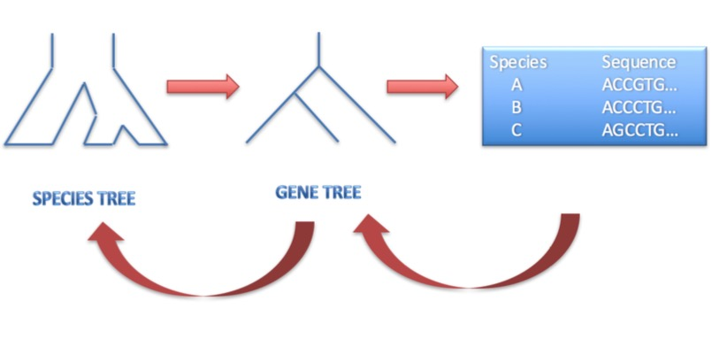
Base in coalescent model mothod for species tree estimating
Summary statistics methods: Start with estimated gene trees
Using estimated branch lengths:
STEM
STEAC
Using topology information only:
STAR
Minimize Deep Coalescences
ASTRAL
ST-ABC
STELLS
MP-EST
Statistical binning

Slide 34
Base in coalescent model mothod for species tree estimating
Summary statistics methods: Start with estimated gene trees
Using estimated branch lengths:
STEM
STEAC
Using topology information only:
STAR
Minimize Deep Coalescences
ASTRAL
ST-ABC
STELLS
MP-EST
Statistical binning

Slide 35
ASTRAL
ASTRAL is a tool for estimating an unrooted species tree given a set of unrooted gene trees.
ASTRAL is statistically consistent under the multi-species coalescent model.
ASTRAL finds the species tree that has the maximum number of shared induced quartet trees with the set of gene trees, subject to the constraint that the set of bipartitions in the species tree comes from a predefined set of bipartitions.

Slide 36
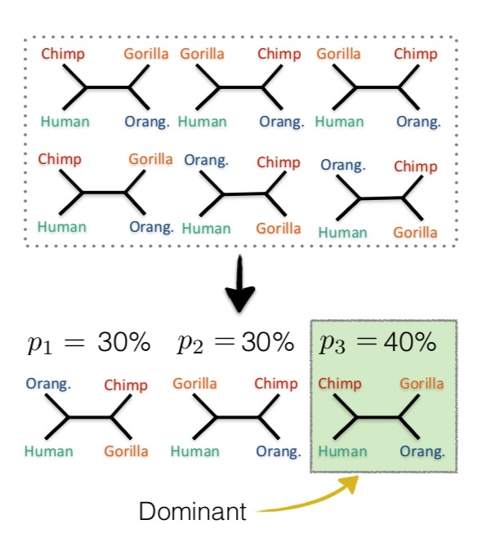
ASTRAL
For 4 species, the dominant quartet topology is the species tree
For >4 species, the dominant topology may be different from the species tree
1. Break up input each gene tree into $\left({n \atop 4}\right)$ trees on 4 taxa (quartet trees)
2. Find all $\left({n \atop 4}\right)$ dominant quartat topologies
3. Combine dominant quartet trees

Slide 37
ASTRAL with >4 speices
A
A
A
B
B
D
C
C
B
D
D
C
E
E
E
Number of gene tree
10
5
1

Slide 38
ASTRAL with >4 speices
A
A
A
B
B
D
C
C
B
D
D
C
E
E
E
Number of gene tree
10
5
1
(A,B),(C,D)

Slide 39
ASTRAL with >4 speices
A
A
A
B
B
D
C
C
B
D
D
C
E
E
E
Number of gene tree
10
5
1
(A,B),(C,D)
(B,C),(D,E)

Slide 40
ASTRAL with >4 speices
A
A
A
B
B
D
C
C
B
D
D
C
E
E
E
Number of gene tree
10
5
1
(A,B),(C,D)
(B,C),(A,D)
(A,D),(B,C)
(B,C),(D,E)
(A,B),(D,E)
(A,D),(B,E)
(A,C),(D,E)
(A,E),(B,C)
(A,D),(C,E)
(A,B),(D,E)
(B,C),(D,E)
(A,B),(C,E)
(A,B),(C,E)
(A,C),(D,E)
(B,D),(C,E)

Slide 41
ASTRAL with >4 speices
A
A
A
B
B
D
C
C
B
D
D
C
E
E
E
Number of gene tree
10
5
1
(A,B),(C,D)
(B,C),(A,D)
(A,D),(B,C)
(B,C),(D,E)
(A,B),(D,E)
(A,D),(B,E)
(A,C),(D,E)
(B,C),(A,E)
(A,D),(C,E)
(A,B),(D,E)
(B,C),(D,E)
(A,B),(C,E)
(A,B),(C,E)
(A,C),(D,E)
(B,D),(C,E)

Slide 42
ASTRAL with >4 speices
Compute the total number of times each resolved quartet was found over all input gene tree
Resolved quartet | Induced by tree(s) | Weight
(A,B),(C,D) | 1 | 10
(B,C),(D,E) | 1+2 | 10+5=15
(A,C),(D,E) | 1+2 | 15
(A,B),(D,E) | 1+2 | 15
(A,B),(C,E) | 1+3 | 11
(B,C),(A,D) | 2+3 | 6
(A,E),(B,C) | 2 | 5
(B,D),(C,E) | 3 | 1
(A,D),(B,E) | 3 | 1
(A,D),(C,E) | 3 | 1

Slide 43
ASTRAL with >4 speices
A
B
C
Score=10+11+15+15+15=66
D
E
A
B
C
Score=15+15+15+6+5=56
D
E
…

Slide 44
ASTRAL with >4 speices
A
B
Best tree
C
Score=10+11+15+15+15=66
D
E
A
B
C
Score=15+15+15+6+5=56
D
E
…

Slide 45
Usage
Java –jar positation/astral.jar –i positation/catree.tre –a positation/speciesname.txt –t 2 –o ***.tre
-jar version of astral
-i input file
-a speciesname
-o output file
-t 2 full annotation

Slide 46
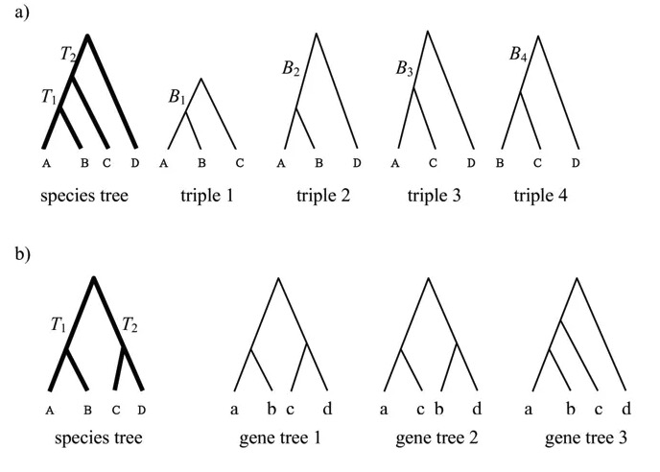
MP-EST
The MP-EST method estimates species trees from a set of rooted binary gene trees by maximizing a pseudo-likelihood function.
The input data of MP-EST are rooted binary gene trees produced by the maximum likelihood phylogenetic programs RAxML, PHYML, PHYLIP, and PAUP etc.
In addition to the gene tree file, a control file must be generated for running MP-EST. The control file contains necessary parameters for running MP-EST.

Slide 47
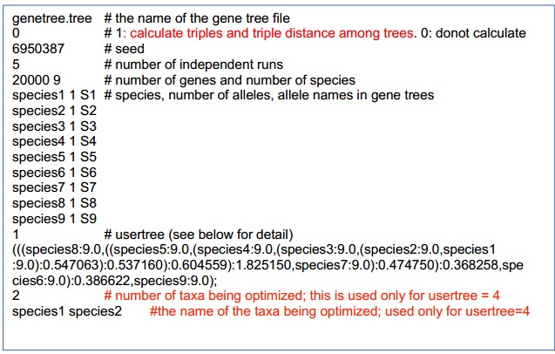
Usage
After finish control file, Type “mpest control” (if the control file is named "control ") to run mp-est on the terminal window (DOS command window on PC)

Slide 48
Comparison of approaches
Summary statistics methods
Advantage: Quick
Disadvantage: Ignore information in the data
Most current implementations do not easily allow assessment of uncertainty (but bootstrap can be used, at the expense of computational eciency)

Slide 49
Comparison of approaches
Summary statistics methods
Advantage: Quick
Disadvantage: Ignore information in the data
Most current implementations do not easily allow assessment of uncertainty (but bootstrap can be used, at the expense of computational eciency)
Full data methods
Advantage: Fully model-based framework
Disadvantage: Computationally intensive, sometimes prohibitively so
BEST, *BEAST/STARBEAST2, BPP, and SNAPP utilize a Bayesian framework and involve MCMC

Slide 50
Thanks for attention

