Slide 1
fastsimocal2

Slide 2
Genetic studies focus on increasingly larger genomic regions of both extant and ancient DNA, and there is a need for simulation software to match these technological advances.
We present here a new coalescent-based simulation program fastsimcoal, which is able to quickly simulate a variety of genetic markers scattered over very long genomic regions with arbitrary recombination patterns under complex evolutionary scenarios.

Slide 3
Feature
The possibility to generates many replicates of random outcome of molecular diversity under a user-defined evolutionary scenario.
Allowing it to very quickly generate genetic diversity for more genomic segments.

Slide 4
Input File Syntax
Number of populations samples
Deme sizes
Sample sizes and sampling times
Growth rates
Migration matrices
Historical events
Genetic information

Slide 5
Input File Syntax
Number of populations samples：The number of samples (or demes) to simulate or goven for estimating parameters.
Deme sizes: The number of individuals for haploid species or two times the number of individuals for diploid species.

Slide 6
Input File Syntax
Growth rates: The exponential growth parameter for all population samples
Sample sizes and sampling times: The haploid size of the sample, optionally the sampling time
Migration matrices: 0 implies no migration between demes

Slide 7
Input File Syntax
Historical events: Each historical event is defined by 7 numbers.
Time: Number of generations t before present at which the historical event happened
Source deme: The first deme is 0
Sink deme: Source and sink refer to demes exchanging migrants
Migrants: the probability for each lineage in the source deme to migrate to the sink deme.
New size: The relative new size of the sink deme
Growth rate: The new growth rate of the sink deme
Migr.matrix: New migration matrix to be used further back in time

Slide 8
Input File Syntax
Genetic information: consist of 3 subsections
Number of independent chromosome segments: The number of independent chromosome segments that needs to be simulated
Number of blocks: The number of blocks to be simulated per chromosome.
Block specificities: The properties of genetic data to be simulated per block(4 subsections)

Slide 9
Input File Syntax
Block specificities
Date type: DNA、SNP
Num loci: Number of markers with this data type to be simulated
Recombination rate and mutation rate
Optional parameters

Slide 10
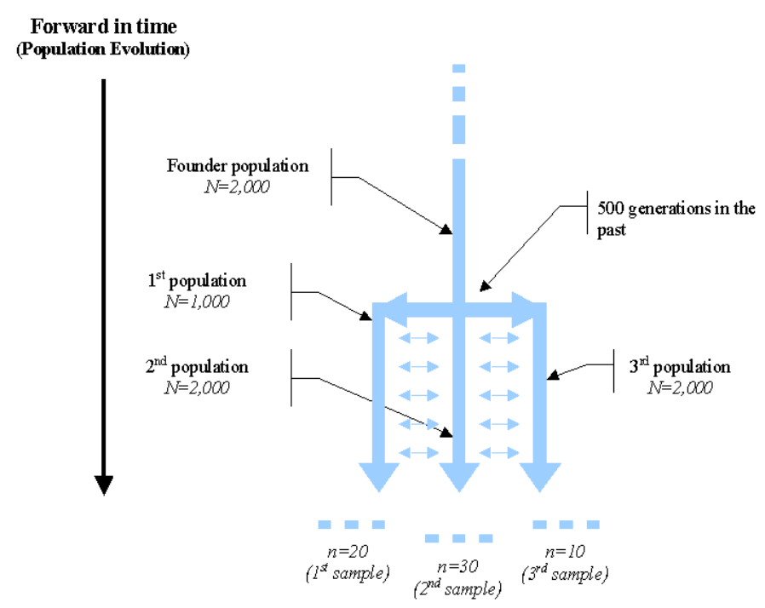
Input File Syntax

Slide 11
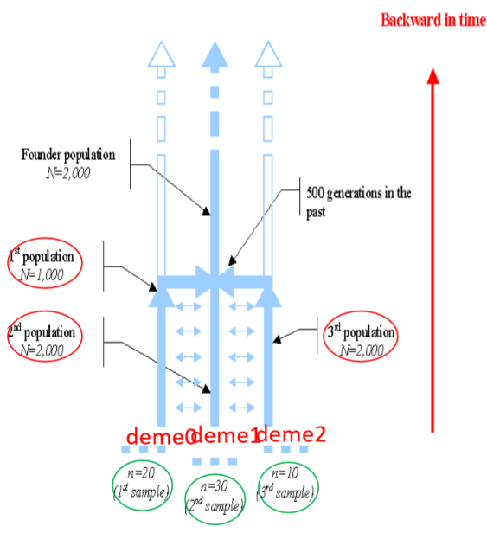
Example of an Input File
Number of populations samples
//Number of population samples (demes)
3 samples to simulate
Deme sizes
//Population effective sizes (number of genes)
1000
2000
1000
Sample sizes and sampling times
//Sample sizes
20 30 10

Slide 12
Example of an Input File
Growth rates
i->j | j0 | j1 | j2
I0 | 0X | 0.005 (deme0->deme1) | 0X
i1 | 0.005 (deme1->deme0) | 0X | 0.005 (deme1->deme2)
i2 | 0X | 0.005 (deme2->deme1) | 0X
//Growth rates : negative growth implies population expansion
0
0
0
Migration matrices
//Number of migration matrices : If 0 : No migration between demes 2 //Migration rates matrix 0 : 0.000 0.005 0.000 0.005 0.000 0.005 0.000 0.005 0.000 //Migration rates matrix 1 : No migrations 0 0 0 0 0 0 0 0 0
Any gene from deme 0 has probability 0.005 to be sent to deme 1, and that a gene from deme 1 has a probability 0.005 to move to deme 0………

Slide 13
Historical events
//Historical event: time, source, sink, proportion of migrants, new deme size, new growth rate, new migration matrix 2 historical events 500 0 1 1 1 0 1 500 2 1 1 1 0 1
Genetic information
//Number of independent loci [chromosome]
1 0
//Per chromosome: Number of linkage blocks
2
//per Block: data type, num loci, rec. rate and mut rate + optional parameters
DNA 1000 0 0.0000002 0.33
SNP 3 0 0

Slide 14
ESTIMATING PARAMETERS FROM THE SITE FREQUENCY SPECTRUM
• fastsimcoal2 implements a new way to estimate demographic parameters from the site frequency spectrum (SFS) computed from DNA sequence data or from ascertained SNP chips.

Slide 15
• fastsimcoal2 simulates the expected SFS under a given set of parameters and computes their (composite) likelihood. It uses a maximization procedure to find those parameters maximizing the composite likelihood.

Slide 16
In order to do this, you need the following three input files:
• 1. A file or a series of files containing the observed (joint) SFS.
• 2. A template file (*.tpl) describes the demographic model and the parameters of interests, which parameters are replaced by keywords.
• 3. An estimation file (*.est )which specifies the list of the search ranges for those parameters.

Slide 17
Site frequency spectrum (SFS)
• Site frequency spectra (SFSs) are widely used to summarize patterns of genomewide variation at the single nucleotide polymorphisms (SNPs) that abound in virtually all organisms.

Slide 18
OBSERVED SFS FILE NAMES
ONE OBSERVED SAMPLE
• -_DAFpop0.obs if it is a file listing the derived allele SFS (unfolded spectrum)
• -_MAFpop0.obs if it is a file listing the minor allele SFS (folded spectrum
If there is a single observed sample

Slide 19
TWO OBSERVED SAMPLES
• -_jointDAFpop1_0.obs if it is a file listing the derived allele SFS (unfolded spectrum)
• -_jointMAFpop1_0.obs if it is a file listing the minor allele SFS (folded spectrum)
If there is two observed samples

Slide 20
MORE THAN TWO OBSERVED SAMPLES
• -_jointDAFpop1_0.obs, _jointDAFpop2_1.obs, _jointDAFpop2_0.obs
• For the folded spectrum, the name would begin by _jointMAF
If there is more than two observed samples

Slide 21
1:5 2:4 4:2 1:5 1:5
• The unfolded site-frequency spectrum for this sample is (3, 1, 0, 1, 0) as explained in the text.

Slide 22
Unfolded site-frequency spectrum
• Define the unfolded site-frequency spectrum as the random vector X (X1, X2, . . . , Xn) of sample configurations Xi, where Xi represent the number of sites that have n-i ancestral and i derived nucleotides for 1≤i≤n-1 among the n aligned nucleotide sequences.

Slide 23
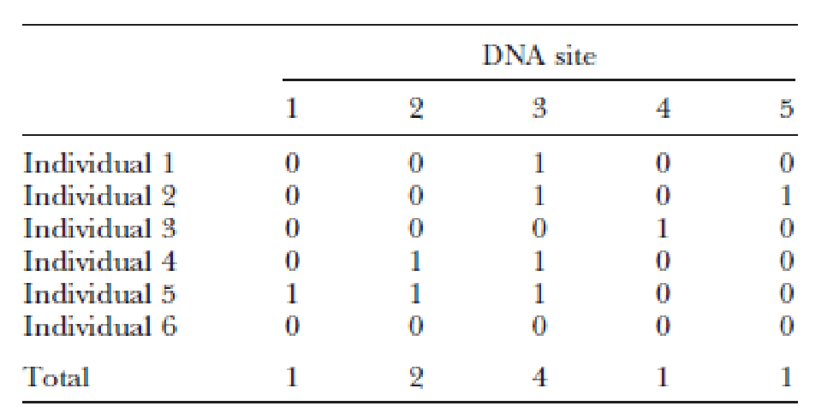
• For the example in Table 1 the unfolded site frequency spectrum is (3, 1, 0, 1, 0) since there are three sites where one individual carries the derived mutation, one site where two individuals carry the derived mutation, no sites where three individuals or five individuals carry the derived mutations, and one site where four individuals carry the derived mutation

Slide 24
Folded site-frequency spectrum
• we have assumed that for each site we know which state is derived and which is ancestral. If this information is unknown, we would model the folded site frequency spectrum, X, defined as the number of sites where 1 individual or (n-1) individuals carry a mutation,2 individuals or (n -2) individuals carry a mutation, ,,,
• so that, for the example above, the folded sitefrequency spectrum is (3, 2, 0).

Slide 26
FOR EXAMPLE:
ISOLATION WITH MIGRATION (IM) SCENARIO

Slide 27
A template file
Notes:
This is example of template file.

Slide 28
An estimation file

Slide 29
Command line
• fsc25 -t *.tpl -n100,000 –N 100,000 –d /-m
-e *.est -M 0.001 -l 10 -L 40 -q -c8
Notes:
This is command line.

Slide 30
• the model is defined in the file *.tpl (-t)
• the search range of the parameters to be estimated are in the file *.est (-e)
• a minimum (-n) and a maximum (-N) of 100,000 simulations need to be done
• a minimum (-l) and maximum (-L) of 10 and 40 ECM cycles
• The criterion (-M) to stop ECM ( each time using a conditional maximization) cycles is 0.001
• a minimum console output (quiet mode -q) is required.
• use 8 threads to speed up computations (-c8)
•computes the SFS for the derived alleles ( -d ) for each population sample and for all pairs of samples
computes the SFS for the minor allele ( -m ) for each population sample and for all pairs of samples
Notes:
This is a detailed explanation of each parameter

Slide 31
• The results are then output in a "<template_generic_name>.bestlhoods" file, containing the estimated parameter values:

Slide 32
thanks

