Slide 1
GO analysis and KEGG
J.Jiang
2020.1.9

Slide 2
1.What's GO and KEGG
GO:gene ontology;a major bioinformatics initiative representing a series of GO terms including cellular component(CC),molecular function(MF) and biological process(BP).
KEGG: Kyoto Encyclopedia of Genes and Genomes;a database resource for understanding high-level functions and utilities of the biological system, such as the cell, the organism and the ecosystem, from molecular-level information, especially large-scale molecular datasets generated by genome sequencing and other high-throughput experimental technologies.

Slide 3
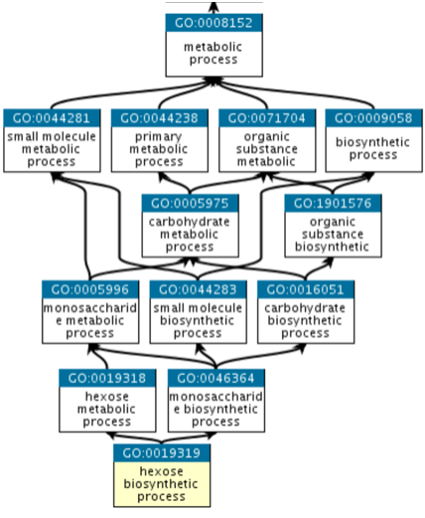
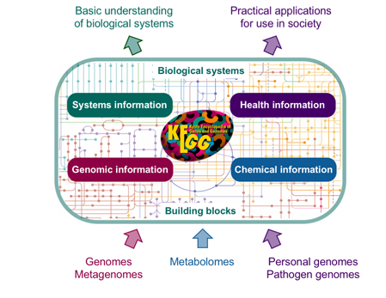
2.Function of GO analysis and KEGG
(1).GO analysis
perform enrichment analysis on gene sets
standard GO annotations
linking different molecular activities
(2).KEGG
systems information;genomic information;chemical information;health information
detailed metabolic pathway;functional orthology;introduction to certain biochemical reaction
KEGG mapper

Slide 4
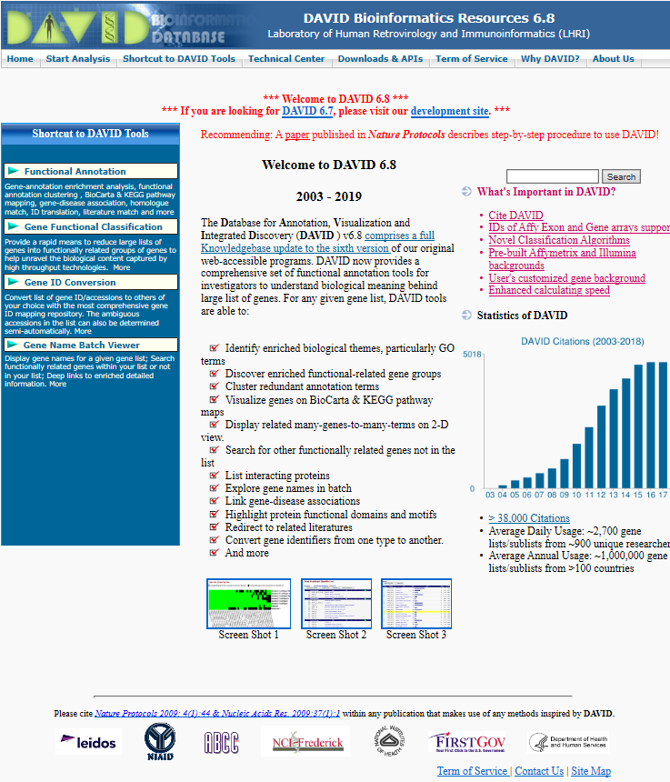
3.How to operate GO and KEGG analysis
Software:GO miner,EASE,GOstat,Onto-express,GoToolBox,GOBar and so on
DAVID,an online analysis tool
website:https://david.ncifcrf.gov/home.jsp

Slide 5
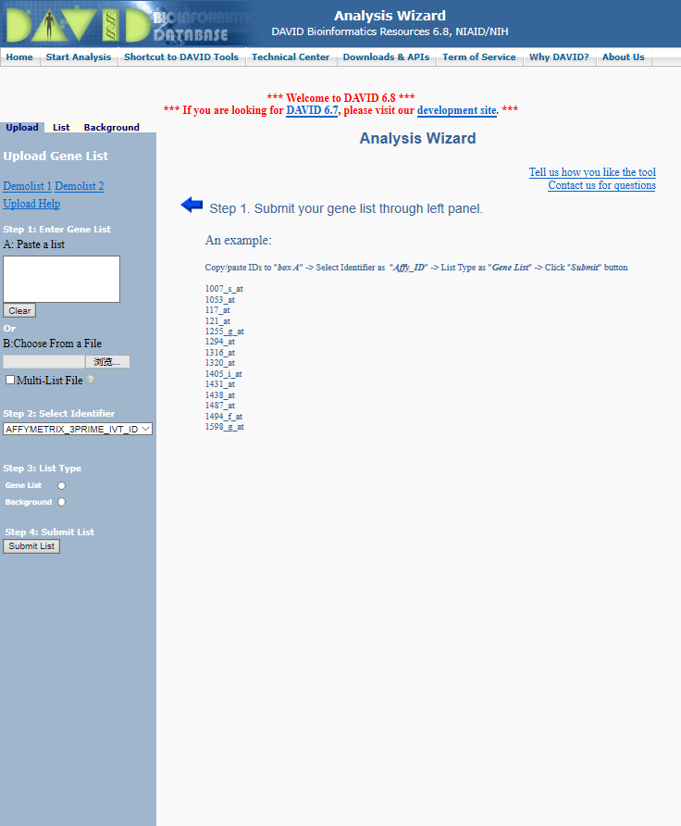
click “Start Analysis”

Slide 6
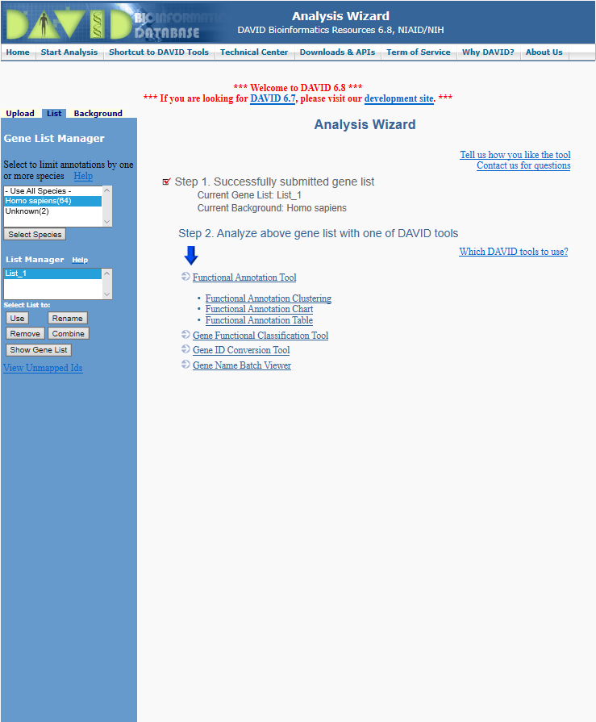
paste a list and click “Gene list”
click random link

Slide 7
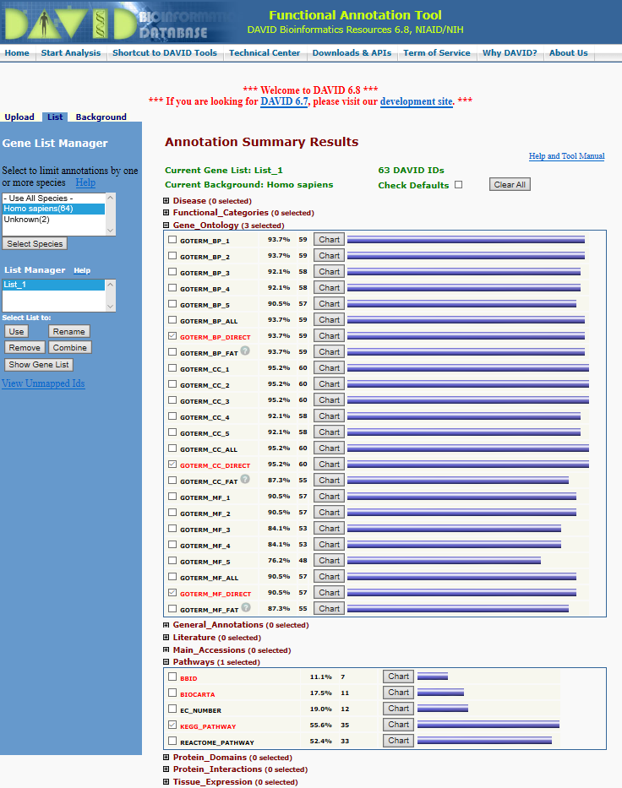
choose what we need

Slide 8
click “Download File”

Slide 9
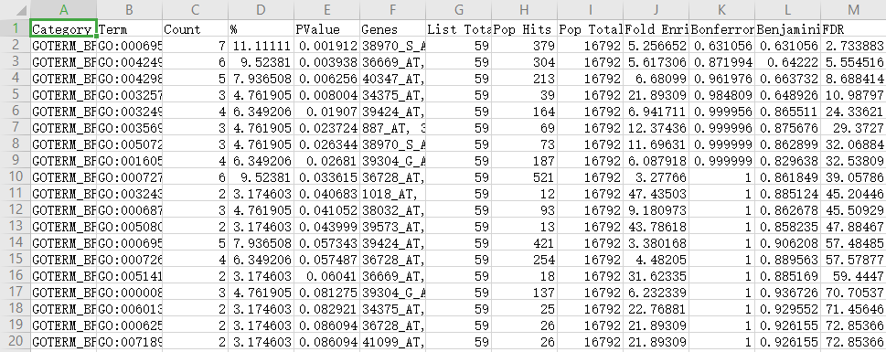
paste statistics into text
open text file in excel

Slide 10
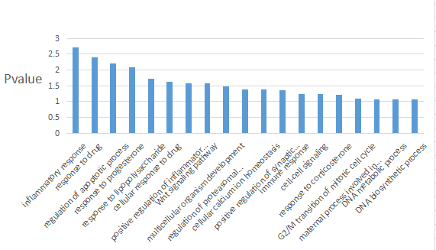

Slide 11
KEGG analysis
KEGG website:https://www.kegg.jp/
(1).KEGG pathway:a collection of manually drawn graphical diagrams, called KEGG pathway maps, representing molecular pathways for metabolism, genetic information processing, environmental information processing, cellular processes, organismal systems, human diseases, and drug development.
(2).KEGG mapper:a collection of tools for KEGG mapping: most popular KEGG pathway mapping, as well as BRITE mapping and MODULE mapping. In this new release, fourteen existing tools were reorganized into just five tools. Three of them, "Reconstruct Pathway", "Search Pathway" and "Search&Color Pathway" allow multiple mapping operations to be done at the same time.

Slide 13
(1).KEGG pathway
①.Reference pathway:this is the original version; white boxes are hyperlinked to KO, ENZYME, and REACTION entries in metabolic pathways; they are hyperlinked to KO entries in non-metabolic pathways.
②.Reference pathway (KO): blue boxes are hyperlinked to KO entries that are selected from the original version.
③.Reference pathway (EC): blue boxes are hyperlinked to ENZYME entries that are selected from the original version.
④.Reference pathway (Reaction): blue boxes are hyperlinked to REACTION entries that are selected from the original version.
⑤.Organism-specific pathway: green boxes are hyperlinked to GENES entries by converting K numbers (KO identifiers) to gene identifiers in the reference pathway, indicating the presence of genes in the genome and also the completeness of the pathway.

Slide 14
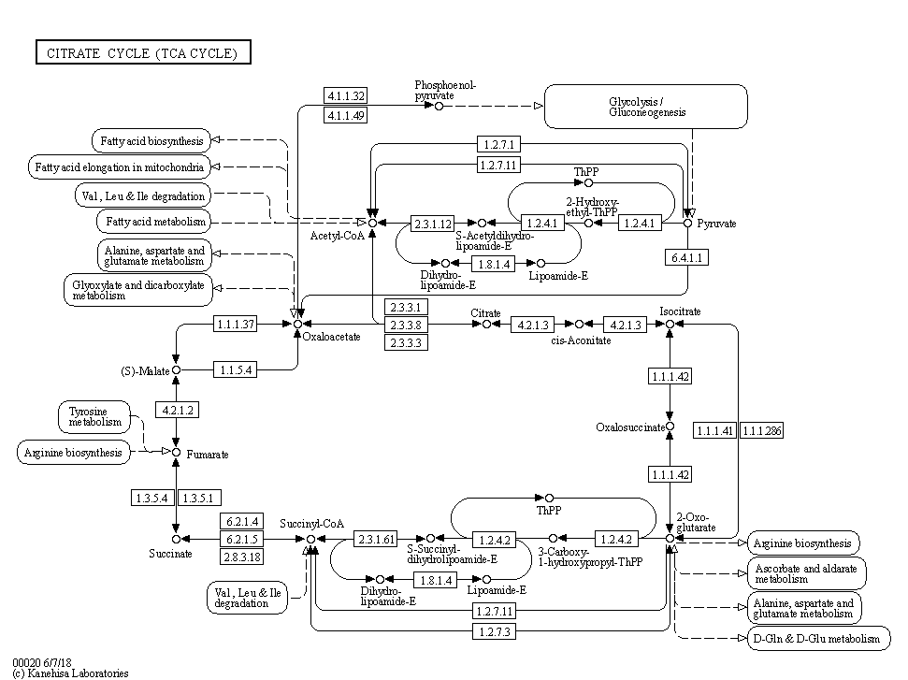
①.Reference pathway
e.g TCA(Citrate) cycle

Slide 15
②.Reference pathway(KO，EC and Rn)

Slide 16
③.Organism-specific pathway(Homo sapiens)

Slide 17
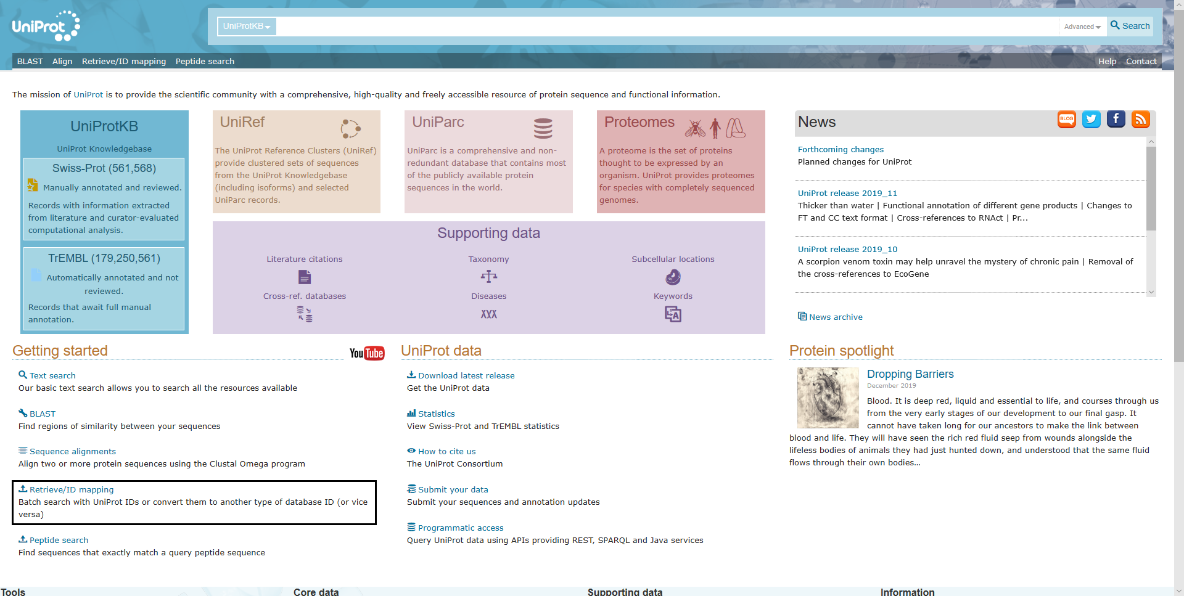
(2).KEGG mapper--Search&Color Pathway
Search&Color Pathway can help us find the pathway related to certain up-regulated/down-regulated genes.
When we input gene ID code,we need to note that KEGG is only compatible with ID code from KEGG,NCBI and Uniprot.So if our ID code differs from the above,we should convert their formation.
Online tool from Uniprot is suggested.
website:http://www.uniprot.org/

Slide 18
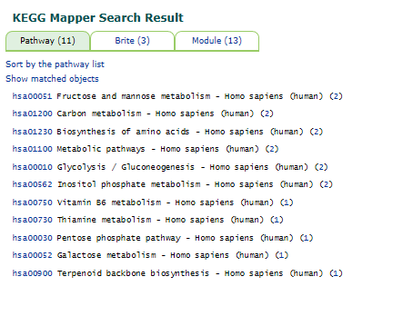
choose one with highest pertinence
input up-regulated/down-regulated gene and their color

Slide 19
final result

Slide 20
Thanks.

